Slide 1


COMP2x0/VR220 Portfolio Development/ Worksheet Support Week 1: Proposals

Slide 2

Workshop function
To support your work in the specialist modules – for Assignment 2 in particular
To encourage development of an online portfolio for showcasing your skills and achievements to prospective employers/clients
This Photo by Unknown Author is licensed under CC BY-SA

Slide 3
Workshop format
Synchronous activities – individual and group
Guided informal discussions
Please raise your (virtual) hand to participate
Asynchronous tasks to complete during the following week
All activities will take place on Teams

Slide 4

Assessment breakdown
Computing artefact: 70%
Tailored to your specialism
Assessed on quality of code, implementation and working practices
Technical report: 30%
Common to all specialisms
Technical poster
Also requires a proposal
Due in Week 2!
Demo piece for your portfolio
This Photo by Unknown Author is licensed under CC BY-ND

Slide 5
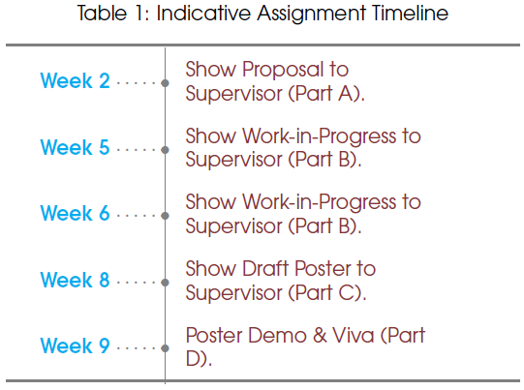
Timeline

Slide 6
Session aims
Recall the purpose(s) of a software proposal document
Discover methods for finding inspiration and generating ideas
Produce a proposal outline for your specialist artefact

Slide 7
Proposal requirements
What is its high concept?
What functionality will it include?
What
Outline the computing artefact you intend to create
Align the computing artefact with your specialism
Identify the broader context and potential application of your computing artefact
Describe the work required
Justify that the computing artefact is feasible in scope
Why
Why is it needed?
How would it be useful?
How
What are the key components?
How long will it take to implement them?
How will you address the architect and research requirement?

Slide 8
Discussion: Why write a proposal?
Notes:
To convince an audience
To convince yourself: make sure the project is worthwhile
To assess the feasibility/scope
To refer back to during implementation

Slide 9
What to propose?
From experience (in your team game, perhaps).
From reading around the subject
Identify a need or problem
Consider possible solutions
Determine the feasibility of implementing the solution
Building on an existing technique
Something entirely new…
How long will it take to develop?
What resources are available to help? (Tutorials, reference material etc.)
Is it something you’re interested in?

Slide 10
Discussion: Sources of inspiration
Notes:
Previous related work – do something similar, or different
Games you’ve played
Team projects
Research papers/journals/conferences
Websites, magazines, blogs
People: ”domain experts”, coursemates

Slide 11
Activity
Write down on the Padlet:
What most interests you about your chosen specialism?
Are there any examples (games played, articles read) that inspired you?
To emulate
To improve
Is there anything in particular that would be useful for your game?
If not – look for some!

Slide 12
Asynchronous task
“What is important in a software proposal”
“How to write a software engineering proposal”
Read guidance on writing a software proposal in sections 2-3 of https://www.ece.rutgers.edu/~marsic/Teaching/SE/proposal.html
Using your notes from the class activity and independent research, write down a sentence to describe each of:
A problem or area for improvement that exists within your specialism
One or more approaches to addressing the problem
The benefits of your suggested approach(es)
Any challenges you can foresee with implementing your approach(es)
Post your response as a new thread in the Proposals channel on Teams
Read and comment on at least one other post in the channel

