Slide 1


COMP2x0/VR220 Portfolio Development/ Worksheet Support Week 2:

Slide 2

Assessment breakdown
Computing artefact: 50%
Tailored to your specialism
Assessed on quality of code, implementation and working practices
Technical report: 50%
Common to all specialisms
Two (main) components:
Technical poster (50%)
Written report, presented as a web page (50%)
Also requires a proposal – due this week!
Expected to form the basis for a portfolio
This Photo by Unknown Author is licensed under CC BY-ND

Slide 3
Technical report: components
Poster
Contents:
Name and project title
Description of the artefact
Illustration of its architecture
At least 1 UML diagram
Key system components, patterns, data structures
Justification of key design decisions
Analyse merits and flaws
Format: Portrait A3 document
Submission: printed and PDF
Report
Contents:
Description of the artefact
Illustration of its architecture
Embedded video of the artefact
Communication of practice-based research
Defence of an argument related to the outcome of this research
Format: web page, ideally part of a portfolio site
Submission: upload zip of html site

Slide 4
Technical report: mark allocation
Poster
Completion: 15%
Description of architecture: 10%
UML diagram: 15%
Context for practice-based research: 10%
Report
Completion: 15%
Reflection on the computing artefact: 10%
Defence of argument: 10%
Appropriateness of practice-based research methods: 10%
Application of academic conventions: 5%

Slide 5
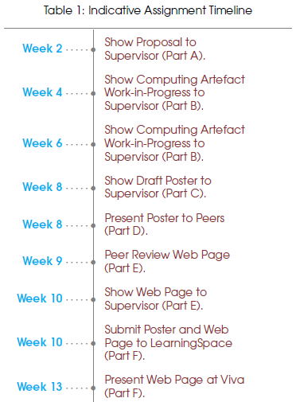
Timeline

Slide 6
Proposal
Outline the computing artefact you intend to create
What is its high concept?
What functionality will it include?
Align the computing artefact with your specialism
Identify the broader context and potential application of your computing artefact
Why is it needed?/How would it be useful?
Describe the work required
What are the key components/requirements?
How will you address the architect and research requirement?
Justify that the computing artefact is feasible in scope
How long do you expect it to take to implement each part?

