Slide 1


COMP2x0/VR220 Portfolio Development/ Worksheet Support Week 3:

Slide 2
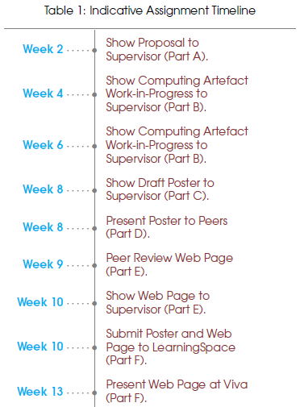
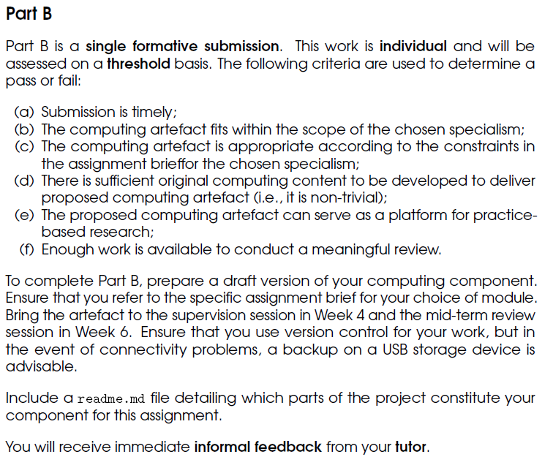
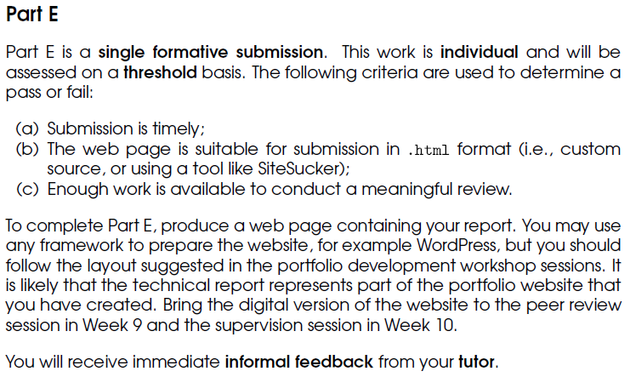
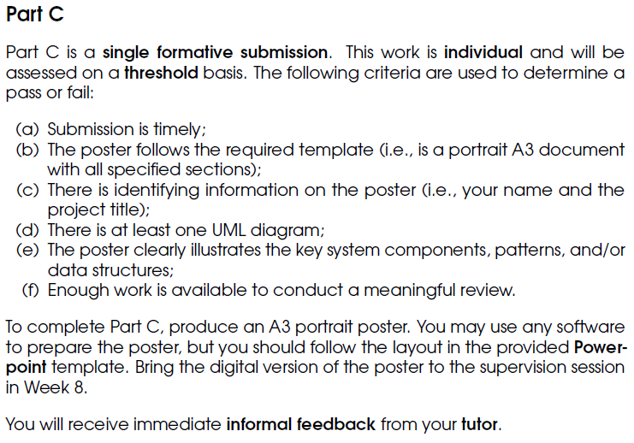
Timeline

Slide 3
Suggested activities
Top recommendation – spend at least some time investigating web platforms (e.g. Wordpress, GitHub pages, Wix, Weebly…) to determine:
How easy is it to use/get the look you want? Try setting up a basic page with some text and images.
How easy is it to download an html copy that works offline? (Test this out!)
Investigate 3rd party tools if need be, e.g. SiteSucker (MacOS), WebCopy (Windows)
Also recommended –
Start writing about the research you’ve done and your argument.
Start drafting your poster – e.g. make notes on content for each section; create/start creating your UML diagram.
If you need to – continue work on your artefact.

