Slide 1


COMP2x0/VR220 Portfolio Development/ Worksheet Support Week 4:

Slide 2
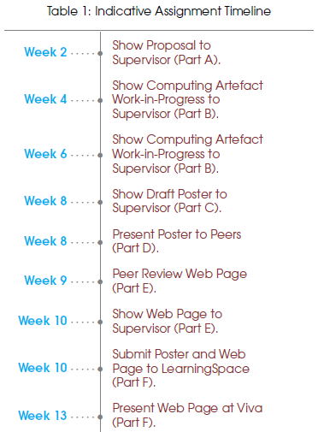
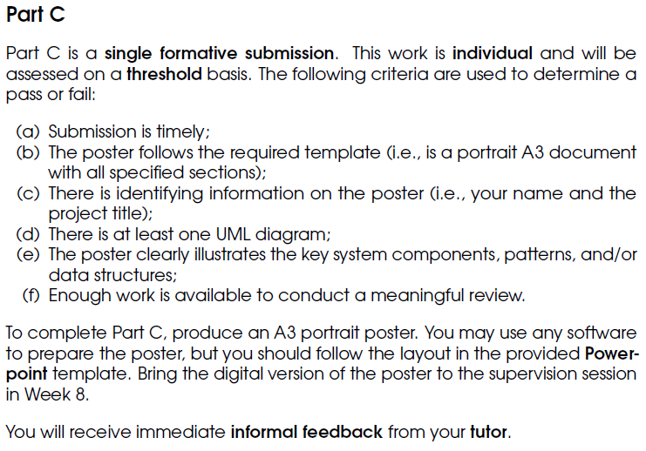
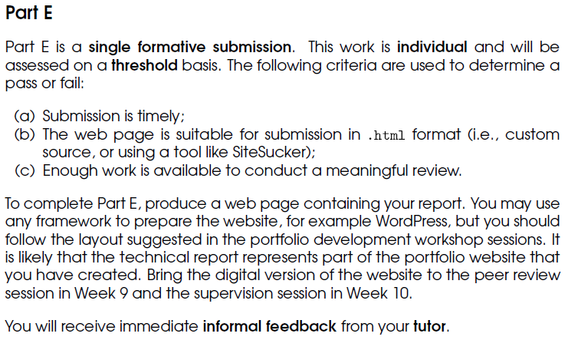
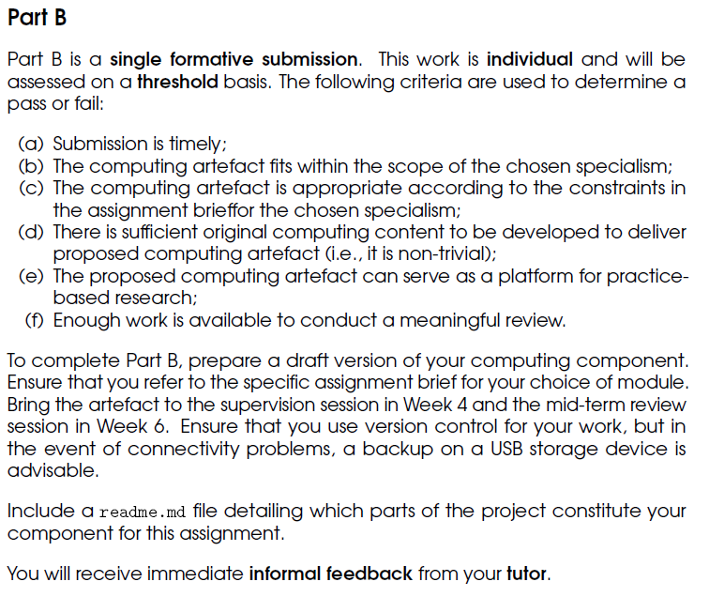
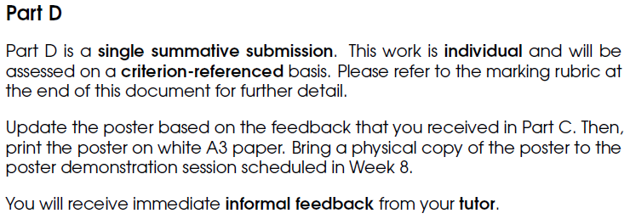
Timeline
Now timetabled!

Slide 3
What does a portfolio look like?
Purpose: to show a prospective employer
who you are, and
what you can do.
Structure: should contain at least the following sections:
About – who are you/where you are now/where you’d like to be
Projects – what you’ve done, including how and why
Include pictures, videos, descriptions, demos – and possibly reasoned arguments…
Contact – details for getting in touch with you (email/contact form – NB beware spammers)
Links to your profiles on LinkedIn and GitHub
More info/examples: https://www.springboard.com/blog/programmer-portfolio/ https://opmjobs.com/programmer-portfolio/ https://collegeinfogeek.com/personal-website-examples/#student-website-examples

Slide 4
How to construct/defend an argument
Purpose: to persuade another person that a course of action you’ve taken is reasonable.
Structure:
Present a claim upon which your decision/action is based
Consider potential evidence to both support and refute your claim
Pros and cons
Experimental evidence/previous (documented) studies/experiences – hard facts!
Consider alternatives in the same way
Justify your decision based on the evidence presented
More info/practice: https://www.ucas.com/file/62641/download?token=sZT0YGZN

Slide 5
Suggested activities
Top recommendation – start creating your portfolio outline using your chosen web platform.
Also recommended –
Look up the date/time of your poster presentation.
Start/continue writing about the research you’ve done and your argument.
If you need to – continue work on your artefact.
Find these slides online at:
https://github.com/Falmouth-Games-Academy/COMP2x0-workshop-slides

