Slide 1


COMP2x0/VR220 Portfolio Development/ Worksheet Support Week 5:

Slide 2
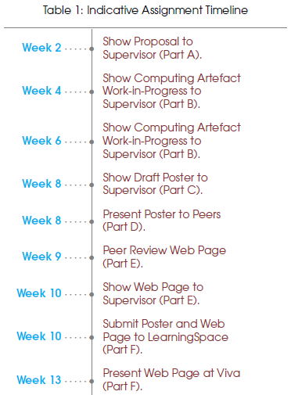
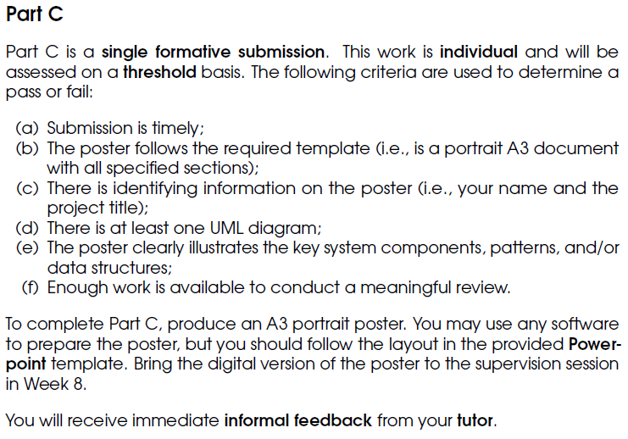
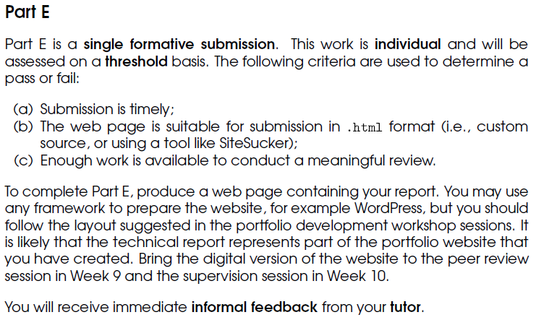
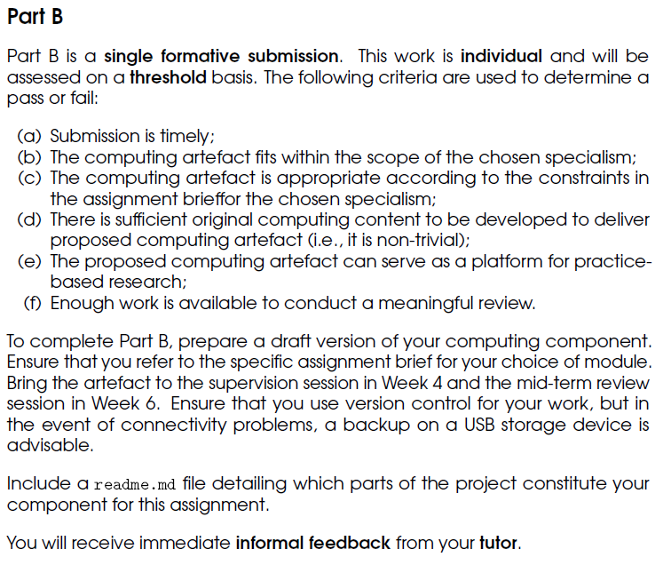
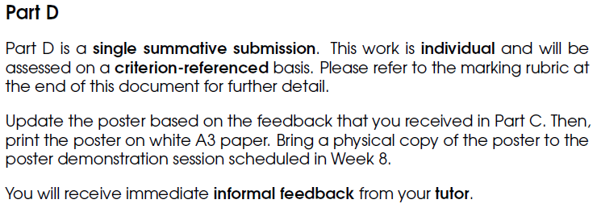
Timeline

Slide 3
Technical posters
Purpose:
To attract passers-by (e.g. at a conference) and create interest in/convey information about your product
To allow lecturing staff/interviewers to assess your ability to articulate technical problem solving
To practice developing this ability, using industry standard terms, tools and techniques
Presenting things visually can occur in various situations, e.g. whiteboard tests
To bump up your grades by up to 25%!

Slide 4
Technical posters
Content: must contain at least the following:
Identifying information – your name and the project title.
UML diagram – at least one.
Design information – clear illustration of:
Key system components
Patterns/data structures
with justification of development choices and design decisions.

Slide 5
Technical posters
Structure: tell a story!
The problem that needed to be addressed, and why it needs solving
A solution that worked (and ones that didn’t: practice-based research…)
The outcome and its impact – does it:
Meet the goals?
Add value?
Open up new areas of interest or approaches?
Have a positive impact for players/users/developers/coworkers etc.?

Slide 6
Technical posters
TITLE
NAME
WHAT IS THE PROBLEM
WHY IS IT AN ISSUE
Style/layout: simple, clear, readable – concentrate on key details and favour images over text.
More info/guidelines: https://www.makesigns.com/tutorials/
WHAT IS THE SOLUTION
USE-CASES
CLASS HIERARCHY
STATE MACHINE
FLOW CHART
PSEUDO CODE
SCREEN CAPS
WHAT WORKED WELL
WHAT IS THE SCOPE FOR IMPROVEMENT(S)

Slide 7
Technical posters
TITLE
NAME
WHAT IS THE PROBLEM
WHY IS IT AN ISSUE
Problem definition: what it is and why it needs solving. May make sense to include
A screenshot
A use case
Or some other illustration of the current state of things...
WHAT IS THE SOLUTION
USE-CASES
CLASS HIERARCHY
STATE MACHINE
FLOW CHART
PSEUDO CODE
SCREEN CAPS
WHAT WORKED WELL
WHAT IS THE SCOPE FOR IMPROVEMENT(S)

Slide 8
Technical posters
TITLE
NAME
WHAT IS THE PROBLEM
WHY IS IT AN ISSUE
Solution description: details of what the solution is, and how it is implemented
Should contain some text – but not too much!
Use references to modelling tools, and images if appropriate
WHAT IS THE SOLUTION
USE-CASES
CLASS HIERARCHY
STATE MACHINE
FLOW CHART
PSEUDO CODE
SCREEN CAPS
WHAT WORKED WELL
WHAT IS THE SCOPE FOR IMPROVEMENT(S)

Slide 9
Technical posters
TITLE
NAME
WHAT IS THE PROBLEM
WHY IS IT AN ISSUE
Modelling tools: a selection of visual tools for articulating your solution
Don’t use all of them, just the ones most appropriate for your problem!
Don’t have to include all the details; an overview may be clearer
No Blueprints screenshots!
WHAT IS THE SOLUTION
USE-CASES
CLASS HIERARCHY
STATE MACHINE
FLOW CHART
PSEUDO CODE
SCREEN CAPS
WHAT WORKED WELL
WHAT IS THE SCOPE FOR IMPROVEMENT(S)

Slide 10
Technical posters
TITLE
NAME
WHAT IS THE PROBLEM
WHY IS IT AN ISSUE
Outcome and impact
Opportunity for reflection and self-criticism
WHAT IS THE SOLUTION
USE-CASES
CLASS HIERARCHY
STATE MACHINE
FLOW CHART
PSEUDO CODE
SCREEN CAPS
WHAT WORKED WELL
WHAT IS THE SCOPE FOR IMPROVEMENT(S)

Slide 11
Suggested activities
Start designing your poster.
Create an appropriate UML diagram of the program/code structure so far.
Create a basic layout in the design tool of your choice, following the template.
Finish creating your basic portfolio structure, including a page for your Technical Report in a relevant section.
Start/continue writing about/making notes on the research you’ve done and your argument.
Work through the exercise at https://www.ucas.com/file/62641/download?token=sZT0YGZN if you need practice presenting your argument.
Continue work on your artefact.
Find these slides online at:
https://github.com/Falmouth-Games-Academy/COMP2x0-workshop-slides

