Slide 1


COMP2x0/VR220 Portfolio Development/ Worksheet Support Week 7:

Slide 2
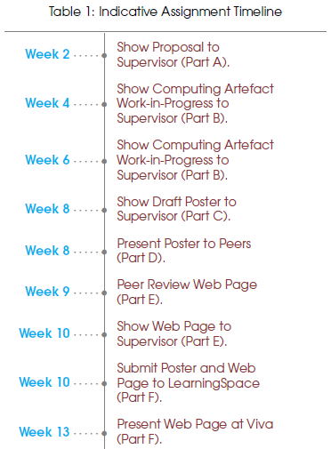
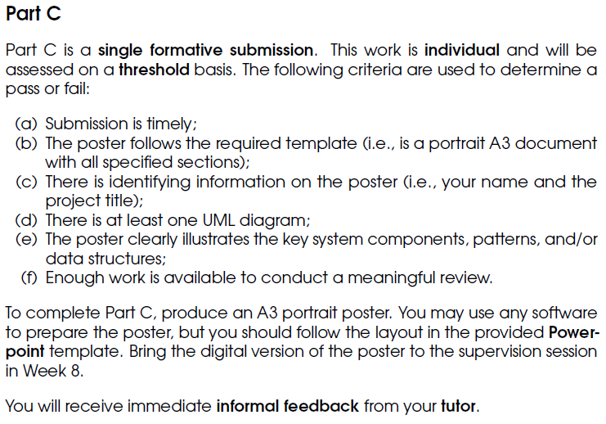
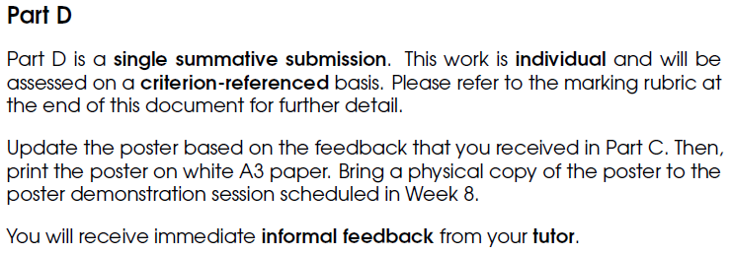
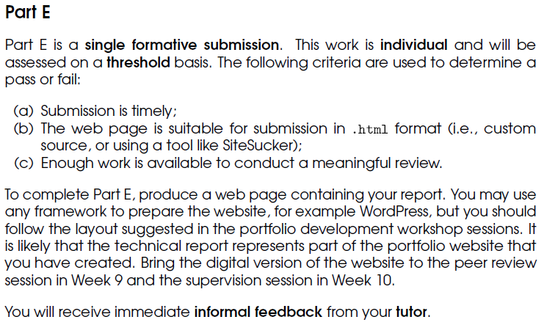
Timeline

Slide 3
Writing reports
Purpose:
To demonstrate your knowledge and analytical skills to a remote audience (examiner, interviewer etc.)
To preserve a record of your work
To act as a reference for your own, or other people’s, future work
To give 25% of your grades…

Slide 4
Writing reports
Content:
Description of your computing artefact
Illustration of the architecture of your computing artefact
Embedded video of your computing artefact
Communication of your practice-based research
i.e. how you found out what to try, what worked and what didn’t
Defence of an argument related to the outcome of this research
i.e. why you chose to try what you tried

Slide 5
Writing reports
Audience:
Supervisors/teaching staff
Potential employers/interviewers
Anyone with an internet connection, and some interest in your specialist area…

Slide 6
Writing reports
Structure:
Introduction: what you planned to do, and why
Aim and context; statement of your argument
Body: what you did, and how
Implementation details, with justification/defence of argument
Description of practice-based research
Results: how well you did it
Measurements, screen shots, video etc.
Conclusion: what it means
Did you achieve your aim? What more would you need to do?
More info: https://studyhub.fxplus.ac.uk/writing-science/science-essays https://studyhub.fxplus.ac.uk/file/243

Slide 7
Writing reports
Style:
Formal, objective tone – state facts, not opinions
Concise and precise: use as few words as possible, avoid vague intensifiers (“really”, “very” etc.)
References – can(/should?) be hyperlinks
Clear layout, using subheadings and bullet points where appropriate
Use images and diagrams to enhance your explanations
An introduction to academic writing: https://studyhub.fxplus.ac.uk/essays-dissertations/introduction-academic-writing
Guide for writing reports and essays: https://studyhub.fxplus.ac.uk/written-assignments/reports

Slide 8
Writing reports
Stages:
Planning Project proposal; also creating a time plan for the remaining stages
Researching Reviewing sources and making notes
Organising Group notes by theme to work out your argument (https://studyhub.fxplus.ac.uk/file/240)
Drafting Including outlining the “shape” of the report
Reviewing
More info: https://studyhub.fxplus.ac.uk/written-assignments/essays-dissertations

Slide 9
Suggested activities
Review resources for written assignments linked from these slides/at https://studyhub.fxplus.ac.uk/written-assignments
If you haven’t done so already, create:
A time plan for writing your report, and
An outline of your report’s structure
Continue work on your poster (see week 5 slides for tips).
Continue work on your artefact.
Find these slides online at:
https://github.com/Falmouth-Games-Academy/COMP2x0-workshop-slides

