Slide 1


COMP2x0/VR220 Portfolio Development/ Worksheet Support Week 8:

Slide 2
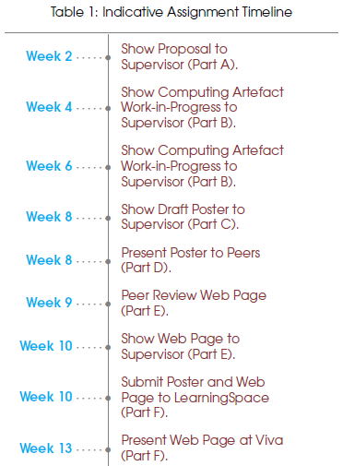
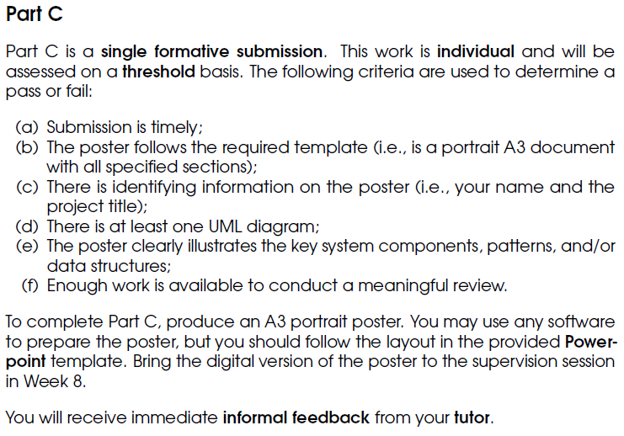
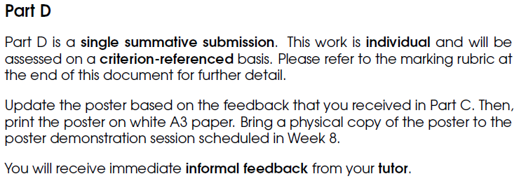
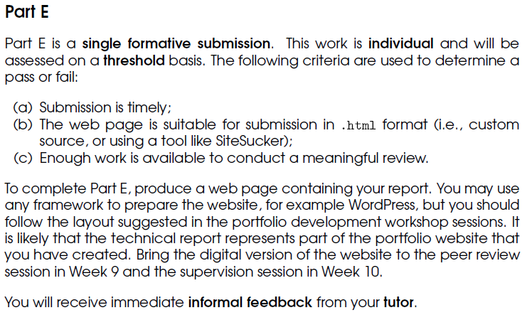
Timeline

Slide 3
Presenting posters
Purpose:
To highlight the key aspects of your work
To practice verbal communication, e.g. for interviews
including dealing with interruptions and questions…

Slide 4
Presenting posters
Structure:
Introduction: “elevator pitch”, to get your audience hooked…
What is your artefact, and why is it important/useful?
Narrative:
Setting the scene: necessary background information, and how did this lead to the idea for your artefact? Who are the “main characters”?
The adventure: how did you arrive at the design for your artefact, and what did you find on the way? Were there any plot twists?!
The conclusion: where did you end up, and what does it mean for your “characters”? Will there be a sequel?
More info: https://www.scientifica.uk.com/neurowire/tips-for-presenting-your-scientific-poster-at-a-conference

Slide 5
Suggested activities
Prepare an outline for your elevator pitch and poster “story”, and practice presenting it to your neighbour (or me)
Continue work on your poster (see week 5 slides for tips).
Continue work on your report (see week 7 slides for tips).
Continue work on your artefact.
Find these slides online at:
https://github.com/Falmouth-Games-Academy/COMP2x0-workshop-slides

