Slide 1



Lecture 9: Employment, Freelancing
& Entrepreneurship
GAM340: Professional Practice
BA(Hons) Game Development

Slide 2
Learning Outcomes
Describe the differences between employee, employer and director roles
Assess the pros and cons of different models of work
Determine which models could work for you, given your earlier interests, goals and ambitions (week 2)

Slide 3
Employment, freelancing & entrepreneurship

Slide 4
Employment, freelancing & entrepreneurship
These terms are often interchangeable
What do they really mean
And what impact will it have on your work

Slide 5
Employment, freelancing & entrepreneurship
Employment
Typically you are an employee of some organisation
You have
Contract
Rights
Covered by employment law
And whatever company wants to put in place over and above that
Or less, see WTD opt outs
Often
Blocked from working for others, or yourself
IP rights assignment in contract of employment
PAYE salaried

Slide 6
Employment, freelancing & entrepreneurship
Employment
Notion that employment is a long-term activity
Games companies have a typical lifespan of 6 years
Either
Collapse
Closedown
Get bought out
Don’t plan for your retirement at company X just yet

Slide 7
Employment, freelancing & entrepreneurship
Employment
Notion that employment is a long-term activity
Employment contracts are often temporary
Zero hours
Fixed term
Fixed term contracts are very common in game dev
Games are projects
Projects require a lot of talented people for a relatively short time
Staff are usually costed at £5-6kpppm
This will burn a lot of cash if not on a project

Slide 8
Employment, freelancing & entrepreneurship
Employment
Employment contracts are often temporary
Project-based contracts
Senior staff, typically cradle to grave
Junior / specialist staff often only in production phase
Companies will often use a mixture of fixed term and freelance roles for a project
Fixed term as PAYE employment contract for a period
Freelance services contract for work/period

Slide 9

Employment, freelancing & entrepreneurship
Employment

Slide 10
Employment, freelancing & entrepreneurship
Freelancing (contracting)
Working for a company based on a contract to provide services
You are generally ‘free’ to lance elsewhere
Often day rate or fixed rate
Day rate is great if the project slips ;)
Fixed rate shows you are taking on risk (IR35)
Often, contracts will get extended
6month rolling is common
Need to be aware of acceptance criteria for contract work

Slide 11
Employment, freelancing & entrepreneurship
Entrepreneurship
Typically, ‘a person who sets up a business or businesses, taking on financial risks in the hope of a profit’
Look to work with businesses (B2B) or customers (B2C)
Impression is of a start-up making products & services (like Launchpad)
Your business may involve selling your services to companies as a freelancer
Draw your salary from company profits
Hire and fire staff

Slide 12
Company vehicles

Slide 13
Company vehicles
As a freelancer or entrepreneur
You are required by law (HMRC) to operate as a business
Sole trader
Limited Company
(business partnership of traders)
Both have strengths and weaknesses depending on what you want to achieve with your business

Slide 14
Company vehicles
Sole Trader
You are the business
The defining difference between sole trader and limited companies, is that you are the business.
All profits in the business are taxed at personal rates
You are responsible for all risks (financial)
Designed for companies that don’t have a lot of residual profits
Model
Revenue – costs = pre-tax profit
HMRC(pre-tax profit) = your income
Reporting
Simple book keeping

Slide 15
Company vehicles
Limited (liability) company
You are a director in the business
Business is an entity in its own rights
All profits in the business are taxed at corporation rates
Business is responsible for all risks (financial)
Designed for companies that do have a lot of residual profits
Can have multiple ownership (shares & directors)
Model
Revenue – costs = pre-tax profit
HMRC(pre-tax profit) = company profit
Draw profits as a director through company dividends
Pay personal tax at dividend rates
Reporting
Full published accounts through accountants

Slide 16
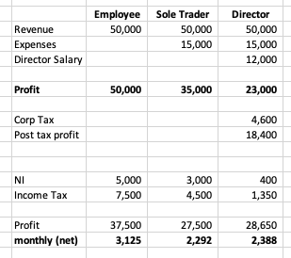
Company vehicles
Notes:
Everyone ‘earns’ the same, but ST and director can offset business expenses against revenue.
Director takes a nominal salary of £12k against profits and draws dividends to lower NI and tax liabilities.
ST and director take home is fairly close.
Employee earns more, but can’t claim costs against salary, so difference is smaller than c£800 suggests

Slide 17
Company vehicles
Why?
Sole trader works well when:
You’re the only boss
There’s little money in the business and you want to keep what you make
There’s little risk
Limited companies work well when:
There’s multiple directors that want to draw income from the business (like a start-up games business)
There’s scope for lots of money to go through the company
You want to keep profit inside the company
There’s a lot of risk (start-up, game dev etc)

Slide 18
Company vehicles
Freelancing / contracting
Typically, if you freelance you will be expected to provide a business to freelance through
Sole trader or Limited
HMRC are cracking down on disguised employees that freelance through Ltd company vehicles (IR35)
Criteria:
Taking on risk of business
Right of substitution
Provision of equipment
Time-bound / feature-bound contract

Slide 19
Company vehicles
Freelancing / contracting
Typically, if you freelance you will be expected to provide a business to freelance through
Sole trader or Limited
HMRC are cracking down on disguised employees that freelance through Ltd company vehicles (IR35)
Criteria:
Taking on risk of business
You run the risk of losing money if the project slips
Right of substitution
Provision of equipment
Time-bound / feature-bound contract

Slide 20
Company vehicles
Freelancing / contracting
Typically, if you freelance you will be expected to provide a business to freelance through
Sole trader or Limited
HMRC are cracking down on disguised employees that freelance through Ltd company vehicles (IR35)
Criteria:
Taking on risk of business
Right of substitution
The contract doesn’t name you as the explicit contractor.
Your business will provide staff to do the job
Provision of equipment
Time-bound / feature-bound contract

Slide 21
Company vehicles
Freelancing / contracting
Typically, if you freelance you will be expected to provide a business to freelance through
Sole trader or Limited
HMRC are cracking down on disguised employees that freelance through Ltd company vehicles (IR35)
Criteria:
Taking on risk of business
Right of substitution
Provision of equipment
You provide the equipment and licences to work, not the business you are contracting to
Time-bound / feature-bound contract

Slide 22
Company vehicles
Freelancing / contracting
Typically, if you freelance you will be expected to provide a business to freelance through
Sole trader or Limited
HMRC are cracking down on disguised employees that freelance through Ltd company vehicles (IR35)
Criteria:
Taking on risk of business
Right of substitution
Provision of equipment
Time-bound / feature-bound contract
You are contracted to deliver something, not just body shopping

Slide 23
Company vehicles
Freelancing / contracting
Typically, if you freelance you will be expected to provide a business to freelance through
Sole trader or Limited
Sole traders are exempt from IR35 ☺

Slide 24
Wrap-up
There are many routes to work
You need to find what suits you
And be aware of the issues of different approaches
Support is available for whatever you want to do
Need to be aware of the alternatives before you end up in a final interview being asked to commit to something you didn’t understand
https://www.gov.uk/browse/business
https://www.gov.uk/browse/business/setting-up
https://www.gov.uk/set-up-self-employed

Slide 25
Module wrap-up

Slide 26
Module wrap-up
Over the last 9 weeks we’ve looked at different aspects of professional practice:
Determining what you find interesting
Creating portfolios to develop and showcase your work
Creating resumé and social media to detail your experiences and channel people to your portfolio
Applying for jobs
Attending different types of interviews & selection processes
Evaluating different ways of working

Slide 27
Module wrap-up
To a large degree, what you end up doing in the games industry will be driven by what drives you
This can be a very tough industry to get into
It often feels like the axe can fall at any moment
There’s always a job out there, if you are prepared to do it.
Eventually, good things will come
https://www.linkedin.com/in/pedramk/

Slide 28
GAM340 Assignment 1 ‘Professional Practice Report’
Hero piece(s)
Peer Review, week 9
Discipline led, done in review sessions
Done in Learning Space
Make sure you have some content for review
Due 12/12/2019 (week 12)
Hero content for your portfolio
Submit a link
-Showcase after xmas (week 13)
Non-UK students can phone this in (skype) if they can’t make the dates

Slide 29
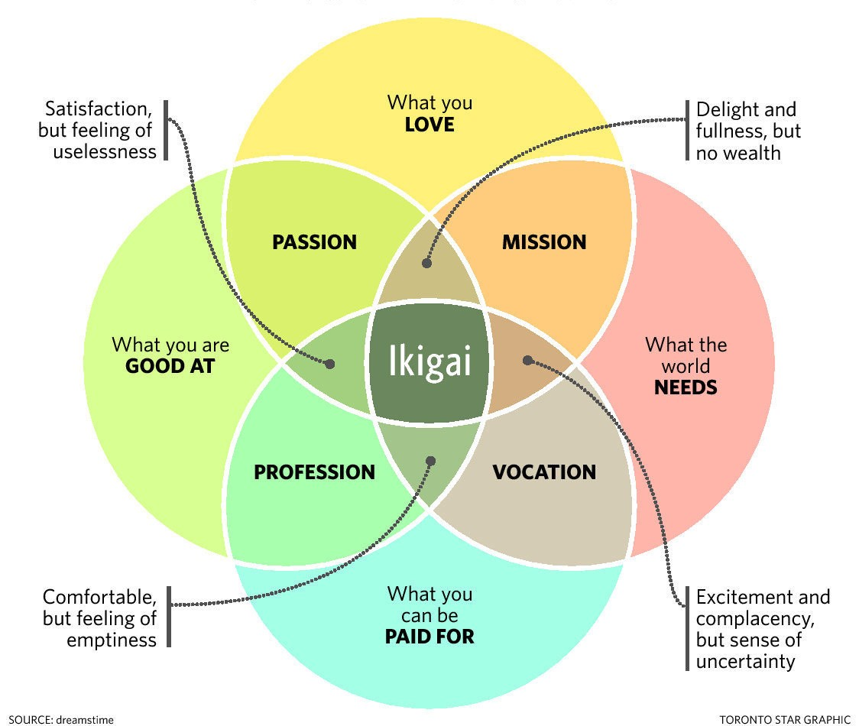
Do you have any questions for me?

