Slide 1

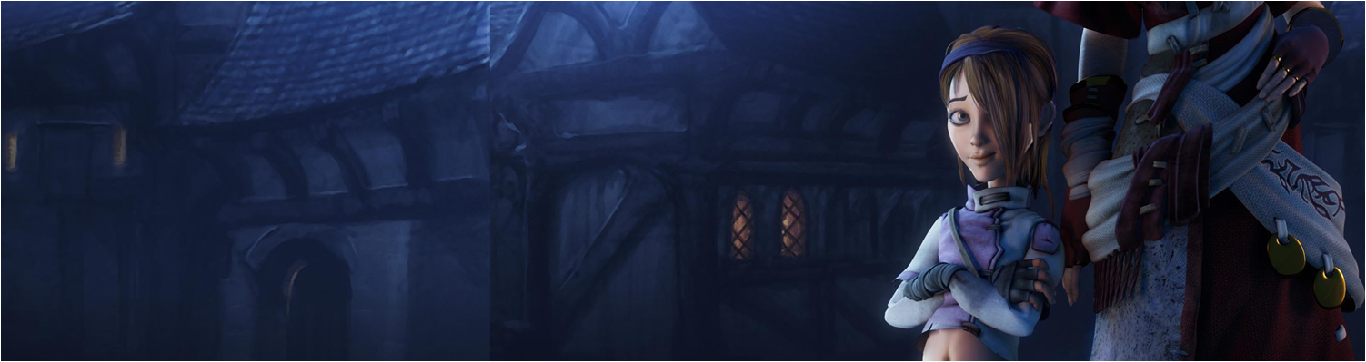

Lecture 2 – Manifestos & Team Identity
GAM320: Major Game Development Project: Pre-Production

Slide 2
Introduction
At the Games Academy we have brought together individuals as teams
Or
You have self organised into a Team
How do you take all your individual values and coalesce this into team values?
If you can do this, then hopefully
It will bring the team together and reduce conflict
It will provide a vision for the team
It will set out the kind of games you want to make

Slide 3
What is a Manifestos?
A manifesto is a declaration of intentions, motives or views
Typically a manifesto is published by political parties to state their ideology and policies for Government
These are usually hashed out via some sort of democratic party process

Slide 4


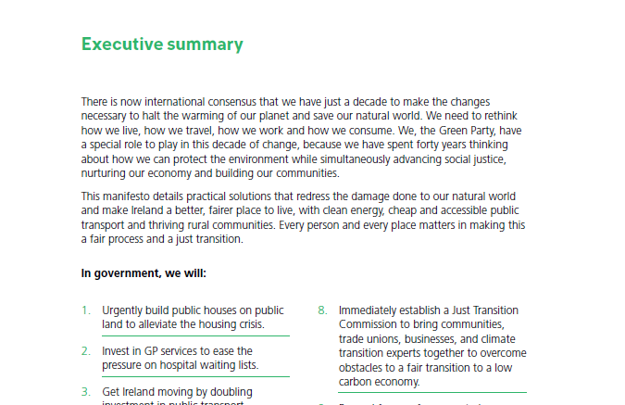
Political Manifesto
https://www.greenparty.ie/wp-content/uploads/2020/01/GREEN_PARTY_TOWARDS_2030-WEB-VERSION.pdf

Slide 5
Beyond Politics
Manifestos are not only for politics
It allows a group to state their aims, objectives and philosophies
In Art, manifestos
Define and criticise an element of culture or art
Define a set of aesthetics to counter
Typically we see manifesto from:
Political Parties
Artists
Game Developers
Open Source Community

Slide 6
Art Manifestos
The Futurist Manifesto
On Cubism
Dada Manifesto
Surrealist Manifesto
Fluxus Manifest
Stuckist manifesto

Slide 7
Game Developer Manifestos
Casual Game Manifesto
Hobbyist Game Developer Manifesto
The Suspicious Developments Manifesto
Not a Manifesto
Realtime Art Manifesto

Slide 8
Other Manifestos
Dogma 95
Hacker Manifesto
Manifesto for Agile Software Development
Software Craftsmanship Manifesto
The GNU Manifesto

Slide 9
Manifesto Tips
Give a name to your movement or group
Give preamble which is ‘against something’ or attacks the norm
State your goals clearly in bullet points
Talk about what you will do or make
Embellish with art work

Slide 10
Activity
As a group, carry out the following:
Research Manifestos, pick 3 – 5 that the group like. Please include some non-game examples!
Build your Teams Manifesto
Decided on a team name
Create a rough logo for the team
Work on your principles
What's your opening statement?
What’s your call to action?
Embellish with artwork, please note this can be concept work or sketches
First drafts of this by end of week 3
Please post this on the Teams Site for the module

Slide 11
Why are we doing this?
Brings the team together under a collective vision
Reduces conflict, if the manifesto is agreed upon
Starts you thinking about your or your games brand
Manifesto creation is fun!

Slide 12
Resources
10 Game Changing Art Manifestos
https://www.royalacademy.org.uk/article/ten-game-changing-manifestos
A Survey of video game manifestos
https://www.blog.radiator.debacle.us/2017/04/a-survey-of-video-game-manifestos.html
Manifesto for Agile Software Development
https://agilemanifesto.org/
Manifesto Jam
https://itch.io/jam/manifesto-jam

