Slide 1


Slide 2
Planning:
Or how I actually made a game in 2nd year

Slide 3
Introduction
We are now in Week 3 of SB2
The Expo day will be in Week 13
This means we have around 10 weeks to complete development (not including Easter!)
We need to start considering the scope of our game
We need to start planning for our project deadlines
We are going to use this lecture to discuss some tools and strategies to

Slide 4
Unblocking

Slide 5
Wall of pain
In our daily practice, there is usually small things that block us
Consider noting these down on card or post-its
As other people encounter the same or similar issues, they can add it to the pile
This way the team can quickly see what are the major pain points in the project
During the next planning session you can bring these to the team and try to unblock

Slide 6
Priortisation

Slide 7
Rank Orderings
This is a collaborative effort to ordering a set of Backlog Items
First sort all your items into a deck
You then draw an item from the deck and place it in the middle
Each team member draws a card, and places it above/Below or alongside
This is based on the perceived priority of the item
Instead of placing a card, a team member can swap two cards
This continues until the deck is empty

Slide 8
Rank Orderings - Setup
Deck

Slide 9
Rank Orderings – 1st turn
Main Character
Blockout

Slide 10
Rank Orderings
Main Character
Blockout
Main Character
Texture

Slide 11
Rank Orderings
Main Character
Idle Animation
Main Character
Blockout
Main Character
Texture

Slide 12
Rank Orderings
Character Controller
Main Character
Idle Animation
Main Character
Blockout
Main Character
Texture

Slide 13
Rank Orderings
Character Controller
Main Character
Blockout
Main Character
Idle Animation
Main Character
Texture

Slide 14
MOSCOW
Stands for:
Must have – features we cannot ship without
Should have – features that we can cut, but would have an impact on the game
Could have – features that we can cut, but can cut without much impact on the game
Won’t have – features that we can cut, without any real impact on the game
Have the whole team go through the blacklog
Sort each backlog item into the above categories

Slide 15
Planning

Slide 16
TIME Boxing
We as developers always want to get our best work into the game
Be it the Programmer who wants to make the best engineered system
Or the Artist who wants to make the perfect piece
Have your team estimate how long a task with take, say 2 hours
Add 10-20%, now around 3 hours
Say that they that much time to work on the task
However they can come back and iterate in later sprints

Slide 17
Burndown charts
This is a graphical representation of the work left to do vs time
X-axis is the project/iteration timeline
Y-axis is the estimated sum of the work that needs to be completed
There is an ideal working line, which connects the start point (0 on the x-axis & total sum of work on y-axis)
As task are carried out, you update the graph, this gives you an actual work remaining line
If the actual work remaining line is above the ideal working line, then the project is behind schedule
If the actual work remaining line is Below the ideal working link, then the project is ahead of schedule

Slide 18
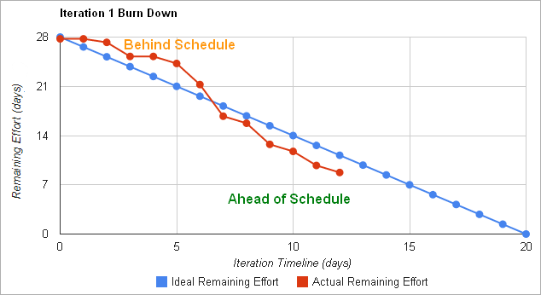
Burndown charts

Slide 19
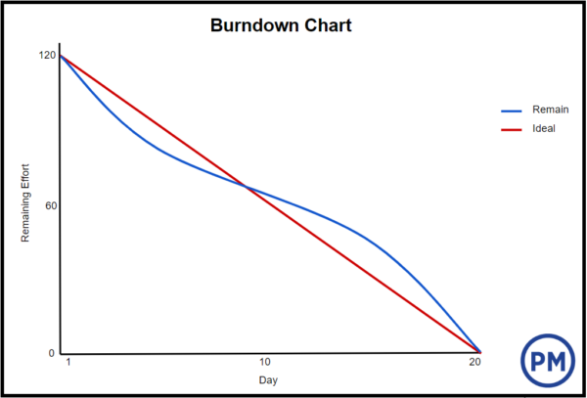
Burndown charts

Slide 20
Burndown charts
Example/Template
https://learningspace.falmouth.ac.uk/mod/url/view.php?id=59322

Slide 21
Questions?

Slide 22
References
RUBIN, Kenneth S. 2013. Essential Scrum : a Practical Guide to the Most Popular Agile Process Upper Saddle River, N.J. ;: Addison-Wesley.
KEITH, Clinton and Grant SHONKWILER. 2017. Gear up! : Advanced Game Development Practices Place of publication not identified: Createspace Independent Publishing Platform.
KEITH, Clinton. 2010. Agile Game Development with Scrum Upper Saddle River, NJ: Addison-Wesley.

