Slide 1



Lecture 7: Networking
GAM340: Professional Practice
BA(Hons) Game Development

Slide 2
SSLG preamble
‘You said, we did’
Lectures are too long
Lectures are boring
Lectures are confusing

Slide 3
SSLG preamble
‘You said, we did’
Lectures are too long
Lectures are boring
Lectures are confusing
Resumé advice tended to be highly contradictory:
Number of pages
Style (infographic vs. text vs. bullet points vs. highlights)
Value of hobbies and interests / other work etc
Make sure your resumé contains enough information to describe what you have done and what you want to do

Slide 4
GAM340 Assignment 2 ‘Promotional Materials’
Due 18/11/2019
Resumé
LinkedIn portfolio
Professional website
Should have the skeleton of your website in place
& links to other content
Can contain placeholders for your hero pieces

Slide 5
GAM340 Assignment 1 ‘Professional Practice Report’
Hero piece(s)
Due 12/12/2019
Hero content for your portfolio
Submit a link
Peer Review, week 9
Discipline led, done in the workshops
Done in Learning Space
Make sure you have some content for review
-Showcase week 13 (after xmas)

Slide 6
GAM320 Assignment 2 ‘Evaluation’
Due 8/11/2019
1,500 word report +/- 10%
Follow the rubric & additional guidance
Use the weighting to work out word count for each section
Using a reflective practice framework may help you to marshal your experiences and thoughts into a plan

Slide 7
GAM320 Assignment 2 ‘Evaluation’
Due 8/11/2019
SMART goals
Think deeply about ‘specific’
‘git gud at art / programming / design / writing’ is not specific

Slide 8
Learning Outcomes
Develop strategies for building small yet meaningful networks of support
Assess social networks, and those within networks, for their ability and likelihood to support you in a professional manner
Avoid toxic environments

Slide 9
Networking, what do we even mean by networking?

Slide 10
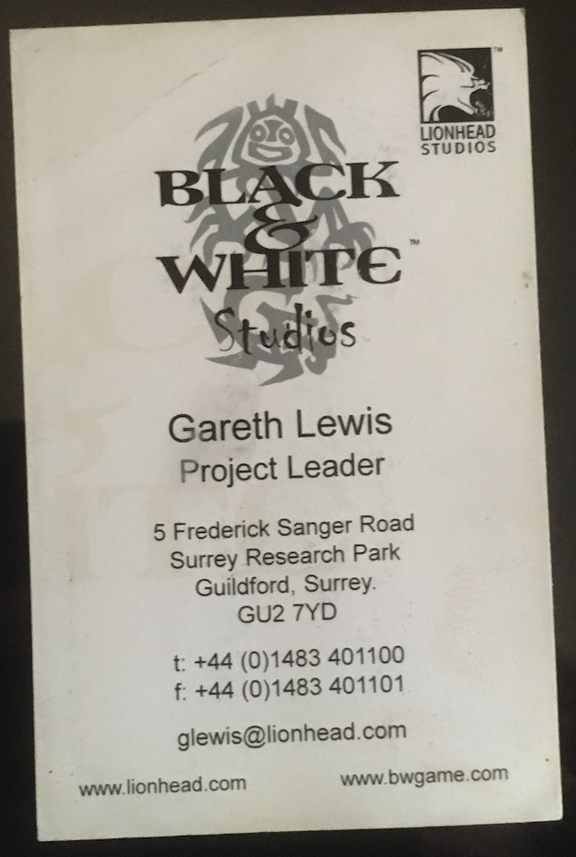
Networking, what do we even mean by networking?
For the people from EGX, did you do any networking with these?

Slide 11
Networking, what do we even mean by networking?
Traditionally:
Having a huge database of names
Getting in front of people to prospect for business
Schmoozing and boozing
"The process of developing and using your contacts to increase your business, enhance your knowledge, expand your sphere of influence or serve your community.” – Ivan Misner
https://www.entrepreneur.com/article/225067
Traditional ‘paper-based’ networking was geared around business cards
Attend meetings specifically to exchange them

Slide 12

Networking, what do we even mean by networking?
Traditional ‘paper-based’ networking was geared around business cards
And geared around sales

Slide 13
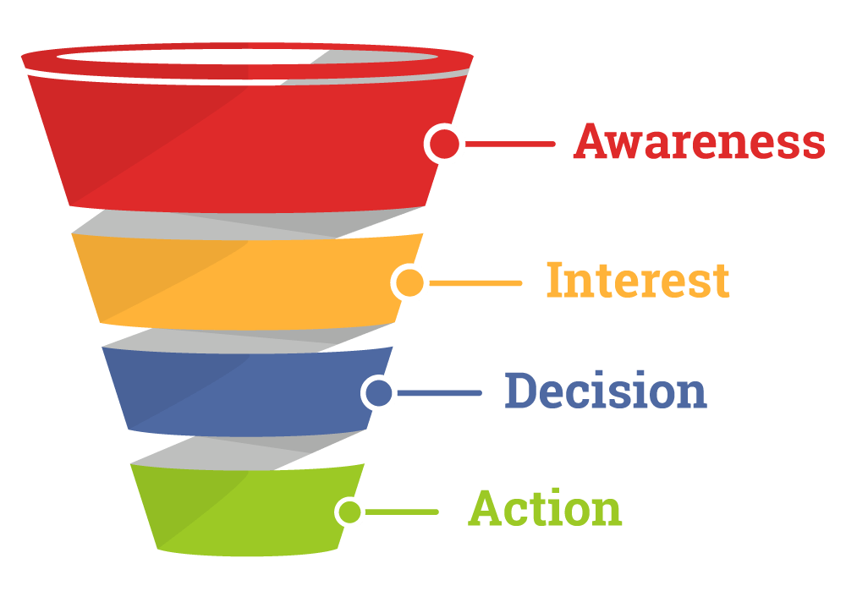
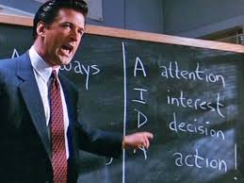
Networking, what do we even mean by networking?
Traditional ‘paper-based’ networking was geared around business cards
And geared around sales

Slide 14
Networking, what do we even mean by networking?
Traditional ‘paper-based’ networking was geared around business cards
And geared around sales
Collect business cards
Perform sales funnel (AIDA)
This is why shows will have a lot of raffles / lotteries based on business cards

Slide 15
Networking, what do we even mean by networking?
Traditional ‘paper-based’ networking was geared around business cards
Nothing fundamentally wrong with business cards and physical networking
Don’t burn your business cards just yet
Do make sure there’s space to write on the back of them though

Slide 16
Networking, what do we even mean by networking?
Traditional ‘paper-based’ networking was geared around business cards
However
Can’t technology help us to be more efficient?
What if I hate the idea of spending a lot of time in a room of strangers?
From MBTI
E (extravert) means you get ‘energy’ from events / people
I (introvert) events / people are likely to drain you
https://www.myersbriggs.org/my-mbti-personality-type/mbti-basics/extraversion-or-introversion.htm

Slide 17
As game development graduates, what do you want networking to do for you?

Slide 18
What do you want networking to do for you?
Are these relevant?
Having a huge database of names
Getting in front of people to prospect for business
Schmoozing and boozing

Slide 19
What do you want networking to do for you?
Are these relevant?
Having a huge database of names
Getting in front of people to prospect for business
Schmoozing and boozing

Slide 20
Questions

