Slide 1



Lecture 1: Module Introduction
GAM320: Major Game Development Project: Pre-Production
BA(Hons) Game Development
BSc(Hons) Computing for Games

Slide 2
Introduction to the module
Everything isn’t different!

Slide 3
Introduction to the module
Everything isn’t different!
Built on GAM320 from last year
Now with:
Product owners are now supervisors
Supervisor meetings are now 1hr30
More guided than before
One to review your builds & sprint plans
One to do peer reviews
New Project Management Tool
Replacing pomeetings
New guide on how to do agile projects

Slide 4
Introduction to the module
Now with:
Assignments are clearer
With added rubrics
https://learningspace.falmouth.ac.uk/course/view.php?id=3976

Slide 5
Introduction to the module
Assignment 1: Studio practice
Assess how you work as a member of an agile team
Assess your game product
Conceptual coherence
Innovation
quality
player engagement
You’re assessed over the duration of semester 1
From week 3
The game is assessed on the demo day (week 13)

Slide 6
Introduction to the module
Assignment 2: Evaluation
Reflective practice report
Look back on what you have done
Look forward to the future with a SMART plan

Slide 7
Introduction to the module
Week 1 | Week 2 | Week 3 | Week 4 | Week 5 | Reading Week
Introduction | Support Lecture | Support Lecture | Support Lecture | Support Lecture
Supervisor Meeting | Supervisor Meeting | Supervisor Meeting | Supervisor Meeting | Supervisor Meeting | Supervisor Meeting
Week 7 | Week 8 | Week 9 | Week 10 | Week 11 | Week 12
Support Lecture | Support Lecture | Support Lecture | Support Lecture | Support Lecture | Support Lecture
Supervisor Meeting | Supervisor Meeting | Supervisor Meeting | Supervisor Meeting | Supervisor Meeting | Supervisor Meeting
Week 13
Demo Day

Slide 8
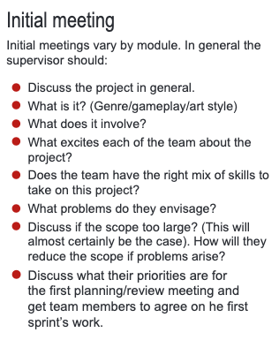
Meeting procedures

Slide 9
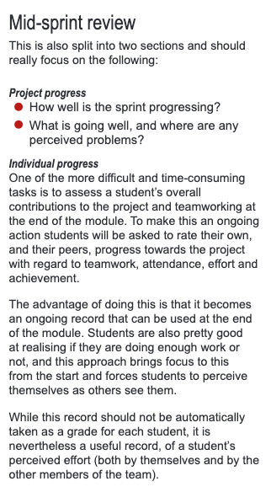
Meeting procedures

Slide 10
Meeting procedures

Slide 11
A note on teamwork

Slide 12
Questions

