Slide 1

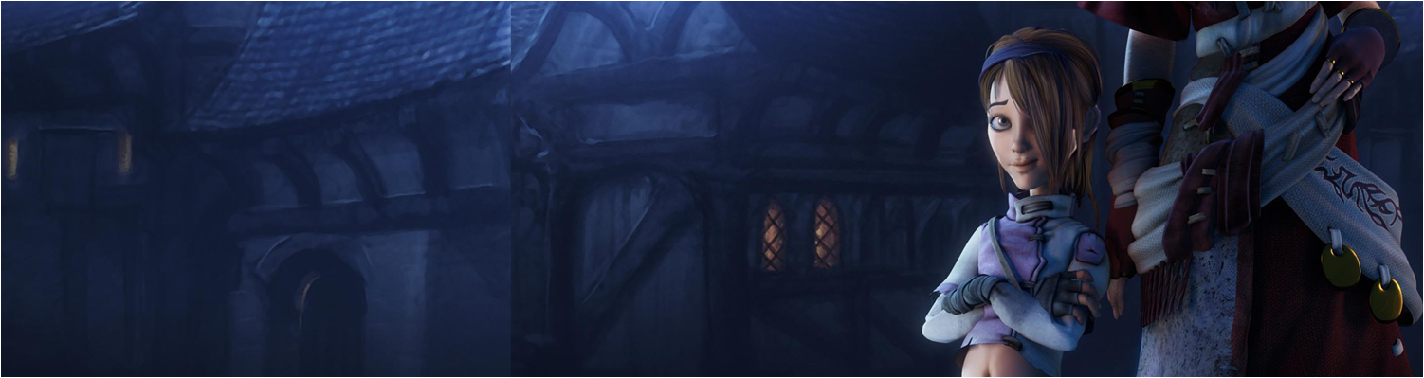

Lecture 1: Module Introduction
GAM340: Professional Practice
BA(Hons) Game Development

Slide 2
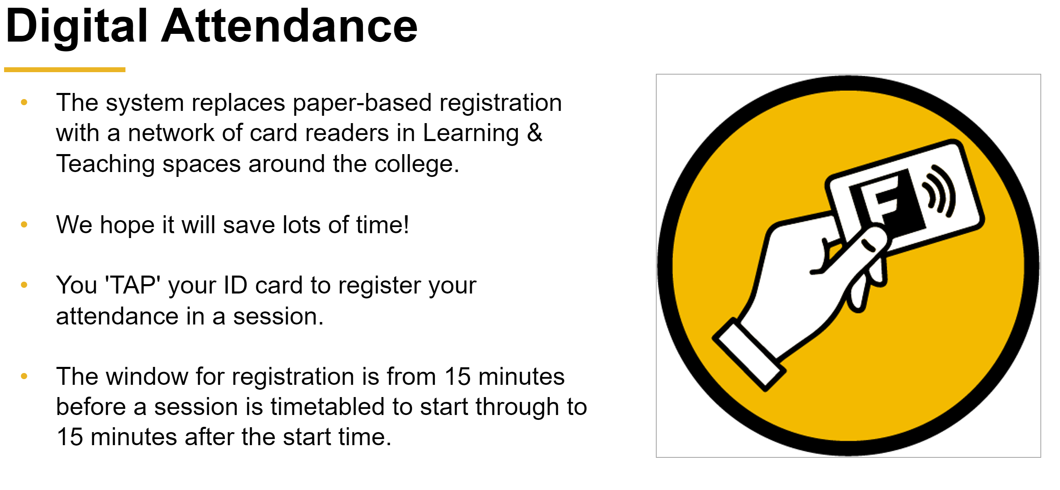

Slide 3
Introduction to the module
Everything is different!

Slide 4
Introduction to the module
Everything is different!
Old GAM340
Interview people and write a report (40%)
Write a business plan (40%)
Make some promotional materials (20%)

Slide 5
Introduction to the module
Everything is different!
New GAM340
Make portfolio pieces (80%)
Make some promotional materials (20%)

Slide 6
Introduction to the module
Assignment 1
‘Professional Practice Report’
Not a professional practice report
Really : create professional portfolio materials
https://learningspace.falmouth.ac.uk/course/view.php?id=4352

Slide 7
Introduction to the module
Assignment 1
‘Professional Practice Report’
Not a professional practice report
Really : create professional portfolio materials
https://learningspace.falmouth.ac.uk/course/view.php?id=4352
Moved to explicit rubrics to make it clearer what you are being assessed on
And what good, bad and indifferent looks like
Linked to the common assessment criteria (CAC)
Showcase your work in week 13

Slide 8
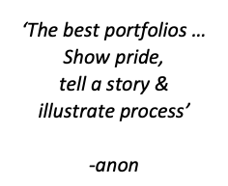
Introduction to the module
Assignment 1
create professional portfolio materials
Precise content will depend on what you want to do
That’s why the rubric is fairly loose
Your tutors will be able to give you guidance

Slide 9
Introduction to the module
Assignment 1
create professional portfolio materials
Precise content will depend on what you want to do
That’s why the rubric is fairly loose
Your tutors will be able to give you guidance
If you want to do something ‘different’ to your route
That’s cool, make it work around your portfolio work
Game programming -> webdev
Anything -> production / business / PR / marketing / community management etc
Anything -> something non-games
Anything -> further education
Talk to me and your route tutor and we can work things out.

Slide 10
Introduction to the module
Assignment 1
Examples
Jonathan Hemmens (Art)
https://jonjo.artstation.com/projects/4b6eql
Andy Finlay (Programming)
https://newtoto.github.io/
Tom King (Design)
https://www.thomaskingleveldesign.com/
Issac Oluyadi (Animation)
https://ioluyadi.wixsite.com/website
Sophie Shepherd
https://80.lv/articles/004adk-studying-animation-with-sophie-shepherd/

Slide 11
Introduction to the module
Assignment 2
‘Promotional materials’
Create materials
Resume
LinkedIn profile
Suitable website / portfolio hosting
https://learningspace.falmouth.ac.uk/course/view.php?id=4352
Again, rubrics to make things clear

Slide 12
Introduction to the module
Week 1 | Week 2 | Week 3 | Week 4 | Week 5 | Reading Week
Introduction | Graduate Destinations | Creating meaningful portfolios | Building and honing your skills | How to network | Studio Practice
 | Tutorial | Tutorial | Tutorial | Tutorial
Week 7 | Week 8 | Week 9 | Week 10 | Week 11 | Week 12
The recruitment process | Creative & effective resumes | Freelancing & Entrepreneurship
Tutorial | Tutorial | Tutorial | Tutorial | Tutorial | Tutorial
Week 13
Showcase Tutorial

Slide 13
Introduction to the module
Tutorials:
Build on lecture materials
Give you support to go and do your own things
Have equipment so you can develop your portfolio pieces

Slide 14
Introduction to the module
Route tutors:
All industry experienced
Route | Tutor | Contact
Animation | Rich Milligan | Richard.Milligan@falmouth.ac.uk
Art | Phoebe Herring Jon Pledger | Phoebe.Herring@falmouth.ac.uk jon.pledger@falmouth.ac.uk
Audio | Pete Shepherd | Pete.Shepherd@falmouth.ac.uk
Design | Terry Greer | Terry.Greer@falmouth.ac.uk
Programming | Gareth Lewis | gareth.lewis@falmouth.ac.uk
Writing | Hannah Wood | Hannah.Wood@falmouth.ac.uk

Slide 15
Introduction to the module
Overall approach
Look to divide your time between GAM320 & GAM340
GAM320 is worth x2 GAM340 (40 vs. 20 credits)
Look to split your time accordingly

Slide 16
Questions

