Slide 1


GAM320 –
Forming
Teams

Slide 2
Introduction
We are going to look at forming teams for next year
This will involve one of two things:
If you have a team, fill out 3rd Year Team Info form
If you are looking to form a team or looking to join a team. Then fill out the 3rd Year Team forming form

Slide 3
Word about Team
Forming

Slide 4
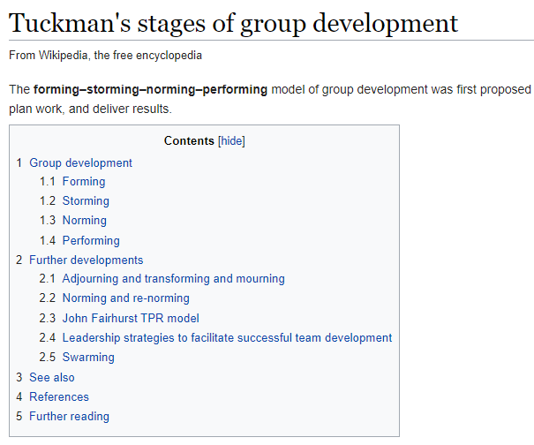
Tuckman, B.W. and Jensen, M.A.C., 1977. Stages of small-group development revisited. Group & Organization Studies, 2(4), pp.419-427.

Slide 5

https://falmouth.primo.exlibrisgroup.com/permalink/44FAL_INST/vct0c5/alma9911155600005136

Slide 6
Questions?

