Slide 1

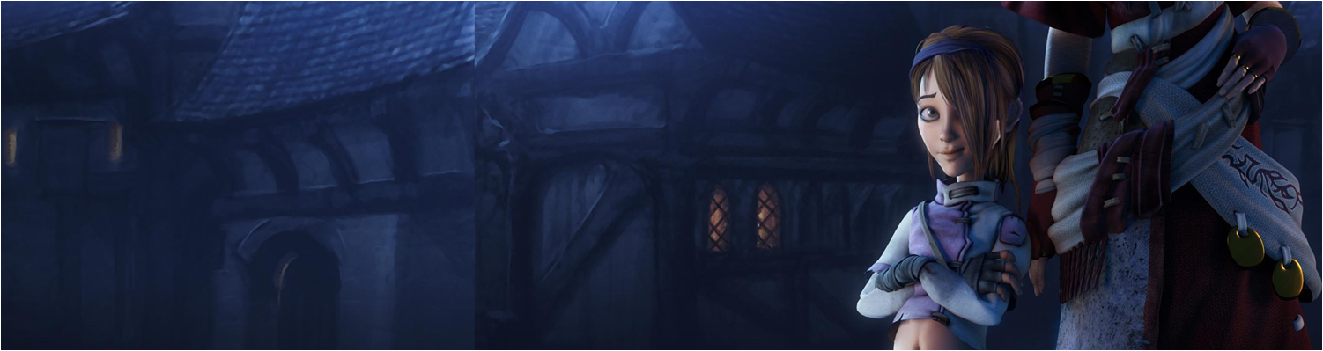

Programming Workshop 5:
SDL Programming
GAM340: Professional Practice
BA(Hons) Game Development

Slide 2
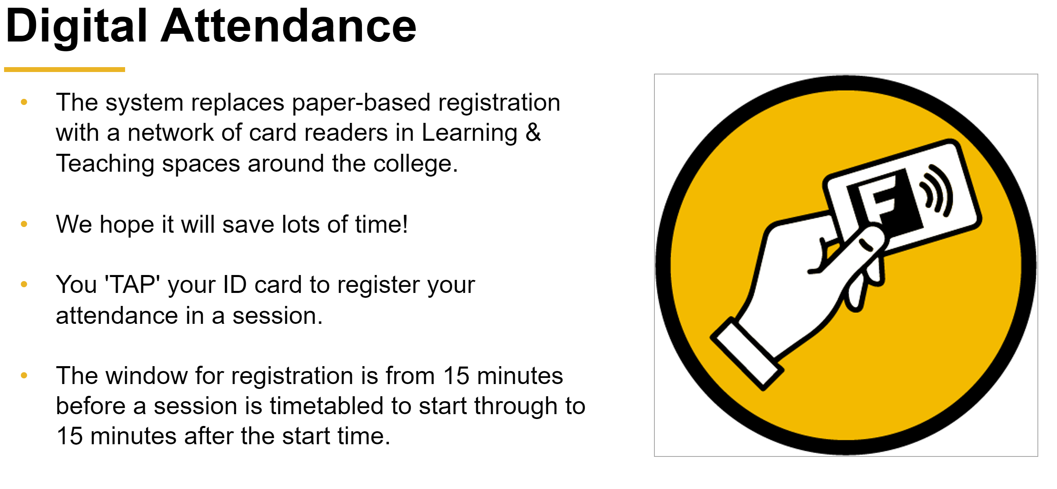

Slide 3
Learning Objectives
Feedback on the SDL podcast
Review the programming activities in the podcast
Create a font renderer to demonstrate texture page mastery
Design & build Pong using OO techniques

Slide 4
SDL Podcast
Did it make any sense?
How far did you get with it?

Slide 5
Texture page use in SDL

Slide 6
Object Oriented Analysis, Design & Programming
Useful for creating applications
Very useful for discussion development practice in interviews ;)

