Slide 1

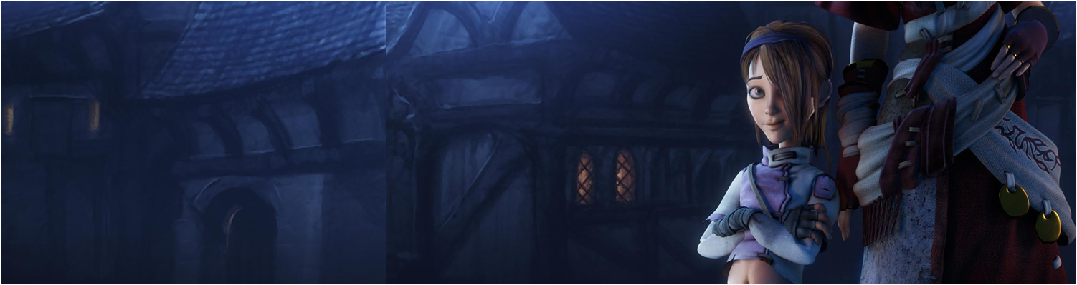

Programming Workshop 5:
SDL Programming
GAM340: Professional Practice
BA(Hons) Game Development

Slide 2
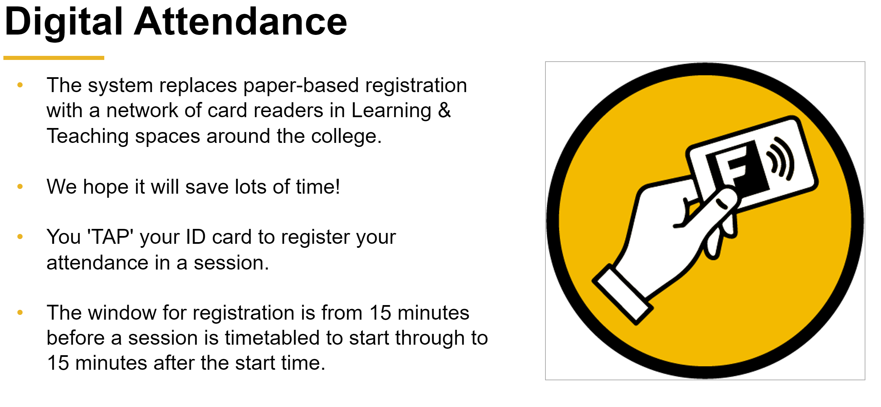

Slide 3
Learning Objectives
Feedback on the SDL podcast
Review the programming activities in the podcast
Create a font renderer to demonstrate texture page mastery
Design & build Pong using OO techniques

Slide 4
SDL Podcast
Did it make any sense?
How far did you get with it?

Slide 5
00. Balls!
Work out how to:
Store some balls
Update them so they bounce in the screen
Use the keyboard controller to add and remove balls on demand

Slide 6
Texture page use in SDL
Fundamental for displaying naff 8-bit text for debug & in-game
Also for working with texture pages (atlases)

Slide 7
01.sdl_printfont
Load a bmp font file
Convert it to 32-bit
Alpha channel that can be alpha tested
Work out the relationship between characters in a string and their glyphs in the font texture
Draw them in the correct place
Use scaling to make things bigger

Slide 8
Booch OO Development method

Slide 9
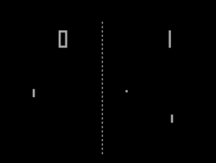
Booch OO Development method
Pong (1972)
First successful arcade game, launched Atari to become the dominant player of the 1st & 2nd computer consoles generations
Cause of first games lawsuit

Slide 10
Booch OO Development method
Pong game design
Pong is a two player game of tennis. Players take it in turns to move up and down the screen to hit the ball to each other. If the player misses the ball and it goes off the screen, the other player is awarded a point and the serve. If the ball goes to the top or the bottom of the screen, the ball will bounce back. The winner is the first player to 10 points.

Slide 11
Booch OO Development method
Pong game design
Pong is a two player game of tennis. Players take it in turns to move up and down the screen to hit the ball to each other. If the player misses the ball and it goes off the screen, the other player is awarded a point and the ball is served into the opponents part of the court. If the ball goes to the top or the bottom of the screen, the ball will bounce back. The winner is the first player to 10 points.
Class | Method | Attributes
Player | Move Hit ball
Ball | Move Bounce Serve
 |  | Players [2] Ball

Slide 12
Booch OO Development method
Pong game design
It’s the nature of designer-led game design that some aspects are implicit
So as implementers, you need to fill in the games to create something that is systemic
This is the nature of iterative activities -> it’s v. difficult to capture everything in one (or a few goes)
Class | Method | Attributes
Player | Move Hit ball | Score Position
Ball | Move Bounce Serve | Position
Game | Play | Players [2] Ball Court

Slide 13
Booch OO Development method
Pong game design – as UML
Ball
Move()
Bounce()
Serve()
Position
Game
Players[2]
Ball
Court
Player
Move()
HitBall()
Score
Position

Slide 14
Booch OO Development method
Design / code choice
What kind of functionality and data will they have?
Class | Method | Attributes
Player | Move Hit ball | Score Position
Ball | Move Bounce Serve | Position
Game | Play | Players [2] Ball Court

Slide 15
Booch OO Development method
Pong game design – as UML
Ball: Object
Move()
Object
Position
Move()=0;
Player:Object
Move()
HitBall()
Score

Slide 16
01. simple pong
Simple working pong game within SDL framework

Slide 17
Booch OO Development method
Pong dynamic behaviour
Pong isn’t just about classes and objects, what happens when they interact?
What states are in the game and how does the game go from one state to another (transition)
This is kind of implicit with the design document
As implementers, it’s our job to dig into this to create straw man systems that can be refined

Slide 18
Booch OO Development method
Pong dynamic behaviour
Entry State | Transition | Description
Attract | Start | Put game in mode where players can start game
Start | P1 Serve | Game serves to player 1
P1 / P2 Serve | Rally | The game will serve at the player who lost the last point
Rally | P1 / P2 Miss | Ball travels between players
P1 / P2 Miss | P1 / P2 Serve | Player misses ball, server back to player

Slide 19
Booch OO Development method
03.simple_states
View the game as a set of states StateMachine::state
Use StateMachine class to hold them
And manage state changing

Slide 20
To Do
Make Pong into a state-based game using the state machine approach
Develop Breakout Game from ‘designer’ brief
Build OO model of game
Build state model of game
Make work in SDL/C++
Use flappybird texture page as a starting point for your own flappy clone
https://flappybird.fandom.com/wiki/Sprites

