Slide 1



Programming Workshop 3:
C++ for Interviews and beyond
GAM340: Professional Practice
BA(Hons) Game Development

Slide 2
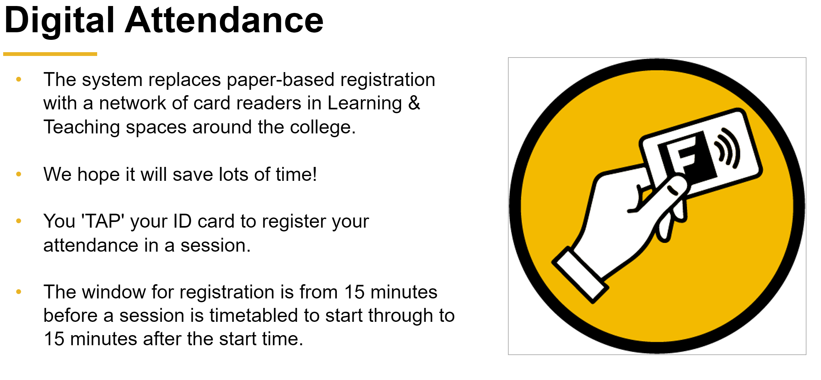

Slide 3
Learning Objectives
Understand the key features of C
Understand the motivations behind C++
Write working code using core C language features and libraries
Understand pointers in C
Solve basic C programming interview problems

Slide 4
C & C++
C was first developed in 1972 as a general purpose language for running utility applications in Unix
Utility applications
Read input (user / files / punched cards)
Process data in memory
Write output (tty, screen, files, punched cards)
A portable language
Would work on different processors / architectures
Support for 8/16/32 bit data & address types

Slide 5
C & C++
C++ was first developed in 1979 as ‘C with Classes’
4 languages in one framework
C programming language
Classes for C
Template metaprogramming
1993 STL

Slide 6
C & C++
C++ was first developed in 1979 as ‘C with Classes’
4 languages in one framework
C programming language
All the goodness of C
Classes for C
Kind of ‘object oriented’ but more ‘with objects’
C# /Java are object oriented in the sense that everything is an object. This is not the case with C++
Template metaprogramming
This is broadly equivalent to templates in C#
1993 STL
Templated data types (array, lists, trees, strings etc) and algorithms to operate on them
This is broadly equivalent to generics in C#

Slide 7
Fundamental C
Example_01
https://onlinegdb.com/HJCzgjEuH
Datatypes
Signed / unsigned data size issues
Control structures (for, if, do, while, switch/case)
rand()

Slide 8
Fundamental C
Example_02
https://onlinegdb.com/HkdBXjEdS
Arrays
Address of a variable
A variable that stores an address
Accessing the value of an address
Iterating through memory

Slide 9
Fundamental C
Example_02
Pointers, why do we do it?
Good question, in the olden days processors were very slow, c1-10Mhz
Accessing data through array lookups a[i] generates more machine code than doing pointer-based access
Make better use of the D-cache
Therefore, it’s faster
However,
Leads to lots of programming issues (run-time errors)
Modern languages tend to hide raw memory from programmers

Slide 10
Fundamental C
string.h : https://onlinegdb.com/SkbCniEdr
C’s string library is the root of many programming tests
Small amount of functionality
All pointer-based
Easy to see results
Links into other fundamental C functionality (ctype.h)
Character types (islower, isalpha etc)

Slide 11
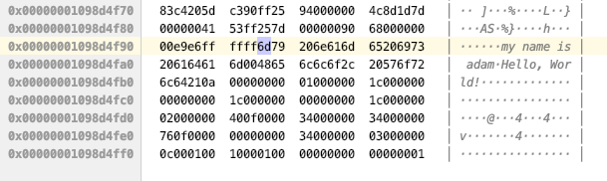
Fundamental C
string.h
All C strings have a NULL terminator
This is key to make them work

Slide 12
Fundamental C
string.h
NB
Strings that are declared like this are stored in read only memory, so you can’t change them

Slide 13
Fundamental C
string.h (http://www.cplusplus.com/reference/cstring/?kw=string.h)
NB
Strings that are declared like this are stored in read only memory, so you can’t change them

Slide 14


Fundamental C
string.h (http://www.cplusplus.com/reference/cstring/?kw=string.h)
NB
Strings that are declared like this are stored in read only memory, so you can’t change them
Also means you can’t process literals in functions
However, this works fine

Slide 15
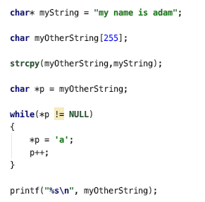
Fundamental C
string.h
Alternatively, let’s copy the string and work with the copy

Slide 16
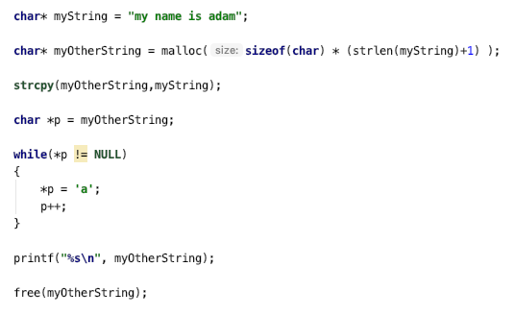
Fundamental C
string.h
Making arbitrary strings is a bad idea, we can address that with dynamic memory allocation

Slide 17
Fundamental C
string.h
Making arbitrary strings is a bad idea, we can address that with dynamic memory allocation
malloc
Will allocate bytes and return a pointer to them
free
Will return bytes allocated

Slide 18
Fundamental C
Programming tests with C/C++
Generally looking at
fundamental algorithms & control flow
Pointer manipulation
Some understanding of core C library functionality
https://onlinegdb.com/ByFME2Vdr

