Slide 1



Lecture 5: Resumes WiP
GAM340: Professional Practice
BA(Hons) Game Development

Slide 2
Learning Outcomes
Create self-marketing materials (resume, LinkedIn) that will create interest from recruiters, employers and industry professionals
Drive traffic to your portfolio.
Link your experiences across multiple sources (LinkedIn, portfolio, social media etc) to create a strong online presence

Slide 3
Building effective résumés

Slide 4
Building effective résumés
A good place to start is thinking about what a résumé is and what is its role?

Slide 5
Building effective résumés
A good place to start is thinking about what a résumé is and what is its role?
A résumé is defined as ‘a brief written account of personal, educational, and professional qualifications and experience, as that prepared by an applicant for a job.‘

Slide 6
Building effective résumés
Of course, résumés mean different things and have different roles for different people.
Let’s use 5Ws&H (who, where, what, when, why and how) to think about resumes from the perspectives of a candidate and a recruiter
5Ws&H | Candidate | Recruiter
Who
Where
What
When
Why
How

Slide 7
Building effective résumés
5Ws&H | Candidate | Recruiter
Who | Me | Whoever, maybe someone technical, maybe someone project related, maybe someone that knows nothing about Unity, programming or games
Where | In my own time, with enough time to write something really good | In the back office when they are keen for a smoke or to go home
What | The definition just given (a brief account … | A checklist of skills to use as pre-interview screening
When | Before I start applying for jobs | Before we interview
Why | A short list of what I’ve done that is easy to share | Cheaper than doing application forms or reading letters or interviewing everyone
How | I write out what I think is important, get a friend to review it and perhaps re-write it again or adjust the font and spacing | I spent a minute or so seeing if the candidate has the skills we’re after, if they don’t they are in the reject pile. If they do, they may go off to another sorting process

Slide 8
Building effective résumés
How different people regard the résumé process
Team-based recruiter (Lead Programmer) | HR department (HR assistant) | Recruitment consultant
I’m looking to replace our junior programmer that resigned last week. I know exactly what I’m looking for, a recent grad with good all-round unity skills and some experience with NGUI. It would help if they like CS:GO otherwise they are going to get creamed at lunch | I have a list of roles to fill across all our development departments at the moment. One of them is for a junior programmer with Unity 2018.2.12 experience. We’re getting a lot of applicants that have only used Unity and they’ve all been rejected as they don’t have the correct skills | The client is after grad programmers, so we’re sending them all the grads we can find with programming on their resume. Apparently that zoology grads that had worked on a world wildlife programme didn’t go down too well, but we wont do that again.

Slide 9
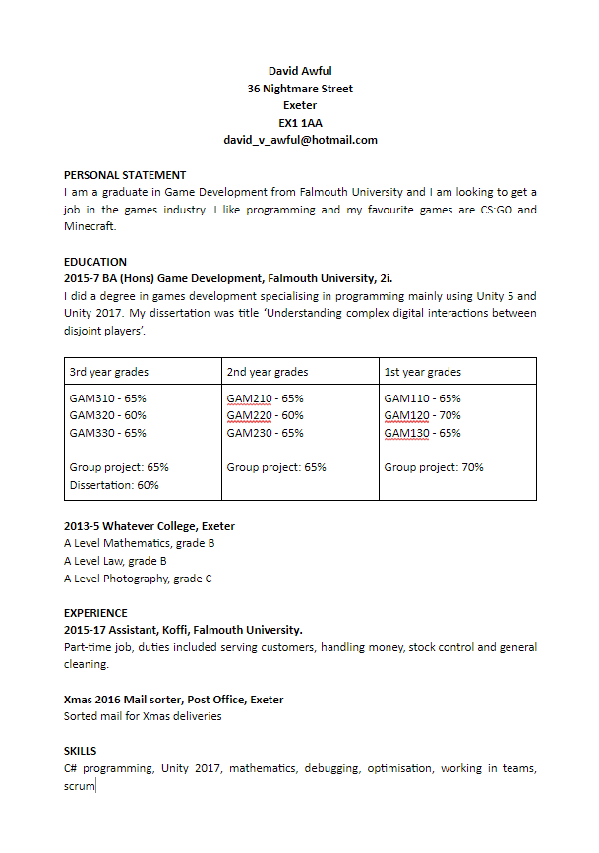
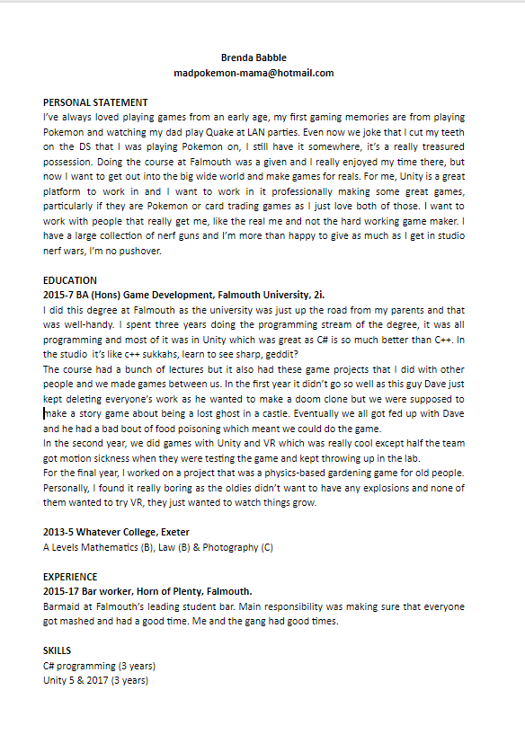
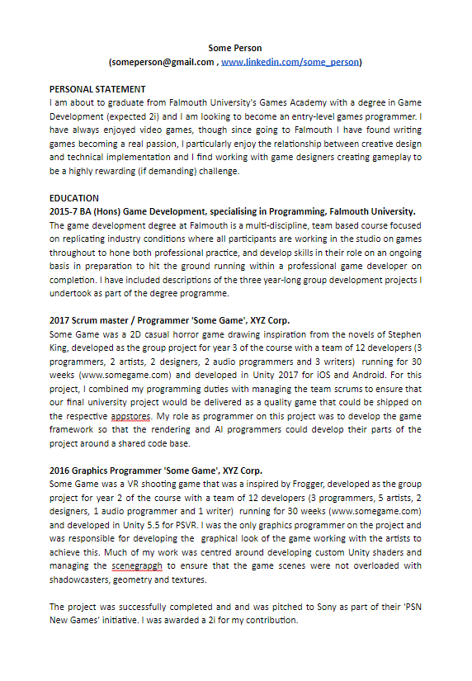
Building effective résumés
Let’s have a look at some resumes

Slide 10
Building effective résumés
Let’s have a look at some résumés
Resumes generally have 4 sections: personal statement, education, work experience & skills
Let’s look at some résumés to see how they match up
 | David Awful | Brenda Babble | Gina Nosobad
Personal statement
Education
Work experience
Skills

Slide 11
Building effective résumés
Let’s have a look at some résumés
 | David Awful | Brenda Babble | Gina Nosobad
Personal statement | Very vague No real detail, no real drive or interest | Lots written, but does it mean anything. Does the candidate come out well or sound like a complete nutter? | A statement of who they are, what interests them (professionally) and what they’d like to be doing
Education | Says very little about the university, course or what they did. The grades are completely opaque to anyone outside of the GA | Again, lots written, but is there any value in what’s been written? | Description of course ambitions – in industry-friendly terms Lots of detail for each year’s project; what the game was, scope and size of project, what their role was, project outcome & links to resources / sites
Work experience | Some experience, which is good to see Very little detail | Some experience, which again is good to see, but do you have any idea of what they were actually doing. Is there any kind of professionalism or responsibility here? | Some experience with some detail about the nature of the role, their responsibility and leadership
Skills | Some skills, but no detail scope what they have done | Some skills, very vague, some indication of durations | Specific skills with duration and what they actually did. Again links to demos

Slide 12
Building effective résumés
Who would you invite to an interview and why?

Slide 13
Building effective résumés
Resumes generally have 4 sections: personal statement, education, work experience & skills
What can we do to make these sections ‘work’ well for an interviewer?

Slide 14
Building effective résumés
What can we do to make these sections ‘work’ well for an interviewer?
1. Tie them into the ‘top ten skills that will get you a job
https://targetjobs.co.uk/careers-advice/career-planning/273051-the-top-10-skills-thatll-get-you-a-job-when-you-graduate
Looked at this in week 1, we need to express experiences in a way that will make sense to employers

Slide 15
Building effective résumés
1. Tie them into the ‘top ten skills that will get you a job
Looked at this previously, we need to express experiences in a way that will make sense to employers
Key skills
Commercial awareness
Communication
Teamwork
Negotiation and persuasion
Problem solving
Leadership
Organisation
Perseverance and motivation
Ability to work under pressure
Confidence

Slide 16
Building effective résumés
1. Tie them into the ‘top ten skills that will get you a job
Looked at this previously, we need to express experiences in a way that will make sense to employers
Apply this to both your education, projects and work experience
In particular, apply it to your university and course
No-one outside Falmouth knows what your degree encompasses, teaches or values, you have to do that.
Few people outside of Falmouth University even know what a Falmouth University is

Slide 17
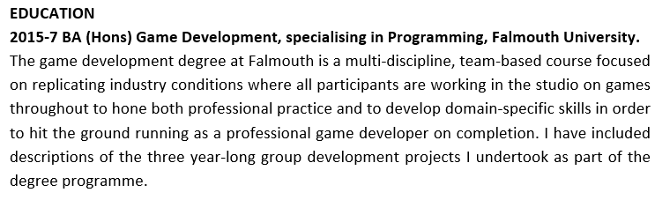
Building effective résumés
1. Tie them into the ‘top ten skills that will get you a job
For education, no-one knows about your university or degree, so we can apply the top ten skills to make everything sing out
Don’t need to use all the terms, just the ones that really work for us

Slide 18
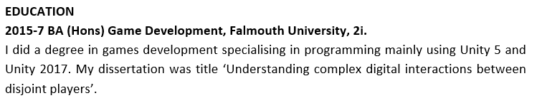
Building effective résumés
1. Tie them into the ‘top ten skills that will get you a job
For education, no-one knows about your university or degree, so we can apply the top ten skills to make everything sing out
This is extremely vague!

Slide 19
Building effective résumés
1. Tie them into the ‘top ten skills that will get you a job
The résumé building process is not an interrogation
You are looking to share information

Slide 20
Building effective résumés
How can your experiences be expressed as key employment skills?
Key Skill | Hidden description of Key Skill
 | Education / projects | Work experience
Commercial Awareness
Communication
Negotiation and persuasion
Problem solving
Leadership
Organisation
Perseverance and motivation
Ability to work under pressure
Confidence

Slide 21
Building effective résumés
Key Skill | Hidden description of Key Skill
 | Education / projects | Work experience
Commercial Awareness | Put a game into a commercial store, Did freelance work Did market analysis | Did a profit-making side hustle Ran a concession Worked in a financial capacity
Communication | Worked in a multi-disciplinary / cross-functional gamedev team dealt with people outside of my role with different perspectives on game / dev | Worked in a team Dealt with customers, suppliers, staff
Negotiation and persuasion | Was scrum master Convinced the team to do X | Dealt with suppliers Dealt with difficult customers
Problem solving | Solved hard problems as an artist, designer programmer etc | Dealt with difficult customers, staff, clients, suppliers
Leadership | Was lead <role> / scrum master | Managed a team in a shop / store / pub /hotel etc
Organisation | Organised team work | Organised work shifts, deliveries etc
Perseverance and motivation | Fixed hard problems Refactored aspects of the project to make it better | Stayed at work
Ability to work under pressure | Crunch, deadlines, multiple deadlines | Dealt with difficult customers, staff, clients, suppliers
Confidence | Did presentations Managed a team / Designed a game | Dealt with difficult customers, staff, clients, suppliers

Slide 22
Building effective résumés
What can we do to make these sections ‘work’ well for an interviewer?
2. Leverage your experiences
Everyone has worked on bad projects, use them to talk about positive resolutions
People have part-time jobs / other jobs, these can be incredibly useful particularly if you have ended up taking responsibilities in your role, being a manager and so on
Development you have done outside of the course, particularly if you have something to show (remember, show don’t tell)

Slide 23
Building effective résumés
What can we do to make these sections ‘work’ well for an interviewer?
3. Are you ‘Smart & gets things done’
The book on technical recruitment by Joel Spolsky (author of Trello)
Describes how candidates benefit from showing intelligence and demonstrating how they can use it.
Look to use this approach to articulate your project and personal development activities
I researched approach X on the interweb
I used technology/approach X to solve problem Y

Slide 24
Building effective résumés
What can we do to make these sections ‘work’ well for an interviewer?
4. Leveraging SMART goals
SMART (specific, measurable, achievable, realistic & time-bound) goals
We can use some of these terms to describe work that we have done (project & work experience)

Slide 25
Building effective résumés
4. Leveraging SMART goals
Specific
Be specific in what the project was; its genre, style, platform and engine to give the résumé reader a clear understanding of that the project was
Be specific in what you have done on a project, think about (the Blue Peter approach) it was my job to …, I was responsible for …
Be specific in what the outcomes of the project were; I got a grade X, we won a prize, I wrote a paper …

Slide 26
Building effective résumés
4. Leveraging SMART goals
Measurable
Include details that include the scope of the project.
How many developers, how long did the project run for etc

Slide 27
Building effective résumés
4. Leveraging SMART goals
Achievable & realistic
How did you make your work achievable in the time frame
What did you cut
How did you decide what to cut
How did you manage the project (as a team)
How did you deal with motivational issues due to cutting features (as a team & individually)
How did you keep things realistic
Did you have to deal with crunch / overwork
Did you deal with burnout / stress
Did you deal with presenteeism

Slide 28
Building effective résumés
4. Leveraging SMART goals
Time-bound
Give an indication of the duration of the work.
For academic work, was it a short individual assignment or a long team project
For commercial work, was it something you did part-time alongside your studies, a summer / vacation job, a year industry, a gap year and so on.

Slide 29
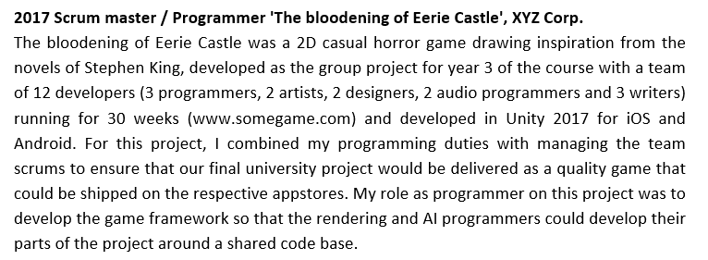
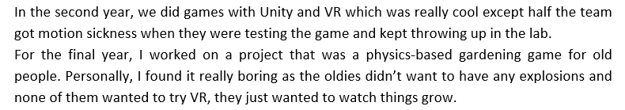
Building effective résumés
vs

Slide 30
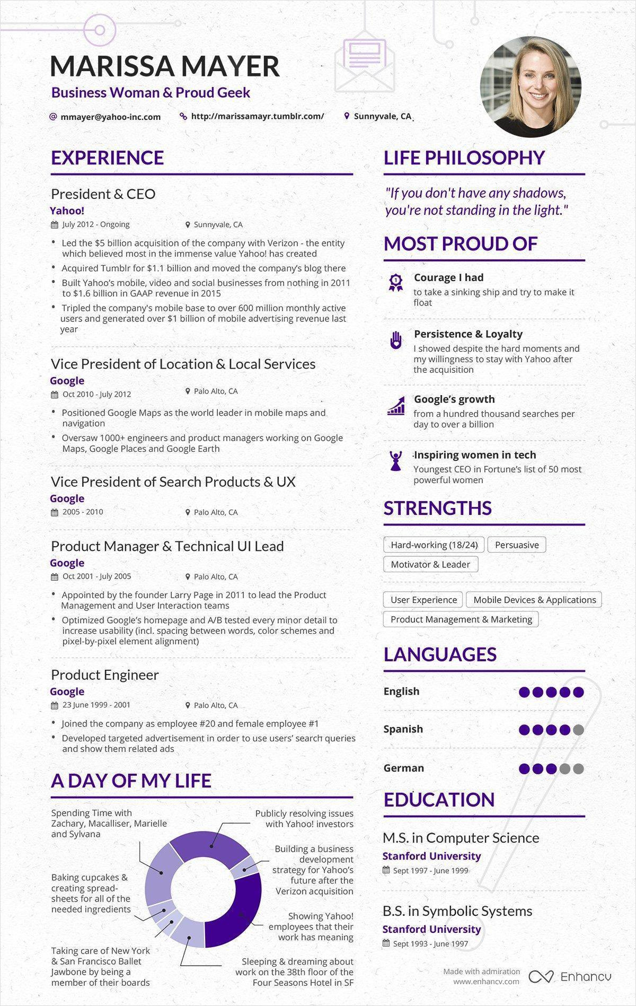
Building effective résumés
What ‘shape’ of resume
There are 3 broad approaches to résumés
1 pager
2 pager
infographic

Slide 31
Building effective résumés
What ‘shape’ of resume
There are 3 broad approaches to résumés
1 pager
Is one page in length
Ideal for grads where it is hard to fill more than one page
Generally, if your resume fits in one page (with enough detail) then use one page
Detail is key, you need to have enough detail to describe what you’ve done in a way that makes sense to recrutiers
2 pager
infographic

Slide 32
Building effective résumés
What ‘shape’ of resume
There are 3 broad approaches to résumés
1 pager
2 pager
‘standard’ resume length for commercial work
Ideal once you have some work experience, particularly if you have had several short contract jobs (c18months)
Don’t have >2 pages and make sure you fill two pages, if you have a page and a bit, look to edit it down
Can be a challenge to edit down if you have lots of work experience:
Concentrate on most recent roles
Concentrate on most relevant roles
infographic

Slide 33
Building effective résumés
What ‘shape’ of resume
There are 3 broad approaches to résumés
1 pager
2 pager
Infographic
A graphical one pager
Can work very well for some roles
Particularly ones that are visually / aesthetically focused
Personally, I find it a poor fit for programming roles, though YMMV.
Programmer art is an issue

Slide 34
Creating effective LinkedIn profiles

Slide 35
Creating effective LinkedIn profiles
LinkedIn is a proxy
If you use other social profiles, they will provide similar functionality
Particularly artstation
linkedIn is like having an online resume
Can have more info than a paper resume
Not controlled by recruiters
Can blank out bits of your resume
It’s also a recruitment site
And a social site where you can create and curate connectivity
And it provides training
Need to talk about
Using linkedin as a digital equivalent of your resume
Can go into more depth than a 1 or 2 pager
Need to keep it up to date -> some 2018 grads are still ‘students’
Recruiters will use linkedin to trawl for candidates, it’s a low effort site to build engagement. Keep it up to date and relevant
Recruitment site has lots of interesting jobs to trawl though
Uses some ML/DS to look for suitable jobs for you
Therefore, the more data you have in your profile, the more likely you are for interesting things to come up
Pipe company doing VR
A useful resource for finding things that you could find interesting (particularly if you have novel skills and interests)
Training site
Contains a vast amount of online training
Can use this to sharpen your axe
Successful course completion has achievements that can go on your profile
If you want to show you’re smart & gets things done, look to build expertise through these courses
Social aspects
Has interest groups and people that will post things -> enhance your understanding of areas you are interested in
Build social network & social capital

Slide 36
Sharing information effectively between your résumé and LinkedIn
From our experiences with marketing, one of the most important lessons is to be consistent with your marketing message
Here, we are marketing ourselves, so the same rules apply

Slide 37
Sharing information effectively between your résumé and LinkedIn
At a simple level, your LinkedIn profile can be a cut & paste of much of your resume
As you become more experienced, it gets harder to fit all your experience (and detail) into a 2 page resume, so your LI profile can contain all the detail
Because that’s where recruiters go to harvest your details
You can slice and dice your resume for different jobs based on the LI profile source

Slide 38
Driving traffic to your sites
Personal website / portfolio
LinkedIn / artstation
Resume
Look to link them to each other
Linkedin -> portfolio
Portfolio -> linkedin & twitter
portfolio -> resume
Twitter -> linkedin & portfolio
Show some examples of this being done

Slide 39
Driving traffic
Twitter
LinkedIn
Profile
Portfolio
website
résumé

Slide 40
Wrap-up
Assume anyone that will read your résumé
Knows nothing
Has very little time to read
Make your résumé
A narrative that makes sense
Speak in terms that makes sense to recruiters
Add the right level of detail
Link your résumé with other social media
Share your content between LinkedIn & résumé
Link to other content

Slide 41
Wrap-up
LinkedIn
Is often viewed as ‘facebook for business people’
Offers Recruitment
Offers Learning / training
& social networking

Slide 42
Questions

