Slide 1



Programming Workshop 4:
Objected Oriented Programming in C++
GAM340: Professional Practice
BA(Hons) Game Development

Slide 2


Slide 3
Learning Objectives
Understand the C++ object model
Explain issues with inheritance in C++
Use const correctness
Demonstrate an awareness of design patterns for C++
Solve basic C++ Architectural class programming interview problems

Slide 4
structs in C -> classes in C++
C doesn’t support classes, but it does support structures
https://onlinegdb.com/rkJmxZLOB
Code and data are split
Can use this approach to make fundamental C containers
Linked List
Binary tree
Directed Acyclic Graph
’Safer’ string classes
‘Maths’ vector, matrix etc
etc

Slide 5
structs in C -> classes in C++
Object orientation provides 4 features that make programming much easier
(Common interview question)
Encapsulation
Data Hiding
Inheritance
Polymorphism
https://onlinegdb.com/SyAJmWLOB

Slide 6
structs in C -> classes in C++
https://onlinegdb.com/SyAJmWLOB
Encapsulation
‘Put into a capsule’
Code and data are stored together
Data Hiding
Limit visibility of data and functions
Public – is visible to users of a class
Private – can only be used in the class
In the Vector class, X & Y can only be accessed by functions in the class
Other types are available
Protected & friend
Inheritance
Base class of ‘GameObject’
Note static initialisation
Has private & protected members
Vector class derives from GameObject
Where it uses GameObject ctor(), they are explicit
Overrides GameObject virtual function
And calls base functionality
Polymorphism
The ‘ability to take on many forms’
Static – functions
Functions with the same name take different arguments
ctor(), Set() & Add()
Dynamic - object casting
Code creates a array of GameObject ptrs
Stores vector ptrs in them
DebugPrint will call derived function, even though it’s an array of base object

Slide 7
structs in C -> classes in C++
Compare and contrast C# OO with C++
C# classes you know and love:
https://onlinegdb.com/S1Jo7ycdB
C++ equivalents:
https://onlinegdb.com/r1e_IJc_H

Slide 8
structs in C -> classes in C++
Abstract base classes
Can’t be instantiated, only used to create derived classes
In C#, abstract is used as a modifier for the class definition
In C# at least one function is defined as pure virtual
virtual void fn() = 0;

Slide 9
structs in C -> classes in C++
Operators & operator overloading
Operators were added to languages to give a more natural feel to writing algorithms
A = B+ C;
vector_Add(&A,&B,&C);
Operators can be chained together
A = ((B + C) * (D*F)) / G;
Anything can have operators written for them
Doesn’t always make sense
Linked List += makes sense
Linked List *= doesn’t

Slide 10
structs in C -> classes in C++
Operators & operator overloading
In C#
https://onlinegdb.com/BJ0Flg9dr
In C++
https://onlinegdb.com/SJyKxx5OS
C# addresses a lot of the ‘issues’ with C++ operators
Removes need for == and !=, and += and +
Remember deep and shallow copy assignments!
Both languages create lots of temp objects
Common to see ‘c style’ math functions
Vector_op(&result, &argA, &argB)

Slide 11
structs in C -> classes in C++
const correctness
A very common interview question
Not a feature in C#, but used extensively in C++ to create read_only object pointers as return types, functions and arguments.
Const correctness is a compile time feature
It will stop code from compiling, rather than leaving you to find bugs/issues at runtime
Const correctness will become pervasive in projects
Const return types will lead to const arguments in functions across the code base

Slide 12
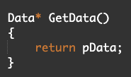

structs in C -> classes in C++
const correctness
A normal project
https://onlinegdb.com/rkwsL3iOH

Slide 13
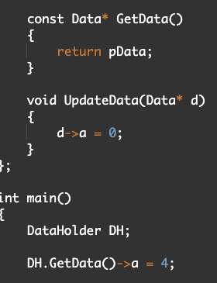
structs in C -> classes in C++
const correctness
A normal project
https://onlinegdb.com/ByEC83suH

Slide 14
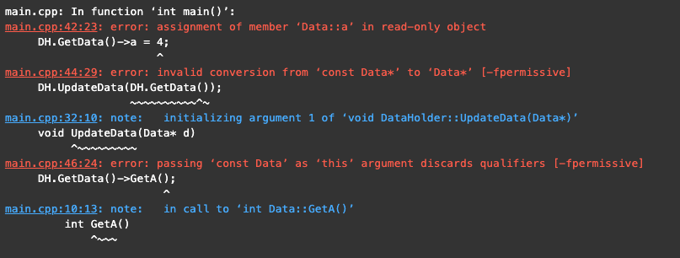
structs in C -> classes in C++
const correctness
A normal project
https://onlinegdb.com/ByEC83suH
Add const correctness to functions that are to take Data*
And functions that are members of the Data class

Slide 15
structs in C -> classes in C++
Programming tests with C/C++
Generally looking at
Understanding of C++ OO features and issues
Ability to use
ABCs
Create and use standard containers
Create sensible class hierarchies
Use of const correctness

Slide 16
OO Programming tests C++
Linked List class (of type x)
https://en.wikipedia.org/wiki/Linked_list#Singly_linked_list
Sorted linked List (of type x)
https://en.wikipedia.org/wiki/Doubly_linked_list
Dynamic array (of type x)
https://gameprogrammingpatterns.com/object-pool.html
Binary tree
https://en.wikipedia.org/wiki/Binary_tree
Balancing a binary tree
https://en.wikipedia.org/wiki/Self-balancing_binary_search_tree
Linked List with ABC & derived classes
Create ABC linkList node, derive your LL-able classes from it
String class implementation with operators & const correctness
Use operators to replace strcat, strcpy and anything else that makes sense

