Slide 1


GAM220 –
Forming
Teams

Slide 2
World Building Reminder
All students who are moving onto GAM220 (non-GART students) have been asked to complete a World Building task
This World Building task feeds into the World Building Assignment, this is worth 20% of the Pitch Assignment
You will pitch your World in Week 1 to your group and a member of staff!
These Worlds will inform the development of your game in 2nd year
Please watch the following lecture from Brian McDonald and Jeff Howard which gives additional guidance for the assignment

Slide 3
GAM220 Assignment Details
Assignment 1 – Pitch (30%)
Week 1 as an Individual you will pitch world concept
Week 5 as a team you will pitch your game concept
More details about the assignment in Week 1 of next session
Assignment 2 – Studio Practice (70%)
You will work as a team in timetabled sessions to build a game
There will be a mid-term review in Week 8
You will show off your game for marking in Week 13
The game should be around Alpha stage
“Alpha is the stage when key gameplay functionality is implemented, and assets are partially finished” - Heather Maxwell Chandler, The Game Production Handbook

Slide 4
Forming Teams
You will have to fill in a form that allows us to assemble teams
Unlike first year there is some flexibility in the team and the game you make
You can specify who you want to work with
You can specify what type of the game you want to make
You can specify what Engine you want to use
We will try to match you with similar answers, HOWEVER we are going to try and create balanced teams
This means we will not be able to guarantee that we can honour your choices in the form

Slide 5
Word about Team
Forming

Slide 6
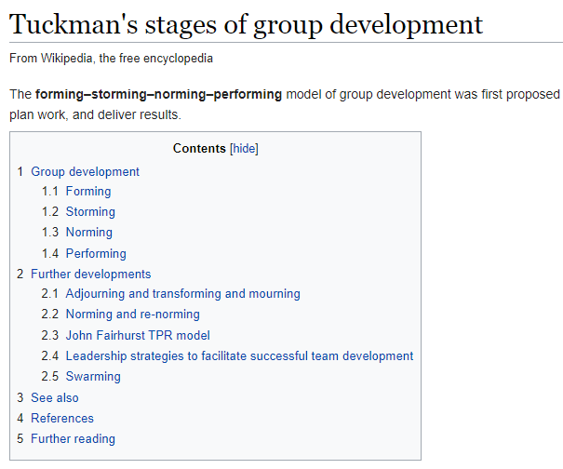
Tuckman, B.W. and Jensen, M.A.C., 1977. Stages of small-group development revisited. Group & Organization Studies, 2(4), pp.419-427.

Slide 7

https://falmouth.primo.exlibrisgroup.com/permalink/44FAL_INST/vct0c5/alma9911155600005136

Slide 8
Questions?

