Slide 1

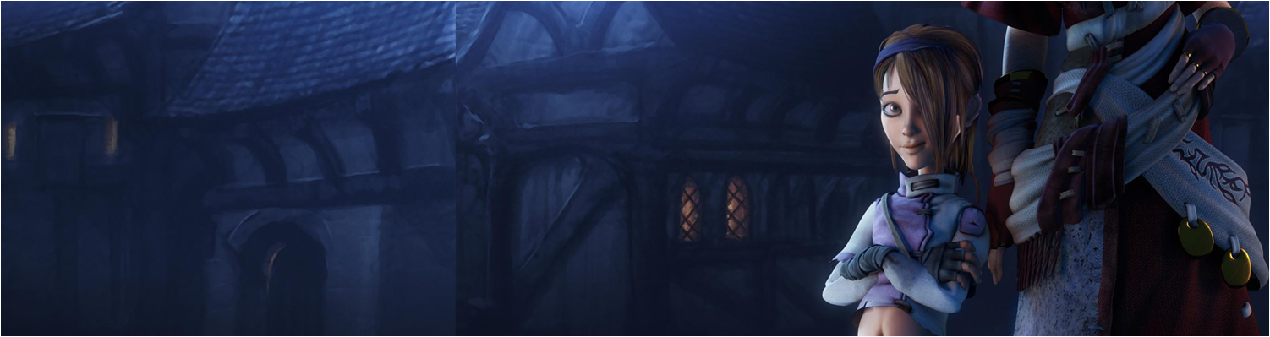


Workshop: 2D Matrices
COMP270: Mathematics for 3D Worlds and Simulation
BSc (Hons) Computing for Games

Slide 2
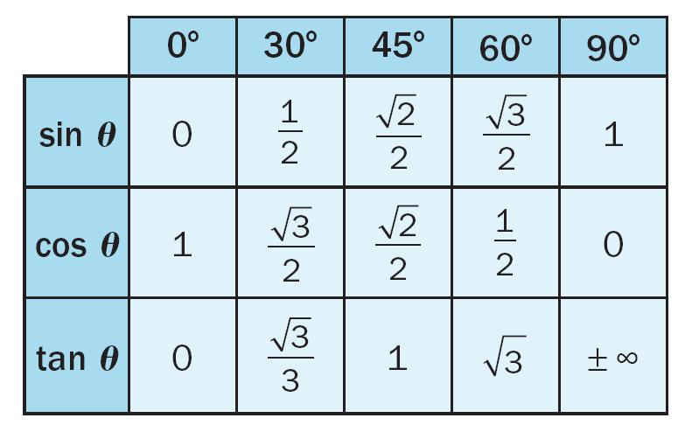

A few formulae…
Matrix multiplication:
$\left(\begin{matrix}a & b \\ c & d\end{matrix}\right)\left(\begin{matrix}e & f \\ g & h\end{matrix}\right)=\left(\begin{matrix}ae+bg & af+bh \\ ce+dg & cf+dh\end{matrix}\right)$
$\left(\begin{matrix}a & b \\ c & d\end{matrix}\right)\left(\begin{matrix}x \\ y\end{matrix}\right)=\left(\begin{matrix}ax+by \\ cx+dy\end{matrix}\right)$
Rotation by θ : $\left(\begin{matrix}cosθ & −sinθ \\ sinθ & cosθ\end{matrix}\right)$
Scale by s_{x}, s_{y}: $\left(\begin{matrix}s_{x} & 0 \\ 0 & s_{x}\end{matrix}\right)$
Horizontal/vertical reflection: $\left(\begin{matrix}−1 & 0 \\ 0 & 1\end{matrix}\right)$, $\left(\begin{matrix}1 & 0 \\ 0 & −1\end{matrix}\right)$

Slide 3

Answers: Question 1
$\left({\begin{matrix}1 & −2\end{matrix} \atop \begin{matrix}5 & 0\end{matrix}}\right)\left({\begin{matrix}−3 & 7\end{matrix} \atop \begin{matrix}4 & \frac{1}{3}\end{matrix}}\right)=\left({\begin{matrix}1×(−3)+(−2)×4 & 1×7+(−2)×\frac{1}{3}\end{matrix} \atop \begin{matrix}5×\left(−3\right)+0×4 & 5×7+0×\frac{1}{3}\end{matrix}}\right)=\left({\begin{matrix}−11 & 6\frac{1}{3}\end{matrix} \atop \begin{matrix}−15 & 35\end{matrix}}\right)$
$\left({\begin{matrix}6 & −7\end{matrix} \atop \begin{matrix}−4 & 5\end{matrix}}\right)\left({3 \atop 3}\right)=\left({6×3+(−7)×3 \atop −4×3+5×3}\right)=\left({−3 \atop 3}\right)$
$\left({\begin{matrix}−3 & −2\end{matrix} \atop \begin{matrix}5 & 4\end{matrix}}\right)\left({\begin{matrix}−2 & −1\end{matrix} \atop \begin{matrix}2\frac{1}{2} & 1\frac{1}{2}\end{matrix}}\right)=\left({\begin{matrix}(−3)×(−2)+(−2)×(\frac{5}{2}) & (−3)×(−1)+(−2)×\frac{3}{2}\end{matrix} \atop \begin{matrix}5×(−2)+4×(\frac{5}{2}) & 5×(−1)+4×\frac{3}{2}\end{matrix}}\right)=\left({\begin{matrix}1 & 0\end{matrix} \atop \begin{matrix}0 & 1\end{matrix}}\right)$
$\left({\begin{matrix}1 & 0\end{matrix} \atop \begin{matrix}0 & 1\end{matrix}}\right)\left({\begin{matrix}a & b\end{matrix} \atop \begin{matrix}c & d\end{matrix}}\right)=\left({\begin{matrix}1×a+0×c & 1×b+0×d\end{matrix} \atop \begin{matrix}0×a+1×c & 0×b+1×d\end{matrix}}\right)$ = $\left({\begin{matrix}a & b\end{matrix} \atop \begin{matrix}c & d\end{matrix}}\right)$
$\left(\begin{matrix}3 & 3\end{matrix}\right)\left({\begin{matrix}6 & −7\end{matrix} \atop \begin{matrix}−4 & 5\end{matrix}}\right)=\left(\begin{matrix}3×6+3×(−4) & 3×\left(−7\right)+3×5\end{matrix}\right)=\left(\begin{matrix}6 & −6\end{matrix}\right)$
(b) vs. (e):
Values are the same, answers are different: order matters!
Vector dimensions determine multiplication order

Slide 4

Answers: Question 2
$\left({1 \atop 0}\right)→\left({0 \atop −1}\right)$ ; $\left({0 \atop 1}\right)→\left({1 \atop 0}\right)$ The matrix describes a 90° clockwise rotation.
$\left({1 \atop 0}\right)→\left({\frac{\sqrt{2}}{2} \atop \frac{\sqrt{2}}{2}}\right)$ ; $\left({0 \atop 1}\right)→\left({− \frac{\sqrt{2}}{2} \atop \frac{\sqrt{2}}{2}}\right)$ The matrix describes a 45° anticlockwise rotation.
$\left({1 \atop 0}\right)→\left({2 \atop 0}\right)$ ; $\left({0 \atop 1}\right)→\left({0 \atop 2}\right)$ The matrix describes a uniform scale of 2 units in both directions.
$\left({1 \atop 0}\right)→\left({4 \atop 0}\right)$ ; $\left({0 \atop 1}\right)→\left({0 \atop 7}\right)$ The matrix describes a nonuniform scale of 4 units in the x direction and 7 in y.
$\left({1 \atop 0}\right)→\left({−1 \atop 0}\right)$ ; $\left({0 \atop 1}\right)→\left({0 \atop 1}\right)$ The matrix describes a reflection across the y-axis.
$\left({1 \atop 0}\right)→\left({0 \atop −2}\right)$ ; $\left({0 \atop 1}\right)→\left({2 \atop 0}\right)$ The matrix describes a combination of the transformations from (a) and (c): $\left({\begin{matrix}0 & 1\end{matrix} \atop \begin{matrix}−1 & 0\end{matrix}}\right)\left({\begin{matrix}2 & 0\end{matrix} \atop \begin{matrix}0 & 2\end{matrix}}\right)$ = $\left({\begin{matrix}0 & 2\end{matrix} \atop \begin{matrix}−2 & 0\end{matrix}}\right)$

Slide 5
Answers: Question 3
3: a reflection across the x-axis (Compare to the matrix in 2a)
1: a uniform scale by 2.5 (Compare to 2c)
4: a combination of a 45° anticlockwise rotation and a reflection across the y-axis. (Combine 2b with 2e… Question: which transformation is being applied first?)
2: a non-uniform scale of 1.5 in the x direction and 2.0 in y.

Slide 6

Answers: Question 4
${\left(\begin{matrix}0 & 1 \\ −1 & 0\end{matrix}\right)}^{−1}=\frac{1}{0×0−1×(−1)}\left(\begin{matrix}0 & −1 \\ 1 & 0\end{matrix}\right)=\left(\begin{matrix}0 & −1 \\ 1 & 0\end{matrix}\right)$
${\left(\begin{matrix}\frac{\sqrt{2}}{2} & − \frac{\sqrt{2}}{2} \\ \frac{\sqrt{2}}{2} & \frac{\sqrt{2}}{2}\end{matrix}\right)}^{−1}=\frac{1}{\left(\frac{\sqrt{2}}{2}\right)\left(\frac{\sqrt{2}}{2}\right)−\left(− \frac{\sqrt{2}}{2}\right)\left(\frac{\sqrt{2}}{2}\right)}\left(\begin{matrix}\frac{\sqrt{2}}{2} & \frac{\sqrt{2}}{2} \\ − \frac{\sqrt{2}}{2} & \frac{\sqrt{2}}{2}\end{matrix}\right)=\left(\begin{matrix}\frac{\sqrt{2}}{2} & \frac{\sqrt{2}}{2} \\ − \frac{\sqrt{2}}{2} & \frac{\sqrt{2}}{2}\end{matrix}\right)$
${\left(\begin{matrix}2 & 0 \\ 0 & 2\end{matrix}\right)}^{−1}=\frac{1}{2×2−0×0}\left(\begin{matrix}2 & 0 \\ 0 & 2\end{matrix}\right)=\left(\begin{matrix}\frac{1}{2} & 0 \\ 0 & \frac{1}{2}\end{matrix}\right)$
${\left(\begin{matrix}4 & 0 \\ 0 & 7\end{matrix}\right)}^{−1}=\frac{1}{4×7−0×0}\left(\begin{matrix}7 & 0 \\ 0 & 4\end{matrix}\right)=\left(\begin{matrix}\frac{1}{4} & 0 \\ 0 & \frac{1}{7}\end{matrix}\right)$
${\left(\begin{matrix}−1 & 0 \\ 0 & 1\end{matrix}\right)}^{−1}=\frac{1}{\left(−1\right)×1−0×0}\left(\begin{matrix}1 & 0 \\ 0 & −1\end{matrix}\right)=\left(\begin{matrix}−1 & 0 \\ 0 & 1\end{matrix}\right)$
${\left(\begin{matrix}0 & 2 \\ −2 & 0\end{matrix}\right)}^{−1}=\frac{1}{0×0−(−2)×2}\left(\begin{matrix}0 & −2 \\ 2 & 0\end{matrix}\right)=\left(\begin{matrix}0 & −\frac{1}{2} \\ \frac{1}{2} & 0\end{matrix}\right)$

Slide 7

Answers: Question 4 cont.
$\left(\begin{matrix}0 & −1 \\ 1 & 0\end{matrix}\right)$ is a 90° anticlockwise rotation.
$\left(\begin{matrix}\frac{\sqrt{2}}{2} & \frac{\sqrt{2}}{2} \\ − \frac{\sqrt{2}}{2} & \frac{\sqrt{2}}{2}\end{matrix}\right)$ is a 45° clockwise rotation.
$\left(\begin{matrix}\frac{1}{2} & 0 \\ 0 & \frac{1}{2}\end{matrix}\right)$ is a uniform scaling by 0.5 units in each direction.
$\left(\begin{matrix}\frac{1}{4} & 0 \\ 0 & \frac{1}{7}\end{matrix}\right)$ is a nonuniform scale of ¹/₄ units in the x direction and ¹/₇ in y.
$\left(\begin{matrix}−1 & 0 \\ 0 & 1\end{matrix}\right)$ is a a reflection across the y-axis.
$\left(\begin{matrix}0 & −\frac{1}{2} \\ \frac{1}{2} & 0\end{matrix}\right)$ is a combination of (a) and (c) – again!

Slide 8
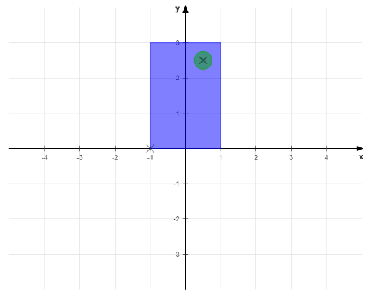
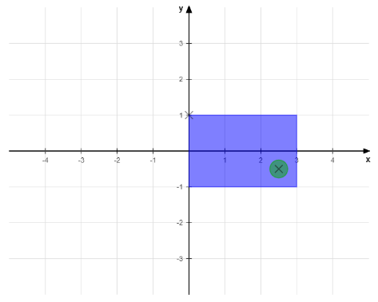
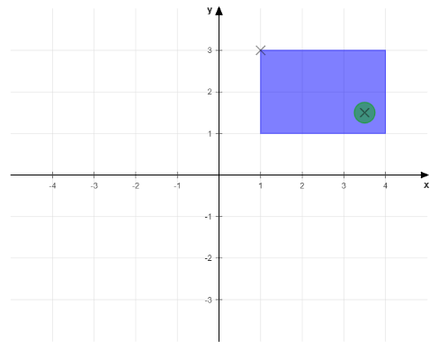

Answers: Question 5
$\left({−1 \atop \begin{matrix}3 \\ 1\end{matrix}}\right)$
$\left(\begin{matrix}1 & 0 & 1 \\ 0 & 1 & 2 \\ 0 & 0 & 1\end{matrix}\right)\left(\begin{matrix}−1 \\ 3 \\ 1\end{matrix}\right)=\left(\begin{matrix}1×\left(−1\right)+0×3+1×1 \\ 0×\left(−1\right)+1×3+2×1 \\ 0×\left(−1\right)+0×3+1×1\end{matrix}\right)=\left(\begin{matrix}0 \\ 5 \\ 1\end{matrix}\right)$
$\left(\begin{matrix}1 & 0 & 1 \\ 0 & 1 & 2 \\ 0 & 0 & 1\end{matrix}\right)\left(\begin{matrix}0 & 1 & 0 \\ −1 & 0 & 0 \\ 0 & 0 & 1\end{matrix}\right)=\left(\begin{matrix}0 & 1 & 1 \\ −1 & 0 & 2 \\ 0 & 0 & 1\end{matrix}\right)$

Slide 9
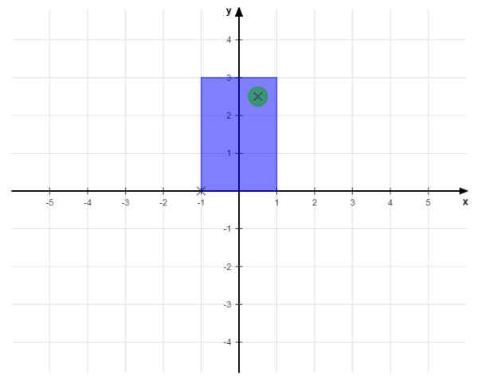
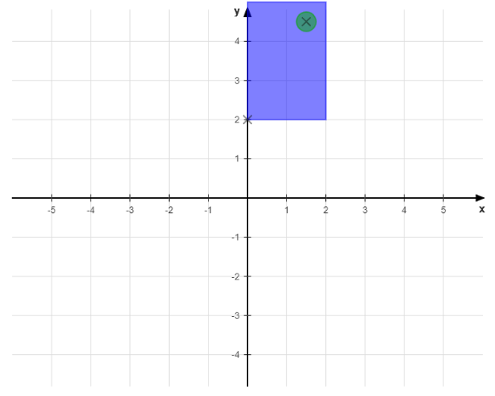
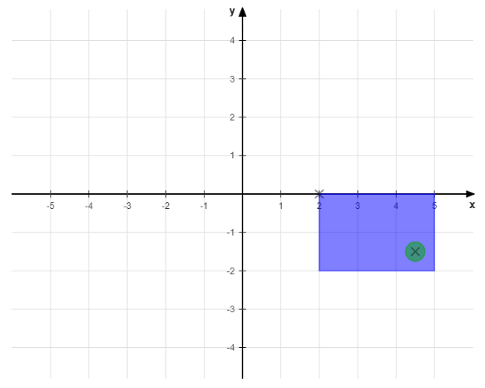

Answers: Question 5 cont.
Applied in the opposite order, $\left(\begin{matrix}0 & 1 & 0 \\ −1 & 0 & 0 \\ 0 & 0 & 1\end{matrix}\right)\left(\begin{matrix}1 & 0 & 1 \\ 0 & 1 & 2 \\ 0 & 0 & 1\end{matrix}\right)=\left(\begin{matrix}0 & 1 & 2 \\ −1 & 0 & −1 \\ 0 & 0 & 1\end{matrix}\right)$

Slide 10

Answers: Question 6
y (north)
$tan\left(22.5°\right)= \sqrt{2}−1= \frac{?}{1}$
$$b=\left(\begin{matrix}1 \\ \sqrt{2}−1\end{matrix}\right)$$
$$\left\|b\right\|=\sqrt{1^{2}+{\left(\sqrt{2}−1\right)}^{2}}=\sqrt{1+2−2\sqrt{2}+1}=\sqrt{4−2\sqrt{2}}=2\sqrt{1−\frac{\sqrt{2}}{2}}$$
$$\hat{b}=\frac{1}{2\sqrt{1−\frac{\sqrt{2}}{2}}}\left({1 \atop \sqrt{2}−1}\right)$$
North-east
East-north-east (b)
45°
?
22.5°
1
x (east)

Slide 11


Answers: Question 6 cont.
$\hat{b}=\frac{1}{2\sqrt{1−\frac{\sqrt{2}}{2}}}\left({1 \atop \sqrt{2}−1}\right)$
$a= \left({2 \atop −1}\right)$
$a∙\hat{b}=\frac{1}{2\sqrt{1−\frac{\sqrt{2}}{2}}}\left(2×1+\left(−1\right)×\left(\sqrt{2}−1\right)\right)=\frac{1}{2\sqrt{1−\frac{\sqrt{2}}{2}}}\left(3−\sqrt{2}\right)≈$ 1.47
y (north)
$$\hat{b}$$
x (east)
a
(2, -1)

