Slide 1


Week 8: 3D Computational Geometry II
COMP270: Mathematics for 3D Worlds & Simulations
BSc(Hons) Computing for Games

Slide 2

“Unfortunately, no-one can be told what the matrix is. You have to see it for yourself” - Morpheus

Slide 3
Matrices in 3D

Slide 4
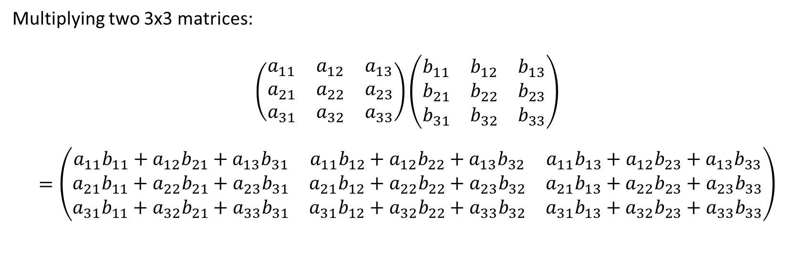
Matrix multiplication
Multiplying two 3x3 matrices:
$$\left(\begin{matrix}a_{11} & a_{12} & a_{13} \\ a_{21} & a_{22} & a_{23} \\ a_{31} & a_{32} & a_{33}\end{matrix}\right)\left(\begin{matrix}b_{11} & b_{12} & b_{13} \\ b_{21} & b_{22} & b_{23} \\ b_{31} & b_{32} & b_{33}\end{matrix}\right)$$
$$=\left(\begin{matrix}a_{11}b_{11}+a_{12}b_{21}+a_{13}b_{31} & a_{11}b_{12}+a_{12}b_{22}+a_{13}b_{32} & a_{11}b_{13}+a_{12}b_{23}+a_{13}b_{33} \\ a_{21}b_{11}+a_{22}b_{21}+a_{23}b_{31} & a_{21}b_{12}+a_{22}b_{22}+a_{23}b_{32} & a_{21}b_{13}+a_{22}b_{23}+a_{23}b_{33} \\ a_{31}b_{11}+a_{32}b_{21}+a_{33}b_{31} & a_{31}b_{12}+a_{32}b_{22}+a_{33}b_{32} & a_{31}b_{13}+a_{32}b_{23}+a_{33}b_{33}\end{matrix}\right)$$

Slide 5
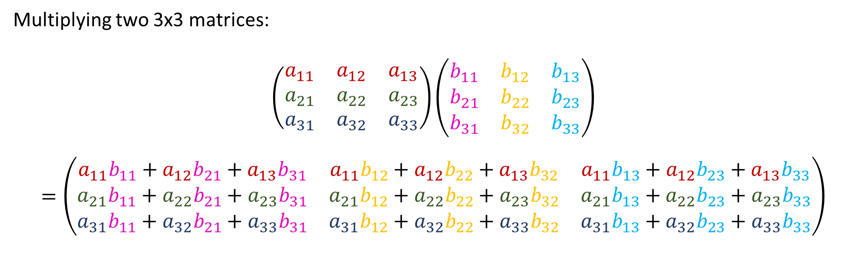
Matrix multiplication
Multiplying two 3x3 matrices:
$$\left(\begin{matrix}a_{11} & a_{12} & a_{13} \\ a_{21} & a_{22} & a_{23} \\ a_{31} & a_{32} & a_{33}\end{matrix}\right)\left(\begin{matrix}b_{11} & b_{12} & b_{13} \\ b_{21} & b_{22} & b_{23} \\ b_{31} & b_{32} & b_{33}\end{matrix}\right)$$
$$=\left(\begin{matrix}a_{11}b_{11}+a_{12}b_{21}+a_{13}b_{31} & a_{11}b_{12}+a_{12}b_{22}+a_{13}b_{32} & a_{11}b_{13}+a_{12}b_{23}+a_{13}b_{33} \\ a_{21}b_{11}+a_{22}b_{21}+a_{23}b_{31} & a_{21}b_{12}+a_{22}b_{22}+a_{23}b_{32} & a_{21}b_{13}+a_{22}b_{23}+a_{23}b_{33} \\ a_{31}b_{11}+a_{32}b_{21}+a_{33}b_{31} & a_{31}b_{12}+a_{32}b_{22}+a_{33}b_{32} & a_{31}b_{13}+a_{32}b_{23}+a_{33}b_{33}\end{matrix}\right)$$

Slide 6
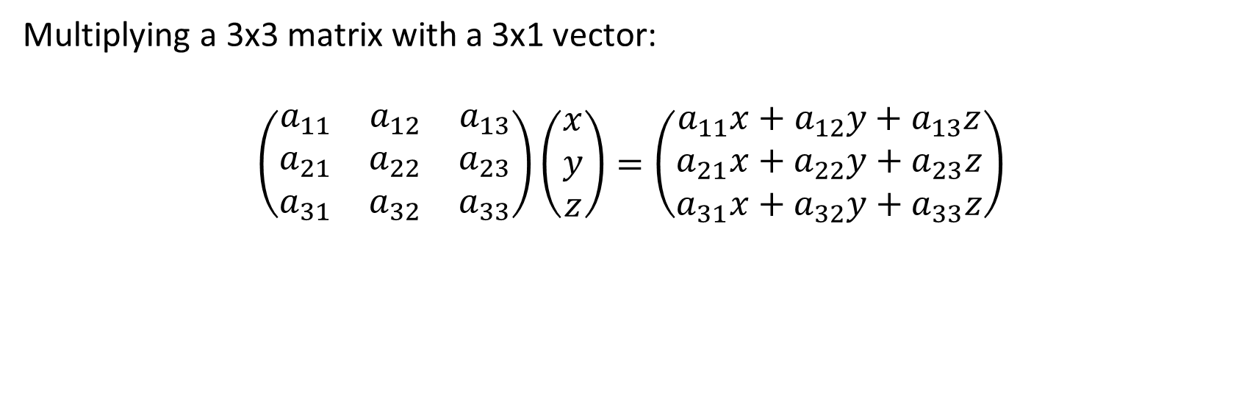
Matrix multiplication
Multiplying a 3x3 matrix with a 3x1 vector:
$$\left(\begin{matrix}a_{11} & a_{12} & a_{13} \\ a_{21} & a_{22} & a_{23} \\ a_{31} & a_{32} & a_{33}\end{matrix}\right)\left(\begin{matrix}x \\ y \\ z\end{matrix}\right)=\left(\begin{matrix}a_{11}x+a_{12}y+a_{13}z \\ a_{21}x+a_{22}y+a_{23}z \\ a_{31}x+a_{32}y+a_{33}z\end{matrix}\right)$$

Slide 7
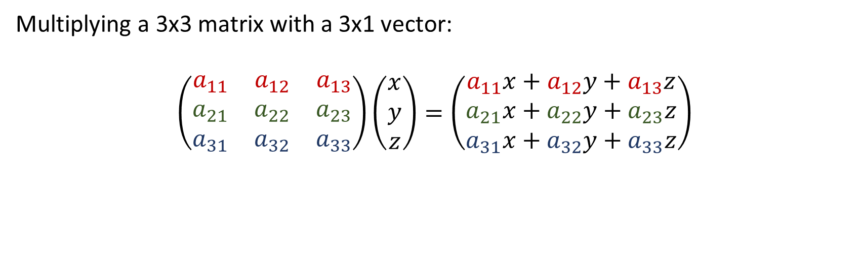
Matrix multiplication
Multiplying a 3x3 matrix with a 3x1 vector:
$$\left(\begin{matrix}a_{11} & a_{12} & a_{13} \\ a_{21} & a_{22} & a_{23} \\ a_{31} & a_{32} & a_{33}\end{matrix}\right)\left(\begin{matrix}x \\ y \\ z\end{matrix}\right)=\left(\begin{matrix}a_{11}x+a_{12}y+a_{13}z \\ a_{21}x+a_{22}y+a_{23}z \\ a_{31}x+a_{32}y+a_{33}z\end{matrix}\right)$$

Slide 8
Inverse of a 3x3 matrix
Method of cofactors:
Calculate the matrix of minors
Convert it to the matrix of cofactors
Find the adjugate
Divide by the determinant…
http://wwwf.imperial.ac.uk/metric/metric_public/matrices/inverses/inverses2.html
https://www.khanacademy.org/math/algebra-home/alg-matrices#alg-determinants-and-inverses-of-large-matrices
“3D Math Primer for Graphics and Game Development”, Chapter 6

Slide 9
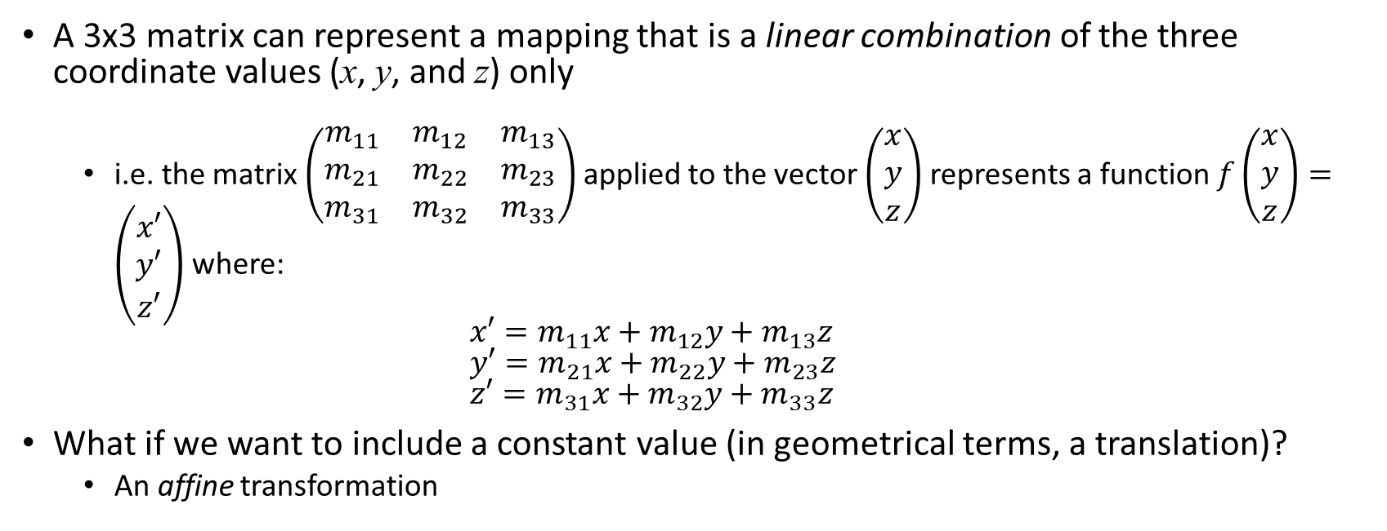
3D homogeneous matrices
A 3x3 matrix can represent a mapping that is a linear combination of the three coordinate values (x, y, and z) only
i.e. the matrix $\left(\begin{matrix}m_{11} & m_{12} & m_{13} \\ m_{21} & m_{22} & m_{23} \\ m_{31} & m_{32} & m_{33}\end{matrix}\right)$ applied to the vector $\left(\begin{matrix}x \\ y \\ z\end{matrix}\right)$ represents a function $f\left(\begin{matrix}x \\ y \\ z\end{matrix}\right)=\left(\begin{matrix}x′ \\ y′ \\ z′\end{matrix}\right)$ where: $x′=m_{11}x+m_{12}y+m_{13}z$ $y′=m_{21}x+m_{22}y+m_{23}z$ $z′=m_{31}x+m_{32}y+m_{33}z$
What if we want to include a constant value (in geometrical terms, a translation)?
An affine transformation

Slide 10
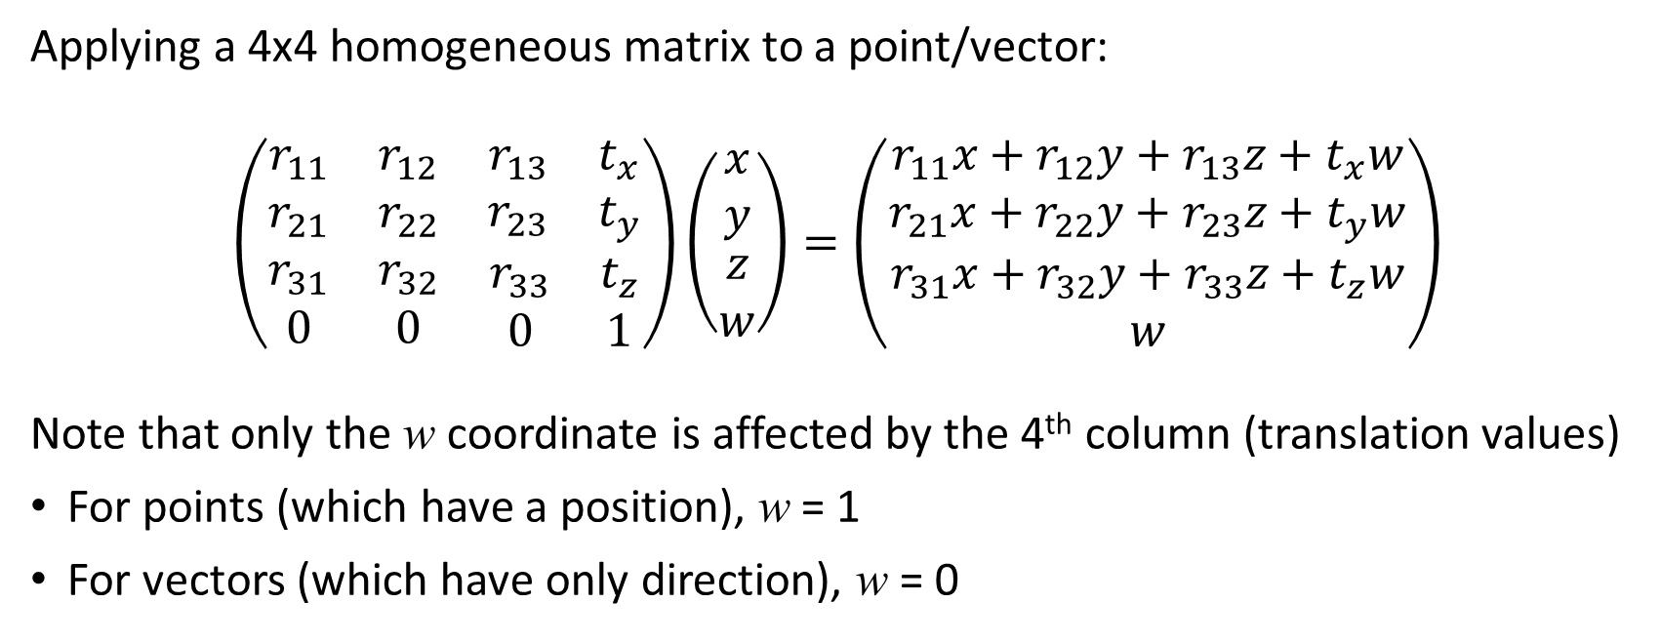
3D homogeneous matrices
Applying a 4x4 homogeneous matrix to a point/vector:
$$\left(\begin{matrix}\begin{matrix}r_{11} & r_{12} \\ r_{21} & r_{22}\end{matrix} & \begin{matrix}r_{13} & t_{x} \\ r_{23} & t_{y}\end{matrix} \\ \begin{matrix}r_{31} & r_{32} \\ 0 & 0\end{matrix} & \begin{matrix}r_{33} & t_{z} \\ 0 & 1\end{matrix}\end{matrix}\right)\left(\begin{matrix}\begin{matrix}x \\ y\end{matrix} \\ \begin{matrix}z \\ w\end{matrix}\end{matrix}\right)=\left(\begin{matrix}\begin{matrix}r_{11}x+r_{12}y+r_{13}z+t_{x}w \\ r_{21}x+r_{22}y+r_{23}z+t_{y}w\end{matrix} \\ \begin{matrix}r_{31}x+r_{32}y+r_{33}z+t_{z}w \\ w\end{matrix}\end{matrix}\right)$$
Note that only the w coordinate is affected by the 4th column (translation values)
For points (which have a position), w = 1
For vectors (which have only direction), w = 0

Slide 11
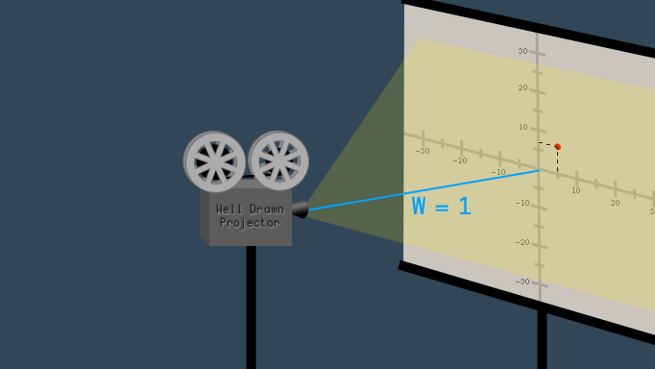

What is w?
An “extra dimension” (not time!) added to allow translations…
Extends 3D space to projective space
A scaling factor/“distance to the projector”:
$(x, y, z, w)→\left(\frac{x}{w},\frac{y}{w},\frac{z}{w}\right)$
w = 1: direct mapping of a point to 3D space
w = 0: a point that is infinitely far away/a vector with infinite length
More info:
https://www.tomdalling.com/blog/modern-opengl/explaining-homogenous-coordinates-and-projective-geometry/
https://hackernoon.com/programmers-guide-to-homogeneous-coordinates-73cbfd2bcc65

Slide 12
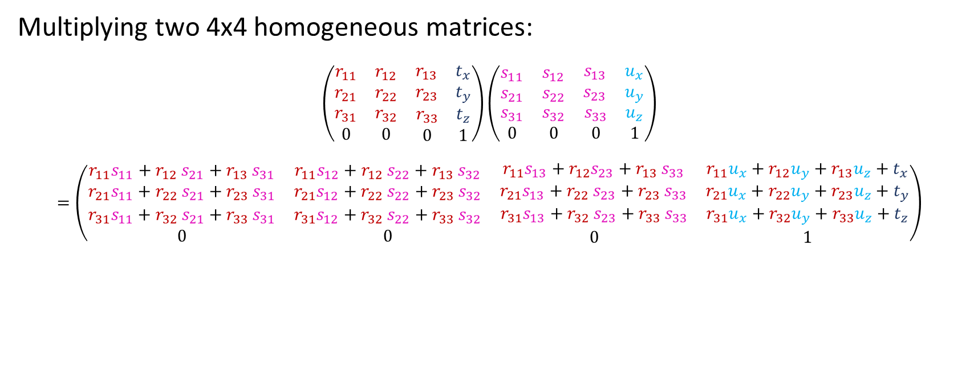
3D homogeneous matrices
Multiplying two 4x4 homogeneous matrices:
$$\left(\begin{matrix}\begin{matrix}r_{11} & r_{12} \\ r_{21} & r_{22}\end{matrix} & \begin{matrix}r_{13} & t_{x} \\ r_{23} & t_{y}\end{matrix} \\ \begin{matrix}r_{31} & r_{32} \\ 0 & 0\end{matrix} & \begin{matrix}r_{33} & t_{z} \\ 0 & 1\end{matrix}\end{matrix}\right)\left(\begin{matrix}\begin{matrix}s_{11} & s_{12} \\ s_{21} & s_{22}\end{matrix} & \begin{matrix}s_{13} & u_{x} \\ s_{23} & u_{y}\end{matrix} \\ \begin{matrix}s_{31} & s_{32} \\ 0 & 0\end{matrix} & \begin{matrix}s_{33} & u_{z} \\ 0 & 1\end{matrix}\end{matrix}\right)$$
$$=\left(\begin{matrix}\begin{matrix}r_{11}s_{11}{+ r}_{12}s_{21}{+ r}_{13}s_{31} & r_{11}s_{12}{+ r}_{12}s_{22}{+ r}_{13}s_{32} \\ r_{21}s_{11}{+ r}_{22}s_{21}{+ r}_{23}s_{31} & r_{21}s_{12}{+ r}_{22}s_{22}{+ r}_{23}s_{32}\end{matrix} & \begin{matrix}r_{11}s_{13}{{ + r}_{12}s}_{23}{+ r}_{13}s_{33} & r_{11}u_{x}+r_{12}u_{y}+r_{13}u_{z}{+ t}_{x} \\ r_{21}s_{13}{+ r}_{22}s_{23}{+ r}_{23}s_{33} & r_{21}u_{x}+r_{22}u_{y}+r_{23}u_{z}{+ t}_{y}\end{matrix} \\ \begin{matrix}r_{31}s_{11}{+ r}_{32}s_{21}{+ r}_{33}s_{31} & r_{31}s_{12}{+ r}_{32}s_{22}{+ r}_{33}s_{32} \\ 0 & 0\end{matrix} & \begin{matrix}r_{31}s_{13}{+ r}_{32}s_{23}{+ r}_{33}s_{33} & r_{31}u_{x}+r_{32}u_{y}+r_{33}u_{z}{+ t}_{z} \\ 0 & 1\end{matrix}\end{matrix}\right)$$

Slide 13
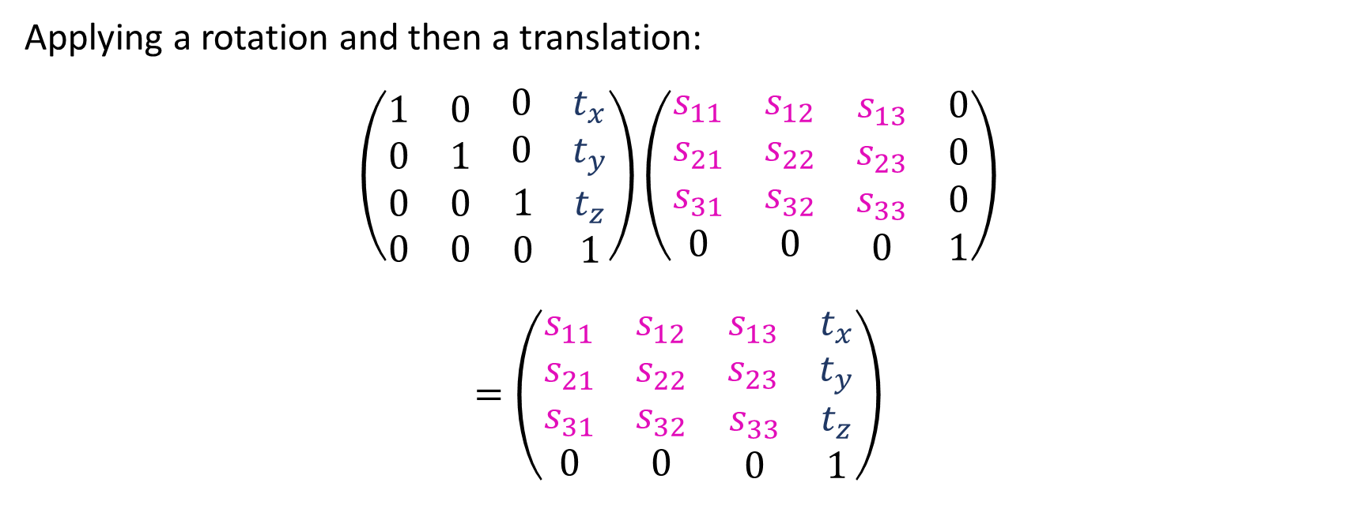
3D homogeneous matrices
Applying a rotation and then a translation:
$$\left(\begin{matrix}\begin{matrix}1 & 0 \\ 0 & 1\end{matrix} & \begin{matrix}0 & t_{x} \\ 0 & t_{y}\end{matrix} \\ \begin{matrix}0 & 0 \\ 0 & 0\end{matrix} & \begin{matrix}1 & t_{z} \\ 0 & 1\end{matrix}\end{matrix}\right)\left(\begin{matrix}\begin{matrix}s_{11} & s_{12} \\ s_{21} & s_{22}\end{matrix} & \begin{matrix}s_{13} & 0 \\ s_{23} & 0\end{matrix} \\ \begin{matrix}s_{31} & s_{32} \\ 0 & 0\end{matrix} & \begin{matrix}s_{33} & 0 \\ 0 & 1\end{matrix}\end{matrix}\right)$$
$$=\left(\begin{matrix}\begin{matrix}s_{11} & s_{12} \\ s_{21} & s_{22}\end{matrix} & \begin{matrix}s_{13} & t_{x} \\ s_{23} & t_{y}\end{matrix} \\ \begin{matrix}s_{31} & s_{32} \\ 0 & 0\end{matrix} & \begin{matrix}s_{33} & t_{z} \\ 0 & 1\end{matrix}\end{matrix}\right)$$

Slide 14
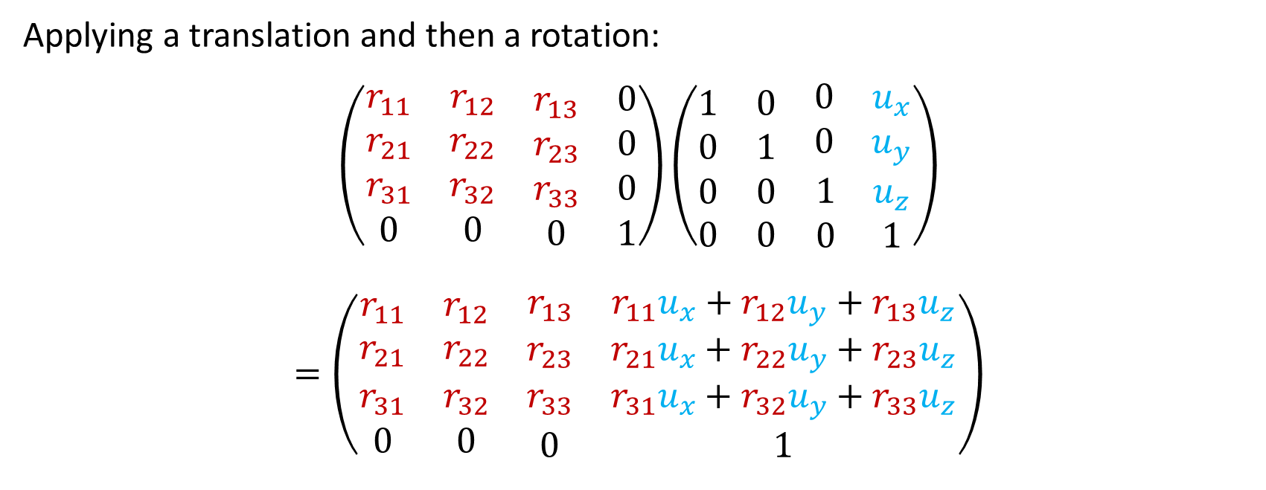
3D homogeneous matrices
Applying a translation and then a rotation:
$$\left(\begin{matrix}\begin{matrix}r_{11} & r_{12} \\ r_{21} & r_{22}\end{matrix} & \begin{matrix}r_{13} & 0 \\ r_{23} & 0\end{matrix} \\ \begin{matrix}r_{31} & r_{32} \\ 0 & 0\end{matrix} & \begin{matrix}r_{33} & 0 \\ 0 & 1\end{matrix}\end{matrix}\right)\left(\begin{matrix}\begin{matrix}1 & 0 \\ 0 & 1\end{matrix} & \begin{matrix}0 & u_{x} \\ 0 & u_{y}\end{matrix} \\ \begin{matrix}0 & 0 \\ 0 & 0\end{matrix} & \begin{matrix}1 & u_{z} \\ 0 & 1\end{matrix}\end{matrix}\right)$$
$$=\left(\begin{matrix}\begin{matrix}r_{11} & r_{12} \\ r_{21} & r_{22}\end{matrix} & \begin{matrix}r_{13} & r_{11}u_{x}+r_{12}u_{y}+r_{13}u_{z} \\ r_{23} & r_{21}u_{x}+r_{22}u_{y}+r_{23}u_{z}\end{matrix} \\ \begin{matrix}r_{31} & r_{32} \\ 0 & 0\end{matrix} & \begin{matrix}r_{33} & r_{31}u_{x}+r_{32}u_{y}+r_{33}u_{z} \\ 0 & 1\end{matrix}\end{matrix}\right)$$

Slide 15
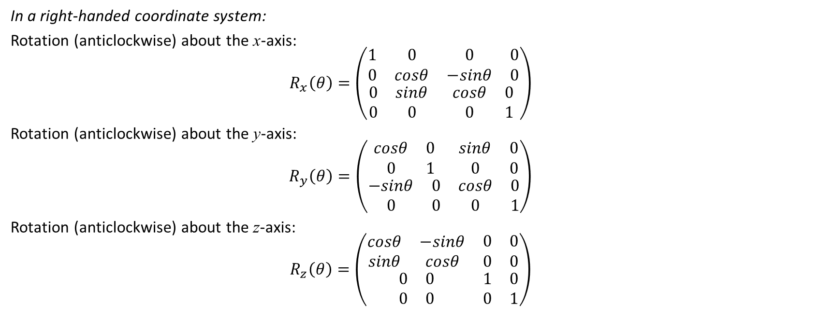
3D homogeneous rotation matrices
In a right-handed coordinate system:
Rotation (anticlockwise) about the x-axis:
$$R_{x}\left(θ\right)=\left(\begin{matrix}\begin{matrix}1 & 0 \\ 0 & cosθ\end{matrix} & \begin{matrix}0 & 0 \\ −sinθ & 0\end{matrix} \\ \begin{matrix}0 & sinθ \\ 0 & 0\end{matrix} & \begin{matrix}cosθ & 0 \\ 0 & 1\end{matrix}\end{matrix}\right)$$
Rotation (anticlockwise) about the y-axis:
$$R_{y}\left(θ\right)=\left(\begin{matrix}\begin{matrix}cosθ & 0 \\ 0 & 1\end{matrix} & \begin{matrix}sinθ & 0 \\ 0 & 0\end{matrix} \\ \begin{matrix}−sinθ & 0 \\ 0 & 0\end{matrix} & \begin{matrix}cosθ & 0 \\ 0 & 1\end{matrix}\end{matrix}\right)$$
Rotation (anticlockwise) about the z-axis:
$$R_{z}\left(θ\right)=\left(\begin{matrix}\begin{matrix}cosθ & −sinθ \\ sinθ & cosθ\end{matrix} & \begin{matrix}0 & 0 \\ 0 & 0\end{matrix} \\ \begin{matrix}0 & 0 \\ 0 & 0\end{matrix} & \begin{matrix}1 & 0 \\ 0 & 1\end{matrix}\end{matrix}\right)$$

Slide 16
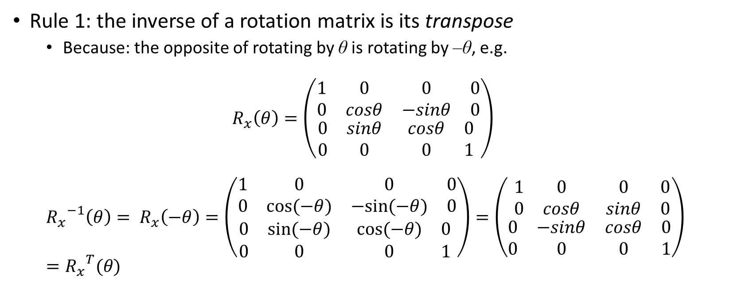
Inverse of a transformation matrix
Rule 1: the inverse of a rotation matrix is its transpose
Because: the opposite of rotating by θ is rotating by –θ, e.g.
$$R_{x}\left(θ\right)=\left(\begin{matrix}\begin{matrix}1 & 0 \\ 0 & cosθ\end{matrix} & \begin{matrix}0 & 0 \\ −sinθ & 0\end{matrix} \\ \begin{matrix}0 & sinθ \\ 0 & 0\end{matrix} & \begin{matrix}cosθ & 0 \\ 0 & 1\end{matrix}\end{matrix}\right)$$
$${R_{x}}^{−1}\left(θ\right)= R_{x}\left(−θ\right)=\left(\begin{matrix}\begin{matrix}1 & 0 \\ 0 & cos⁡(−θ)\end{matrix} & \begin{matrix}0 & 0 \\ −sin⁡(−θ) & 0\end{matrix} \\ \begin{matrix}0 & sin⁡(−θ) \\ 0 & 0\end{matrix} & \begin{matrix}cos⁡(−θ) & 0 \\ 0 & 1\end{matrix}\end{matrix}\right)=\left(\begin{matrix}\begin{matrix}1 & 0 \\ 0 & cosθ\end{matrix} & \begin{matrix}0 & 0 \\ sinθ & 0\end{matrix} \\ \begin{matrix}0 & −sinθ \\ 0 & 0\end{matrix} & \begin{matrix}cosθ & 0 \\ 0 & 1\end{matrix}\end{matrix}\right)={R_{x}}^{T}(θ)$$

Slide 17
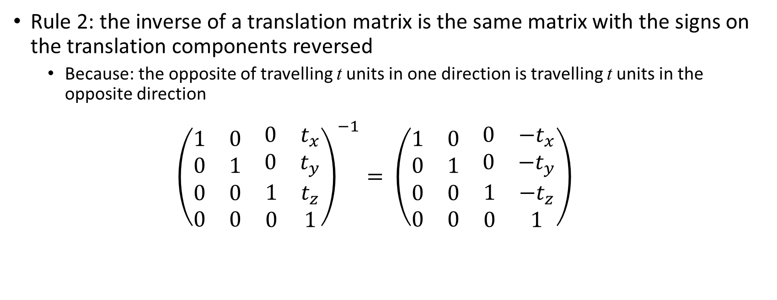
Inverse of a transformation matrix
Rule 2: the inverse of a translation matrix is the same matrix with the signs on the translation components reversed
Because: the opposite of travelling t units in one direction is travelling t units in the opposite direction
$${\left(\begin{matrix}\begin{matrix}1 & 0 \\ 0 & 1\end{matrix} & \begin{matrix}0 & t_{x} \\ 0 & t_{y}\end{matrix} \\ \begin{matrix}0 & 0 \\ 0 & 0\end{matrix} & \begin{matrix}1 & t_{z} \\ 0 & 1\end{matrix}\end{matrix}\right)}^{−1}= \left(\begin{matrix}\begin{matrix}1 & 0 \\ 0 & 1\end{matrix} & \begin{matrix}0 & {−t}_{x} \\ 0 & −t_{y}\end{matrix} \\ \begin{matrix}0 & 0 \\ 0 & 0\end{matrix} & \begin{matrix}1 & −t_{z} \\ 0 & 1\end{matrix}\end{matrix}\right)$$

Slide 18
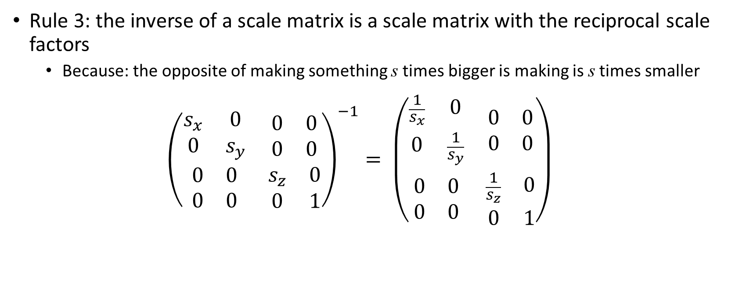
Inverse of a transformation matrix
Rule 3: the inverse of a scale matrix is a scale matrix with the reciprocal scale factors
Because: the opposite of making something s times bigger is making is s times smaller
$${\left(\begin{matrix}\begin{matrix}s_{x} & 0 \\ 0 & s_{y}\end{matrix} & \begin{matrix}0 & 0 \\ 0 & 0\end{matrix} \\ \begin{matrix}0 & 0 \\ 0 & 0\end{matrix} & \begin{matrix}s_{z} & 0 \\ 0 & 1\end{matrix}\end{matrix}\right)}^{−1}= \left(\begin{matrix}\begin{matrix}\frac{1}{s_{x}} & 0 \\ 0 & \frac{1}{s_{y}}\end{matrix} & \begin{matrix}0 & 0 \\ 0 & 0\end{matrix} \\ \begin{matrix}0 & 0 \\ 0 & 0\end{matrix} & \begin{matrix}\frac{1}{s_{z}} & 0 \\ 0 & 1\end{matrix}\end{matrix}\right)$$

Slide 19
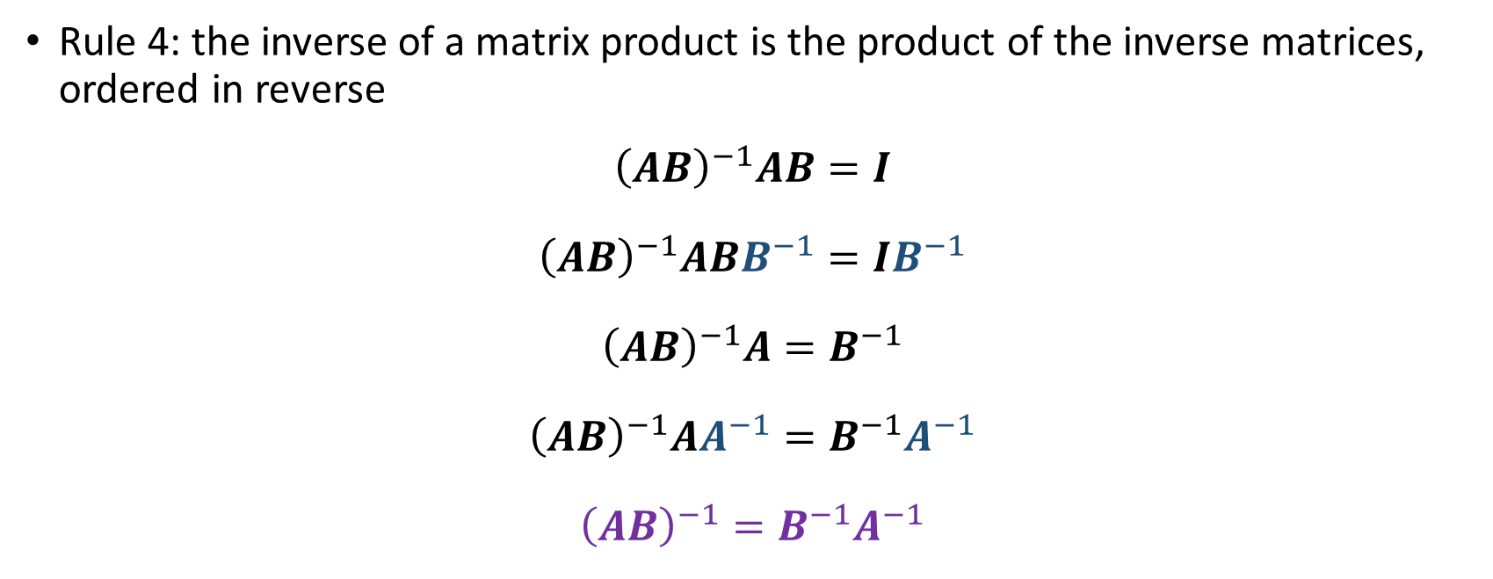
Inverse of a transformation matrix
Rule 4: the inverse of a matrix product is the product of the inverse matrices, ordered in reverse
$${\left(AB\right)}^{−1}AB=I$$
$${\left(AB\right)}^{−1}ABB^{−1}=IB^{−1}$$
$${\left(AB\right)}^{−1}A=B^{−1}$$
$${\left(AB\right)}^{−1}AA^{−1}=B^{−1}A^{−1}$$
$${\left(AB\right)}^{−1}=B^{−1}A^{−1}$$

Slide 20
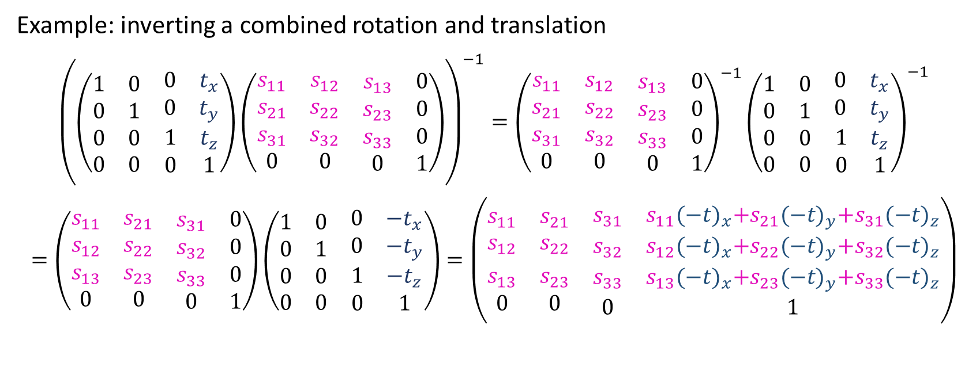
Inverse of a transformation matrix
Example: inverting a combined rotation and translation
$${\left(\left(\begin{matrix}\begin{matrix}1 & 0 \\ 0 & 1\end{matrix} & \begin{matrix}0 & t_{x} \\ 0 & t_{y}\end{matrix} \\ \begin{matrix}0 & 0 \\ 0 & 0\end{matrix} & \begin{matrix}1 & t_{z} \\ 0 & 1\end{matrix}\end{matrix}\right)\left(\begin{matrix}\begin{matrix}s_{11} & s_{12} \\ s_{21} & s_{22}\end{matrix} & \begin{matrix}s_{13} & 0 \\ s_{23} & 0\end{matrix} \\ \begin{matrix}s_{31} & s_{32} \\ 0 & 0\end{matrix} & \begin{matrix}s_{33} & 0 \\ 0 & 1\end{matrix}\end{matrix}\right)\right)}^{−1}={\left(\begin{matrix}\begin{matrix}s_{11} & s_{12} \\ s_{21} & s_{22}\end{matrix} & \begin{matrix}s_{13} & 0 \\ s_{23} & 0\end{matrix} \\ \begin{matrix}s_{31} & s_{32} \\ 0 & 0\end{matrix} & \begin{matrix}s_{33} & 0 \\ 0 & 1\end{matrix}\end{matrix}\right)}^{−1}{\left(\begin{matrix}\begin{matrix}1 & 0 \\ 0 & 1\end{matrix} & \begin{matrix}0 & t_{x} \\ 0 & t_{y}\end{matrix} \\ \begin{matrix}0 & 0 \\ 0 & 0\end{matrix} & \begin{matrix}1 & t_{z} \\ 0 & 1\end{matrix}\end{matrix}\right)}^{−1}$$
$$=\left(\begin{matrix}\begin{matrix}s_{11} & s_{21} \\ s_{12} & s_{22}\end{matrix} & \begin{matrix}s_{31} & 0 \\ s_{32} & 0\end{matrix} \\ \begin{matrix}s_{13} & s_{23} \\ 0 & 0\end{matrix} & \begin{matrix}s_{33} & 0 \\ 0 & 1\end{matrix}\end{matrix}\right)\left(\begin{matrix}\begin{matrix}1 & 0 \\ 0 & 1\end{matrix} & \begin{matrix}0 & {−t}_{x} \\ 0 & {−t}_{y}\end{matrix} \\ \begin{matrix}0 & 0 \\ 0 & 0\end{matrix} & \begin{matrix}1 & {−t}_{z} \\ 0 & 1\end{matrix}\end{matrix}\right)=\left(\begin{matrix}\begin{matrix}s_{11} & s_{21} \\ s_{12} & s_{22}\end{matrix} & \begin{matrix}s_{31} & s_{11}{(−t)}_{x}+s_{21}{(−t)}_{y}+s_{31}{(−t)}_{z} \\ s_{32} & s_{12}{(−t)}_{x}+s_{22}{(−t)}_{y}+s_{32}{(−t)}_{z}\end{matrix} \\ \begin{matrix}s_{13} & s_{23} \\ 0 & 0\end{matrix} & \begin{matrix}s_{33} & s_{13}{(−t)}_{x}+s_{23}{(−t)}_{y}+s_{33}{(−t)}_{z} \\ 0 & 1\end{matrix}\end{matrix}\right)$$

Slide 21
Coordinate spaces

Slide 22
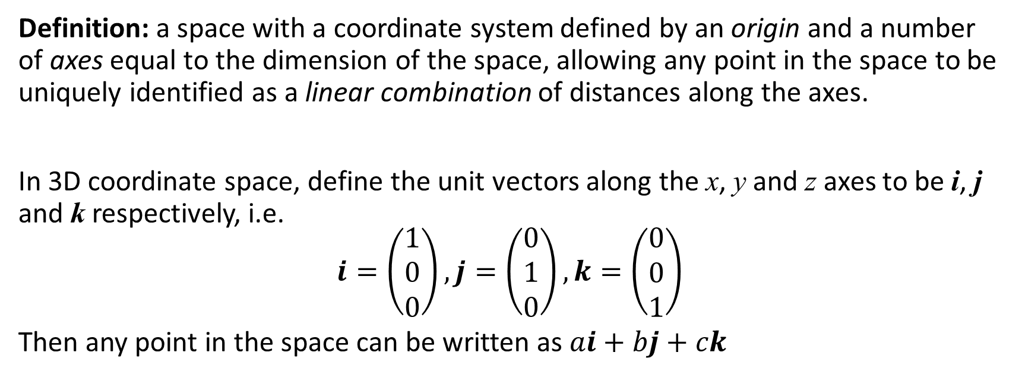
What is a coordinate space?
Definition: a space with a coordinate system defined by an origin and a number of axes equal to the dimension of the space, allowing any point in the space to be uniquely identified as a linear combination of distances along the axes.
In 3D coordinate space, define the unit vectors along the x, y and z axes to be i, j and k respectively, i.e. $$i=\left(\begin{matrix}1 \\ 0 \\ 0\end{matrix}\right),j=\left(\begin{matrix}0 \\ 1 \\ 0\end{matrix}\right),k=\left(\begin{matrix}0 \\ 0 \\ 1\end{matrix}\right)$$
Then any point in the space can be written as $ai+bj+ck$

Slide 23
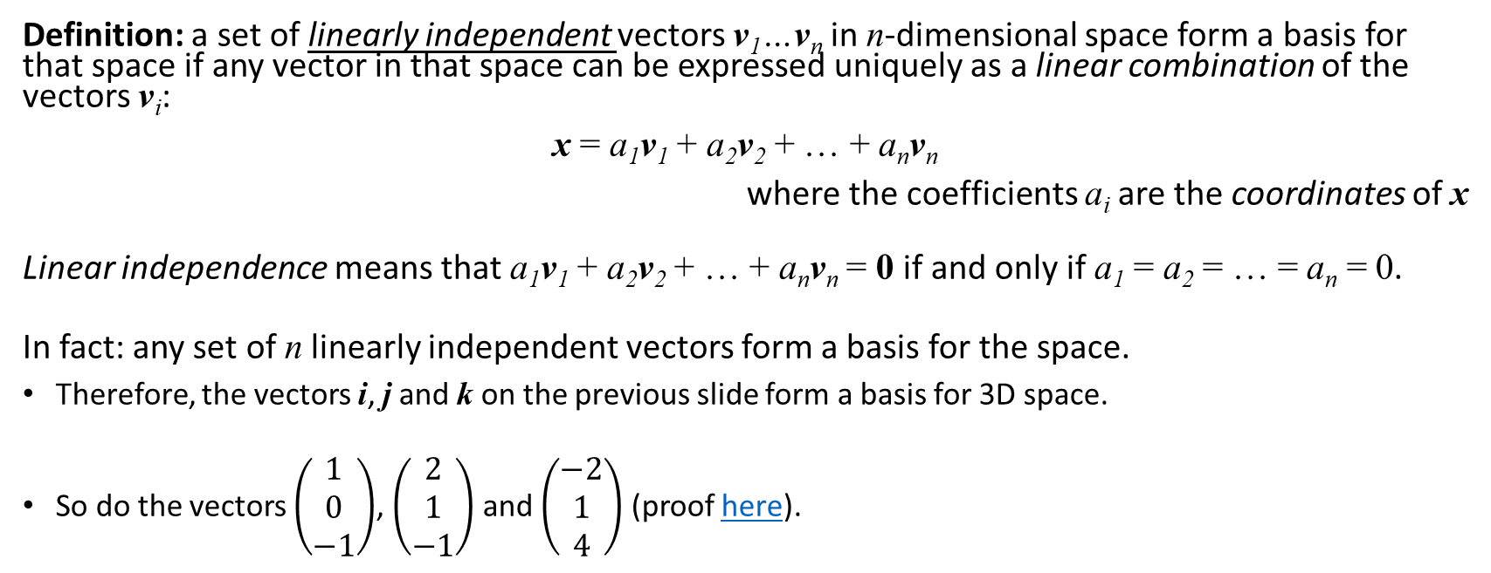
Basis vectors
Definition: a set of linearly independent vectors v₁…v_{n} in n-dimensional space form a basis for that space if any vector in that space can be expressed uniquely as a linear combination of the vectors v_{i}:
x = a₁v₁ + a₂v₂ + … + a_{n}v_{n}
where the coefficients a_{i} are the coordinates of x
Linear independence means that a₁v₁ + a₂v₂ + … + a_{n}v_{n} = 0 if and only if a₁ = a₂ = … = a_{n} = 0.
In fact: any set of n linearly independent vectors form a basis for the space.
Therefore, the vectors i, j and k on the previous slide form a basis for 3D space.
So do the vectors $\left(\begin{matrix}1 \\ 0 \\ −1\end{matrix}\right)$, $\left(\begin{matrix}2 \\ 1 \\ −1\end{matrix}\right)$ and $\left(\begin{matrix}−2 \\ 1 \\ 4\end{matrix}\right)$ (proof here).

Slide 24
Orthonormal basis vectors
Definition: an orthonormal basis is a set of basis vectors that are orthogonal and unit length.
This means that:
The coordinates are uncoupled, so that any given coordinate of a vector x can be determined solely from the coefficient and the corresponding basis vector.
Displacement along one basis vector does not cause any displacement along any of the others.
Each coordinate of x is the signed displacement in the direction of the corresponding basis vector, which can be computed using the dot product.

Slide 25
Properties of a coordinate space
A coordinate system has:
A set of axes (orthonormal basis)
An origin
-> directions
-> position
… relative to what?!

Slide 26
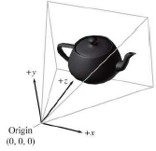
Some common coordinate spaces
World space: establishes a global reference frame for all other coordinate reference frames.
Covers the whole area/volume in which the action is currently taking place
Directions are fixed for all objects: e.g. north, south, east, west
Object space: the local coordinate space associated with a particular object.
Origin is the object’s centre of mass, root joint etc.
May have several nested/hierarchical spaces for different components of the model
Useful for applying rotation/scale
Directions are relative to each object: e.g. left, right, up, down
Camera space: the object space associated with the viewpoint used for rendering.
Convention: left-handed with viewing direction along the positive z axis from the origin (camera position).
Screen space: the 2D space onto which the camera space view is projected.

Slide 27
Transforming between coordinate spaces
AKA expressing points known in one coordinate space in a frame of reference relative to another, e.g.
Individual vertices of an object are probably stored in object space, with the object’s overall transform specified in world space
To find collisions between two objects, we need both sets of vertices in the same space
Either transform both to world space, or one object to the other object’s space (via the world)
To render the objects, we need to know their vertex positions in camera space (via world space).

Slide 28
Transforming between coordinate spaces
Duality between describing a point in a different coordinate space, and applying a transformation to the point:
Transforming a point to a new coordinate space = transforming the new space to the old
i.e. applying the inverse of the new space’s transform in the old space

Slide 29


Transforming between coordinate spaces
World space to local space: translate (to the world space origin), rotate, scale
i.e. we’re performing the opposite transformation to the one that describes the local space in world coordinates
x
y
s_{x}
θ
s_{y}
Scale by $\left({\frac{1}{s_{x}} \atop \frac{1}{s_{y}}}\right)$
Translate by $\left({−x \atop −y}\right)$
Rotate through -θ

Slide 30


Transforming between coordinate spaces
Local space to world space: scale, rotate, translate
i.e. we’re performing the same transformation as the one that describes the local space in world coordinates… this is just how we move objects (models) around the world!
x
y
s_{x}
θ
s_{y}
Translate by $\left({x \atop y}\right)$
Rotate through θ
Scale by $\left({s_{x} \atop s_{y}}\right)$

Slide 31
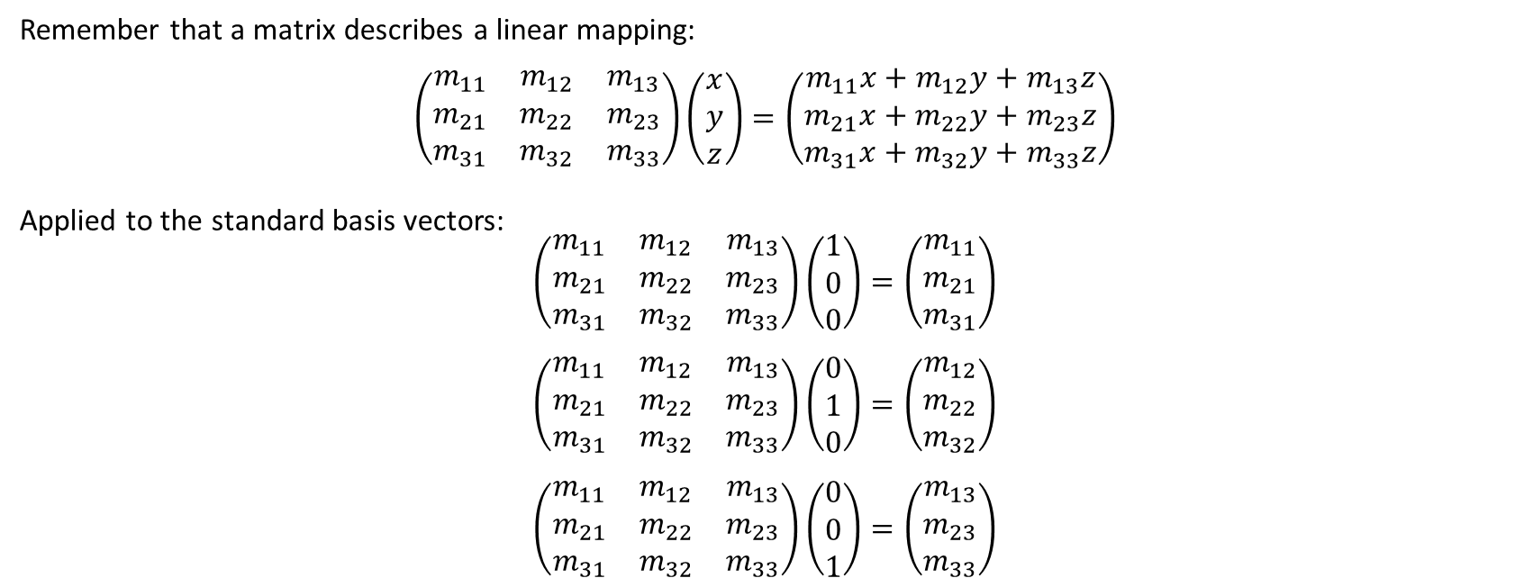
Matrices and coordinate space transforms
Remember that a matrix describes a linear mapping:
$$\left(\begin{matrix}m_{11} & m_{12} & m_{13} \\ m_{21} & m_{22} & m_{23} \\ m_{31} & m_{32} & m_{33}\end{matrix}\right)\left(\begin{matrix}x \\ y \\ z\end{matrix}\right)=\left(\begin{matrix}m_{11}x+m_{12}y+m_{13}z \\ m_{21}x+m_{22}y+m_{23}z \\ m_{31}x+m_{32}y+m_{33}z\end{matrix}\right)$$
Applied to the standard basis vectors:
$$\left(\begin{matrix}m_{11} & m_{12} & m_{13} \\ m_{21} & m_{22} & m_{23} \\ m_{31} & m_{32} & m_{33}\end{matrix}\right)\left(\begin{matrix}1 \\ 0 \\ 0\end{matrix}\right)=\left(\begin{matrix}m_{11} \\ m_{21} \\ m_{31}\end{matrix}\right)$$
$$\left(\begin{matrix}m_{11} & m_{12} & m_{13} \\ m_{21} & m_{22} & m_{23} \\ m_{31} & m_{32} & m_{33}\end{matrix}\right)\left(\begin{matrix}0 \\ 1 \\ 0\end{matrix}\right)=\left(\begin{matrix}m_{12} \\ m_{22} \\ m_{32}\end{matrix}\right)$$
$$\left(\begin{matrix}m_{11} & m_{12} & m_{13} \\ m_{21} & m_{22} & m_{23} \\ m_{31} & m_{32} & m_{33}\end{matrix}\right)\left(\begin{matrix}0 \\ 0 \\ 1\end{matrix}\right)=\left(\begin{matrix}m_{13} \\ m_{23} \\ m_{33}\end{matrix}\right)$$

Slide 32

Matrices and coordinate space transforms
Theorem: the columns of a transformation matrix M can be interpreted as basis vectors of the space that M transforms to.
Since any vector x can be written as a linear combination of i, j and k:
$$x=ai+bj+cj$$
$$Mx=M(ai+bj+ck)$$
$$=M\left(ai\right)+M\left(bj\right)+M\left(ck\right)$$
$$=a\left(Mi\right)+b\left(Mj\right)+c(Mk)$$
$$=a\left(\begin{matrix}m_{11} \\ m_{21} \\ m_{31}\end{matrix}\right)+b\left(\begin{matrix}m_{12} \\ m_{22} \\ m_{32}\end{matrix}\right)+c\left(\begin{matrix}m_{13} \\ m_{23} \\ m_{33}\end{matrix}\right)$$
Note: we’ve already been using this fact to construct the transformation matrices (e.g. rotation)!
Tip: visualise the kind of transformation by extracting the basis vectors and comparing them to the original axes.

Slide 33

Example: generalised camera coordinates
Simple camera – recap:
Camera (COP) oriented along the (positive) world-space z-axis
Direction of view along the negative z-axis
Vertically aligned with the positive y-axis
y
z
Centre of Projection (COP)
x

Slide 34
Example: generalised camera coordinates
Generalised camera – viewing coordinate (VC) system parameters:
View reference point (VRP): the origin (point) of the VC system in world space
The point with respect to which the COP and view plane are defined
View plane normal (VPN): direction vector specifying the positive z-axis of the VC system in world space
Direction the camera is pointing
View up vector (VUV): direction vector used to define the positive y-axis of the VC system in world space
The VC y-axis is formed by projecting the VUV onto a plane perpendicular to the VPN, passing through the VRP

Slide 35
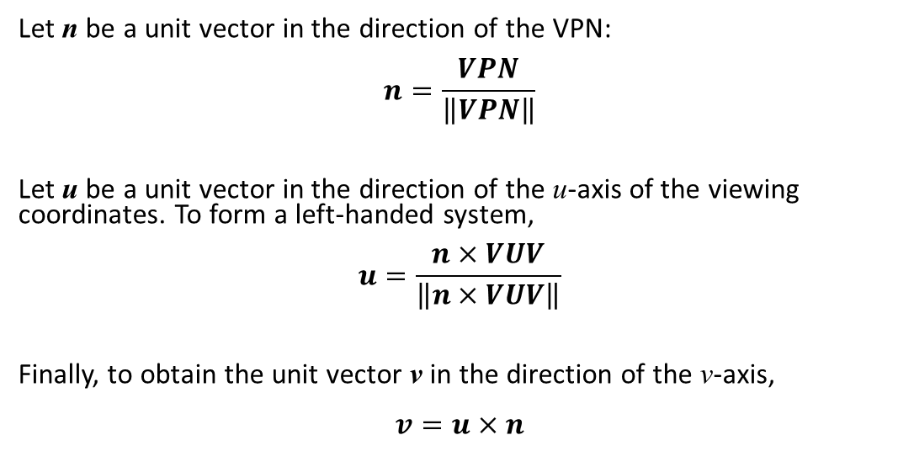
Example: generalised camera coordinates
Let the x-, y- and z-axes of the viewing coordinates be referred to as u, v and n respectively:
y
Let n be a unit vector in the direction of the VPN: $$n=\frac{VPN}{\left\|VPN\right\|}$$
Let u be a unit vector in the direction of the u-axis of the viewing coordinates. To form a left-handed system, $$u=\frac{n×VUV}{\left\|n×VUV\right\|}$$
Finally, to obtain the unit vector v in the direction of the v-axis, $$v=u×n$$
u
v
VUV
VRP
n
x
z

Slide 36
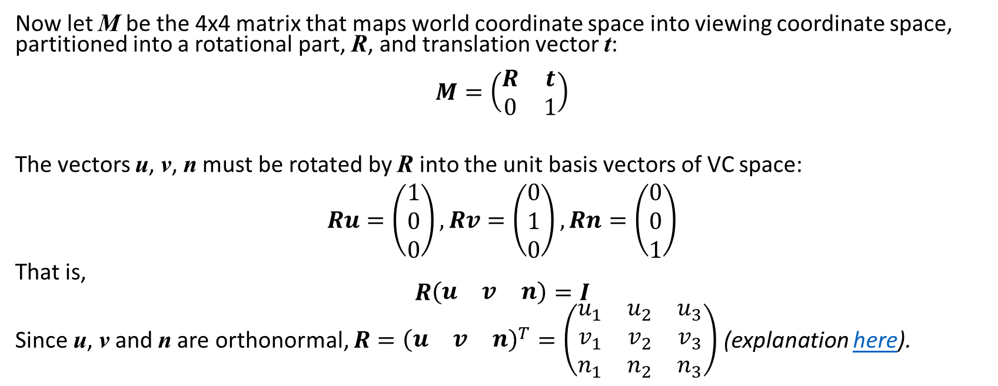
Example: generalised camera coordinates
Now let M be the 4x4 matrix that maps world coordinate space into viewing coordinate space, partitioned into a rotational part, R, and translation vector t: $$M=\left(\begin{matrix}R & t \\ 0 & 1\end{matrix}\right)$$
The vectors u, v, n must be rotated by R into the unit basis vectors of VC space: $$Ru=\left(\begin{matrix}1 \\ 0 \\ 0\end{matrix}\right),Rv=\left(\begin{matrix}0 \\ 1 \\ 0\end{matrix}\right),Rn=\left(\begin{matrix}0 \\ 0 \\ 1\end{matrix}\right)$$
That is, $$R\left(\begin{matrix}u & v & n\end{matrix}\right)=I$$
Since u, v and n are orthonormal, $R={\left(\begin{matrix}u & v & n\end{matrix}\right)}^{T}=\left(\begin{matrix}u_{1} & u_{2} & u_{3} \\ v_{1} & v_{2} & v_{3} \\ n_{1} & n_{2} & n_{3}\end{matrix}\right)$ (explanation here).

Slide 37
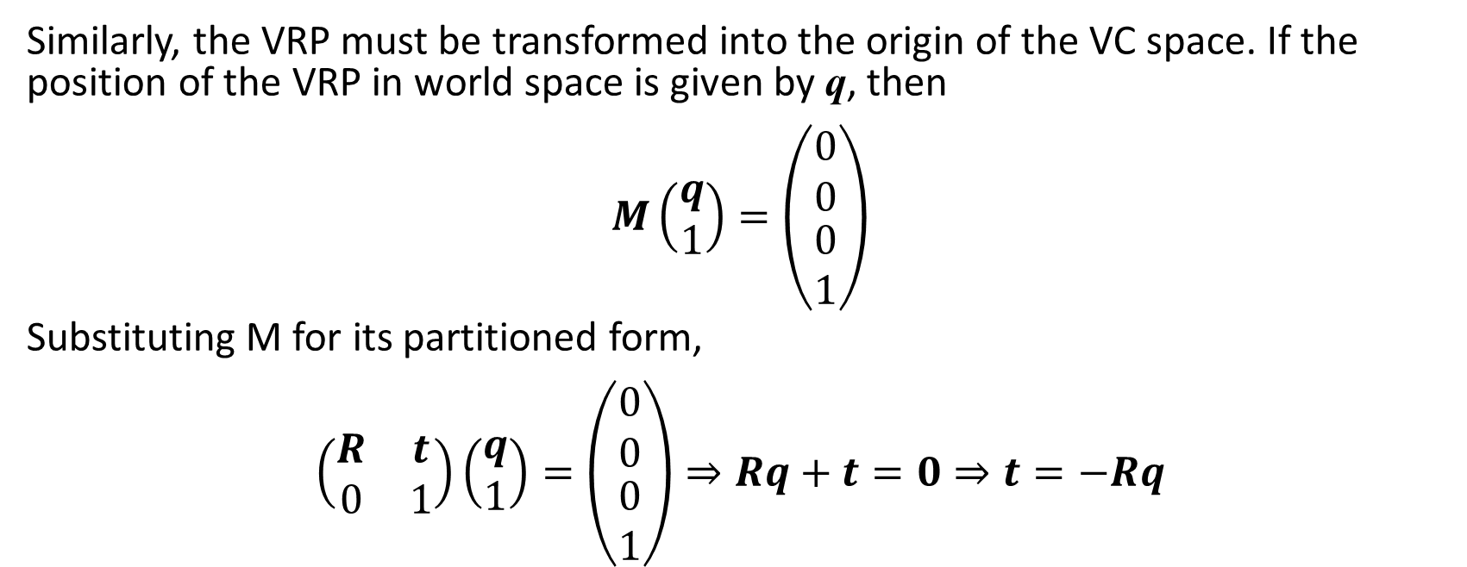
Example: generalised camera coordinates
Similarly, the VRP must be transformed into the origin of the VC space. If the position of the VRP in world space is given by q, then $$M\left(\begin{matrix}q \\ 1\end{matrix}\right)=\left(\begin{matrix}\begin{matrix}0 \\ 0\end{matrix} \\ \begin{matrix}0 \\ 1\end{matrix}\end{matrix}\right)$$
Substituting M for its partitioned form, $$\left(\begin{matrix}R & t \\ 0 & 1\end{matrix}\right)\left(\begin{matrix}q \\ 1\end{matrix}\right)=\left(\begin{matrix}\begin{matrix}0 \\ 0\end{matrix} \\ \begin{matrix}0 \\ 1\end{matrix}\end{matrix}\right)⇒Rq+t=0⇒t=−Rq$$

Slide 38
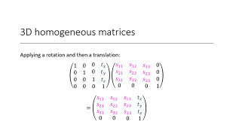
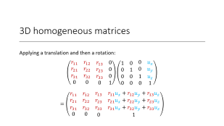
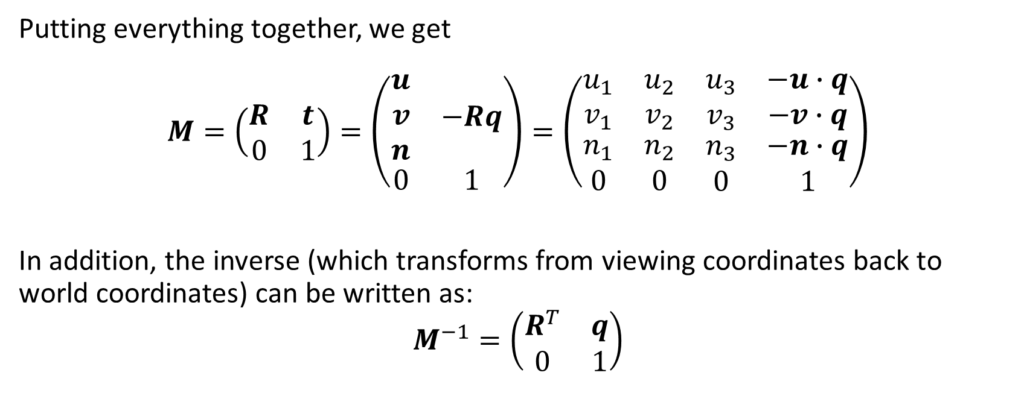
Example: generalised camera coordinates
Putting everything together, we get $$M=\left(\begin{matrix}R & t \\ 0 & 1\end{matrix}\right)=\left(\begin{matrix}\begin{matrix}u \\ v \\ n\end{matrix} & −Rq \\ 0 & 1\end{matrix}\right)=\left(\begin{matrix}\begin{matrix}u_{1} & u_{2} \\ v_{1} & v_{2}\end{matrix} & \begin{matrix}u_{3} & −u∙q \\ v_{3} & −v∙q\end{matrix} \\ \begin{matrix}n_{1} & n_{2} \\ 0 & 0\end{matrix} & \begin{matrix}n_{3} & −n∙q \\ 0 & 1\end{matrix}\end{matrix}\right)$$
In addition, the inverse (which transforms from viewing coordinates back to world coordinates) can be written as: $$M^{−1}=\left(\begin{matrix}R^{T} & q \\ 0 & 1\end{matrix}\right)$$

Slide 39
More on rotations

Slide 40
Pros and cons of matrices
Pros | Cons
Explicit/“brute force” representation: can be applied directly to vectors | Take up more memory than is really needed for the information stored
Commonly used by graphics APIs | Not intuitive for humans to use
Concatenation of multiple transforms in a single matrix | Can easily be ill-formed: Scale, skew, reflection or projection matrices aren’t orthogonal Bad input data, e.g. from mocap Floating point errors (from successive incremental changes): matrix creep requires re-orthogonalisation
The opposite transform is given by the inverse, which is relatively straightforward to compute

Slide 41
Pros and cons of matrices
Pros
Cons
Explicit/“brute force” representation: can be applied directly to vectors
Take up more memory than is really needed for the information stored
Commonly used by graphics APIs
Not intuitive for humans to use
Concatenation of multiple transforms in a single matrix
Can easily be ill-formed:
Scale, skew, reflection or projection matrices aren’t orthogonal
Bad input data, e.g. from mocap
Floating point errors (from successive incremental changes): matrix creep requires re-orthogonalisation
The opposite transform is given by the inverse, which is relatively straightforward to compute

Slide 42
Other ways to represent rotation: Euler angles
Define an angular displacement as a sequence of three rotations about three mutually perpendicular axes (usually x, y, z).
Can be applied in any order – must be specified.
Many variations on conventions/nomenclature, e.g. yaw-pitch-roll, or heading-pitch-bank
Rotations occur about the body (local space) axes, which change after each rotation…
Equivalent to a fixed-axes system provided that the rotations are performed in the opposite order.
Original (symmetric) system: first and last rotations are about the same axis
Sensible order:
First about the vertical axis (y)
Second about the body lateral axis (x)
Third about the body longitudinal axis (z)

Slide 43
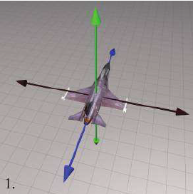
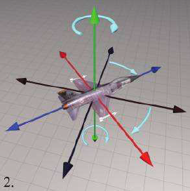
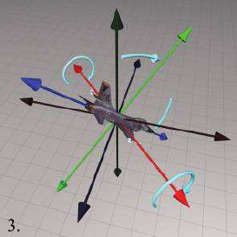
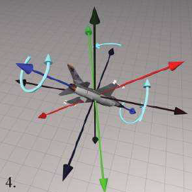
Euler angles example
Initial orientation
Heading rotation (vertical / y-axis)
Pitch rotation (lateral / x-axis)
Bank rotation (longitudinal / z-axis)
“3D Math Primer for Graphics and Game Development” (2nd Ed), figures 8.4-8.7

Slide 44
Euler angles and aliasing
Gimbal lock
Problem: different angles can give the same result
Adding a multiple of 360° changes the numbers but not the rotation
The angles are not completely independent of each other
e.g. pitching down 135° = heading 180°, pitching down 45°, banking 180°
(Partial) solution: restrict range of angles to a canonical set, e.g. (-180°, +180°] for heading/bank and (-90°, +90°] for pitch.
But still: 45° right then 90° down = down 90° then bank/twist 45°
Generally: an angle of ±90° for the second rotation causes the first and third rotations to be about the same axis
Additional restriction: assign all rotation about the vertical axis to the first (heading) rotation, leaving the last (bank) at zero.

Slide 45
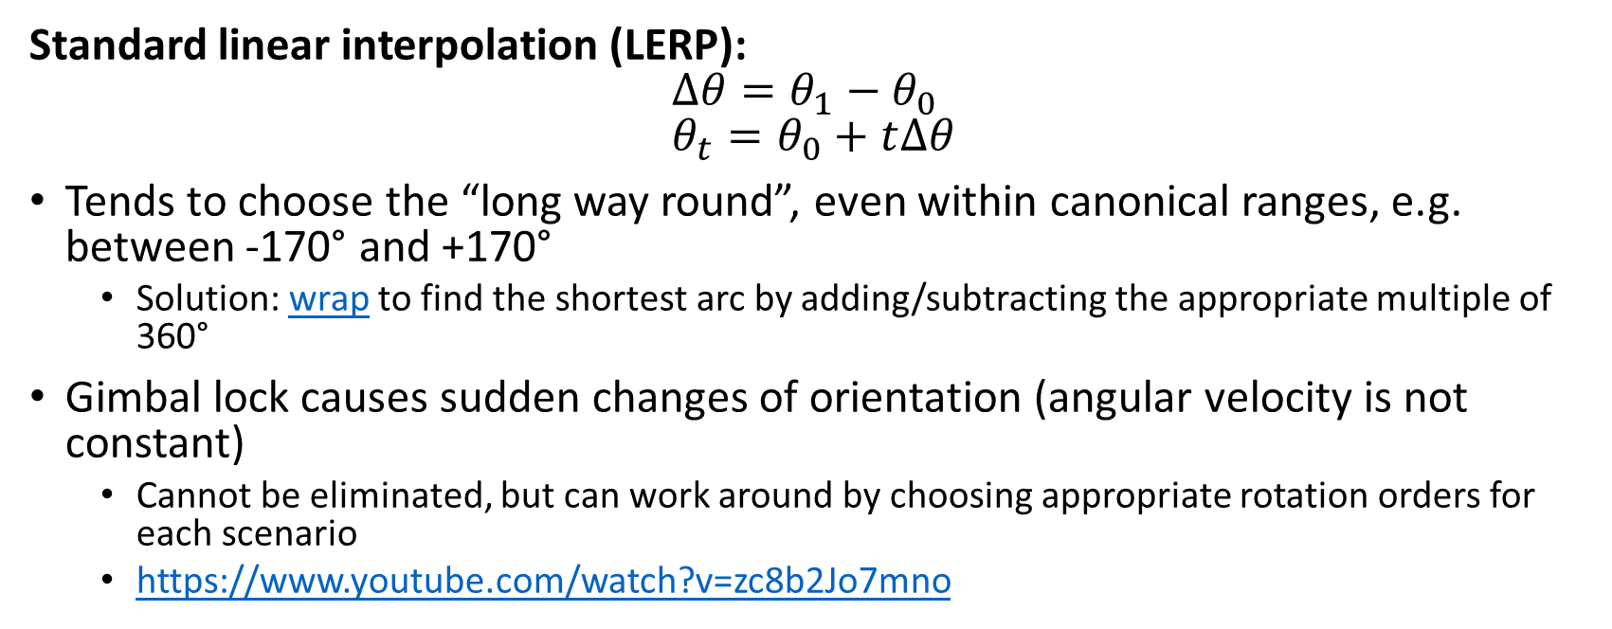
Interpolating Euler angles
Standard linear interpolation (LERP): $$∆θ=θ_{1}−θ_{0} \\ θ_{t}=θ_{0}+t∆θ$$
Tends to choose the “long way round”, even within canonical ranges, e.g. between -170° and +170°
Solution: wrap to find the shortest arc by adding/subtracting the appropriate multiple of 360°
Gimbal lock causes sudden changes of orientation (angular velocity is not constant)
Cannot be eliminated, but can work around by choosing appropriate rotation orders for each scenario
https://www.youtube.com/watch?v=zc8b2Jo7mno

Slide 46
Pros and cons of Euler angles
Pros | Cons
More intuitive to visualise (for some people??) | The representation for a given orientation is not unique Angles are cyclical and not mutually independent
Smallest possible representation – no wasted space | Interpolation is problematic Gimbal lock
Can be compressed if necessary: angle values are larger than the sin/cosine values stored in matrices, so require less precision
Any set of three numbers is valid (will produce a valid rotation)

Slide 47
Pros and cons of Euler angles
Pros
Cons
More intuitive to visualise (?)
The representation for a given orientation is not unique
Angles are cyclical and not mutually independent
Smallest possible representation – no wasted space
Interpolation is problematic
Gimbal lock
Can be compressed if necessary: angle values are larger than the sine/cosine values stored in matrices, so require less precision
Need to be converted to matrices to use
Any set of three numbers is valid (will produce a valid rotation)

Slide 48
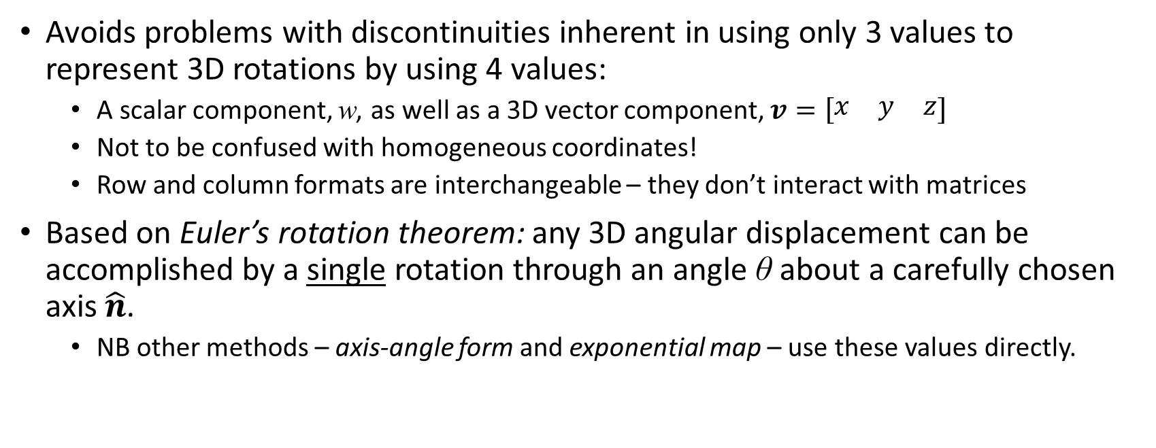
Other ways to represent rotation: Quaternions
Avoids problems with discontinuities inherent in using only 3 values to represent 3D rotations by using 4 values:
A scalar component, w, as well as a 3D vector component, $v=\left[\begin{matrix}x & y & z\end{matrix}\right]$
Not to be confused with homogeneous coordinates!
Row and column formats are interchangeable – they don’t interact with matrices
Based on Euler’s rotation theorem: any 3D angular displacement can be accomplished by a single rotation through an angle θ about a carefully chosen axis $\hat{n}$.
NB other methods – axis-angle form and exponential map – use these values directly.

Slide 49
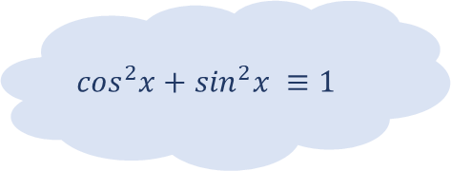
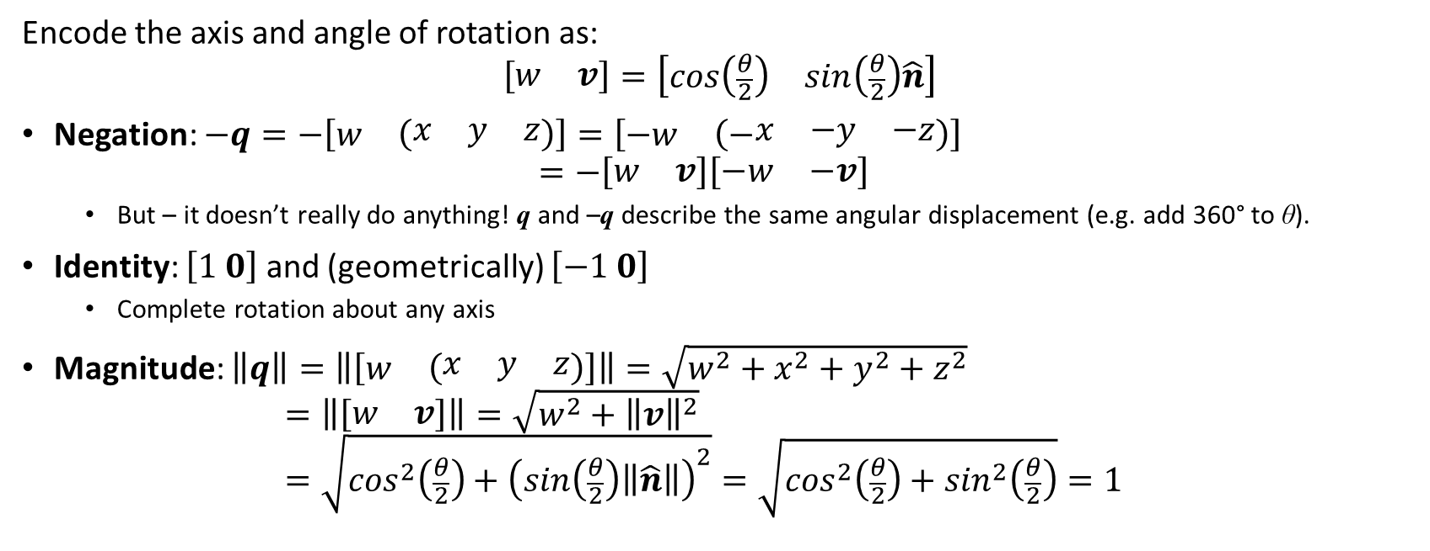
Quaternion properties and operations
Encode the axis and angle of rotation as: $$\left[\begin{matrix}w & v\end{matrix}\right]=\left[\begin{matrix}cos\left(\frac{θ}{2}\right) & sin\left(\frac{θ}{2}\right)\hat{n}\end{matrix}\right]$$
Negation: $−q=−\left[\begin{matrix}w & \left(\begin{matrix}x & y & z\end{matrix}\right)\end{matrix}\right]=\left[\begin{matrix}−w & \left(−\begin{matrix}x & −y & −z\end{matrix}\right)\end{matrix}\right]$ $=−\left[\begin{matrix}w & v\end{matrix}\right]\left[\begin{matrix}−w & −v\end{matrix}\right]$
But – it doesn’t really do anything! q and –q describe the same angular displacement (e.g. add 360° to θ).
Identity: $\left[1 0\right]$ and (geometrically) $\left[−1 0\right]$
Complete rotation about any axis
Magnitude: $\left\|q\right\|=\left\|\left[\begin{matrix}w & \left(\begin{matrix}x & y & z\end{matrix}\right)\end{matrix}\right]\right\|=\sqrt{w^{2}+x^{2}+y^{2}+z^{2}}$ $=\left\|\left[\begin{matrix}w & v\end{matrix}\right]\right\|=\sqrt{w^{2}+{\left\|v\right\|}^{2}}$ $=\sqrt{\cos^{2}\left(\frac{θ}{2}\right)+{\left(sin\left(\frac{θ}{2}\right)\left\|\hat{n}\right\|\right)}^{2}}=\sqrt{\cos^{2}\left(\frac{θ}{2}\right)+\sin^{2}\left(\frac{θ}{2}\right)}=1$
$$\cos^{2}x+\sin^{2}x ≡1$$

Slide 50
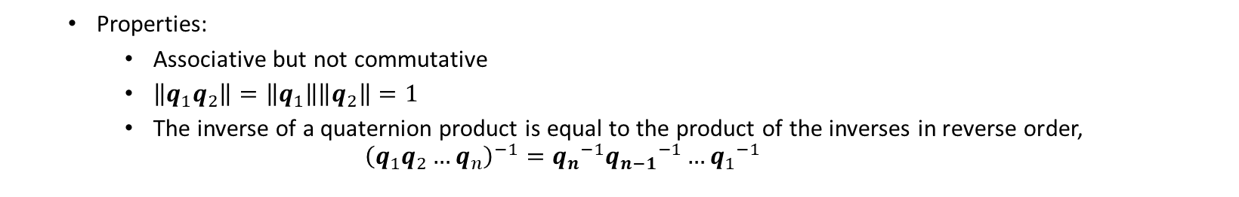
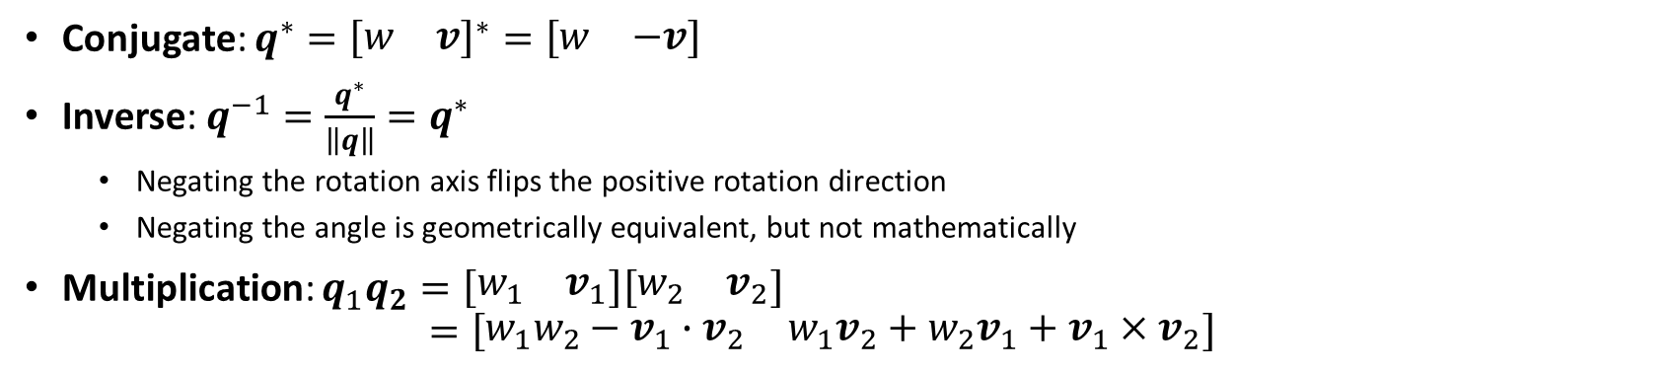
Quaternion inverse and multiplication
Conjugate: $q^{∗}={\left[\begin{matrix}w & v\end{matrix}\right]}^{∗}=\left[\begin{matrix}w & −v\end{matrix}\right]$
Inverse: $q^{−1}=\frac{q^{∗}}{\left\|q\right\|}=q^{∗}$
Negating the rotation axis flips the positive rotation direction
Negating the angle is geometrically equivalent, but not mathematically
Multiplication: $q_{1}q_{2}=\left[\begin{matrix}w_{1} & v_{1}\end{matrix}\right]\left[\begin{matrix}w_{2} & v_{2}\end{matrix}\right]$ $=\left[\begin{matrix}w_{1}w_{2}−v_{1}∙v_{2} & w_{1}v_{2}+w_{2}v_{1}+v_{1}×v_{2}\end{matrix}\right]$
AKA Hamilton product
Properties:
Associative but not commutative
$\left\|q_{1}q_{2}\right\|=\left\|q_{1}\right\|\left\|q_{2}\right\|=1$
The inverse of a quaternion product is equal to the product of the inverses in reverse order, ${\left(q_{1}q_{2}…q_{n}\right)}^{−1}={q_{n}}^{−1}{q_{n−1}}^{−1}…{q_{1}}^{−1}$

Slide 51
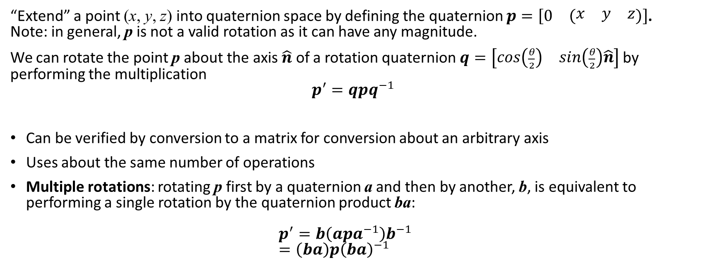
Applying a quaternion to a point
“Extend” a point (x, y, z) into quaternion space by defining the quaternion $p=\left[\begin{matrix}0 & \left(\begin{matrix}x & y & z\end{matrix}\right)\end{matrix}\right]$. Note: in general, p is not a valid rotation as it can have any magnitude.
We can rotate the point p about the axis $\hat{n}$ of a rotation quaternion $q=\left[\begin{matrix}cos\left(\frac{θ}{2}\right) & sin\left(\frac{θ}{2}\right)\hat{n}\end{matrix}\right]$ by performing the multiplication $$p^{′}=qpq^{−1}$$
Can be verified by conversion to a matrix for conversion about an arbitrary axis
Uses about the same number of operations
Multiple rotations: rotating p first by a quaternion a and then by another, b, is equivalent to performing a single rotation by the quaternion product ba: $p^{′}=b\left(apa^{−1}\right)b^{−1}$ $=\left(ba\right)p{\left(ba\right)}^{−1}$

Slide 52
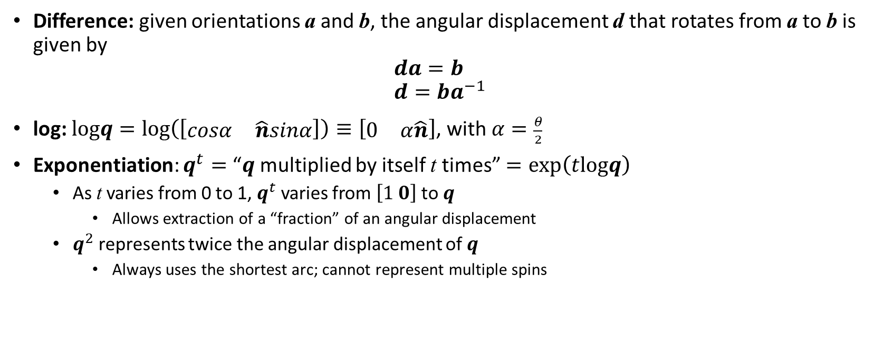
Quaternion difference and exponentiation
Difference: given orientations a and b, the angular displacement d that rotates from a to b is given by $da=b$ $d=ba^{−1}$
log: $logq=log\left(\left[\begin{matrix}cosα & \hat{n}sinα\end{matrix}\right]\right)≡\left[\begin{matrix}0 & α\hat{n}\end{matrix}\right]$, with $α=\frac{θ}{2}$
Exponentiation: $q^{t}=$ “$q$multiplied by itself t times” $=exp\left(tlogq\right)$
As t varies from 0 to 1, $q^{t}$ varies from $\left[1 0\right]$ to $q$
Allows extraction of a “fraction” of an angular displacement
$q^{2}$ represents twice the angular displacement of $q$
Always uses the shortest arc; cannot represent multiple spins

Slide 53

Quaternion interpolation
Spherical linear interpolation (SLERP):
$$slerp\left(q_{0},q_{1},t\right)= {\left(q_{0}{q_{1}}^{−1}\right)}^{t}q_{0}$$
Algebraic/theoretical form of computation
Actually use a mathematically equivalent, but computationally more efficient, form…
To be continued…

Slide 54
Pros and cons of quaternions
Pros | Cons
Only four values to store | One more than Euler angles Component values do not interpolate smoothly, so harder to compress
Only representation that provides smooth interpolation | Can become invalid (from bad input or rounding errors)
Fast concatenation and inversion | Least intuitive representation
Fast conversion to and from matrix form

Slide 55
Pros and cons of quaternions
Pros
Cons
Only four values to store
One more than Euler angles
Component values do not interpolate smoothly, so harder to compress
Only representation that provides smooth interpolation
Can become invalid (from bad input or rounding errors)
Fast concatenation and inversion
Least intuitive representation
Fast conversion to and from matrix form

Slide 56
References

Slide 57
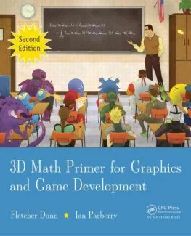
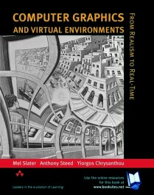
Some useful reading material
Books
“3D Math Primer for Graphics and Game Development” (2nd Ed) Fletcher Dunn and Ian Parberry, CRC Press
Chapters 3-6 and 8
Some images taken from here!
“Computer Graphics and Virtual Environments” Mel Slater, Anthony Steed and Yiorgos Chrysanthou, Addison Wesley
Chapters 2, 5 and 7
Websites
ScratchAPixel
Wolfram MathWorld

