Slide 1


Week 8: Profiling & Optimisation
COMP270: Mathematics for 3D Worlds & Simulations
BSc(Hons) Computing for Games

Slide 2
Time is of the essence

Slide 3
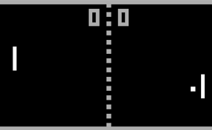
A brief history of (frame) time
Beginning of frame
60fps means 16.67ms per frame…
Origin: US & Japanese TV systems run NTSC
Gives 30fps
Updates at 60fps
Electrical power is generated at 60Hz
Early games drew using the CRT scan directly
“Racing the Beam: The Atari Video Computer System”, Ian Bogost and Nick Montfort, MIT Press
Drawing took up all the time during the scan; other work had to be done during the “fly back”.
PAL is 50fps; has a higher vertical resolution
But satisfy the most demanding!
NB can’t run NTSC code directly on PAL (e.g. runs at ⁵/₆ speed): need to port
VR needs even faster frame-rate – 100fps for two screens – as do hi-res displays
More on the history here: https://www.howtogeek.com/428987/whats-the-difference-between-ntsc-and-pal/
Frame time
Fly back
End of frame
We still follow this pattern of separating the core/game logic from the drawing

Slide 4
Signs that something isn’t quite right
The game “feels slow”
Doesn’t meet required frame rate
The fan is always running/machine gets hot
It takes a long time to load a level
It takes a long time to build the code

Slide 5
Types of optimisation
Space vs. time
Often improve one at some cost to the other
CPU, memory and GPU
Micro vs. macro
Looking for “hot spots” and focussing on a few lines at a time
Pareto Principle (80:20 rule): most of the problems will come from a small amount of code
Looking at the overall design/structure for systemic issues
Design anti-patterns – e.g. “God objects”/”Swiss Army classes”, long functions
Design pattern misuse/overuse
Over-engineered solutions
UML,
flow charts

Slide 6
Maths is complex

Slide 7
Breaking things down
Taking the dot product of two n-dimensional vectors involves:
n multiplications
n-1 additions
Multiplying two nxn matrices (= nxn n-dimensional dot products) involves:
n³ multiplications
n³ – n² additions
For 3D vectors: 3 multiplications and 2 additions
For general 4x4 matrices: 64 multiplications and
48 additions
For homogeneous 4x4 matrices: 36 multiplications and
27 additions

Slide 8
Breaking things down
Finding the length of an n-dimensional vector involves:
n multiplications
n - 1 additions
One square root
Normalising an n-dimensional vector involves:
All the above, plus
n divisions!
For 3D vectors: 3 multiplications, 2 additions – and a square root
Function | Time complexity (best case*)
multiplication | O(n^{1.585})
sqrt | O(M(n))
trig, exp/log | O(M(n)logn)
* For non-large input
Where M(n) is the time complexity of the chosen multiplication algorithm
Source: https://en.wikipedia.org/wiki/Computational_complexity_of_mathematical_operations

Slide 9
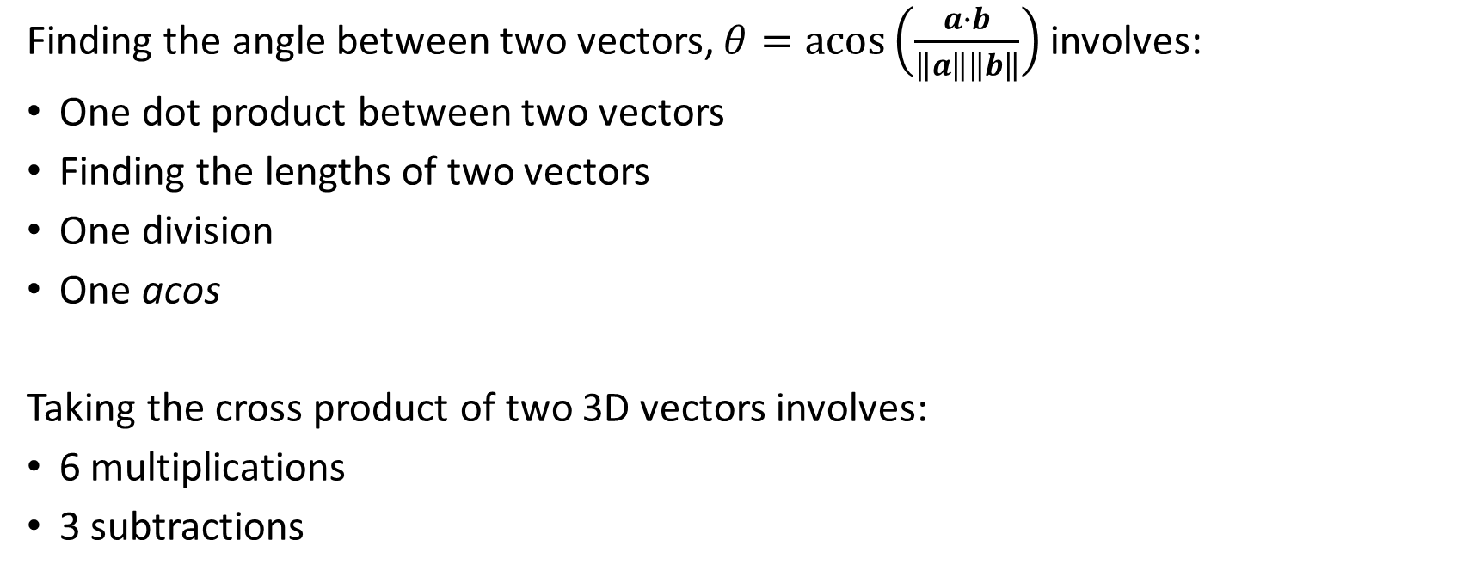
Breaking things down
Finding the angle between two vectors, $θ=acos⁡\left(\frac{a∙b}{\left\|a\right\|\left\|b\right\|}\right)$ involves:
One dot product between two vectors
Finding the lengths of two vectors
One division
One acos
Taking the cross product of two 3D vectors involves:
6 multiplications
3 subtractions
For 3D vectors: 9 multiplications, 1 division, 6 additions, 2 square roots – and an acos…

Slide 10
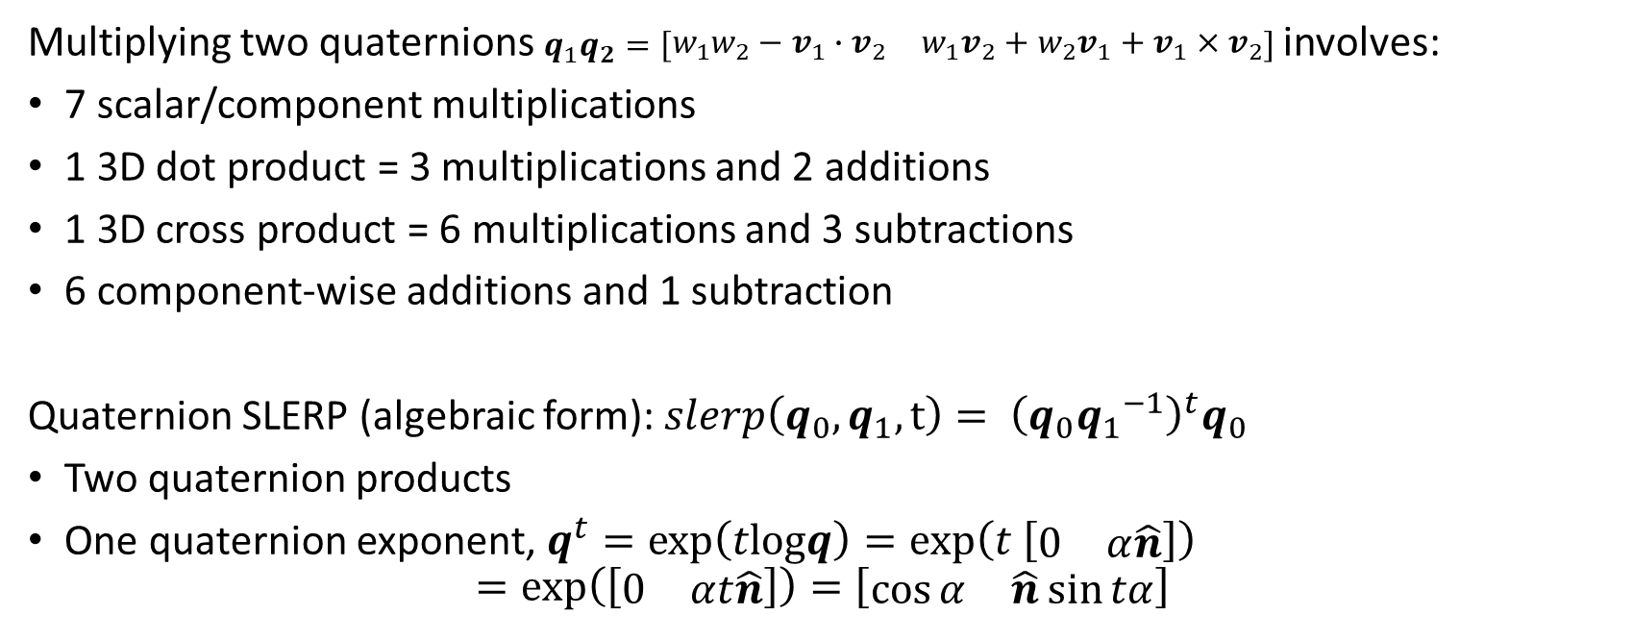
Breaking things down
x2 to apply to vector!
Multiplying two quaternions $q_{1}q_{2}=\left[\begin{matrix}w_{1}w_{2}−v_{1}∙v_{2} & w_{1}v_{2}+w_{2}v_{1}+v_{1}×v_{2}\end{matrix}\right]$involves:
7 scalar/component multiplications
1 3D dot product = 3 multiplications and 2 additions
1 3D cross product = 6 multiplications and 3 subtractions
6 component-wise additions and 1 subtraction
Quaternion SLERP (algebraic form): $slerp\left(q_{0},q_{1},t\right)= {\left(q_{0}{q_{1}}^{−1}\right)}^{t}q_{0}$
Two quaternion products
One quaternion exponent, $q^{t}=exp\left(tlogq\right)=\exp\left(t \left[\begin{matrix}0 & α\hat{n}\end{matrix}\right]\right)$
$$=\exp\left(\left[\begin{matrix}0 & αt\hat{n}\end{matrix}\right]\right)=\left[\begin{matrix}\cos{α} & \hat{n}\sin{tα}\end{matrix}\right]$$
Total:
16 multiplications,
8 additions and
4 subtractions

Slide 11
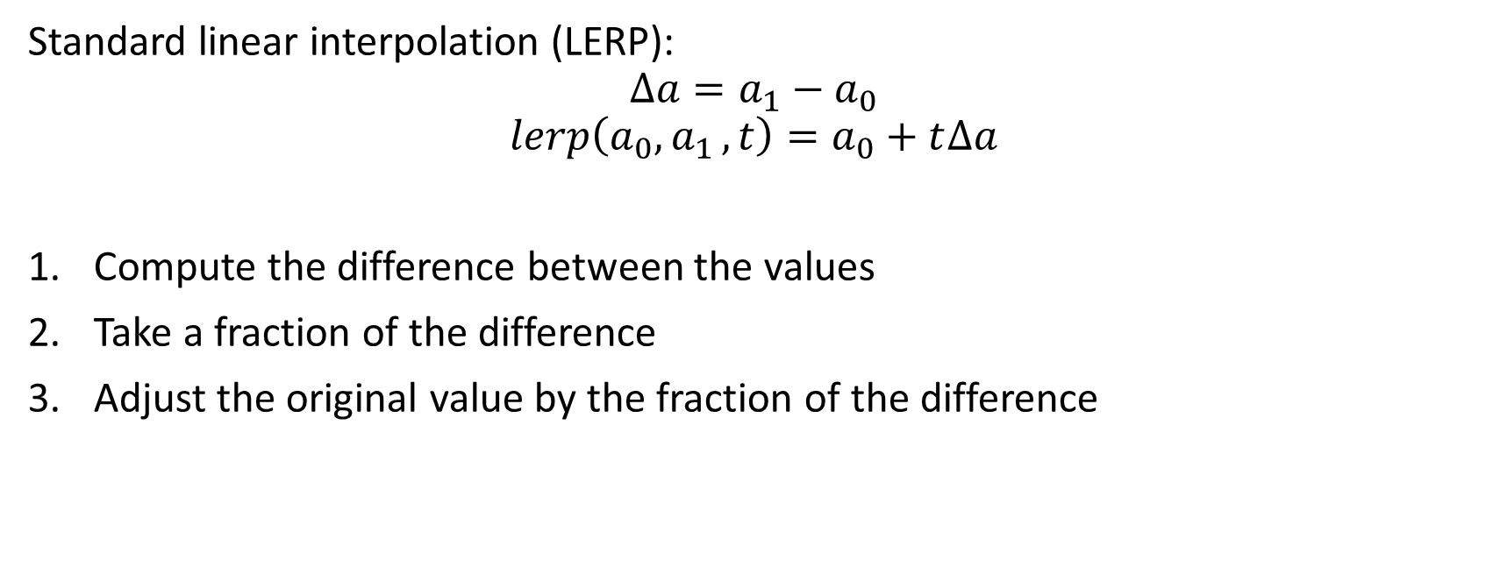
SLERP derivation
Standard linear interpolation (LERP):
$$∆a=a_{1}−a_{0}$$
$$lerp\left(a_{0}{, a}_{1}, t\right)=a_{0}+t∆a$$
Compute the difference between the values
Take a fraction of the difference
Adjust the original value by the fraction of the difference

Slide 12
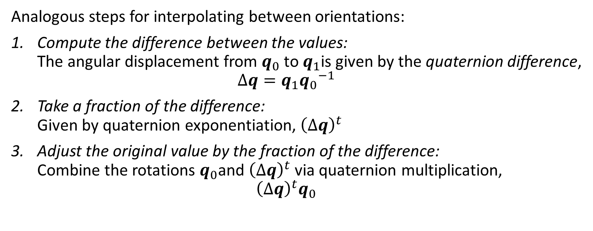
SLERP derivation (cont.)
Analogous steps for interpolating between orientations:
Compute the difference between the values: The angular displacement from $q_{0}$ to $q_{1}$is given by the quaternion difference, $∆q=q_{1}{q_{0}}^{−1}$
Take a fraction of the difference: Given by quaternion exponentiation, ${\left(∆q\right)}^{t}$
Adjust the original value by the fraction of the difference: Combine the rotations $q_{0}$and ${\left(∆q\right)}^{t}$ via quaternion multiplication, ${\left(∆q\right)}^{t}q_{0}$

Slide 13
Complex things take time

Slide 14
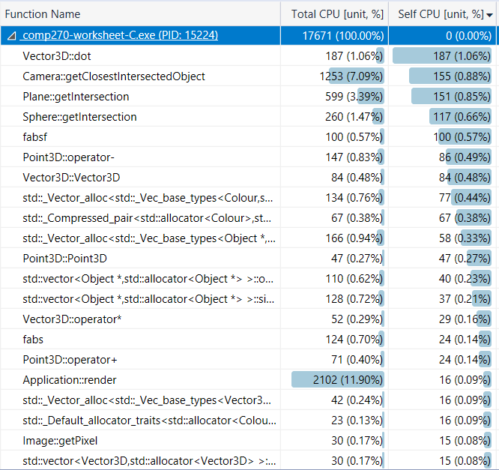
Adding things up

Slide 15
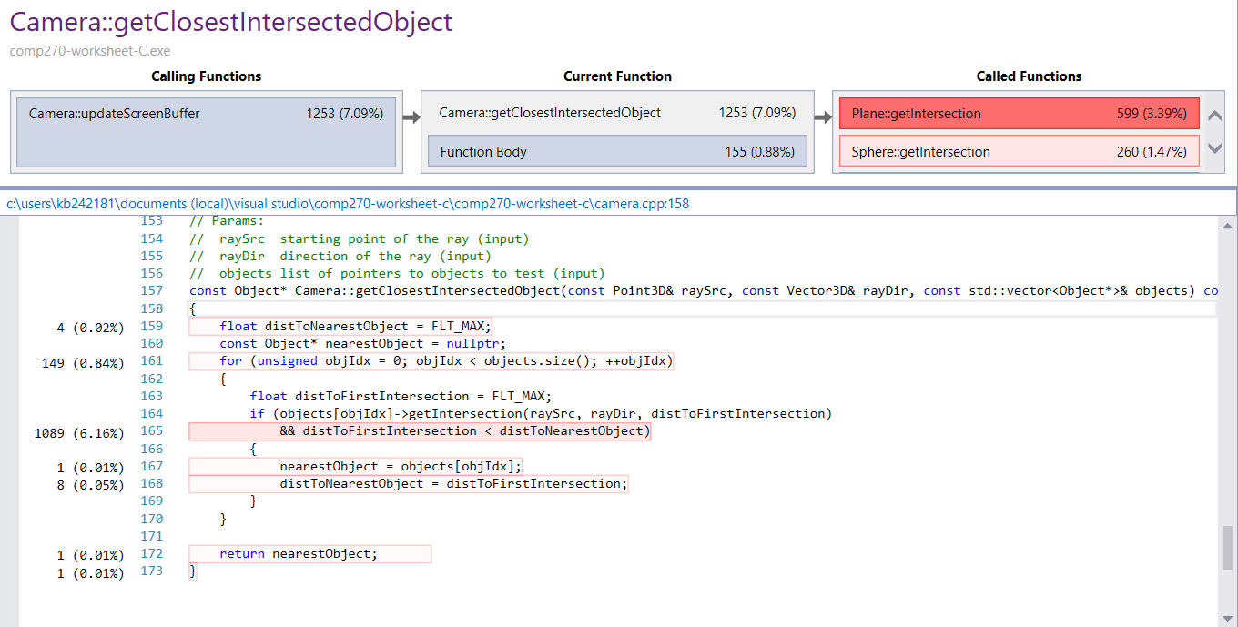

Slide 16
Avoidance strategies

Slide 17


General approach
Don’t assume / be “penny wise but pound foolish”…
Find out which operation is taking the most time
Change how this operation is implemented
Does it still work?
Is it faster?
Are you done?
Yes
Yes
Yes
Regression tests
And has it resolved the original issue?
No
No
No
Pro tip: use version control!
Benchmark
What is “done”?
Ideally:
Each operation is implemented as efficiently as possible
Only essential operations are carried out
Realistically:
The code runs fast enough to support the desired frame rate
(You’ve run out of time/ideas for how to improve the efficiency…)

Slide 18
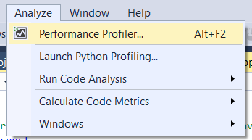
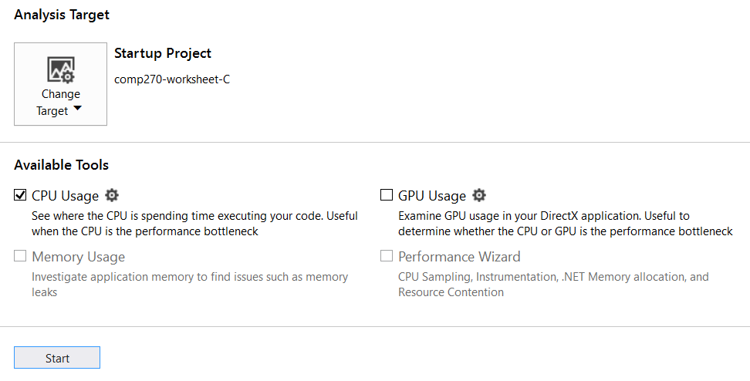
Step 1: Finding the time
Use built-in profilers, e.g. Visual Studio:
https://docs.microsoft.com/en-us/visualstudio/profiling/
Alternatively, profiling packages are available, e.g. Shiny:
https://sourceforge.net/projects/shinyprofiler/
Use quantitative data:
Frame rate/time
Memory use
Loading time
Counter for the number of times a function is called
Create a reusable test case
Keep records of previous results to refer back to!

Slide 19
Benchmark
A point of reference for the game, which serves as a standard for comparison
A good benchmark should be:
Consistent between runs
Quick to carry out
Representative of an actual game situation
Responsive to changes

Slide 20
Step 2: Reducing the cost
Do less:
Get rid of pointless code (especially in older projects)
Precompute/cache results
e.g. m_pixelRays in Worksheet C
Early exits with inexpensive tests
e.g. using the dot product to rule out invisible/non-intersecting objects; performing tests on simpler “bounding shapes/volumes” first
Avoid creating new objects
… but make sure you delete the old ones!
Increases storage cost; requires memory look-ups
May increase storage cost/memory look-ups

Slide 21
Step 2: Reducing the cost
2. Do it more efficiently:
Pre-process data and/or use a more appropriate data structure
e.g. sorting/using a set rather than a vector
Spatial data structures: octree, kd-tree, bounding volume hierarchy (BVH)
Try a different algorithm/reformulate the computation
To reduce the number of calculations
e.g. SLERP, ray-sphere intersection test
To increase memory coherence/minimise load times

Slide 22
Choosing an appropriate data structure
Memory model | Examples | Use when | Look-up/search time | Insertion time
Sequential | Array, vector | Data is static: few insertions/deletions | O(1) for known look-up O(n) for searching | O(n)
Linked | List, linked list, DAG | Data is dynamic: many insertions/deletions | O(n) | O(1) (unless sorted)
Associative | Dictionary, map, binary search tree | Data is not indexed by integer (and ideally static) | O(1) to O(logn) | O(1) to O(logn)
More here: https://www.bigocheatsheet.com/

Slide 23
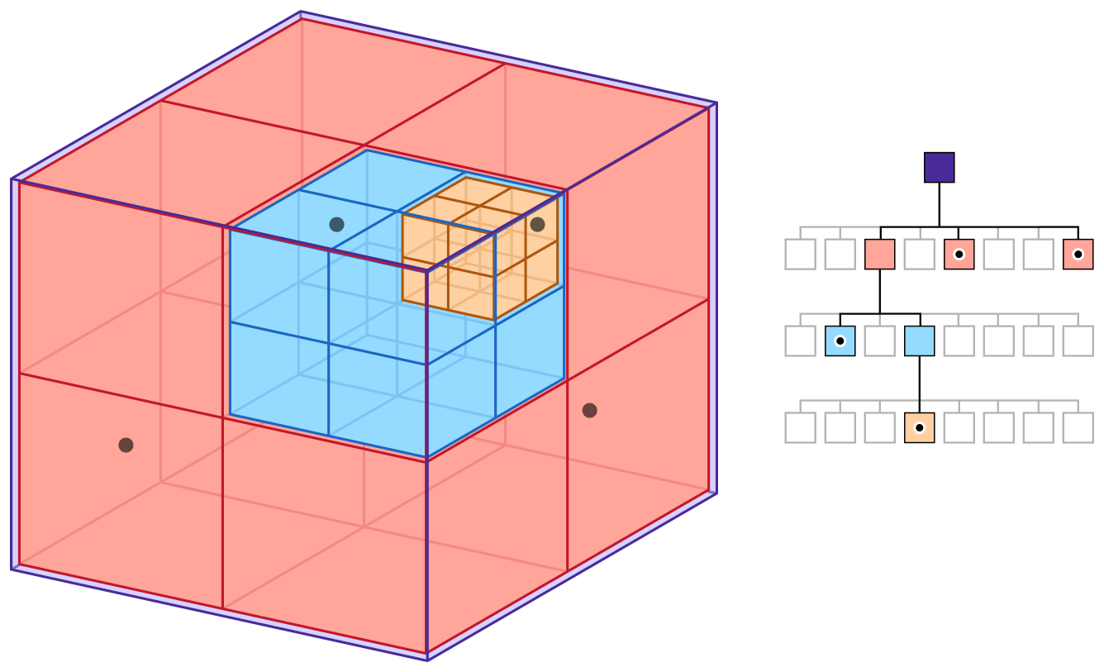
Some spatial data structures
Octree: a tree data structure in which each internal node has exactly eight children.
Recursively subdivide 3D space into octants (2D space equivalent: quadtree)
Store objects in the “cell” corresponding to their position in space (leaf nodes are points)
https://www.gamedev.net/articles/programming/general-and-gameplay-programming/introduction-to-octrees-r3529/

Slide 24
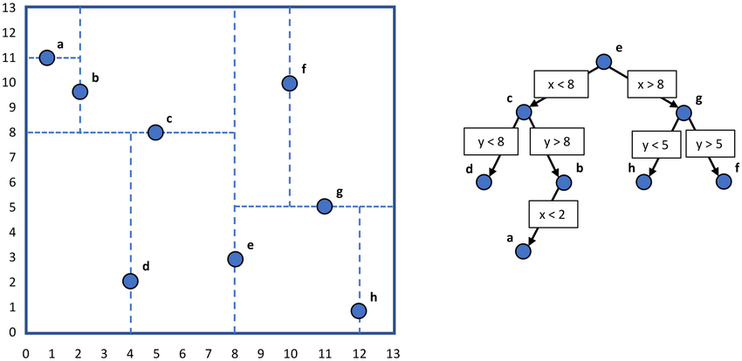
Some spatial data structures
K-d tree: a binary space-partitioning data structure for organising points in a k-dimensional space.
Every leaf node is a k-dimensional point
Every non-leaf node represents a division of space into half-spaces by a hyperplane
Points to the left of the hyperplane are stored in the left subtree, etc.
https://www.geeksforgeeks.org/k-dimensional-tree/

Slide 25
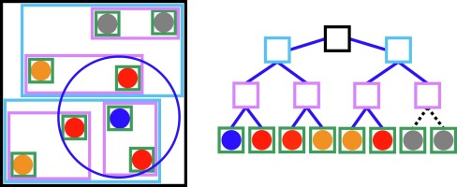
Some spatial data structures
Bounding volume hierarchy (BVH): a tree structure containing a set of geometric objects, which are enclosed in bounding volumes that are the leaf nodes.
Partitions the objects instead of space
Used to accelerate collision detection, ray intersection etc.
Groups of nearby bounding volumes are enclosed in larger bounding volumes
A single complex object may have several bounding volumes for separate components
Some cost to maintaining/updating as objects move around!
http://www.pbr-book.org/3ed-2018/Primitives_and_Intersection_Acceleration/Bounding_Volume_Hierarchies.html

Slide 26
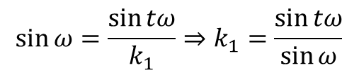
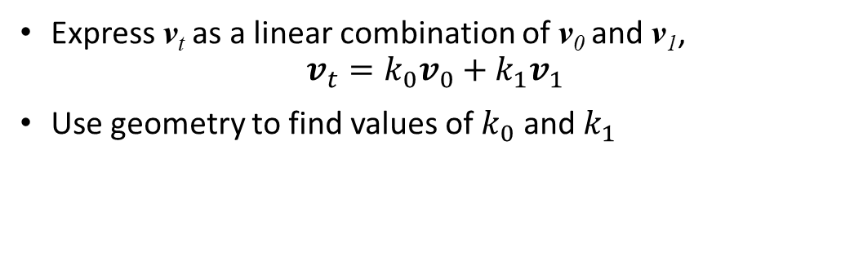
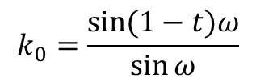
Reformulation example: SLERP
Interpret quaternions as existing in a 4D Euclidean space:
Since all rotation quaternions are unit length, they “live” on the surface of a 4D hypersphere
Interpolate around the arc along the surface of the hypersphere, which connects the quaternions:
v₁
Express v_{t} as a linear combination of v₀ and v₁, $v_{t}=k_{0}v_{0}+k_{1}v_{1}$
Use geometry to find values of $k_{0}$ and $k_{1}$
Arc length: s = rθ
_{sin(1-t)ω}
v_{t}
_{ω}
_{(1-t)ω}
_{sinω}
_{sintω}
$$\sin{ω}=\frac{\sin{tω}}{k_{1}}⇒k_{1}=\frac{\sin{tω}}{\sin{ω}}$$
$$k_{0}=\frac{\sin{(1−t)ω}}{\sin{ω}}$$
_{tω}
_{ω}
k₁v₁
k₀v₀
v₀

Slide 27
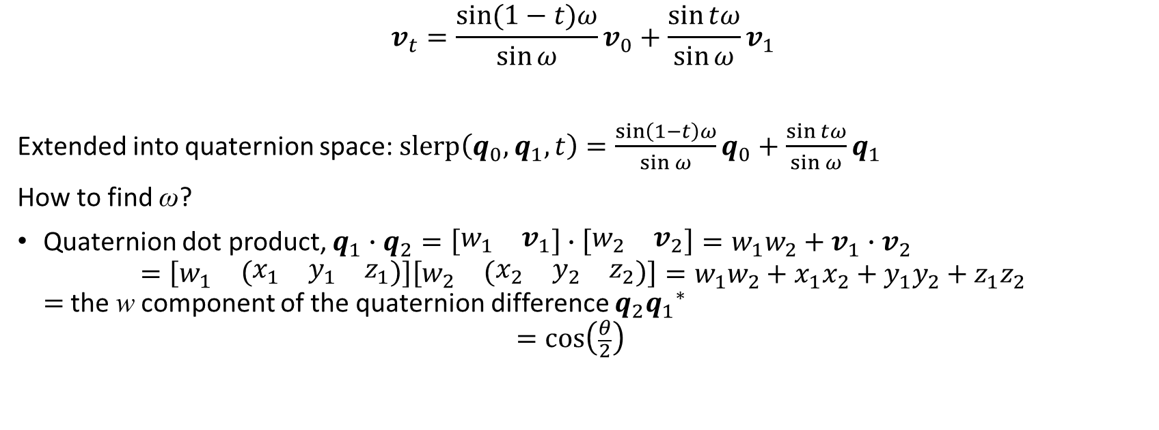
Reformulation example: SLERP (cont.)
$$v_{t}=\frac{\sin{(1−t)ω}}{\sin{ω}}v_{0}+\frac{\sin{tω}}{\sin{ω}}v_{1}$$
Extended into quaternion space: $slerp\left(q_{0},q_{1},t\right)=\frac{\sin\left(1−t\right)ω}{\sin{ω}}q_{0}+\frac{\sin{tω}}{\sin{ω}}q_{1}$
How to find ω?
Quaternion dot product, $q_{1}∙q_{2}=\left[\begin{matrix}w_{1} & v_{1}\end{matrix}\right]∙\left[\begin{matrix}w_{2} & v_{2}\end{matrix}\right]=w_{1}w_{2}+v_{1}∙v_{2}$ $=\left[\begin{matrix}w_{1} & \left(\begin{matrix}x_{1} & y_{1} & z_{1}\end{matrix}\right)\end{matrix}\right]\left[\begin{matrix}w_{2} & \left(\begin{matrix}x_{2} & y_{2} & z_{2}\end{matrix}\right)\end{matrix}\right]=w_{1}w_{2}+x_{1}x_{2}+y_{1}y_{2}+z_{1}z_{2}$ $=$the w component of the quaternion difference $q_{2}{q_{1}}^{∗}$ $=\cos\left(\frac{θ}{2}\right)$

Slide 28
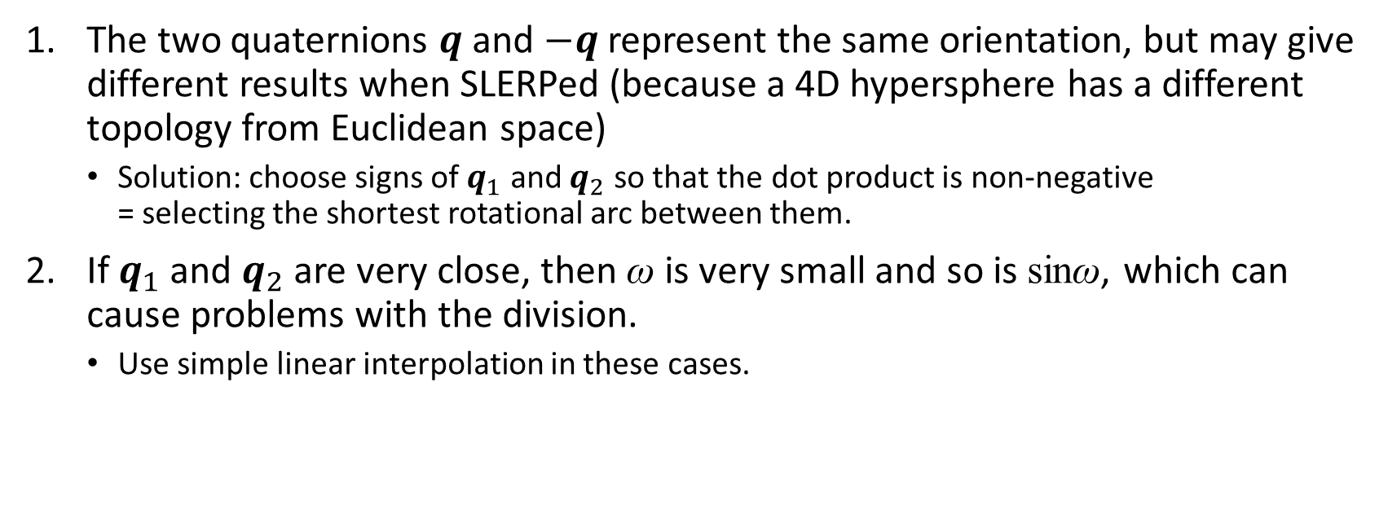
SLERPing problems
The two quaternions $q$ and $−q$represent the same orientation, but may give different results when SLERPed (because a 4D hypersphere has a different topology from Euclidean space)
Solution: choose signs of $q_{1}$ and $q_{2}$ so that the dot product is non-negative = selecting the shortest rotational arc between them.
If $q_{1}$ and $q_{2}$ are very close, then ω is very small and so is sinω, which can cause problems with the division.
Use simple linear interpolation in these cases.

Slide 29
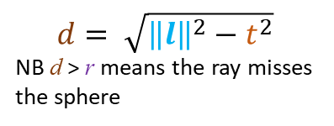
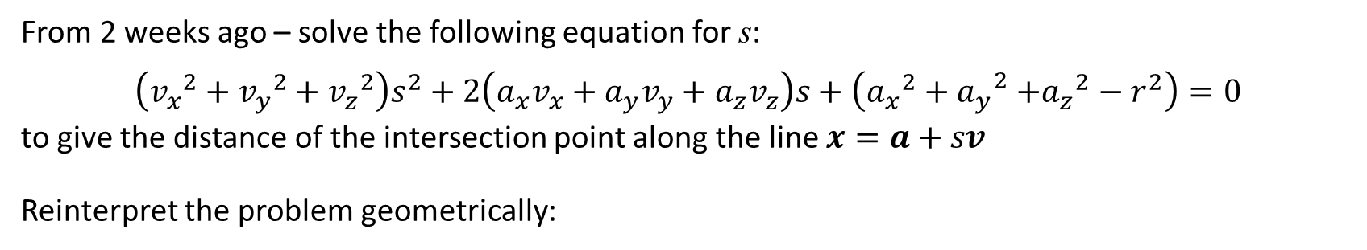

Reformulation example: ray-sphere intersection
From 2 weeks ago – solve the following equation for s: $$\left({v_{x}}^{2}+{v_{y}}^{2}+{v_{z}}^{2}\right)s^{2}+2\left(a_{x}v_{x}+a_{y}v_{y}+a_{z}v_{z}\right)s+\left({a_{x}}^{2}{+ a_{y}}^{2}+{a_{z}}^{2}−r^{2}\right)=0$$
to give the distance of the intersection point along the line $x=a+sv$
Reinterpret the problem geometrically:
v
t_{c}
p₁
s₀= t - t_{c}
s₁= t + t_{c}
$$d= \sqrt{{\left\|l\right\|}^{2}−t^{2}}$$
NB d > r means the ray misses the sphere
t_{c}
t
d
r
p₀
r
l = c - a
t = l∙v (projection)
NB t < 0 means the intersection is “behind” a
$$t_{c}= \sqrt{r^{2}−d^{2}}$$
c
l
s₀
s₁
a

Slide 30
Memory optimisation
Problems with speed may be due to poor memory management
Different techniques for increasing efficiency, based on memory structure:

Slide 31
Registers and cache
Registers:
The only memory directly on the CPU
“Scratch pad” for current calculations
Slow to transfer data from RAM (typically 26 cycles + 57ns)
Cache:
Intermediate between CPU and all off-board memory
Usually different levels, with different capabilities depending on the CPU
e.g. Intel i-7 4770 (Haswell) has:
L1 data cache: 32KB with 4 cycles for simple access
L1 instruction cache: 32Kb
L2 cache: 256KB with 12 cycles
L3 cache: 8MB with 26 cycles

Slide 32
Improving memory management
Reduce footprint
Use smaller data types, e.g. bit flags to replace several booleans
Can fit more in the cache at once!
Use memory-aligned data
Read faster by the CPU
An n-byte piece of data is memory aligned if its starting address is evenly divisible by n
e.g. a 32-bit int is aligned if its starting address is 0x04000000, but not 0x04000002
Order members of class/struct from largest to smallest
Structure code so as to reduce memory traversal
Increase cache hits/avoid misses

Slide 33
Compiler and linker rules
Assumptions you can safely make to avoid cache misses:
The machine code for a single function is contiguous in memory
Functions are laid out in memory in the order they appear in the cpp file
Functions in the cpp file are always contiguous
So:
Keep high performance code as small as possible
Avoid calling functions from a performance critical section of code
If you do have to call a function, place it as close as possible (never in another translation unit/source file)
Use inline functions – judiciously!
Overuse can lead to code bloat and increase cache misses

Slide 34
Tips and tricks
Make use of version control – commit each time you get it working!
Do most of your profiling in release build
though debug can be helpful to start with
Before starting to optimise, make sure that your code:
Works fully – later changes/features may invalidate your efforts!
Is as clean as possible:
No unused variables, functions etc.
Every operation has a purpose
No memory leaks, crashes etc.
No “smells”: https://en.wikipedia.org/wiki/Code_smell
Focus on one section/problem at a time, creating a specific and consistent test case
Possibly hard-coding/limiting other aspects to narrow scope/exaggerate the situation
Make sure to revert any code changes afterwards!
Premature optimisation

Slide 35
Worksheet C: submit by Monday 25th if you’d like feedback!

