Slide 1
Research PRACTICE
COMP320
Introduction to Data Analysis and Inference with Statistical Tests

Slide 2
Objectives for Today
After this session, you should be able to:
Explain the link between making inferences from research data and statistical analysis
Recall key descriptive statistics such as measures of central tendencies and dispersion
Explain the foundations of null-hypothesis significance testing

Slide 3
Objectives for Today
After this session, you should be able to:
Outline the importance of validity and reliability in data analysis
Suggest the most appropriate statistical test to apply to given data

Slide 4
Further Learning
By the end of this module, you should be able to:
Analyze data using R
Interpret and explain inferences that can be made from the output of statistical tests conducted in R
Utilize computational statistics in your research

Slide 5
Objectives for Today
1. Using Statistical Tests to Support Inference
Foundations of Quantitative Data Analysis for Inference
Discrete and Continuous Data
2. Research Quality
Validity and Reliability
False Discovery and Replicability
3. Common Statistical Tests
Measures of Relation versus Measures of Difference
Correlations, Chi-Square, and Regression
F-tests, t-tests and ANOVA
Interpreting p-values from correlations

Slide 6
Using Statistical Tests to Support Inference
Making Claims Beyond Your Observations

Slide 7
Statistical Inference
Why analyse quantitative data?
Aim to generalise the findings from researcher’s observations to a broader population
Known as ‘inference’
Derive a logical conclusion from premises known to be true
Applying statistical analyses to data from a survey or experiment
Ecological fallacy
Inferences about specific individuals cannot be made based solely on statistics collected for the group to which those individuals belong

Slide 8
Statistical Inference
Statistical inference is concerned primarily with understanding the quality of parameter estimates. For example, a classic inferential question is ‘How sure are we that the estimated mean is near the true population mean?’. While the equations and details change depending on the research context, the foundations for inference are the same.
(Diez, Barr & Cetinkaya-Rudel, 2015, p. 168)

Slide 9
Quantitative Data Analysis
Population A set of items that share a characteristic; a total set from which observations may be drawn.
Some populations are very large
Possible combinations of a deck of cards:
~50 quintillion
People:
~7 billion
“British” 65.6 million
Falmouth Students 5,446
Too many to conduct a census to involve everyone in the research!

Slide 10
Quantitative Data Analysis
Sample
A set of observations of items collected and/or selected from a population by a defined procedure.
Researchers collect data from a sample of items belonging to a broader population they are interested in
Ideally, randomly
Consider “representativeness”

Slide 11
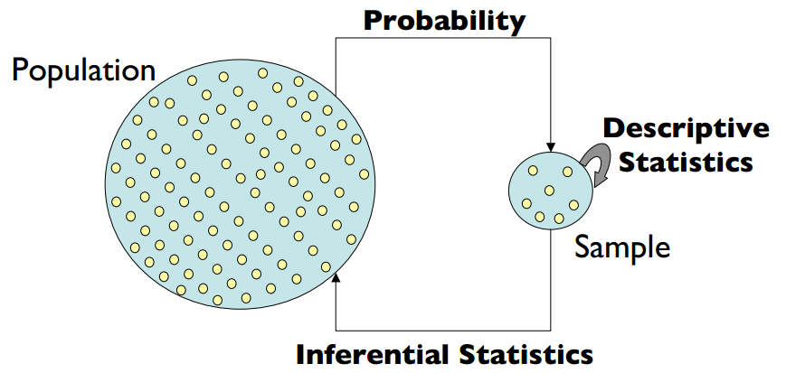

Slide 12
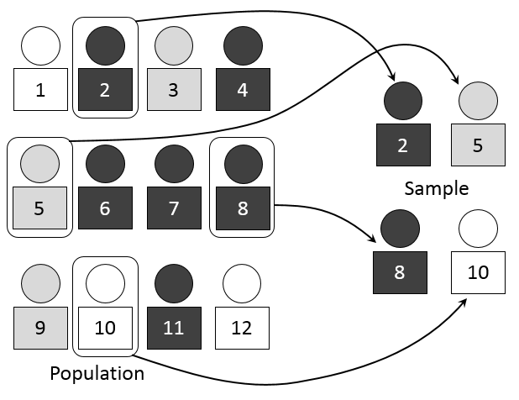

Slide 13
Sampling Methods
Probability
Random
Stratified Random
Systematic
Non-Probability
Convenience
Quota
Purposive
Snowball

Slide 14
Exploratory Data Analysis
Before making inferences from data it is essential to examine all your variables.
Why listen to the data?
Catch mistakes
See patterns in the data
Find violations of assumptions
Generate new hypotheses
…and because if you don’t, you will have trouble later

Slide 15
Discrete vs Continuous Data
A set of data is said to be continuous if the values belonging to the set can take on any value within a finite or infinite interval.
Analysts typically measure values using instruments, and arrive at interval or ratio values.
Examples: successful hits (interval); velocity (ratio).
A set of data is said to be discrete if the values belonging to the set are distinct and separate.
Analysts typically count the occurrences of nominal or ordinal values in datasets for analysis.
Examples: ethnicity (nominal); age-bracket (ordinal).

Slide 16
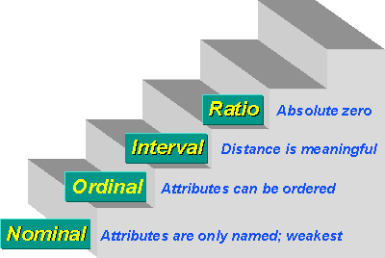
Levels of Measurement

Slide 17
Analysing Discrete Data
Discrete variables are those which have a defined set of distinct values; often, these are categories:
Gender, nationality, marital status, grade, education level
Level of measurement?
Nominal
Ordinal
It is usually valuable to know how many cases belong to each group as defined by your categorical variables
How many cases are there in each category group?
Most statistical tests require
roughly equal numbers of cases in each group
at least 4 cases to estimate t (but more = better) in all groups
Strive for low standard error
...in order to produce dependable results

Slide 18
Analysing Discrete Data
Example: “Are there national differences in the ease of learning particular game genres?”
What was the relative proportion of British and non-British observations in your sample?
Demographic information is normally reported in the method section of your report
Is the sample suitably representative of the population of interest?
Is there enough data in each group to make a meaningful comparison?
You may need to collect more data
If the sample does not reflect the demographic structure of the target population
If the populations under study radically unbalanced or particular cells in factorial analyses are too small

Slide 19
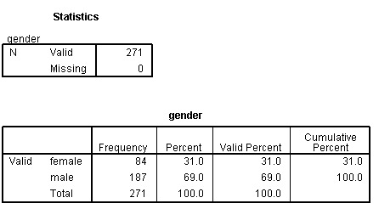
Analysing Discrete Data
In R to obtain descriptive statistics for categorical variables, select:
Sapply()
Summary()
Describe()
Comparing the groups may be problematic in this case. Why?

Slide 20
Analysing Discrete Data
Frequency tables may also be sufficient to fully answer simple questions
e.g. Running a count on responses to a question:
“Which is your favourite game genre?”
Could also provide a rank order of popularity
But no test of statistical ‘significance’
For example: in a sample of 200, 99 male respondents and 101 female respondents said that they play Overwatch.
So, can we conclude that there are more female players than male players on Overwatch?

Slide 21
Analysing Discrete Data
Frequency tables may also be sufficient to fully answer simple questions
e.g. Running a count on responses to a question:
“Which is your favourite game genre?”
Could also provide a rank order of popularity
But no test of statistical ‘significance’
For example: in a sample of 200, 99 male respondents and 101 female respondents said that they play Overwatch.
So, can we conclude that there are more female players than male players on Overwatch? No!

Slide 22
Analysing Continuous Data
Continuous variables are scale level measures
e.g. Age, weight, height, time, test scores, number of customers.
Level of measurement?
Interval
Ratio
Makes little sense to look at frequency tables, though bucketing and histograms can provide insight into likely distribution of values
More interested in summary statistics such as:
Measures of central tendency
Measures of variability (i.e., dispersion)
Measures of normality

Slide 23
Analysing Continuous Data – Central Tendency
The central tendency is the value which all the data tends towards:
Mean
Sum of all values divided by the number of values (N or n)
Most statistical difference tests are based on this
Median
Arrange values in order and pick the middle value (if N is odd) or average the two middle numbers (if N is even)
More useful for ordinal and non-normal data
Unaffected by extreme scores
Mode
Most frequent value in the data set
Not at all interesting for continuous data
More useful for categorical data (nominal and ordinal)

Slide 24
Analysing Continuous Data – Central Tendency
The following numbers represent the seconds (in minutes) that players spent on a loading screen for a new level are: 4, 5, 1, 3, 24, 5
Mean? Median? Mode?
The mean time is: (4+5+1+3+24+5)/6 = 42/6 = 7 seconds
The median is: 4, 5, 1, 3, 22 →1, 3, 4, 5, 5, 22 → 4.5 seconds
The mode is: 5 minutes
What is the median for: 4, 5, 1, 3, 22? → 4
What is the mode for: 4, 5, 1, 3, 22? → No mode
What is the mode for: 4, 5, 1, 3, 22, 5, 1? → 1 and 5 (Two modes)
Notes:
24

Slide 25
Analysing Continuous Data – Variability
Reporting the central tendency is not enough to describe your data
We also need to know how much the data values vary (i.e. how spread out they are).
Example: two groups, each with 10 people, self-report the number of hours they play online daily.
Group 1 data: 4+4+4+4+4+6+6+6+6+6
Group 2 data: 0+0+0+0+0+10+10+10+10+10
The mean of both datasets is 5 hours.
So the data is similar...? Not really!

Slide 26
Analysing Continuous Data – Variability
Standard deviation (SD)
Average difference of values from the sample mean
Larger standard deviation indicates greater differences between the scores
In the previous slide (Group 1 SD = 1 vs. Group 2 SD = 5)
In a normal distribution ~68% of values lie within 1 SD of the mean
Key statistic in difference tests

Slide 27
Analysing Continuous Data – Variability
Range
Difference between lowest score and highest score
Simple way of identifying outliers (extreme values), but doesn’t say anything about the variability within the dataset.
Often used to define sample ages in the “Method” section of a report

Slide 28
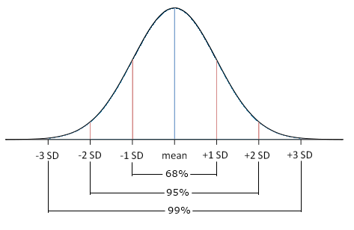
Analysing Continuous Data – Normality
Height, weight, IQ and other physical measures follow a normal (bell shaped curve) distribution of values
For a large enough population sample, many observations will result in a normal distribution
Many statistical tests assume that data within a variable is distributed normally
SD can be used to determine the proportion of values that lie within a particular range.

Slide 29
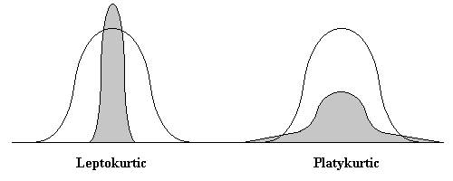
Analysing Continuous Data – Normality
Kurtosis
The ‘peakedness’ of the distribution
Zero kurtosis score means normal
Negative kurtosis → distribution is flat; more extreme cases than expected
Positive kurtosis → ‘pointy’ distribution; values tend to cluster around centre
Excessive kurtosis are normally only a problem for small samples (N < 200)

Slide 30
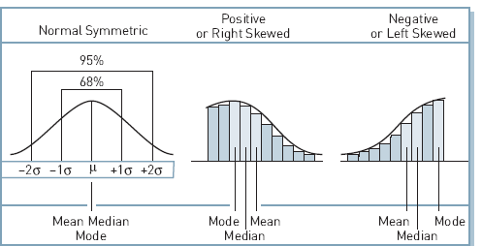
Analysing Continuous Data – Normality
Skewness
The symmetry of the distribution
Positive skew → more low values than expected
Negative skew → more high values than expected
Example: Student scores in a too hard/too easy exam
30
Notes:
30

Slide 31
Statistics & Quality
Garbage In, Garbage Out

Slide 32

Garbage In, Garbage Out

Slide 33
Research Quality
All research is subject to limitations
However, not all research is equal
Unique resources or contexts available
“Natural” experimental conditions
Funding
The quality of a research finding is often called its rigour and relates to how inherent limitations have been overcome by the researcher

Slide 34
Research Quality
There are three main components to research quality:
Validity
Measurement Validity (e.g. Construct Validity)
Internal Validity
External Validity
Reliability
Replicability

Slide 35
Validity
Construct validity means selecting the most appropriate measurement tool for the concepts being studied. Does your tool really measure what you want to assess?

Slide 36
Validity
Internal validity is another term for using different methodological tools to ‘triangulate’ the data. What other methods can you use to check for the same phenomenon? Are there flaws in the design of the study that allow for alternative explanations?

Slide 37
Validity
External validity refers to how well the data can be applied beyond the circumstances of the case to more general situations.
Can you apply your data across the industry and to others?

Slide 38
Reliability
Reliability means the extent to which the data collection can be repeated in ways that yield the same data. That is, the extent to which the data itself is accurate.
Are you confident that your study can be repeated by others and the results will be the same?

Slide 39
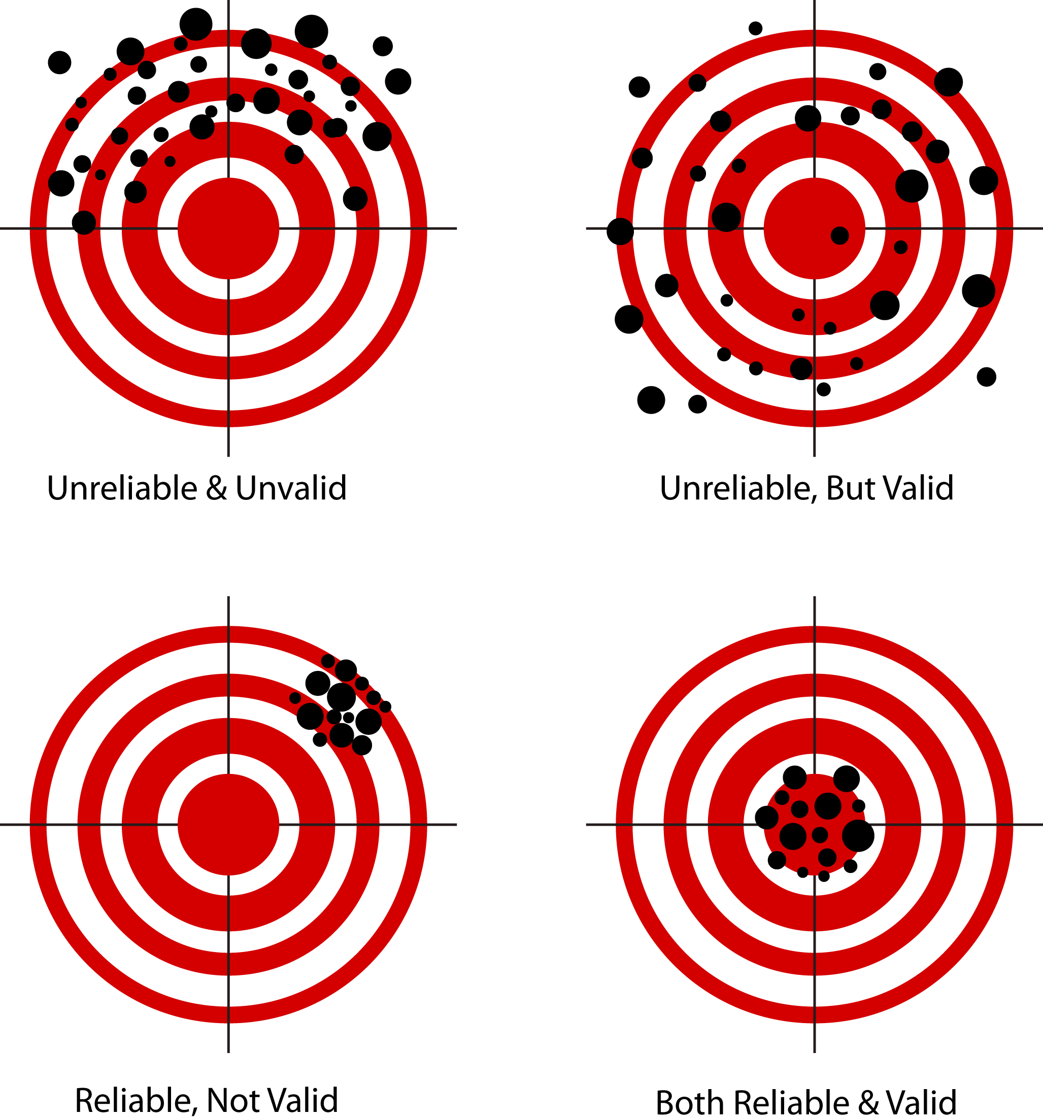

Slide 40
False Discovery & Replicability
Replicability means the extent to which the results can be reproduced by another researcher working in a similar context. That is, the extent to which the results are accurate and stable.
Is there sufficient description to recreate the conditions of the study? Is there a possibility of a Type-I or Type-II error?

Slide 41
False Discovery & Replicability
When we make claims as researchers, we are often subject to error and so replication is important:
 |  | Reality
 |  | True | False
Decision | Accept Claim | Good Decision | Type-1 Error (“False Positive”)
 | Reject Claim | Type-2 Error (“False Negative”) | Good Decision

Slide 42
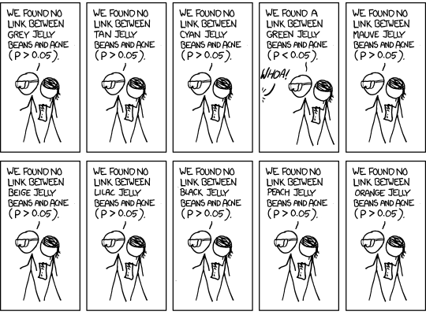
False Discovery & Replicability

Slide 43
False Discovery & Replicability
An alternative to replication is to use a larger dataset and to assess multiple hypotheses with reasonable adjustment. For example:
Benjamini Hochberg Used in multiple hypothesis testing on the same dataset
Bonferroni Used for multiple group comparisons using the same dataset

Slide 44
Common Statistical Tests
Use in your Dissertations

Slide 45
Research Questions
Researchers often want to know if there is a significant relationship between two variables
How strong is the relationship between login queue waiting time and player satisfaction?
Does an increase in in-game prompts correspond to an increased number of in-game micro transactions?
Is there a relationship between employees’ levels of stress and talent retention?
Does age predict play-style?

Slide 46
Research Questions
Or if there is a difference between one or more scores/conditions/groups
Is game-0 selling more copies than game-1 in the UK?
Does working in pairs improve programming performance?
Has allowing programmers to work from home decrease game development productivity?
Has the new character caused a significant disruption to game balance in terms of win/loss ratio?
Is there a difference in the way male and female players interact with costume-orientated micro transactions in an MMORPG?

Slide 47
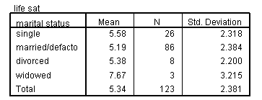
Statistical tests: Why we need them?
Does marital status affect play?
‘In a scale from 1 to 8, how often do you play games?’
Great! I found a difference!!
How confident are you? Is it an accident (due to chance)?
We need to have a statistical test to make the inference!

Slide 48
Choosing the right test
If you browse any introductory statistics text book you’ll find a bewildering array of different statistical tests
Each has:
a specific purpose (i.e. exploring relationships, comparing groups)
Assumptions and data requirements (categorical, ordinal or continuous data, normal distribution)
Most of the well known tests are very easy to run in R
However, it is critically important to be able to
Select the most appropriate test given your research question
Understand conceptually what the test is computing
Effectively interpret the output

Slide 49
Step 1: What is your question?
Remember, when conducting research it is important to be clear about the questions you are trying to answer…ideally before you begin data collection
The questions...
Does an increase in in-game prompts correspond to an increased number of in-game micro transactions?
Is there a relationship between employees’ levels of stress and talent retention?
...require quite different statistical tests to questions like:
Is game-0 selling more copies than game-1 in the UK?
Has allowing programmers to work from home decrease game development productivity?

Slide 50
Relationships vs. Difference
Analysing relationships:
Correlation – are continuous variables, X and Y, related?
Pearson’s rho for normally-distributed ratio data
Spearman’s rank correlation for non-normal or interval data
Chi-square – is there an association between two categorical variables.
Useful for inferring differences between groups on discrete measures
Also used for ‘goodness of fit’ tests when comparing matricies
Regression – does the ‘level’ of X predict the ‘level’ of Y?
OLS regression for continuous data with normally distributed residuals
Logistic regression used for discrete data, based on probability of belonging
Flexible, can re-code some nominal/ordinal data as binary values

Slide 51
Relationships vs. Difference
Analysing differences:
T-tests - differences between two groups (e.g. experienced, inexperienced) according to some continuous variable (e.g. score)
Mann-Whitney U Test – based on ranks, lower power but more robust and can compare two groups with non-normal data.
Analysis of Variance (ANOVA) measure differences when there are more than two groups.
Kruskal-Wallis H Test – like Mann-Whitney U, but for multiple groups.
Analysis of Co-variance (ANCOVA) measure differences when there are more than two groups and/or continuous predictors.
Essentially, combines ANOVA with regression.
MANOVA/MANCOVA – multivariate versions for more than one dependent variable.

Slide 52
Step 2: Select your data
Which variables will you be using?
Which is the independent variable (IV)?
The variable that is believed to affect the dependent variable
What you control/manipulate
Which is the dependent variable (DV)?
The observation that is believed to be affected by the IV
What you measure (aka outcome variable)
Identify the IV and DV in the following questions:
Does gender affect product ratings?
Does revision time affect test scores?
Does the website background colour influence reading speed?
Which type of interface results in higher user satisfaction?

Slide 53
Step 2: Select your data
What is the level of measurement for each variable?
Categorical or continuous?
Examples of categorical variables?
Examples of continuous variables?

Slide 54
Step 3: Describe your data
Descriptive statistics should be used to define the characteristics of your data (last lecture)
For categorical variables you need to know if numbers in each group/category are balanced
(e.g. Reliable comparison of gender effect not possible if 25 males and only 3 females)
For continuous variables you need to know if the distribution is normally distributed (e.g. Not skewed)

Slide 55
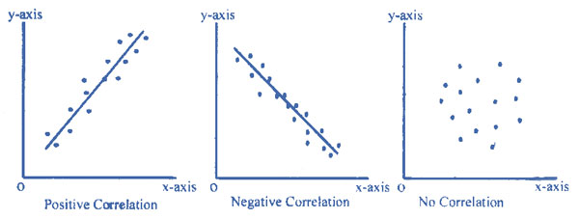
Correlation
Extent to which two continuous variables co-vary (change together)
Ice-cream sales relate to temperature
Waiting time relates to customer satisfaction
Correlations have
Direction
Positive (as the one increases the other variable increases as well)
Negative (as the one increases the other one decreases)
Magnitude – how closely related?

Slide 56
Pearson’s correlation
Provides a numerical measure of the magnitude/direction of the correlation known as r
any value between -1 to +1
-1 (negative), 1 (positive), Close to 0 (no/low)
Pearson r, is a parametric test so assumes both variables
Are continuous
Have an approximately normal distribution

Slide 57
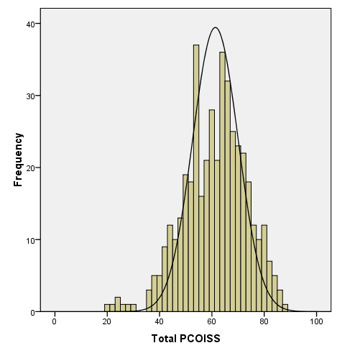
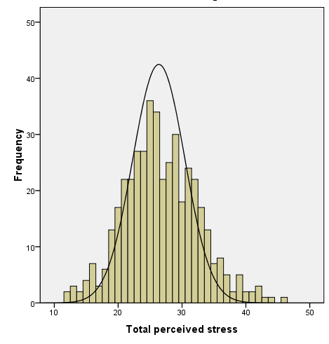
Example: control and stress
Using Survey data
Survey.sav is on the portal
Do people with high levels of perceived control (IV) experience lower levels of perceived stress (DV)?
IV = “tpcoiss” (perceived control)
DV = “tpstress” (levels of stress)
Are the data for both normally distributed?

Slide 58
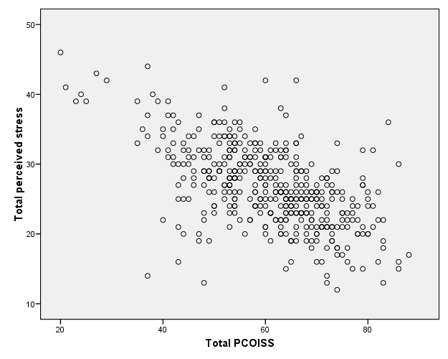
Example
Looking at the scatter-plot
Positive or negative?
Strong or weak?
https://campus.datacamp.com/courses/data-visualization-in-r/a-quick-introduction-to-base-r-graphics?ex=3#skiponboarding

Slide 59
Statistical Tests
Enable us to assign a confidence value to an observed relationship or difference between groups or treatment conditions
This is what statisticians call significance level (or sometimes alpha α)
Significance is the probability (p) that observations as extreme or more extreme were made under the assumption that the null hypothesis is true
A lower significance value implies a lower probability that the result is within expected variance assuming the null hypothesis is true

Slide 60
Statistical tests
Significance depends on various factors:
Size of difference / degree of relationship
Degree of variability or dispersion within the sample(s)
Size of the sample
Conventionally p = 0.05 is used as the threshold of significance
Means 1 in 20 chance that observed difference/relationship is not real
Lower values → better (e.g. p = 0.01, p = 0.001)
Threshold should be lowered if you are computing many tests on the same data because chance of false positive increases

Slide 61
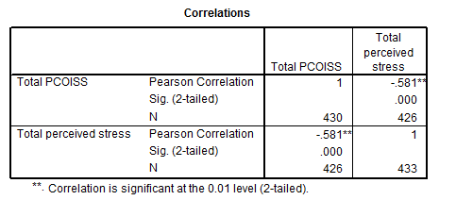
Computing Pearson r
Effect Size – some value between -1 and +1
Significance (p) value - are we looking for higher or lower values?
N – number of valid cases

Slide 62
Interpreting output - I
The magnitude of the coefficient is the measure of the strength of relationship
Small r = 0.10 to 0.29
Medium r = 0.30 to 0.49
Large r = 0.50 to 1.0
It’s polarity indicates direction
Positive sign means X and Y vary in the same direction
Negative sign means X and Y vary in opposite directions
r=0.5 is just as strong as r=-0.5; just different direction

Slide 63
Interpreting output - II
Significance
Remember a p-value of 0.05 or lower is normally deemed significant
This only refers to the reliability of the result, not the strength of the relationship (the coefficient tells us that)
Even quite small r can be highly significant when N is large

