Slide 1
Research PRACTICE
COMP320
Ethics, Testing, Statistical Data Analysis III

Slide 2
Deadlines are coming
Peer review of proposal and artefact on Monday
Final deadline soon after! (check MyFalmouth)
Make sure you go through the criteria in the Research Dissertation Handbook – don’t forget to include anything that’s required!

Slide 3
Ethics

Slide 4
Why is ethics important in research?
Already discussed in detail earlier in the module (weeks 1 and 5)
We must abide by Falmouth University’s Research Integrity and Ethics Policy
Participants in your research must give informed consent
You must minimise potential risks arising from your research

Slide 5
High risk categories
Will your project involve clinical trials?
Will your project involve the use of human blood or other human tissue?
Will your project involve administering any drugs, placebos, food stuffs or drink to participants?
Will your project involve the participation of NHS and/or Social Services staff, patients, equipment and/or facilities?
Will your project involve participants who are particularly vulnerable? (e.g. refugees, prisoners, victims of violence)
Will your project involve participants who are unable to give informed consent? (e.g. children, people with learning disabilities)
Will your project risk causing psychological stress or anxiety or other harm or negative consequences beyond that normally encountered by the participants in their life outside research?
Will your project involve actively deceiving the participants? (e.g., will participants be deliberately falsely informed, will information be withheld from them or will they be misled in such a way that they are likely to object or show unease when debriefed about the study)
Will your project involve accessing and/or storing data that comes under the Official Secrets Act and/or poses a risk to National security?
Is there potential for your project to have unintended harmful consequences (e.g. military use of technology / ‘weaponisation’ of artificial intelligence)?

Slide 6
Medium risk categories
Will your project involve participants?
Will it be necessary for participants to take part in the study without their knowledge and consent at the time? (e.g. covert observation of people in non-public places)
Will financial inducements (other than reasonable expenses and compensation for time) be offered to participants?
Will your project involve collecting participant data (e.g. personal and/or sensitive data referring to a living individual)?
Will your project involve accessing secondary data that is not in the public domain (e.g. personal data collected by another user)?
Will your project involve accessing commercially sensitive information?
Could your project have negative environmental impacts (e.g. disturbance of natural habitats; damage to, or contamination of, buildings/artefacts/wildlife)

Slide 7
Consent
Participants in your research must give informed consent
You must typically provide two documents
Information sheet
Consent form
(In the case of an online study these could be electronic)
See Appendices 5 and 6 of the Handbook for Research Integrity and Ethics (on LearningSpace)

Slide 8
Information sheet
Should enable a potential participant to decide whether or not they want to take part
Describe the project – answer the question ”why are you asking me to take part?”
Explain what you are asking the participant to do
Provide contact details for if participants have further questions

Slide 9
Consent form
I confirm that I have read and understand the information provided above for the research study. I have had the opportunity to consider the information, ask questions and I have had these answered satisfactorily.
I understand that my participation is voluntary and that I am free to withdraw at any time without giving any reason, without my legal rights being affected.
I agree to take part in the above study.

Slide 10
Personal data
Handling of personal data is covered by the General Data Protection Regulation (GDPR)
Personal data = any data that relates to a specific living person
If data is anonymous then it doesn’t count as personal data – as long as it can’t be de-anonymised

Slide 11
Data handling best practices
Only collect data that is necessary for the research
Particularly, avoid collecting personal information (e.g. names, contact details) unless it’s essential
Ensure that data is stored and handled securely and GDPR-compliantly (e.g. on university network drives)

Slide 12
Testing

Slide 13
Testing
One of the requirements for the dissertation is a plan to validate, verify and test your computing artefact
Validation: are you building the right product?
Verification: are you building the product right?

Slide 14
Validation
Are you building the right product?
What are the requirements?
How will you determine whether the requirements have been met?

Slide 15
Verification
Are you building the product right?
Does your artefact work correctly?
How will you verify this?
Unit tests?
Playtesting?
If your artefact has a data collection component, how will you test this in particular?

Slide 16
Data management

Slide 17
Data management plan
You must describe how you plan to collect, analyse and present data
Basically demonstrate a pipeline – from initial data collection to statistical analysis and presentation
(In the next few slides I will refer to ”R code” – if using other tools e.g. Python then the principles still apply)

Slide 18
Data collection
Advisable to collect data in a format that R can read, e.g. Comma Separated Values (CSV)
Survey data – can your survey tool export into an appropriate format?
Paper surveys – how will you transcribe them?
Telemetry data – how will the artefact output it and how will you collect it?

Slide 19
Data analysis
Once the data is in R, how will you analyse it?
What statistical test(s)?
Provide sample code for how these will be run

Slide 20
Data presentation
How will data be presented?
Again provide R code

Slide 21
Information Presentation
Illustrating Your Findings

Slide 22
Information Presentation
There are various techniques for reformatting and reducing data to make the analysis more interpretable or to illustrate a key point
Graphical representations will also assist in decision making and reinforce the justification for those decisions --- e.g., has a hypothesis been falsified? To what extent is it clearly falsified?
An overall picture of the data can be gleaned and initial conclusions drawn
Notes:
22

Slide 23
Information Presentation
It is important to select the most effective ways to illustrate your findings in the dissertation
Your communication skills are under assessment --- keep all graphical depiction meaningful to justifying your analysis and/or your intellectual decisions
Provides an overall picture of the data underlying your findings to reach and support your conclusions
Be wary of delegating charts solely to important data:
Depictions can distort message of original data
Concise, but often lacks precision
Ensure adequate support in body of text
Leverage explicit references (e.g., “as shown in Figure 1”)
Notes:
23

Slide 24
Information Presentation
There are many ways of creating graphs in R and Rstudio!
We will use a library called ggplot2, which you may need to install and load
> install.packages("ggplot2", dependencies=TRUE)
> library(ggplot2)
Among its functions should be a qplot(), which covers most of the common charts.
Notes:
24

Slide 25
Information Presentation
Common formats for presenting information include:
Bar Chart
Histogram
Frequency Polygon & Ogive
Pie Chart
Scatter Plot
Box Plot

Slide 26
Do You Know Your Charts and Graphs?
Which chart or graph is associated with which description?
Frequency distribution |  | A circular chart with slices presenting percentage breakdown
Histogram |  | A summary of data presented as classes and frequencies
Ogive |  | A two-dimensional graph of data from two variables
Pie chart |  | A cumulative frequency polygon
Scatter plot |  | A vertical bar chart presenting a frequency distribution
Notes:
26

Slide 27
Bar Chart
A bar chart or bar graph is a chart or graph that presents categorical data with rectangular bars with heights or lengths proportional to the values that they represent.
The bars can be plotted vertically or horizontally.
Bar charts are useful for displaying data that are classified into nominal or ordinal categories in order to make comparisons.

Slide 28
Bar Chart
To a simple bar chart:
> qplot(dat$GENDER, geom="bar", stat="identity")
The geom argument refers to the type of chart that qplot will produce.
The stat argument is depreciated, but useful when no statistical analysis or summary statistic like a mean is needed. For a bar chart, “identify” defaults to a count.

Slide 29
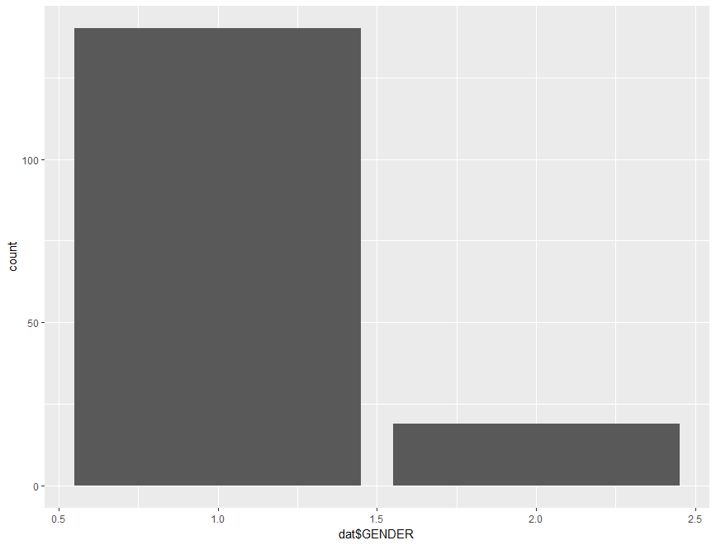
Bar Chart

Slide 30
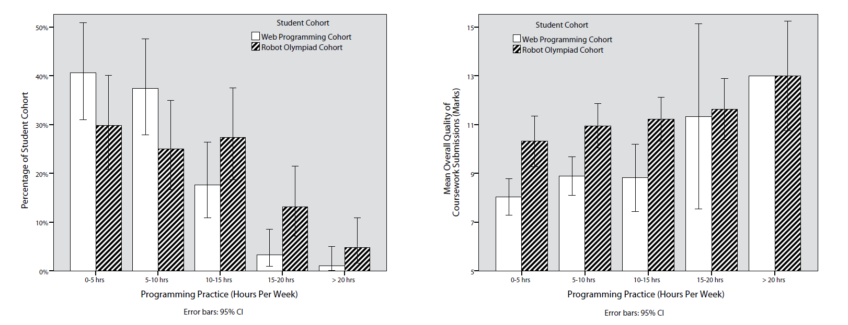
Bar Chart
Bar charts can be made much more complex using other ggplot functions:
http://www.cookbook-r.com/Graphs/Bar_and_line_graphs_(ggplot2)/

Slide 31
Histogram
A type of vertical bar chart used to depict a frequency distribution
Construction steps:
Label the x axis with the class endpoints
Label the y axis with the frequencies
Label the chart with an appropriate title, i.e. not ‘bar chart’
A quick look at the histogram reveals which class intervals produce the highest frequency totals
E.g. which age group most often enrols in undergraduate computing courses?
Notes:
31

Slide 32
Histogram
To display a frequency table, examining birth years from 1975 to 2000 in 5-year intervals, use the following command:
> summary(cut(dat$BIRTH_YEAR, c(1975,seq(1980,2000,5)), include.lowest=T,right=FALSE))
To display a histogram based on this data:
> hist(dat$BIRTH_YEAR, xlab="Year of Birth", ylab="Count", main="Breakdown of Birth Years", breaks=5)
Notes:
32

Slide 33
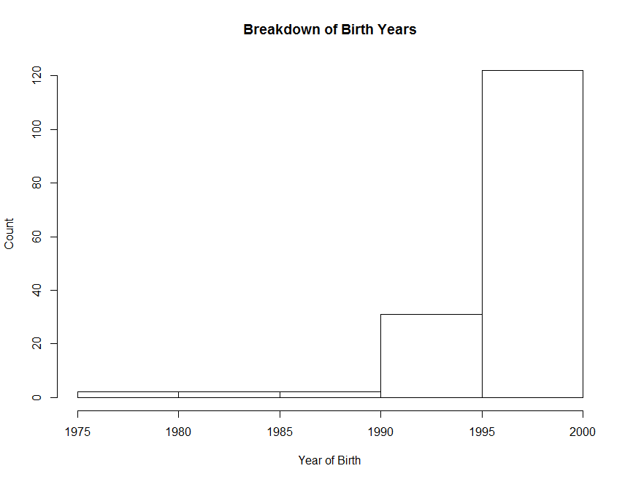
Histogram
Notes:
33

Slide 34
Frequency Polygon
A graph in which line segments connecting the dots depict a frequency distribution
Construction steps:
Label the x axis with the class endpoints
Label the y axis with the frequencies
Plot a dot for the frequency value at the midpoint of each class interval (different to Ogive)
Connect these dots with a line
Notes:
34

Slide 35
Frequency Polygon
To display a histogram of students’ conscientiousness, use the following command:
> ggplot(dat, aes(CONSCIENTIOUSNESS), stat="count") +
geom_freqpoly(binwidth = 20)
Notes:
35

Slide 36
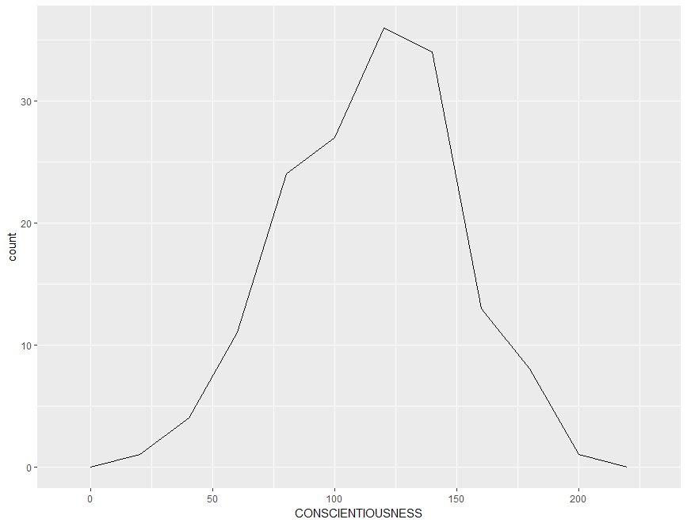
Frequency Polygon
Notes:
36

Slide 37
Ogive
A Cumulative Frequency (CF) polygon
Construction steps:
Label the x axis with the class endpoints
Label the y axis with the cumulative frequencies
A dot of ‘0’ is placed at the beginning of the first class
Mark a dot for the CF value at the end of each class interval
Connect these dots with a line
Notes:
37

Slide 38
Ogive
To construct an ogive, you need to format the data into cumulative frequencies:
> cumfreq0 <- c(0, cumsum(table(cut(dat$CONSCIENTIOUSNESS, seq(0, 240, by=20), right=FALSE))))
Then plot the chart based on this data:
> plot(seq(0, 240, by=20), cumfreq0, main="Range of Conscientiousness", xlab="Level of Conscientiousness", ylab="Cumulative Frequency") + lines(seq(0, 240, by=20), cumfreq0)
Notes:
38

Slide 39
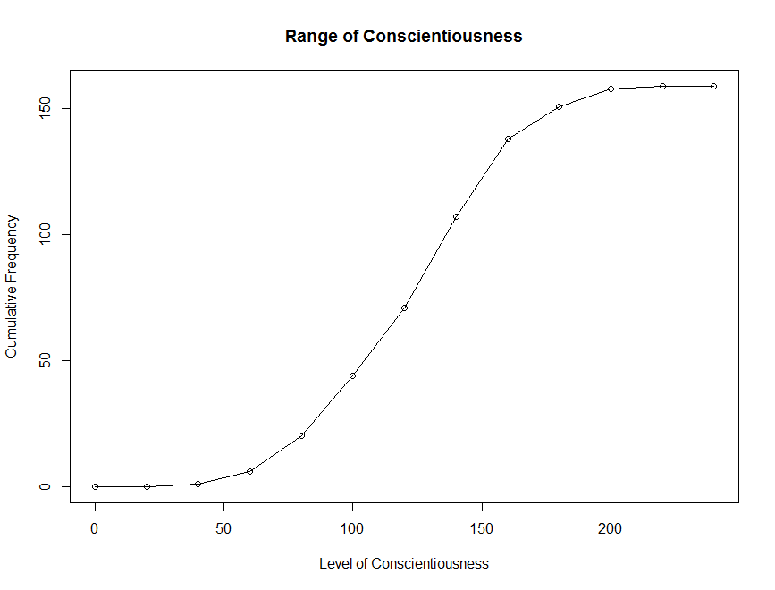
Ogive
Notes:
39

Slide 40
Pie Chart
A circular depiction of data where the area of the whole pie = 100% of the data being studied. Slices represent a % breakdown of each of the values
Business uses: e.g. for depicting budget categories, market share, time and resource allocation
Generally more difficult to interpret the size of the slices compared to the bars in a histogram. But- usage of ‘%’ can clarify slice size
Notes:
40

Slide 41
Pie Chart
Construction steps:
Convert each toothpaste brand amount to a proportion by dividing each individual amount by the total
E.g. 102 / 200 = 0.51
Convert each proportion to degrees by multiplying by 360°
E.g. 0.51 * 360° = 183.6°
Notes:
41

Slide 42
Pie Chart
To construct a pie chart, you first need to label the categories:
> Lbls <- c("Prior Experience with \na Pre-University Qualification", "Prior Experience without \na Pre-University Qualification", "No Prior Experience")
Then plot the pie chart based on this data:
> pie(table(dat$PRIOR_EXP), labels = lbls)
Notes:
42

Slide 43
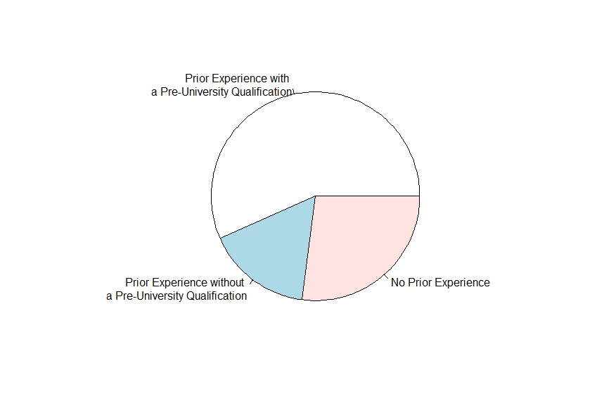
Pie Chart
Notes:
43

Slide 44
Pie Chart
Wrapping up commands into a single line:
> qplot(factor(dat$PRIOR_EXP, labels=c("Prior Experience with \na Pre-University Qualification", "Prior Experience without \na Pre-University Qualification", "No Prior Experience")), dat$ANXIETY, geom = "boxplot", main="Anxiety of Students from Different Backgrounds", xlab="Background", ylab="Level of Programming Anxiety")
Take note of the factor() command --- useful for distinguishing between different nominal characteristics or members of experimental and non-experimental groups!
The labels struct is setup in ascending order.
Notes:
44

Slide 45
Scatter Plot
Illustrates the relationship between two variables based on its underlying data points
E.g. the link between neurotic personality traits and programming anxiety
Scatter graph - a two-dimensional graph plot of pairs of points from two variables
Relationships will vary in strength, line of best fit used to indicate magnitude through slope
Notes:
45

Slide 46
Scatter Plot
For the line of best fit, going to use the rlm() function for a robust linear model to mitigate the influence of dataset outliers:
> library(MASS)
Then using the qplot() command with a combination of geom arguments including “point” (the scatter dots) and “smooth” (the line of best fit.
> qplot(dat$ANXIETY, dat$NEUROTICISM, geom = c("point", "smooth"), method="rlm", main="Correlation between Anxiety and Neuroticism", xlab="Anxiety", ylab="Neuroticism")
Try without the method argument. What happens?
Notes:
46

Slide 47
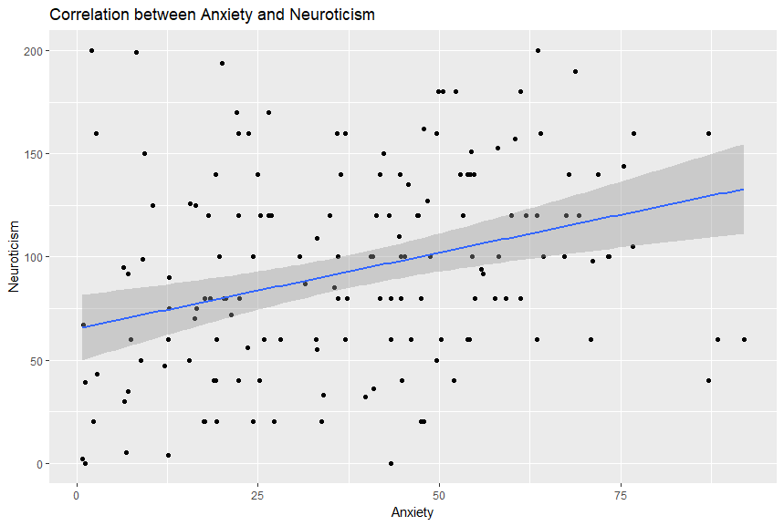
Scatter Plot
Notes:
47

Slide 48
Box Plot
Illustrates proportions of a distribution, and useful for comparing groups
Looking “down” on the distribution from the top, like viewing hills on a plane
Lines outside the box represent range
Box represents the lower and upper quartiles
Line inside the box represents the median
Notes:
48

Slide 49
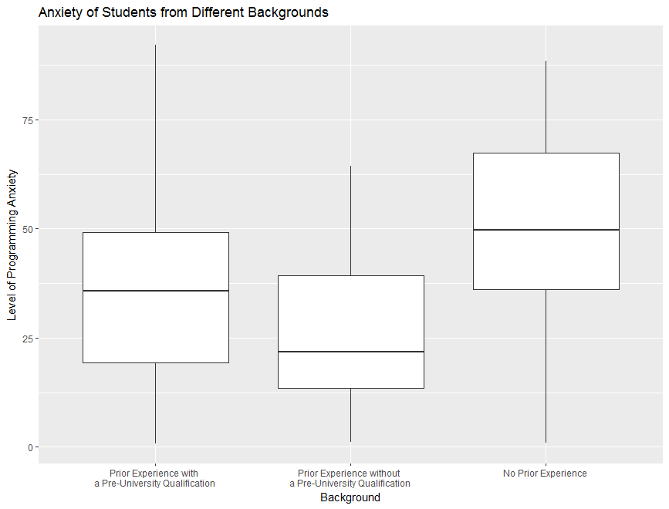
Box Plot
Notes:
49

