Slide 1



Lecture 5: Networking with Game Engines
COMP280: Creative Computing
BSc(Hons) Computing for Games
BA(Hons) Game Development: Programming

Slide 2


Slide 3
Learning outcomes
Configure Unreal Engine to support HTTP
Integrate JSON functionality into Unreal Engine
Develop a simple Unreal Engine application to show GET & POST functionality
Extend your Unreal Engine testbed for a real application

Slide 4
Key Full stack Technologies
Client
Server
View
(Python/PyQt)
(Unreal)
Data Comms
(HTTP / JSON)
Controller
(Python)
Model
(SQL/Sqlite)

Slide 5
Key Full stack Technologies
Last week:
Looked at broad Python-based client-server architecture
Addressed issues with JSON for better data transfer
SQL for persistent data management
→ Basis of a powerful backend framework

Slide 6
This week
Game engine integration approaches
Game & Architectural design considerations

Slide 7
Unity Integration

Slide 8
Unity Integration
Unity leverages C# & .NET as its run-time architecture
.NET is very good for client/server development
Often used as an alternative to Python
Choice is often:
Python (bespoke / Django)
C# (.Net / ASP.NET)
JavaScript (bespoke / Node.js)

Slide 9
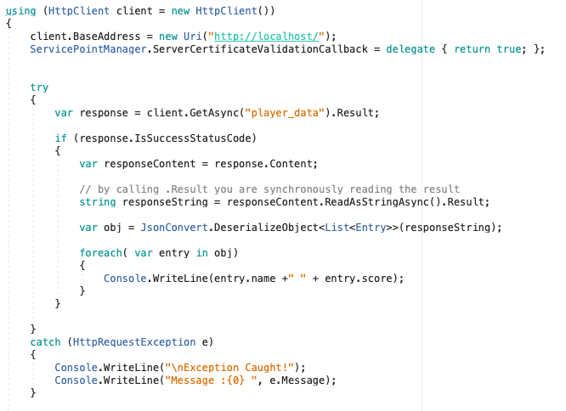
Unity Integration
Generic C# HTTP Client functionality
Functionally identical to Python
GetAsync() is ‘GET’
Slightly more code, Python is more geared towards rapid development
Python uses 3rd party s/w for JSON support
Newtonsoft
Typed nature of C# combined with refection makes JSON relatively easy to work with

Slide 10
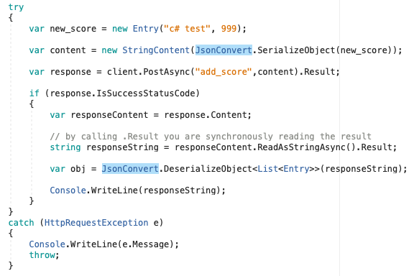
Unity Integration
Generic C# HTTP Client functionality
Functionally identical to Python
PostAsync() is ‘POST’
Slightly more code, Python is more geared towards rapid development

Slide 11
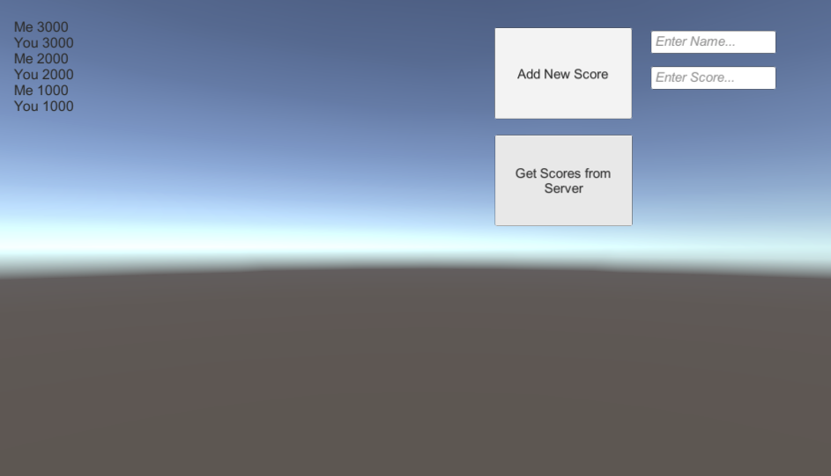
Unity Integration
Generic C# HTTP Client functionality
Can take this straight into Unity project

Slide 12
Unity Integration
Create a UI with:
A multi-line textbox to display score info
A button widget to get scores from the server
A button widget to send score to the server
2 text input widgets to enter name + score for new data

Slide 13
Unity Integration
Create a UI with:
Add Score Button
Uses OnClick()
Calls scorewidget.AddScore
Get Scores Button
Uses OnClick()
Calls scorewidget.GetScores()
These functions call the standalone .NET code from before
Also copy data for AddScore
And paste data into textbox for GetScores

Slide 14
Unreal Integration

Slide 15
Unreal Integration
Works in much the same way
However, uses Unreal C++ wrapper code to deal with:
HTTPClient
JSON data
Unreal has its own fun issues
Json parsing

Slide 16
Questions

