Slide 1

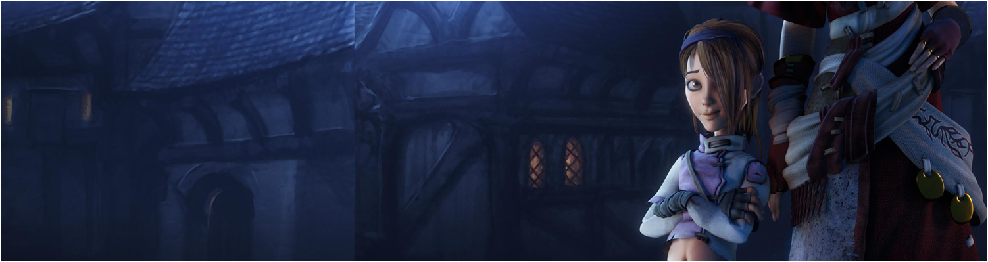

Lecture 1: Introduction
COMP260: Distributed Systems
BSc (Hons) Computing for Games

Slide 2
Today’s session:
Introduction to the module
MUD and their pivotal role in the development of video games

Slide 3
Introduction to the module

Slide 4
Introduction to the module
A 12 week module to introduce you to distributed processing (networking)
Focus is on
Client / server software development
Threading
Managing remote servers
Games as a service

Slide 5
Introduction to the module
Week 1 | Week 2 | Week 3 | Week 4 | Week 5 | Reading Week
Intro & MUD | IP & Sockets | Threading | UX Programming | Peer Review | Studio Practice
Week 7 | Week 8 | Week 9 | Week 10 | Week 11 | Week 12
Assignment 1 Viva | Working with Databases | Client Accounts | Salting data | Encryption & Security | Peer Review
Week 13
Assignment 2 Viva

Slide 6
Introduction to the module
Module is split into 2 parts:
Part I
Fundamental socket-based client/server application development
Python as a prototyping and development language
Part II
Software as a service development
Hosting and managing remote services (Digital Ocean services)
Python as a server language
C# as a client language
Assignments:
2 development assignment
Build a multi-player MUD
Develop MUD as a service
Research journal on network security

Slide 7
Introduction to the module
Delivery
Just like COMP220 in semester I
1 hour lecture of theory
1 hour session with Tris to develop your skills
2 hour tutorial to explore the theory sessions
These will build into your assignments
NB:
This isn’t the schedule for each week
Peer review weeks will be different!

Slide 8
Introduction to the module
Help, help
I don’t know / I can’t remember Python
https://www.pluralsight.com/courses/python-getting-started
I don’t know PyQT
https://wiki.python.org/moin/PyQt
I don’t know C#
https://app.pluralsight.com/library/courses/c-sharp-fundamentals-with-visual-studio-2015
Don’t forget, you can pair program, form a self-help group / action learning set
https://rapidbi.com/action-learning-sets/

Slide 9
MUD and their pivotal role in the development of video games

Slide 10
MUDs
We are in the 1970s, first thing to consider is that this if before the home computer revolution of the early 1980s
So, no
smart phones
Laptops
Ipads / tablets
PCs / macs and so on
No internet as we know it
Early personal computers:
1977 Apple II ($1300 ->$5k in today’s money)
1981 ZX81 (£100 -> £250)
1981 BBC Model B (£350 -> £875)
1982 C64 ($600 -> £1500)

Slide 11
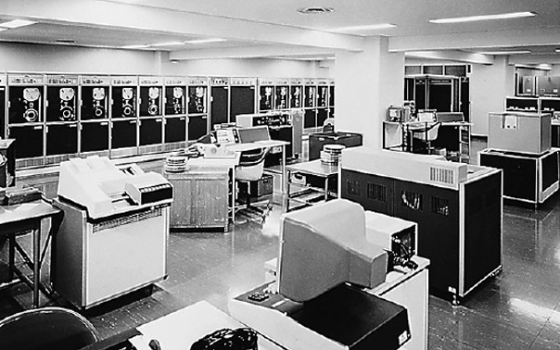
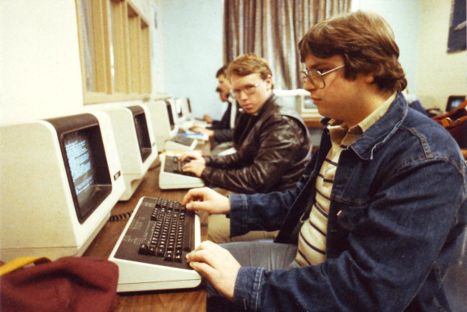
MUDs
University computer facilities were mainframes and minicomputers with dumb terminals
All processing occurred in the mainframe, terminals just took input & displayed responses

Slide 12
MUDs
University computer facilities were mainframes and minicomputers with dumb terminals
Early form of the MVC (model, view, controller) pattern
Mainframe had the ‘model’ as working memory or disk storage or relational database
Mainframe processed model with controller application (ASM, C, COBOL etc)
Dumb terminals allowed users to send commands to mainframe app and receive results as a view.
Just like modern cloud computing

Slide 13
MUDs
Multi-user dungeons first became popular in academic environments in the mid-1970s
1975 University of Illinois
1978 Essex University ‘MUD’
Created by students rather than staff
Relied on university mini computers (DECs running Unix)
And academic networks (JANET, PLATO) to link players to MUDs
Often full of very sardonic humour based on campus experiences / staff / students

Slide 14
MUDs
What is a MUD?
Simplest definition, it’s digital ’Dungeons and Dragons’ type role playing
Game consists of (simplest form):
A dungeon of inter-connected rooms
Human players
Text-based interactions

Slide 15
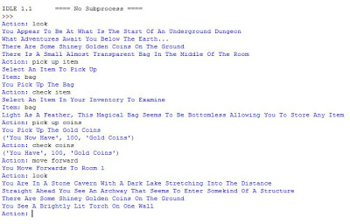
MUDs
What is a MUD?

Slide 16
MUDs
What is a MUD?
Simplest definition, it’s digital ’Dungeons and Dragons’ type role playing
Scope for:
A defined, connected and explorable world
Dungeon-based narrative / plot
Collectable game objects
Object/action challenges
NPCs to drive plot
Player interactions (chat / give objects / perform magic)
PvNPC combat
PvP combat
2D/3D gfx

Slide 17
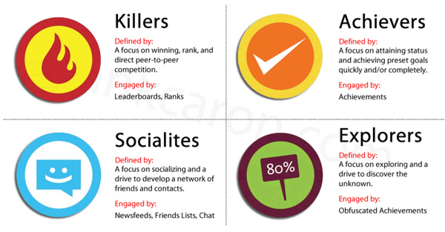
MUDs
What is a MUD?
Bartle’s player Types
https://repignite.com/2014/07/richard-bartle-player-types/

Slide 18
MUDs
Why are they pivotal?
Fighting fantasy novels
Table-top
role playing
MMOs
MUD
Social
networks
Narrative gaming
Adventure games
Video Adventure games

Slide 19
Making a Single-user Dungeon

Slide 20
Making a Single-user Dungeon
To make a SUD, we need to start off with some creative design that we can build our app from.
The SUD is a collection of rooms that are laid out on one level (there are no up or down exits). Rooms can be joined by north, south, east or west connections. A room does not have to have connections in all directions and it may not have more than one connection per direction and the connections do not have to be bidirectional.
When the player enters a room, they will be presented with a textual description of the room along with a list of exits they can take from that room. Typing help will give the player all of the text commands. Entering a command incorrectly will result in an error message.

Slide 21
Making a Single-user Dungeon
To make a SUD, we need to start off with some creative design that we can build our app from.
Room
Room
Room
Room
Room
Room
Room

Slide 22
Making a Single-user Dungeon
Do a linguistic breakdown of the design,
Objects (nouns), methods (verbs) , attributes (adjectives)
The SUD is a collection of rooms that are laid out on one level (there are no up or down exits). Rooms can be joined by north, south, east or west connections. A room does not have to have connections in all directions and it may not have more than one connection per direction and the connections do not have to be bidirectional.
When the player enters a room, they will be presented with a textual description of the room along with a list of exits they can take from that room. Typing help will give the player all of the text commands. Entering a command incorrectly will result in an error message.

Slide 23
Making a Single-user Dungeon
Create a 1st pass class hierarchy
Class | Method | Attributes
SUD |  | Player Collection<Room>
Player | Typing GO <direction> HELP Error message | Room Incorrect typing
Room |  | Connections (north, south, east, west) Description

Slide 24
Making a Single-user Dungeon
Create a 1st pass class hierarchy
Player
Typing()
GO <direction>()
HELP()
Error message()
Room
Incorrect Typing
SUD
Player
Collection<Room>
Room
Connections (north, south, east, west)
Description

Slide 25
Making a Single-user Dungeon
Create a 1st pass state diagram
Invalid for room
GO <direction>
Valid for room
Player:Idle
HELP
Display Help
Syntax error
Display Error

Slide 26
Making a Single-user Dungeon
What are the open issues to address
How to store dungeon and room data
How to make a text-driven interface
How to process user input

Slide 27
Making a Single-user Dungeon
1.How to store dungeon and room data
From the class hierarchy:
The dungeon will be collection of rooms
Each room will contain a description and links to other rooms
What containers make sense for this?

Slide 28
Making a Single-user Dungeon
1.How to store dungeon and room data
From the class hierarchy:
The dungeon will be collection of rooms
Each room will contain a description and links to other rooms
What containers make sense for this?
Could use an array
Does it make sense to index rooms from 0
Will this cause issues for our designers?
Could use a list
Put room name into each room
But that will give us an O(n/2) look up, do we want that?

Slide 29
Making a Single-user Dungeon
1.How to store dungeon and room data
From the class hierarchy:
The dungeon will be collection of rooms
Each room will contain a description and links to other rooms
What containers make sense for this?
Could use a dictionary of <string, room>
Means we can use the name of the room as a key

Slide 30
Making a Single-user Dungeon
2.How to make a crappy text-driven interface
For prototyping, command line applications can be very useful
Just need to work out how to read text & display it
In Python:
input()

Slide 31
Making a Single-user Dungeon
3.How to process user input
User input will be a string of characters
Maybe one word: HELP
Maybe two words: GO <direction>
Need to be able to process these strings to see what they contain and if they are valid commands
Split string using spaces into an array of strings
In python
string.split(‘ ‘) # split string into an array using ‘ ‘ as a separator
Remember to remove any empty string from the array, if the user types lots of spaces

Slide 32
Making a Single-user Dungeon
3.How to process user input
Is input valid?
As a developer, you know what the command formats should be, so test accordingly
Converting input to lower case makes it easier to do comparisons ;)
In Python
string.lower()

Slide 33
Making a Single-user Dungeon
3.How to process user input
Process input
In Python
Use nested if/else to test for each command
If all the ifs fail (because the user types rubbish)
Have a fall out case to tell the user their input is no good

Slide 34
Worksheet 1: Make a Single-user Dungeon

Slide 35
Questions

