Slide 1

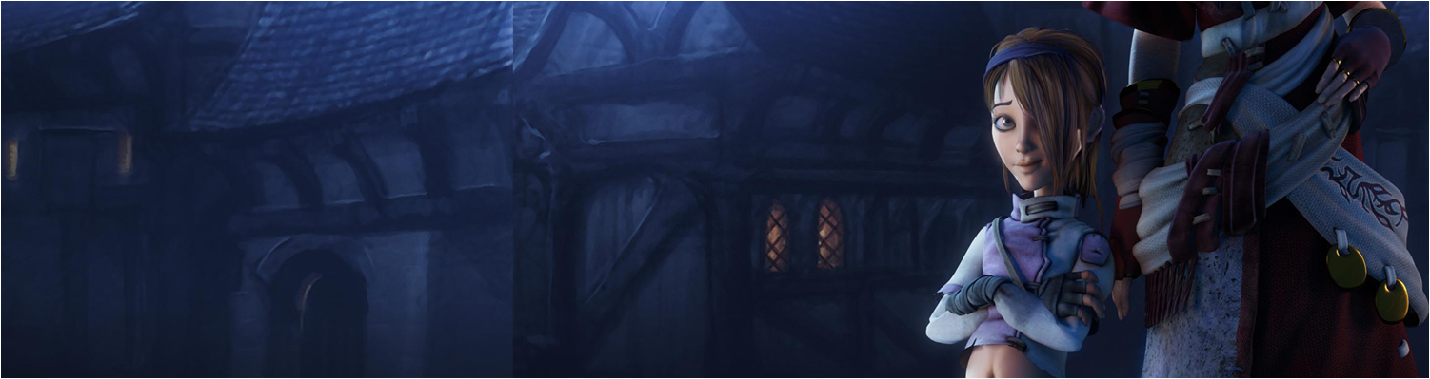

Lecture 1: Module Introduction
COMP260: Distributed Systems
BSc (Hons) Computing for Games

Slide 2
Today’s session:
Introduction to the module & assignments
Introduction to socket-based programming

Slide 3
Introduction to the module

Slide 4
Introduction to the module
A 10 week module to introduce you to distributed processing (networking)
In two parts:
My part (turn-based networking)
Fundamental socket programming
Technical Architecture
Hosting services on remote servers
Al’s part (real-time networking)
Real-time provision in Unity & networking engines
Games that rely on object duplication & synchronisation

Slide 5
Introduction to the module
Week 1 | Week 2 | Week 3 | Week 4 | Week 5 | Reading Week
 | Turn-based Service Provision
Introduction | IP & Socket Programming | Networking & Concurrency | Concurrency in Clients (chat service) | Games-As-A-Service (hosting)
 | Proposal Review |  | Tutorial |  | Tutorial
 | Portfolio Dev | Portfolio Dev | Portfolio Dev | Portfolio Dev
Week 7 | Week 8 | Week 9 | Week 10 | Week 11 | Week 12
Real-time Gaming Provision
Real-time Networking 1 | Real-time Networking 2 | Real-time Networking 3 | Real-time Networking 4
 | Tutorial
Portfolio Dev | Portfolio Dev | Portfolio Dev | Peer Review | Portfolio Dev | Portfolio Dev
Week 13
VIVA OF DOOM

Slide 6
Introduction to the module
Assignments
Assignment 1: Computing Artefact
Two Parts
Create a turn-based game & host on a remote server
Technical analysis
Technical design
Demo on remote server
Create a real-time networked game
Create a ‘simple’ game that multiple people can play together over a network
FPS Deathmatch
Multiplayer arcade game
Assignment 2: Technical Report
This is shared across all individual specialist computing projects modules

Slide 7
Introduction to the module
Do you have any questions for me?

Slide 8
Introduction to socket-based programming

Slide 9
Introduction to socket-based programming
In COMP280, we looked at HTTP as a network protocol
POST & GET provide client-controlled communications
Network gaming requires server to initiate communication with client, so HTTP is no use

Slide 10
Introduction to socket-based programming
In COMP280, we looked at HTTP as a network protocol
HTTP is part of the internetworking protocol (IP) stack
Along with all the other ‘TP’ services we use (FTP, SMTP etc)
The underlying networking stack for IP defines end-to-end communications over connected networks (inter networking)
This comes from the US Dept. of Defence cold-war research for nuclear-proof networking

Slide 11
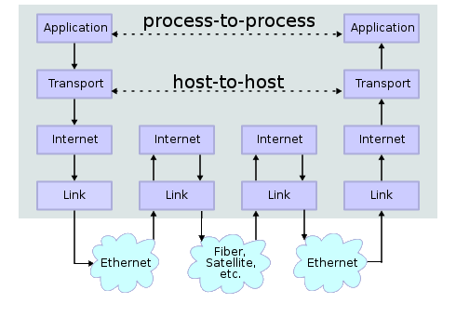
Introduction to socket-based programming
IP Stack
From a software developer’s perspective, an application using the IP to communicate works across platforms (they don’t have to think about the underlying stack)

Slide 12
Introduction to socket-based programming
IP Stack
Two flavours of IP stack we are interested in for games:
TCP/IP
Guaranteed delivery & guaranteed order of deliver
‘slow n steady’
Datagram/IP
Nothing is guaranteed
‘fast n loose’
Early network games (Quake et al) used datagrams as it allowed the most data to be sent and had no stalling (through retries)
Far more common to use TCP/IP nowadays

Slide 13
Introduction to socket-based programming
IP Sockets
Host-to-host communications are implemented through sockets & socket libraries
Platform-independent
Sockets define a protocol (messages & data formats) any user of sockets has to implement that protocol
System / language interoperability
Anything that uses sockets can communicate with anything else that uses sockets

Slide 14
Introduction to socket-based programming
Anatomy of socket communications
Server and client are roles, rather than bits of h/w
Server will serve up data for requests from clients
An app can be both a client and a server (to different servers and clients)
Server Use Case | Client Use Case
Create a socket Listen for clients Accept new connection(s) Receive and send data Close connections | Create a socket Connect to server Receive and send data Close connections

Slide 15
Introduction to socket-based programming
Anatomy of socket communications
Client
Server
Create a Socket
Socket = Socket()
Create a Socket
Bind to IP & port
Set listen count
Connect to IP & port
Accept connect request
Receive message
socket.recv()
Send message
socket.send()
Send message
socket.send()
Receive message
socket.recv()
End
socket.close()
End
socket.close()

Slide 16
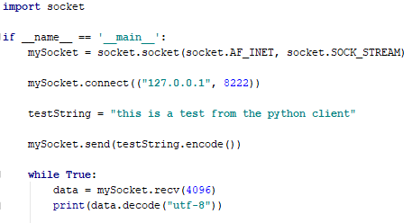
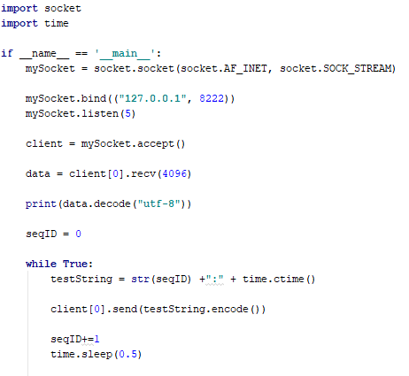
Introduction to socket-based programming
In Python
Client
Server

Slide 17
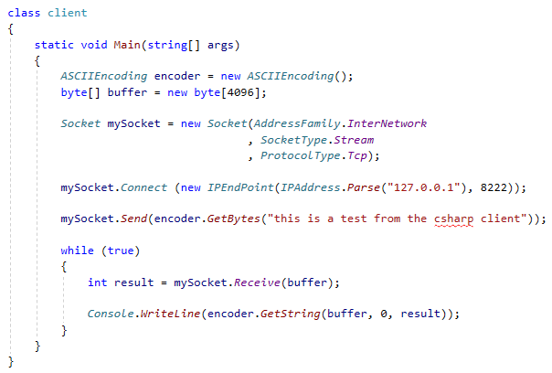
Introduction to socket-based programming
In C#
Client

Slide 18
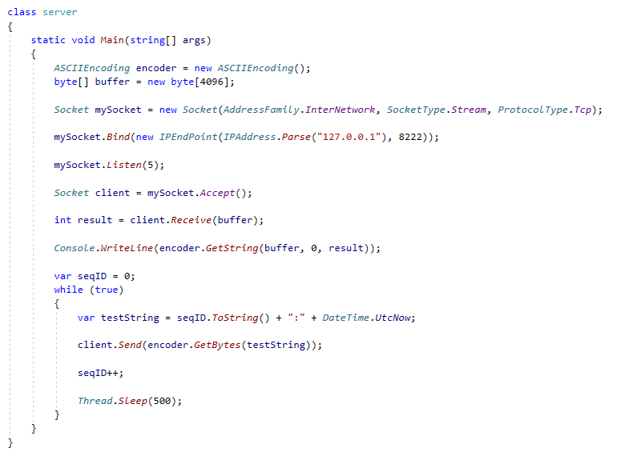
Introduction to socket-based programming
In C#
Server

Slide 19
Introduction to socket-based programming
Regardless of programming language
Sockets work in the same way
Create, bind, listen, connect, accept, send receive, close
‘Broadly’ equivalent to working with files (open, read, write, close)
Think of a socket as a file you can read & write to
Data is sent as a stream of bytes (just like HTTP)
Convert data to bytes (serialise)
Send it as bytes
Receive it as bytes
Convert bytes to data (de-serialise)
This makes it ‘easy’ to communicate between applications, machines and operating systems
Sockets are relatively platform agnostic
Be aware of string formats (ASCII encoding, utf-8 etc)

Slide 20
Questions

Slide 21
For Next Week
Experiment with the client/server code
Particularly mix & match Python and C# applications
Proposal Reviews on Tuesday
What do want to build with Al?

