Slide 1
Tinkering Audio II: Further Notes on Digital Sound
Creative Computing: Tinkering – Lecture 9 – Michael Scott

Slide 2
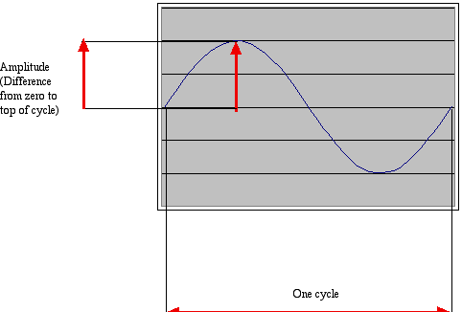
Recap on Last Week
Sounds are waves of air pressure
Sound comes in cycles
The frequency of a wave is the number of cycles per second (cps), or Hertz
Complex sounds have more than one frequency in them.

Slide 3
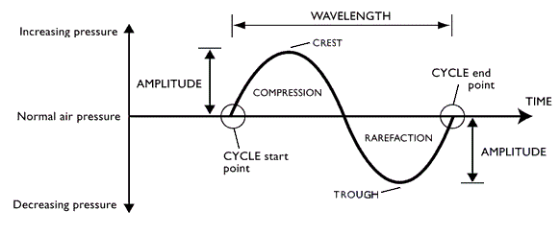
Recap on Last Week

Slide 4
Recap on Last Week
Our perception of volume is related (logarithmically) to changes in amplitude
If the amplitude doubles, it's about a 3 decibel (dB) change
Our perception of pitch is related (logarithmically) to changes in frequency
Higher frequencies are perceived as higher pitches
We can hear between 5 Hz and 20,000 Hz (20 kHz)
A above middle C is 440 Hz

Slide 5
“Logarithmically?” – Further Notes
It's strange, but our hearing works on ratios not differences, e.g., for pitch.
We hear the difference between 200 Hz and 400 Hz, as the same as 500 Hz and 1000 Hz
Similarly, 200 Hz to 600 Hz, and 1000 Hz to 3000 Hz
Intensity (volume) is measured as watts per meter squared
A change from 0.1W/m2 to 0.01 W/m2, sounds the same to us as 0.001W/m2 to 0.0001W/m2

Slide 6
“Logarithmically?” – Further Notes
A decibel is a ratio between two intensities: 10 * log₁₀(I₁/I₂)
As an absolute measure, it's in comparison to threshold of audibility
0 dB can't be heard.
Normal speech is 60 dB.
A shout is about 80 dB

Slide 7
TONE GENERATION
Tinkering Audio

Slide 8
Learning Objectives
By the end of this section, you will be able to:
Recognise the importance of the Nyquist Theorem
Explain why knowing the bit depth and sample rate is important for generating a tone
Write a function that will generate a tone using a sine function

Slide 9
Tones and Tone Generation
Has anyone generate tones using sin() waves?
Post a simple solution on Slack
What is the maximum possible amplitude? and Why?
Discuss on Slack for 5 minutes
What happens if you keep increasing the frequency?
Tutor Demonstration

Slide 10
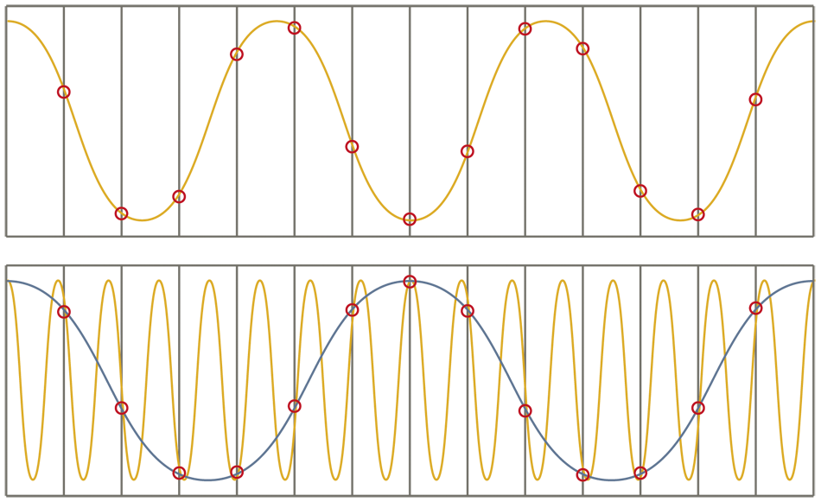
Aliasing

Slide 11
Nyquist Theorem
We need twice as many samples as the maximum frequency in order to represent (and recreate, later) the original sound.
The number of samples recorded per second is the sampling rate
If we capture 8000 samples per second, the highest frequency we can capture is 4000 Hz
That's how phones work
If we capture more than 44,000 samples per second, we capture everything that we can hear (max 22,000 Hz)
CD quality is 44,100 samples per second

Slide 12
TONE COMBINATION
Tinkering Audio

Slide 13
Learning Objectives
By the end of this section, you will be able to:
Recognise the importance of the Fourier’s notion of superposition
Explain how complex waves can be defined as a series of simple waves
Write a function that will generate a complex tone using a series of simpler tones

Slide 14
Fourier and Superposition
Prior to Fourier's work, no solution to a particular complex equation was known in the general case, although particular solutions were known if the variables behaved in a simple way; in particular, following the sine or cosine functions.
These simple solutions are now sometimes called “eigensolutions”.

Slide 15
Fourier and Superposition
Fourier's idea was to model a complicated variable as a superposition (or linear combination) of simple sine and cosine waves, and then to write the solution as a superposition of the corresponding eigensolutions.
This superposition (or linear combination) is now called the Fourier series. Correspondingly, Fourier series’ can be used in the construction of complex tones.

Slide 16
Approximating a Square Wave

Slide 17
Approximating a Saw-Tooth Wave

Slide 18
https://www.youtube.com/watch?v=YsZKvLnf7wU

Slide 19
Writing a Tone Combination Function
Write a function to combine two tones from your generator together.
Once you have done this, attempt to re-create a saw-tooth and/or square wave. Use the explore() command in JES to see if you have succeeded.

Slide 20
NORMALISATION AND CLIPPING
Tinkering Audio

Slide 21
Learning Objectives
By the end of this section, you will be able to:
Explain the terms normalization and clipping
Write a function that will normalise a sound

Slide 22
Normalisation
“the application of a constant amount of gain to an audio recording to bring the average or peak amplitude to a target level (the norm)”

Slide 23
Normalizing Sound
This loop finds the loudest
sample
def normalize(sound):
largest = 0
for s in getSamples(sound):
largest = max(largest, getSampleValue(s))
amplification = 32767.0 / largest
print "Largest sample value in original sound was", largest
print ”Amplification multiplier is", amplification
for s in getSamples(sound):
louder = amplification * getSampleValue(s)
setSampleValue(s, louder)
Why 32,767.0?
This loop actually amplifies
the sound

Slide 24
Avoiding clipping
Why are we being so careful to stay within range? What if we just multiplied all the samples by some big number and let some of them go over 32,767?
The result then is clipping
Clipping: The awful, buzzing noise whenever the sound volume is beyond the maximum that your sound system can handle.
Notes:
Be sure to generate some clipping here!

Slide 25
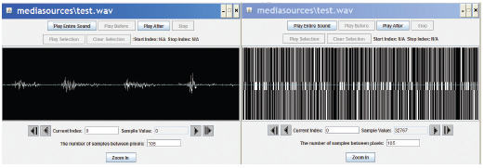
All Clipping, All the Time
What happens when we maximise a sound?
All samples over 0: Make it 32767
All samples at or below 0: Make it -32768
def maximize(sound):
for sample in getSamples(sound):
value = getSampleValue(sample)
if value > 0:
setSampleValue(sample, 32767)
if value < 0:
setSampleValue(sample, -32768)

Slide 26
We can hear the speech!
Try it! You can understand speech in this mangled sound.
Why?
Implications:
Human understanding of speech relies more on frequency than amplitude.
Note how many bits we need per sample. A single bit per sample can record legible speech.

Slide 27
SPICING AND SWAPPING AUDIO
Introduction to Digital Sound

Slide 28
Learning Objectives
By the end of this section, you will be able to:
Write code that will splice, reverse, and mirror sounds
Explain how to use loops and ranges to select components of a sound
Describe the principle of variable scope and how it apliues to the problem of sound splicing

Slide 29
Processing only part of the sound
What if we wanted to increase or decrease the volume of only part of the sound?
Q: How would we do it?
A: We'd have to use a range() function with our for loop
Just like when we manipulated only part of a picture by using range() in conjunction with getPixels()

Slide 30
Using for to count with range
>>> print range(1,3)
[1, 2]
>>> print range(3,1)
[]
>>> print range(-1,5)
[-1, 0, 1, 2, 3, 4]
>>> print range(1,100)
[1, 2, 3, 4, 5, 6, 7, 8, 9, 10, 11, … 99]

Slide 31
Knowing where we are in the sound
More complex operations require us to know where we are in the sound, which sample
Not just process all the samples exactly the same
Examples:
Reversing a sound
It's just copying, like we did with pixels
Changing the frequency of a sound
Using sampling, like we did with pixels
Splicing sounds

Slide 32
Increasing volume by sample index
def increaseVolumeByRange(sound):
for sampleNumber in range(0, getLength(sound)):
value = getSampleValueAt(sound, sampleNumber)
setSampleValueAt(sound, sampleNumber, value * 2)
def increaseVolume(sound):
for sample in getSamples(sound):
value = getSample(sample)
setSample(sample,value * 2)
What is the difference between these two functions?

Slide 33
Modify different sound sections
The index lets us modify parts of the sound now - e.g. here we increase the volume in the first half, and then decrease it in the second half.
def increaseAndDecrease(sound):
length = getLength(sound)
for index in range(0, length/2):
value = getSampleValueAt(sound, index)
setSampleValueAt(sound, index, value*2)
for sampleIndex in range(length/2, length):
value = getSampleValueAt(sound, index)
setSampleValueAt(sound, index, value*0.2)

Slide 34
Array References
Square brackets ([ ]) are standard notation for arrays (or lists). To access a single array element at position index, we use array[index]
>>> myArray = range(0, 100)
>>> print myArray[0]
0
>>> print myArray[1]
1
>>> print myArray[99]
99

Slide 35
Splicing Sounds
Splicing gets its name from literally cutting and pasting pieces of magnetic tape together
Doing it digitally is easy (in principle), but painstaking
The easiest kind of splicing is when the component sounds are in separate files.
All we need to do is copy each sound, in order, into a target sound.
Here's a recipe that creates the start of a sentence, “Guzdial is …” (You may complete the sentence.)

Slide 36
Splicing whole sound files
def merge():
guzdial = makeSound(getMediaPath("guzdial.wav"))
isSound = makeSound(getMediaPath("is.wav"))
target = makeSound(getMediaPath("sec3silence.wav"))
index = 0
for source in range(0, getLength(guzdial)):
value = getSampleValueAt(guzdial, source)
setSampleValueAt(target, index, value)
index = index + 1
for source in range(0, int(0.1*getSamplingRate(target))):
setSampleValueAt(target, index, 0)
index = index + 1
for source in range(0, getLength(isSound)):
value = getSampleValueAt(isSound, source)
setSampleValueAt(target, index, value)
index = index + 1
normalize(target)
play(target)
return target

Slide 37
What additional functions must be in the file for that program to work?
normalize()
play()
getMediaPath()
maximize()

Slide 38
How it works
Creates sound objects for the words “Guzdial”, “is” and the target silence
Set target's index to 0, then let each loop increment index and end the loop by leaving index at the next empty sample ready for the next loop
The 1st loop copies “Guzdial” into the target
The 2nd loop creates 0.1 seconds of silence
The 3rd loop copies “is” into the target
Then we normalize the sound to make it louder

Slide 39
Splicing words into a speech
Say we want to splice pieces of speech together:
We find where the end points of words are
We copy the samples into the right places to make the words come out as we want them
(We can also change the volume of the words as we move them, to increase or decrease emphasis and make it sound more natural.)

Slide 40
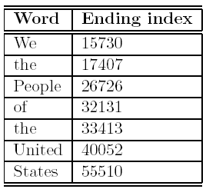
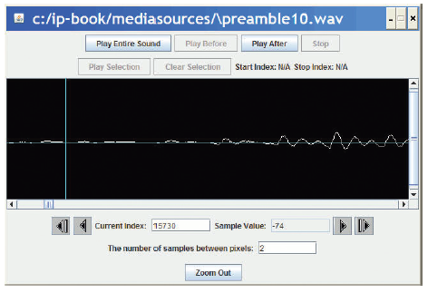
Finding the word end-points
Using MediaTools and play before/after cursor, we can figure out the index numbers where each word ends
We want to splice a copy of the word “United” after “We the” so that it says, “We the United People of the United Kingdom”.

Slide 41
Now, it's all about copying
We have to keep track of the source and target indices, srcSample and destSample
destSample = Where-the-incoming-sound-should-start
for srcSample in range(startingPoint, endingPoint):
sampleValue = getSampleValueAt(source, srcSample)
setSampleValueAt(dest, destSample, sampleValue)
destSample = destSample + 1

Slide 42
The Whole Splice
def splicePreamble():
file = getMediaPath(“preamble10.wav”)
source = makeSound(file)
target = makeSound(file) # This will be the newly spliced sound
targetIndex =17408 # targetIndex starts at just after "We the" in the new sound
for sourceIndex in range( 33414, 40052): # Where the word "United" is in the sound
setSampleValueAt(target, targetIndex, getSampleValueAt(source, sourceIndex))
targetIndex = targetIndex + 1
for sourceIndex in range(17408, 26726): # Where the word "People" is in the sound
setSampleValueAt(target , targetIndex, getSampleValueAt(source, sourceIndex))
targetIndex = targetIndex + 1
for index in range(0, 1000): #Stick some quiet space after that
setSampleValueAt(target, targetIndex, 0)
targetIndex = targetIndex + 1
play(target) #Let's hear and return the result
return target

Slide 43

What's going on here?
First, set up a source and target.
Next, we copy “United” (samples 33414 to 40052) after “We the” (sample 17408)
That means that we end up at 17408+(40052-33414) = 17408+6638=24046
Where does “People” start?
Next, we copy “People” (17408 to 26726) immediately afterward.
Do we have to copy “of” to?
Or is there a pause in there that we can make use of?
Finally, we insert a little (1/1441th of a second) of space – 0's
Kingdom

Slide 44
What if we didn't do that second copy? Or the pause?
def spliceSimpler():
file = getMediaPath(“preamble10.wav”)
source = makeSound(file)
target = makeSound(file) # This will be the newly spliced sound
targetIndex =17408 # targetIndex starts at just after "We the" in the new sound
for sourceIndex in range( 33414, 40052): # Where the word "United" is in the sound
setSampleValueAt(target, targetIndex, getSampleValueAt(source, sourceIndex))
targetIndex = targetIndex + 1
# Let's hear and return the result
play(target)
return target

Slide 45
General clip function
We can simplify those splicing functions if we had a general clip method that took a start and end index and returned a new sound clip with just that part of the original sound in it.
def clip(source, start, end):
target = makeEmptySound(end - start)
tIndex = 0
for sIndex in range(start, end):
value = getSampleValueAt(source, sIndex)
setSampleValueAt(target, tIndex, value)
tIndex = tIndex + 1
return target

Slide 46
General copy function
We can also simplify splicing if we had a general copy method that took a source and target sounds and copied the source into the target starting at a specified target location.
def copy(source, target, start):
tIndex = start
for sIndex in range(0, getLength(source)):
value = getSampleValueAt(source, sIndex)
setSampleValueAt(target, tIndex, value)
tIndex = tIndex + 1

Slide 47
Simplified preamble splice
Now we can use these functions to insert “United” into the preamble in a much simpler way.
def createNewPreamble():
file = getMediaPath("preamble10.wav")
preamble = makeSound(file) # old preamble
united = clip(preamble, 33414, 40052) # "United"
start = clip(preamble, 0, 17407) # "We the"
end = clip(preamble, 17408, 55510) # the rest
len = getLength(start) + getLength(united)
len = len + getLength(end) # length of everything
newPre = makeEmptySound(len) # new preamble
copy(start, newPre, 0)
copy(united, newPre, getLength(start))
copy(end, newPre, getLength(start)+getLength(united))
return newPre

Slide 48
Changing the splice
What if we wanted to increase or decrease the volume of an inserted word?
Simple! Multiply each sample by something as it's pulled from the source.
Could we do something like slowly increase volume (emphasis) or normalize the sound?
Sure! Just like we've done in past programs, but instead of working across all samples, we work across only the samples in that sound!

Slide 49
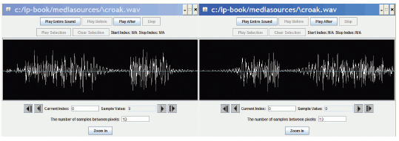
Reversing Sounds
We can also modify sounds by reversing them
def reverse(source):
target = makeEmptySound(getLength(source))
sourceIndex = getLength(source) - 1 # start at end
for targetIndex in range(0, getLength(target)):
value = getSampleValueAt(source, sourceIndex)
setSampleValueAt(target, targetIndex, value)
sourceIndex = sourceIndex - 1 # move backwards
return target

Slide 50
What does makeEmptySong take as input?
Based on that last program, what do you think makeEmptySong takes as input?
Number of samples needed in the new song.
Number of bytes needed in the new sound.
Number of seconds needed in the new song.
A song to copy.

Slide 51
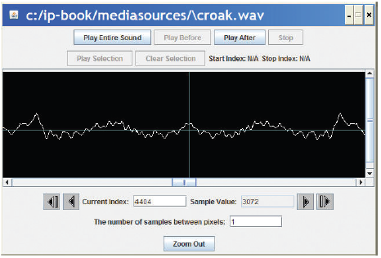
Mirroring
We can mirror sounds in exactly the same way we mirrored pictures
def mirrorSound(sound):
len = getLength(sound)
mirrorpoint = len/2
for index in range(0, mirrorpoint):
left = getSampleObjectAt(sound, index)
right = getSampleObjectAt(sound, len-index-1)
value = getSampleValue(left)
setSampleValue(right, value)

Slide 52
Functions and Scope
Defined:
Let's call the variable that represents the input a “parameter variable”
Key idea:
The parameter variable in a function has NOTHING to do with any variable (even with the same name) in the Command Area – or anywhere else.
Parameter variables are LOCAL to the function.
We say that it's in the function's SCOPE.

Slide 53
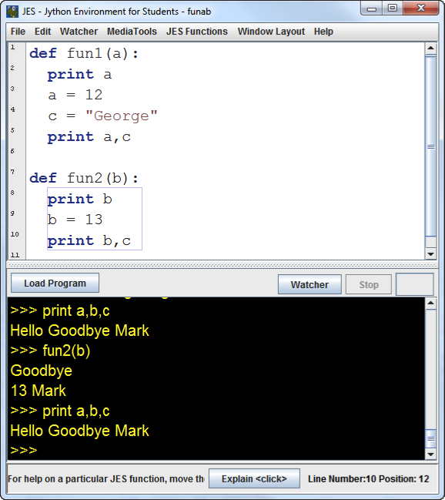
Think this through:

Slide 54
Values are copied into parameters
When a function is called, the input values are copied into the parameter variables.
Changing the parameter variables can't change the input variables.
All variables that are local disappear at the end of the function.
We can reference variables external to the function, if we don't have a local variable with the same name.

Slide 55
Parameters as Objects
Note: Slightly different when you pass an object, like a Sound or a Picture.
You still can't change the original variable, but you've passed in the object. You can change the object.
>>> p = makePicture(pickAFile())
>>> increaseRed(p)
increaseRed() can't change the variable p, but it can apply functions and methods to change the picture that p references.
That picture, the object, is the value that we passed in to the function.

Slide 56
FINAL REMARKS
Introduction to Digital Sound

Slide 57
Additional Resources
Royalty-Free Digital Sound Clips http://incompetech.com/
Digital Sound Manipulation http://www.superflashbros.net/as3sfxr/

Slide 58
Thank You For Listening
Michael Scott

