Slide 1
PREPARING AN ESSAY on GAME PLATFORM HISTORY
Liz Wragg
ASK: Academic Skills

Slide 2
1000 Words
Submit draft in Week 4 – 30% of mark (pass or fail)
Essay review session Week 5
Revise and re-submit

Slide 3
1000 words
Describe in comprehensive detail the platform that has been selected
Discuss the significance of the platform within its historic context and its contribution to the industry
Historic Context
Of the game platform in terms of similar platforms, predecessors, derivatives, available technology, the state of the market. An in depth understanding of the time period is required alongside familiarity with other platforms in that period.
Discussion
The significance of the game platform and its contribution to the industry (or not). It is debateable – this forms the basis of discussion.
Analytical and evaluative
‘a detailed treatment of or about something, through commentary, done in order to reach a decision or to exchange ideas’
Involves making a decision, recommendation or conclusion and firmly justifying it OR can also be analytical in the form of comparing and contrasting several different things without a firm conclusion

Slide 4
Assessed ON:
Appropriateness of referenced articles
Relevance to and focus on the game platform
Depth of insight into technical detail
Correctness of descriptive content
Adequacy of analytical content
Adequacy of discussion
Quality of academic writing

Slide 5
research
thinking
writing

Slide 6
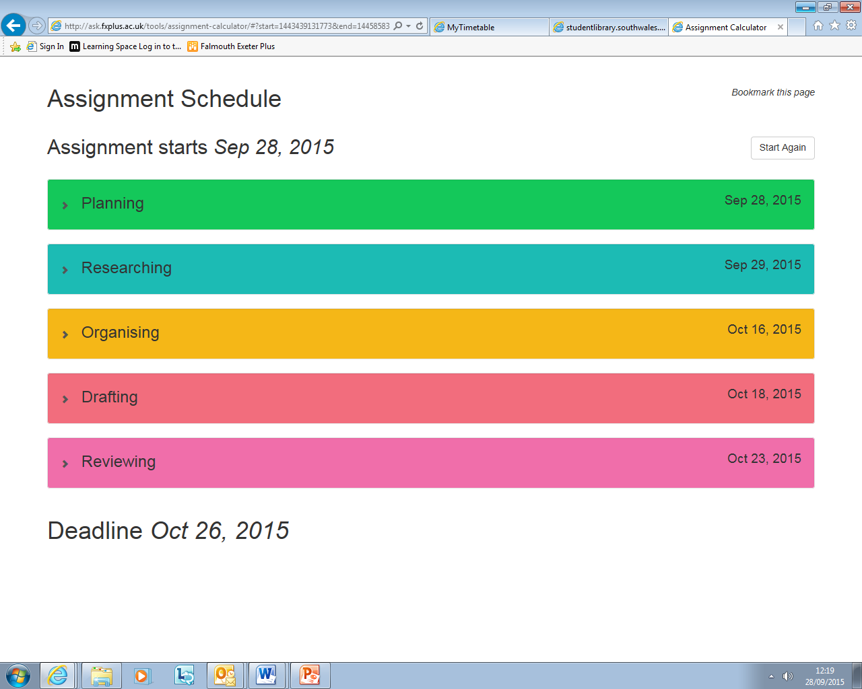
Assignment calculator

Slide 7
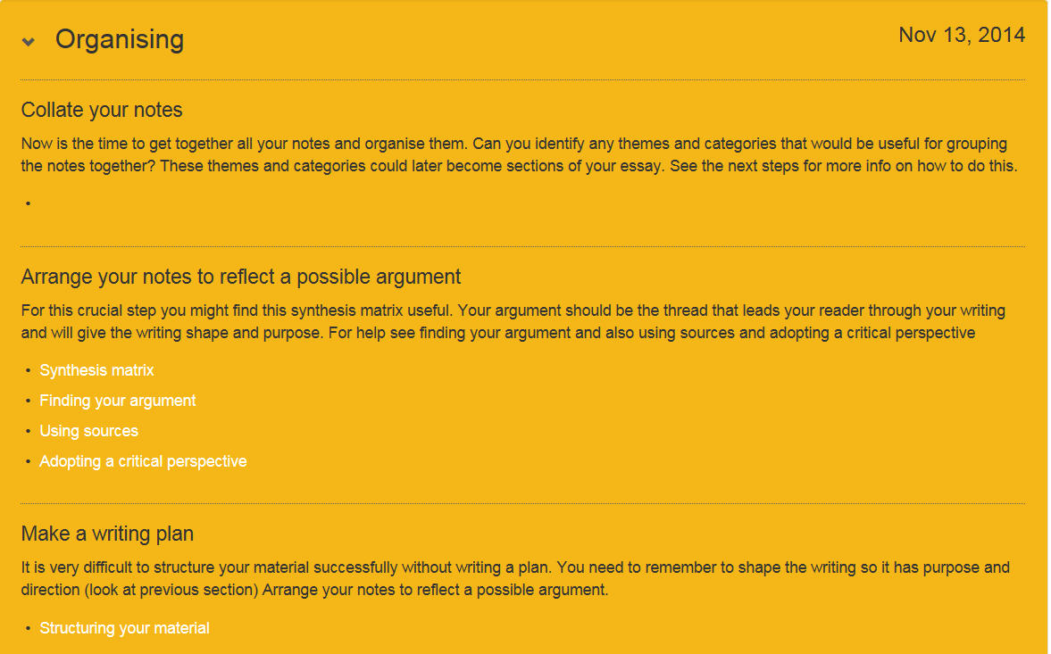
organising

Slide 8
what does argument mean?
the argument is the point of view about your source material that you are putting across – it is the sense that you have made of your source material and that you are communicating to the reader
a clear argument will provide direction for the writing
makes a claim
develops a perspective you can support
a vague/undeveloped argument will make it harder work to keep on track
if you don’t know where the writing will lead or what your conclusions are it is easy to get dragged off on tangents
Notes:
try to write out your argument – what are you trying to say?

Slide 9
the ‘rules’
introduction 10%
conclusion 10%
divide what’s left (‘main body’) into 3
and if necessary into 3 again
a paragraph is usually between 150 and 250 words
every paragraph needs to make a point supported by explanation and evidence

Slide 10
introduction 100 words
first part – theme/idea A 300 words (2 paragraphs)
middle part – theme/idea B 300 words (2 paragraphs)
third part - theme/idea C 300 words (2 paragraphs)
conclusion 100 words
Notes:
students to try to make a rough outline of their writing up

Slide 11
synthesis matrix
 | book/article1 | book/article 2 | book/article 3 | book/article 4 | book/article 5
Theme A | 3 planes of learning, community, interpersonal and personal p6 central to view of situated learning is that all 3 planes have to be considered in developing understanding of any one plane |  |  | [Elwood's spectrum or continuum is like figure 2.1]I prefer the planes and the individualisation - especially as my job involves a lot of work with individual learners.
Theme B |  | Meaning exists in the dynamic relation of living in the world. P31. | Cognitive development occurs as people learn to use cultural tools for thinking… with the help of others more experienced with such tools and cultural insitutions. P49
Theme C |  | Reification can be both process and product p37. Creates points of focus around which negotiation of meaning becomes organised p36. Dangers of classification and thingness p38 | P51 cultural tools inherited can be extended, modified, passed on. Quote vygotsky p82 as people engage in joint activity the ways in which they think and act accommodate to the functions and limitation so tools in use.

Slide 12
synthesis matrix
 | McCormick and Murphy 2000 | Wenger 1998 | Rogoff 2003 | Elwood 2008 | Dysthe and Engelsen 2004 | Sfard 2006 | Hicks 2001 | Holland et al 1998
Critique of spectrum | 3 planes of learning, community, interpersonal and personal p6 central to view of situated learning is that all 3 planes have to be considered in developing understanding of any one plane |  |  | [Elwood's spectrum or continuum is like figure 2.1]I prefer the planes and the individualisation - especially as my job involves a lot of work with individual learners. |  | Particpationist v traditional acquisitionist. Thinking originates in interpersonal communication. [learning starts collectively and then individualised] strong capacity to learn from others. Participation does not deny the need for biological pre-requisites. P124 unit of anlaysis eg activity, practice, forms of life all have collective and individual versions. P124
Negotiation of meaning participation reification. Cultural tools cultural scripts |  | Meaning exists in the dynamic relation of living in the world. P31. | Cognitive development occurs as people learn to use cultural tools for thinking… with the help of others more experienced with such tools and cultural insitutions. P49 |  |  | Unit of analysis practice, activity, form of life. p.124 T wo complementary processes – individualisation of the collective and the collectivisation of the individual. [learning and thinking tend to be equated – what about the learning of movement expressive or repetitive, improvisation where do these fit? What about practice eg of an instrument, involves learning but not entirely about ‘thinking’. ] 128 participation is not always learing – there must be some discrepancy. Need to make sense of what other people think – how they act
Idea of the essay and academicness |  | Reification can be both process and product p37. Creates points of focus around which negotiation of meaning becomes organised p36. Dangers of classification and thingness p38 | P51 cultural tools inherited can be extended, modified, passed on. Quote vygotsky p82 as people engage in joint activity the ways in which they think and act accommodate to the functions and limitation so tools in use. |  |  | Endorsed narratives – sets of propositions accepted as true by community [ but what happens if overlapping communities don’t accept the same propositions in the same way]
Identity and belonging | P5 a novice starts on the outside of the community and, as understanding increases, moves towards more central participation in that community of practice, eventually taking part in its transformation. Formation of sense of identity is learning and the identity itself is knowledge. P8 In the formation of identity the agency of an individual builds up skills and knowhow based on successes and failures. When individuals move into a new situation they may (or may not) want to become part of that and share the identity of those that belong. P9 no separation of cognitive and affective aspects of knowledge – identity is made up of both. | Participation as a source of identity – goes beyond the direct engagement (see identity below) p 34 | P55. A person develops through participation in an activity changing to be involved in the situation in ways that contribute to the ongoing event and to the person’s preparation for involvement in similar events. [this is all a bit positive – what about negative events that in some way damage or distress the individual] |  |  | P127 human society divided into partially overlapping communities of discourse. P126 natural human tendency for alignment [?] endorsed narratives – sets of propositions accepted as true by community. P128 – l[earning maths – the little girls imitate aspects of adult behaviour and language without understanding. Are rehearsing, trusting. ] a ritual, a game played with others for the sake of togetherness. P128. | [jake doesn't feel like he belongs - need to create or ifnd a space to act in ways that feel authentic - fit in with his understanding of own identity. SG Jake needed opportunite in school to see a cultural space ofr the things he most valued. tand to have his literacy skills recognised and validated. he did not feel that he had a sposition of legitimacy within the schooled community from which to negotiate its meanings. He did not experince mutuality int he settings in school.. instead the space that was extended to him as increasingly for tasks that made no sense. p116 sg his idenitity was one of not belonging and of restricted competence. | [language we use and the way we use it plus deeds, places emotions, clothes are an 'index to social relationships' we signal membership of different groups - social, gender.] in new and strange groups eg female african americanstudents can try 'passing' ie pretending. some accept some oppose. can exclude other people (eg by use of language). some people not accepted perhaps ridiculted . people develop different relational identities in different worlds. mulitple selves p 155 relational identities are publicly performed. aspirations dreams about being a photographer, an artist, a student, an adult in the world. HE v much about aspiration - probably much more so than school or employment.

Slide 13
 | Wenger 1998 | Rogoff 2003 | Sfard 2006 | Holland et al 1998
Negotiation of meaning participation reification. Cultural tools cultural scripts | Meaning exists in the dynamic relation of living in the world. P31. | Cognitive development occurs as people learn to use cultural tools for thinking… with the help of others more experienced with such tools and cultural insitutions. P49 | Unit of analysis practice, activity, form of life. p.124 T wo complementary processes – individualisation of the collective and the collectivisation of the individual. [learning and thinking tend to be equated – what about the learning of movement expressive or repetitive, improvisation where do these fit? What about practice eg of an instrument, involves learning but not entirely about ‘thinking’. ] 128 participation is not always learing – there must be some discrepancy. Need to make sense of what other people think – how they act
Identity and belonging | Participation as a source of identity – goes beyond the direct engagement (see identity below) p 34 | P55. A person develops through participation in an activity changing to be involved in the situation in ways that contribute to the ongoing event and to the person’s preparation for involvement in similar events. [this is all a bit positive – what about negative events that in some way damage or distress the individual] | P127 human society divided into partially overlapping communities of discourse. P126 natural human tendency for alignment [?] endorsed narratives – sets of propositions accepted as true by community. P128 – l[earning maths – the little girls imitate aspects of adult behaviour and language without understanding. Are rehearsing, trusting. ] a ritual, a game played with others for the sake of togetherness. P128. | [language we use and the way we use it plus deeds, places emotions, clothes are an 'index to social relationships' we signal membership of different groups - social, gender.] in new and strange groups eg female african americanstudents can try 'passing' ie pretending. some accept some oppose. can exclude other people (eg by use of language). some people not accepted perhaps ridiculted . people develop different relational identities in different worlds. mulitple selves p 155 relational identities are publicly performed. aspirations dreams about being a photographer, an artist, a student, an adult in the world. HE v much about aspiration - probably much more so than school or employment.
student belonging |  |  |  | place where person can no longer speak or even think inhis or her native voice p 153 - not sure about this. p 157 figured identities are reproduced in the imagination p 157 consists of dreams, visions, aspirations

Slide 14
quotation or paraphrase
‘Minicomputer makers, however, still largely followed the highly integrated model pioneered by mainframe makers. They provided hardware, operating systems, and some applications—though they often charged separately for the apps. The biggest challenges to the industry’s traditional structure and way of doing business were under way but almost invisible. Few noticed as the foundations were being laid for the PC revolution. The ensuing story has been told often, so we will just sketch some of the highlights’.
https://mitpress.mit.edu/sites/default/files/titles/content/9780262050852_Download_the_full_text.pdf

Slide 15
using other people’s words…
In the 1970s. before the PC Revolution, ‘minicomputer makers […] largely followed the highly integrated model pioneered by mainframe makers’ (Evans et al 2006: 85).
EVANS, David S, Andrei HAGIU, and Richard L. SCHMALENSEE. 2006. Invisible engines: how software platforms drive innovation and transform industries. Cambridge, MA: The MIT Press.

Slide 16
Referencing a game
In your writing:
The Dead Space series – which includes Dead Space (2008) and Dead Space (2011) – uses progressively more sophisticated gameplay mechanics…
In your reference list:
Dead Space. 2008. EA Redwood Shores, Electronic Arts.
Dead Space 2. 2011. Visceral Games, Electronic Arts.
Because we don’t have an individual author or creator we are using the title of the game(in italics) to begin the reference. You may be asked by your course to also include the format or platform if appropriate. In this case we have included the studio or division of EA which is responsible.

Slide 17
Some useful online sources
The OWL at Purdue - paragraphs
Monash University – Writing Skills
Royal Literary Fund - Argument
Sandra Gollin Kies – Structure
ASK Assignment Calculator and Essay Guide and referencing guides
RefMe

Slide 18
Recommended reading:
COTTRELL, Stella. 2008. The Study Skills Handbook. Basingstoke: Palgrave Macmillan.
CRÈME, Phyllis and Mary LEA. 2008. Writing at University: A Guide for Students (3rd Edition). Milton Keynes: Open University Press.
GODFREY, Jeanne. 2009. How to Use your Reading in your Essays. Basingstoke: Palgrave Macmillan.
PECK, John and Martin COYLE. 1999. The Student’s Guide to Writing. Basingstoke: Palgrave Macmillan.

Slide 19
ASK: Academic Skills
Falmouth Office
The Hub
Monday- Friday 9.00 am – 5.00 pm
01326 370438
Referencing drop-in
Falmouth Campus Library
Tuesday
12.30 pm to 1.30 pm
Penryn Office
Tremough House
Monday – Friday 9.00 am – 5.00 pm
01326 370438
website: ask.fxplus.ac.uk
email: ask@falmouth.ac.uk

