Slide 1

7: Memory
COMP110 Principles of Computing

Slide 2
Research journal
Presentations this week
Check your timetable
Peer review next week
Have a draft ready!

Slide 3
Worksheets
No worksheet this week
If you still have worksheets to complete, there is still time!

Slide 4
What is memory?
Allows the computer to store data
Usually when we say “memory” we mean Random Access Memory (RAM)
Readable and writable
Volatile (loses its contents when the machine is powered off)
Also encompasses
Read Only Memory (ROM)
Cache
Non-volatile storage (SSD, hard disk, flash memory, …)

Slide 5
Memory hierarchy
Registers
Cache
Graphics memory
Low capacity (high £/MB)
Fast
Short-term
Registers
Cache
Main memory
Solid state disk (SSD)
Hard disk
Magnetic tape
GPU
On CPU
In computer
Outside computer
Volatile
Non-volatile
Network storage (NAS)
Cloud storage
High capacity (low £/MB)
Slow
Long-term

Slide 6
Registers
Memory locations on the CPU itself
Very fast to read and write
Typically hold intermediate results of calculations, and values about to be used by other instructions
Intel x64 processor has ~40 registers, each 64-bit, so a total of ~320 bytes of register memory

Slide 7
Cache
A small amount of RAM on the CPU itself
Very fast, but not quite as fast as registers
Can be further divided into levels, lower levels being smaller and faster
Typically hold frequently or recently used data to avoid having to fetch it from main RAM
Clever algorithms to determine what to store
On a recent CPU (Intel Core i9 Comet Lake):
Level 2 cache: 10 x 256KB (divided between 10 cores) = 2.5MB
Level 3 cache: 20MB (shared between all cores)

Slide 8
But what is memory?
All types of memory are just ways of storing binary digits (bits – 0s and 1s)
These are organised into bytes
Conceptually, memory is a sequence of bytes, each with a numerical address

Slide 9
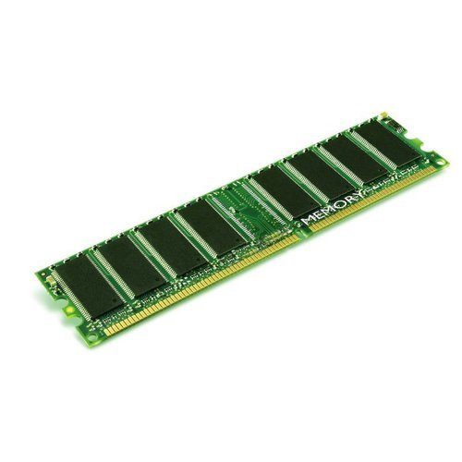
Physical addressing
Address | Contents
00000000 | 01101011
00000001 | 10001011
00000002 | 10111000
00000003 | 11000110
00000004 | 11000010
00000005 | 00000001
… | …

Slide 10
Virtual Addressing
Historically, programs used physical addressing
Nowadays, the operating system hides the physical addressing of memory and gives programs a virtual address space
This allows for multitasking (programs can coexist)
Means the OS can decide how to map virtual memory to physical memory
Keep frequently accessed data in cache
Move infrequently accessed data to a swap file on disk
Allocate memory lazily rather than all at once
Keeping memory spaces of programs separate helps stability and security

Slide 11
Virtual addressing
Virtual addressing is an abstraction of the underlying physical memory
We can’t get away from this particular abstraction without hacking the OS
Most of the time we can take for granted that the abstraction works
Understanding the abstraction can be useful for optimisation
Data-oriented design is one example of this

Slide 12


Memory allocation
Programs can allocate memory in contiguous blocks
E.g. malloc in C, new in C++
I need 1000 bytes of memory
OK, your memory starts at virtual address 2468454

Slide 13
Memory deallocation
Programs can deallocate a previously allocated memory block
E.g. free in C, delete in C++
I have finished with the 1000 bytes of memory starting at 2468454
OK

Slide 14
Memory leaks
Forgetting to deallocate memory that is not needed any more is called a memory leak
A common source of bugs in C/C++ programs
Generally leads to program’s memory usage increasing over time, eventually exceeding physical memory capacity

Slide 15
Managed memory
Many high-level languages use a managed memory model
Including C#, Python, Java, JavaScript, …
A garbage collector (GC) detects when a block of memory is not needed any more, and deallocates it automatically
GC takes some CPU resources, but eliminates risk of memory leaks

Slide 16
Storing numbers
Integer numbers are stored in memory using binary notation
8-bit numbers stored in 1 byte
Larger numbers stored in multiple consecutive bytes, in one of two ways…

Slide 17
Endianness
E.g. storing the 16-bit number 1234
Binary: 0000010011010010
Big endian format:
Little endian format:
First byte | Second byte
00000100 | 11010010
First byte | Second byte
11010010 | 00000100

Slide 18
Which endian?
Modern PCs (Intel x64) use little endian
Main advantage is ease of converting between different sizes of integer value
 | 1st byte | 2nd byte | 3rd byte | 4th byte | 5th byte | 6th byte | 7th byte | 8th byte
16-bit | 11010010 | 00000100
32-bit | 11010010 | 00000100 | 00000000 | 00000000
64-bit | 11010010 | 00000100 | 00000000 | 00000000 | 00000000 | 00000000 | 00000000 | 00000000
 | 1st byte | 2nd byte | 3rd byte | 4th byte | 5th byte | 6th byte | 7th byte | 8th byte
16-bit | 00000100 | 11010010
32-bit | 00000000 | 00000000 | 00000100 | 11010010
64-bit | 00000000 | 00000000 | 00000000 | 00000000 | 00000000 | 00000000 | 00000100 | 11010010

Slide 19
Storing other data
Any data stored by a computer can be thought of as a sequence of numbers
Text: sequence of character codes in ASCII, UTF-8 etc (see week 3)
Graphics: sequence of RGB pixel values (see COMP120)
Audio: sequence of sample values representing sound waves (see COMP120)
Video: sequence of image frames and accompanying audio
3D mesh: sequence of vertex coordinates
Executable: sequence of CPU instruction opcodes and parameters (see week 12)

Slide 20
Short-term vs long-term storage
Previous slide describes raw forms of data storage
Typically used in RAM to allow for efficient computation
Non-volatile storage (SSD, HDD etc) generally uses other data formats
Compression – especially where data access speed > time to decompress
Headers and metadata for file interchange
Standardised file formats vs application-specific memory layout

Slide 21
Data storage formats
Text: usually still raw text in ASCII / UTF-8 etc
Graphics: JPEG, PNG, BMP, TIFF,…
Audio: WAV, FLAC, OGG, MP3, …
Video: MP4, AVI, …
3D mesh: OBJ, FBX, …
Executable: EXE (contains machine code and metadata)

Slide 22
Summary
Memory refers to how computers store data
Memory stores bits, or sequences of numbers in binary – all other data reduces down to this
There is a hierarchy of memory – fast to slow, small to large, temporary to permanent
Virtual memory and garbage collection are useful abstractions for us as programmers

