Slide 1
magnitude
y
direction
x

Slide 2
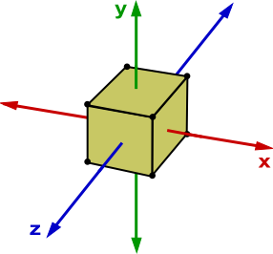
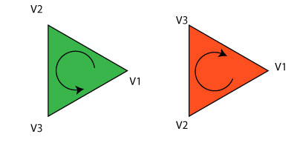
D
C
A
B
F (behind)
G
E
H
A
D
B
C

Slide 3
X
Y
Z
R
G
B
A
V₀
V₁
V₂

Slide 4
X
Y
Z
R
G
B
A
-0.5 | -0.5 | 0.0 | 1.0 | 0.0 | 0.0 | 1.0
0.5 | -0.5 | 0.0 | 0.0 | 1.1 | 0.0 | 1.0
0.0 | 0.2 | 0.0 | 0.0 | 0.0 | 1.0 | 1.0
V₀
V₁
V₂

Slide 5
Stride
X
Y
Z
R
G
B
A
-0.5 | -0.5 | 0.0 | 1.0 | 0.0 | 0.0 | 1.0
0.5 | -0.5 | 0.0 | 0.0 | 1.1 | 0.0 | 1.0
0.0 | 0.2 | 0.0 | 0.0 | 0.0 | 1.0 | 1.0
V₀
V₁
V₂

Slide 6
Offset = 3 * sizeof(float)
X
Y
Z
R
G
B
A
-0.5 | -0.5 | 0.0 | 1.0 | 0.0 | 0.0 | 1.0
0.5 | -0.5 | 0.0 | 0.0 | 1.1 | 0.0 | 1.0
0.0 | 0.2 | 0.0 | 0.0 | 0.0 | 1.0 | 1.0
V₀
V₁
V₂

Slide 7








$$E$$
$$C$$
$$T3$$
$$T1$$
$$T2$$
$$D$$
$$A$$
$$B$$
vertexA | vertexB | vertexC | vertexD | vertexE
0 | 1 | 2 | 3 | 4
Vertex buffer
0 | 1 | 2 | 1 | 3 | 2 | 3 | 4 | 2
Index buffer
Triangle 1
Triangle 2
Triangle 3

Slide 8







Screen space
$$y$$
World space
Camera space
$$x$$
$$y$$
$$y$$
$$z$$
$$z$$
Object spaces
Centre of Projection (COP)
$$x$$
View plane (screen)
$$x$$

