Slide 1
Research PRACTICE
COMP320
Research Philosophies and Putting them into Practice

Slide 2
Objectives for Today
After this session, you should be able to:
Explain what ‘computing’ research is
Discuss the main characteristics of different research philosophies
Recognize the challenges associated with different forms of reasoning
Analyze how research methods are justified through underpinning philosophy

Slide 3
Objectives for Today
Why bother reviewing philosophy?
Helps you reflect upon and sharpen your thinking about the nature of knowledge and how it is constructed
Provides a framework that underpins your activity as a scientist in your chosen field, helping you to make decisions about your work
Shapes your engagement with the work of others
Prepares you to better articulate the justification for your choice of research method

Slide 4
Objectives for Today
1. Research
2. Research Philosophy
On the Philosophy of Science
Characteristics of Research Philosophies
Ontologies
Epistemologies
Axiology
3. Methods of Reasoning and Inference
Deductive
Inductive
Abductive
4. Well-Known Research Philosophies
Positivism vs Interpretivism

Slide 5
Research
Understanding the Path to Discovery

Slide 6
What Is Research?
What do you understand by the term ‘research’?
What distinguishes business and management research from research more generally?

Slide 7
Group Activity
In groups of 4-6:
Discuss some potential answers to these questions with your peers (5 minutes)
Sketch how you see research (5 minutes)
Explain your sketch to the other groups (5 minutes)

Slide 8
What is Computing Research?
A systematic inquiry, the objective of which is to provide information to solve technical problems* with computational solutions.
Trans-disciplinary --- computers are used in nearly every field.
Engages both with theory and practice
Used in every area of computing for games:
Algorithms: collision detection, AI techniques, distributed systems
Development Practice: software engineering techniques, dev strategies
Effects: perception of quality, technology-design relation, software psychology
* any problem or opportunity that requires insight about technology or social effect of technology

Slide 9
What is Computing Research?
Research
Research-informed Practice
Traditional Research
Practice-based Research
Practice-led Research
Invention
Practice as Research
Practice

Slide 10
What is Computing Research?
Research
Research-informed Practice
Traditional Research
Practice-based Research
Practice-led Research
Invention
Practice as Research
Practice

Slide 11
What is Good Research?
Standards of the scientific method:
Purpose clearly defined
Any statement of the decision or problem should include its scope, its limitations, and the precise meanings of all words and terms.
Research process detailed
Research procedures used should be described in sufficient detail to permit another researcher to repeat the research
Research design thoroughly planned
Sampling, data collection procedures, experimental controls etc. planned.
Limitations clearly stated
Report, with complete honesty, any flaws in procedural design, and estimate their effect on the research findings. There is no such thing as a perfect research design!
High ethical standards applied
Safeguard against causing mental or physical harm to participants and that makes data integrity a first priority should be valued highly.

Slide 12
What is Good Research?
Standards of the scientific method:
Adequate analysis for decision maker’s needs
Analysis is sound and claims are based on the evidence
Findings presented unambiguously
Use restrained, clear and precise language. Other researchers should be able to replicate the findings.
Conclusions justified
Conclusions should be limited to those for which the data provide an adequate basis. Don’t over-interpret or over-generalise.
Researcher’s experience reflected
The researcher is experienced, has a good reputation in the research field and is a person of integrity.

Slide 13
Research Philosophy
What is ‘knowledge’?

Slide 14
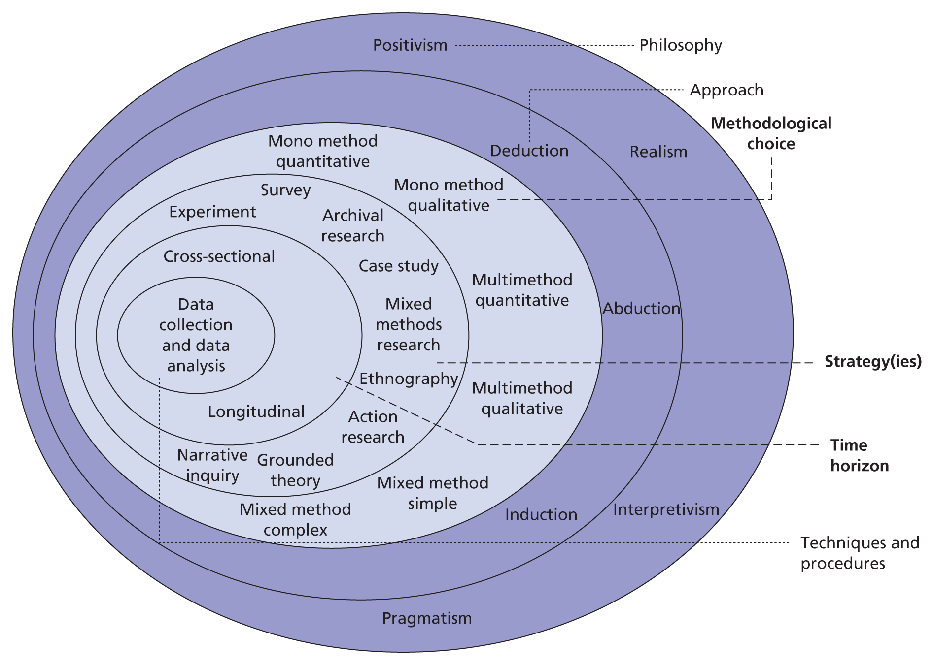

Slide 15
What is Research Philosophy?
An overarching term relating to the development of knowledge and the nature of that knowledge.

Slide 16
What is Research Philosophy?
All research is based on assumptions about how the world is and how we can best come to understand it
These assumptions (and practical considerations) will guide our research strategy and methods
One research question, different approaches and choices.
There are many philosophies – none is ‘better’ than the other...

Slide 17
Characteristics of Research Philosophies
Ontology – your view of the nature of reality; assumptions on what the world is and how the world works
Epistemology – your view of the nature of knowledge; beliefs on what constitutes knowledge and acceptable evidence
Axiology – your view of value; the purpose of research; role of researchers; how researchers should conduct themselves to add value
Reasoning – they way in which researchers make sense of things and infer conclusions

Slide 18
Ontology
What constitutes reality?
How can we understand existence?
“facts are facts” – there is a truth
“people are people” – truth is complex and relative to individuals
“we all observe the same objective reality”
“reality is transient and socially constructed”

Slide 19
Epistemology
What constitutes valid knowledge?
How can we obtain valid knowledge?
“empiricism - observation and evidence”
“rationalism - reasoning by debate”
“constructivism – from experience”

Slide 20
Epistemology
What constitutes valid knowledge?
How can we obtain valid knowledge?
“results must be replicated by others”
“depth and individual variation is valid”

Slide 21
Epistemology
What constitutes valid knowledge?
How can we obtain valid knowledge?
“only has value if potentially falsifiable”
“justifiable beliefs count as knowledge”

Slide 22
Axiology
The study of the nature of value and valuation:
Pragmatics --- research justified by the current needs of a society, change shape to do what works best on the ground
Idealism --- research activity guided by ideology and foundational principles, follow principles (particularly those from the enlightenment)
Objectivism --- researchers should distance themselves from their work as undue interference compromises the value of the work
Subjectivism --- all contributions have value, they offer unique perspectives and wisdom, no matter their muddiness

Slide 23
Axiology
Idealism
Objectivism
Subjectivism
Pragmatism

Slide 24
Activity: What Are Your Thoughts?
In pairs:
Focus on your own field and discipline*
Discuss your ontological beliefs
Discuss your epistemological beliefs
Discuss your axiological beliefs
Come to some choice and justification.
You will then present your thoughts to the class
You have:
5 minutes to reflect
10 minutes to discuss and take notes
1 minute each to present
*recall the distinction we made last week

Slide 25
Methods of Reasoning
How ‘do we know’ what we know?

Slide 26
Methods of Reasoning
How do you draw conclusions?
When do you use theory?
Are you starting with a theory?
Are you finishing with a theory?
Deduction
Induction
Abduction

Slide 27
Deduction
Conclusions follow necessarily from the stated premises:
Premise 1: All humans are mortal.
Premise 2: Socrates is a human.
Conclusion: Socrates is mortal.
Deduction is generally an inference by reasoning from the general to the specific.
The reasoning in this argument is valid, because when premises, 1 and 2, are true then the conclusion, 3, cannot be false.

Slide 28
Deduction
Theories are developed and a research strategy designed to assess hypotheses:
Theory
Hypotheses
Observation
Confirmation

Slide 29
Deduction
Falsificationism is based on deductive reasoning
H: All swans are white
O: I observe a black swan
Conclusion: H is false

Slide 30
Deduction
Falsificationism is based on deductive reasoning
H: All swans are white
O: I observe a black swan
Conclusion: H is false
Is this conclusion correct?

Slide 31
Induction
Conclusions, either specifically or generally, are made based on previous observation(s).
Premise 1: The Sun has risen in the east today
Premise 2: The Sun has risen in the east today
Conclusion: The Sun will rise in the east tomorrow
Induction is generally an inference by reasoning from the specific to the general
The truth of the premises does not guarantee the truth of the conclusion.

Slide 32
Induction
Data are collected and theories are developed as a result of the analysis:
Theory
Tentative Hypothesis
Pattern
Observation

Slide 33
Induction
Inductivism is based on inductive reasoning:
O1: Iron is magnetic
O2: Nickel is magnetic
O3: Cobalt is magnetic
Conclusion: All metals are magnetic

Slide 34
Induction
Inductivism is based on inductive reasoning:
O1: Iron is magnetic
O2: Nickel is magnetic
O3: Cobalt is magnetic
Conclusion: All metals are magnetic
Is this conclusion correct?

Slide 35
Abduction
Use theory and argument to determine the best conclusion from premises
Premise 1: The lawn is wet
Theory: If it rained, then it would be unsurprising that the lawn is wet
Conclusion: It rained
Abduction is generally inference by selecting the most probable conclusion
The truth of the premise and the theory does not guarantee the truth of the conclusion, such that they are “sufficient but not always necessary”

Slide 36
Abduction
Data are collected and the most probable theory is selected:
Observation
Tentative Hypothesis
Candidate Theories

Slide 37
Abduction
Diagnosis is often based on abductive reasoning, such that the best explanation is selected based on available evidence
Premise: The child has a fever
Premise: It is winter
Theory: It would be unsurprising for the child to have a cold if they have a fever in winter
Conclusion: The child has a cold

Slide 38
Abduction
Diagnosis is often based on abductive reasoning, such that the best explanation is selected based on available evidence
Premise: The child has a fever
Premise: It is winter
Theory: It would be unsurprising for the child to have a cold if they have a fever in winter
Conclusion: The child has a cold
Is this conclusion correct?

Slide 39
Reasoning
Inductivism
Derive conclusions from observation
Use evidence to create new theory
Specific to general
Falsification
Derive conclusions from observation
Use evidence to falsify existing theory
General to specific

Slide 40
Activity: What Are Your Thoughts?
In pairs or small groups:
Unpack the research method that you might deploy in your particular study
Discuss the approach(es) to reasoning that you might deploy as part of that method
Try to identify how this aligns with the philosophies discussed earlier
Share your thoughts to the class
You have:
5 minutes to reflect
10 minutes to discuss and take notes
1 minute each to present

Slide 41
Well-Known Research Philosophies
Who knows what?

Slide 42
What is Research Philosophy?
There are four well-known research philosophies:
Positivism
Interpretivism
Realism
Pragmatism
We will compare positivism and interpretivism. Review the other two independently.

Slide 43
Positivism
Origin in natural sciences
Only observable phenomena lead to credible data
Use existing theory to formulate hypothesis

Slide 44
Positivism
Collect data
Test hypothesis based on statistical analysis of data
Confirm or reject hypothesis
For example, two different researchers looking into the merger of two firms will arrive at the same conclusions, and a single explanation can be given.

Slide 45
Positivism
Key Principles:
The world exists externally and is viewed objectively
Research is value-free
‘Facts are facts’ – no influence from us
The researcher is independent, taking the role of an objective analyst.
Assumptions
The world is observed by collecting objective facts.
The world consists of simple elements to which it can be reduced.

Slide 46
Interpretivism
Can the social aspects of computing for games and technology be explained with the ‘law-like’ propositions of positivists?
Every technical interaction or situation, or associated social phenomenon is complex, and unique!
A situation which is a function of circumstances and individuals at a particular time, seen from the point of view of the individuals.
Research is done among people by people: ‘social actors’

Slide 47
Interpretivism
Key Principles:
the social world is constructed and is given meaning subjectively by people
the researcher is part of what is observed
research is driven by interests
Assumptions:
The social world is observed by seeing what meanings people give to it and interpreting these meanings from their viewpoint.
Social phenomena can only be understood by looking at the totality.

Slide 48
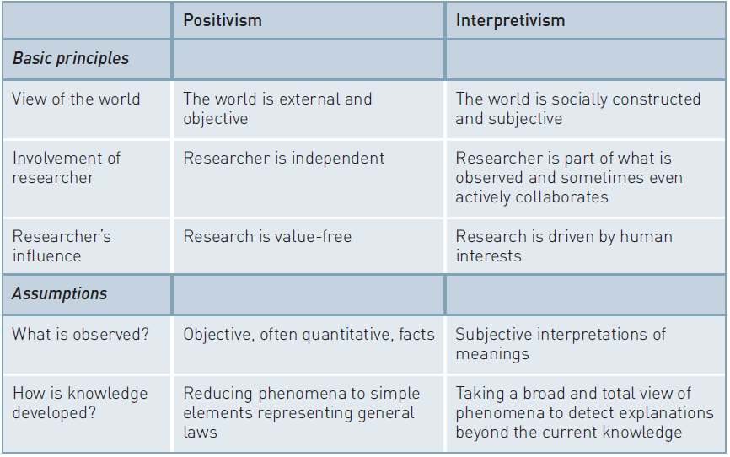
Positivism and Interpretivism

Slide 49
Activity: Mary’s Research
Mary decided to conduct a research project on stress in game studios, focusing on programmers and software defects.
How would you conduct this research?
What philosophies inform this choice?
Get into small groups.
You have:
5 minutes to reflect
10 minutes to discuss and take notes
2 minutes each to present

Slide 50
Philosophies and Approaches
Positivist Approach
Mary started with a hypothesis that higher levels of stress lead to a higher incidence of defects.
She decided to use a large number of programmers in a company.
She administered a questionnaire in order to establish their levels of stress as well as static code analysis and git blame to establish points at which defects were introduced into the game.
She found a strong relationship between levels of stress and the probability of checking a defect into source control.
She concluded that the data confirmed her hypothesis.
Interpretivist Approach
Mary interviews a number of key staff. She was interested in their views about possible causes of stress, their strategies to cope with stress at work, and how they viewed the company policies in relation to stress.
She also holds a focus group where programmers could, confidentially, reflect upon and discuss bugs they had introduced into the codebase, probing whether stress was a factor
Her data allowed her to make recommendations about possible causes of stress, working practices associated with stress-induced software defection, and how companies could better support their programmers.
Which is better, which more useful?

Slide 51
Next Week
Prepare for Ed’s Session

Slide 52
Task I - Hypotheses
A hypothesis is:
“a supposition or proposed explanation made on the basis of limited evidence as a starting point for further investigation”
It’s a provisional answer to your question!
By next week you should:
Tidy your research question
Review notes on hypotheses
Using your research question, devise at least ONE hypothesis
Strive to state hypotheses in a formal way

Slide 53
Task II - Ethics
If you intend to involve people in your research, you must obtain ethical clearance.
Even if you don’t, you still need your ethics signed-off!
https://goo.gl/cfbmcK
By next week you should:
Download and complete a draft of your ethics application form
Bring it with you to your supervision meeting

