Slide 1
Research PRACTICE
COMP320
Statistical Data Analysis II

Slide 2
Presentations

Slide 3
Presentations
Scheduled for Monday and Tuesday next week – check timetable for individual slots
Assessed on a threshold basis – i.e. turn up and present to pass
Prepare a 10 minute presentation
Use whatever you like to prepare slides
But please ensure you have your slides readily accessible on the day – I strongly advise bringing them on a USB stick rather than relying on the cloud!
Consider this a practice run for your proposal vivas after Christmas

Slide 4
What to include
(E) Deliver a 10-minute practice presentation that will:
explain the context of your project
identify and discuss the scientiﬁc literature relevant to your project
propose one or more research questions for your project
articulate the ethical considerations you have made
illustrate your approach to collecting, analysing, and presenting data

Slide 5
What to include
Part E consists of a single formative submission. This work is individual and will be assessed on a threshold basis. To pass, answer the following questions:
What is the context of your project? How does it ﬁt into the research ﬁeld of computing for games?
What are the key results from the literature upon which your project will be built?
What is the current state of knowledge in the ﬁeld? What are the open questions and challenges?
What is (are) the key research question(s) that you will seek to answer in your project?
What are the key legal, social, ethical, and/or professional issues associated with your project?

Slide 6
Effect Size

Slide 7
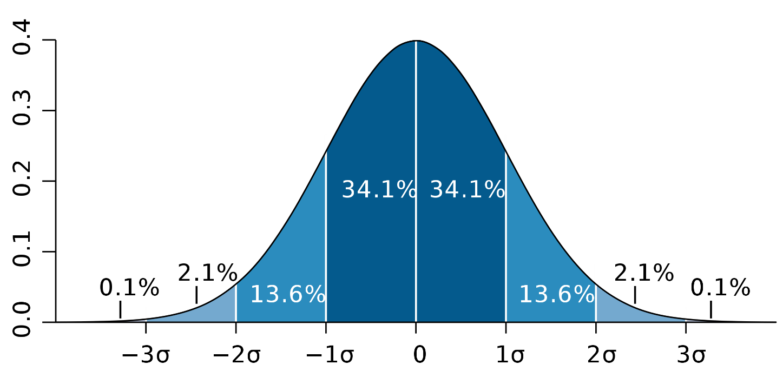

Standard Deviation
Denoted $σ$
A measure of the “width”, “spread”, “variability” of a normal distribution
https://commons.wikimedia.org/wiki/File:Standard_deviation_diagram.svg

Slide 8
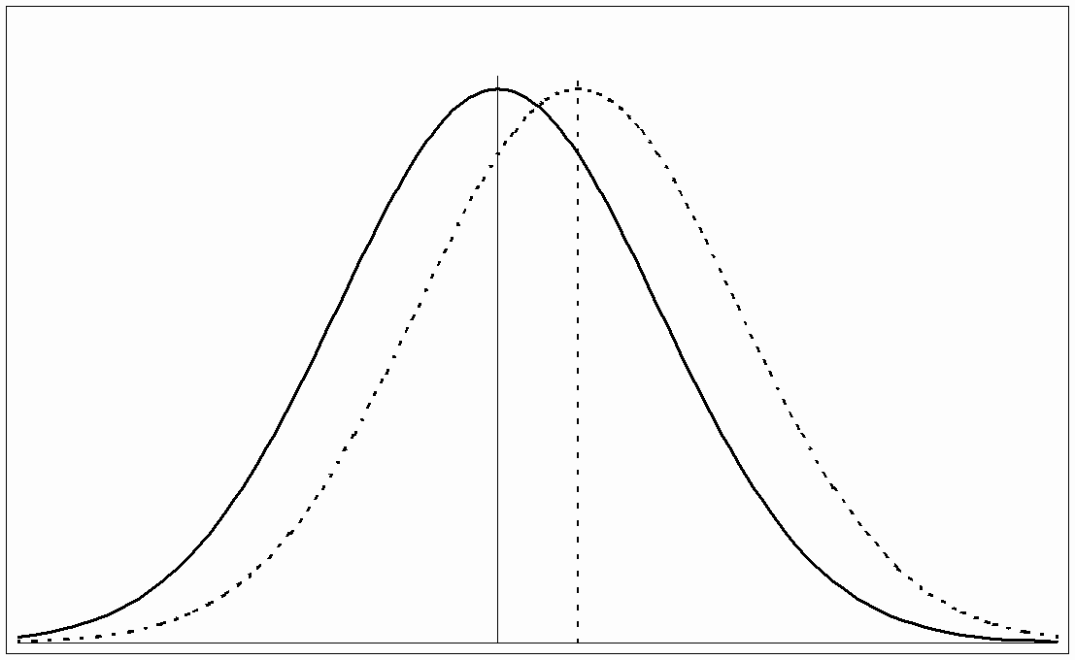
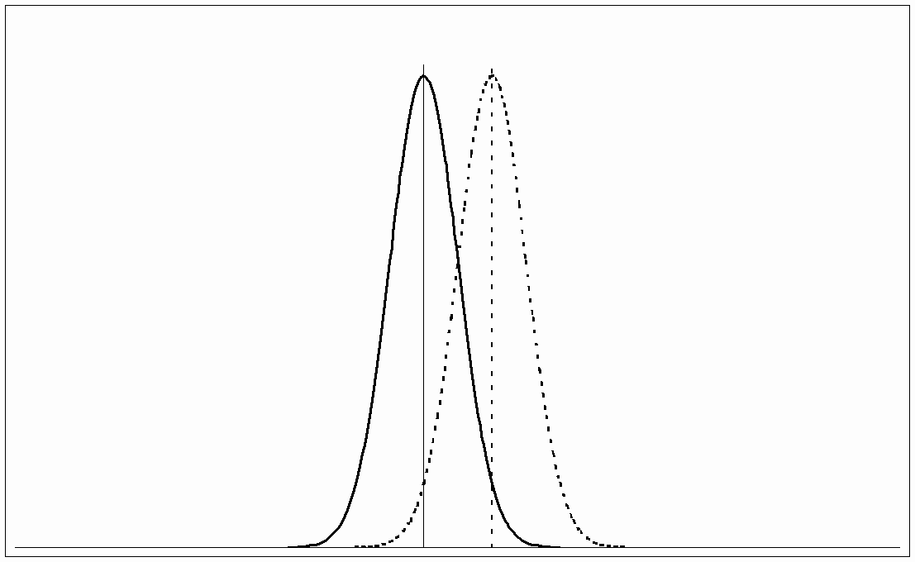

Effect Size
Consider two samples with means $μ_{1}$ and $μ_{2}$
Is the difference between $μ_{1}$ and $μ_{2}$ statistically significant?
https://www.leeds.ac.uk/educol/documents/00002182.htm

Slide 9
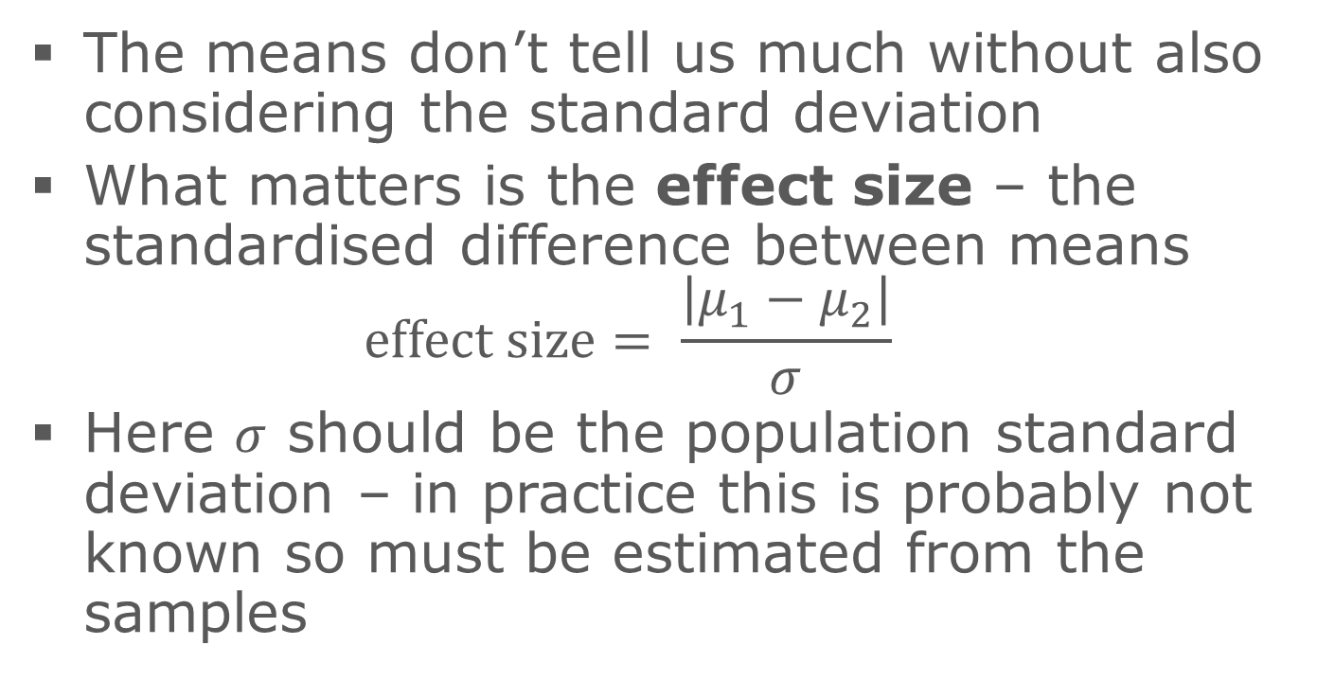
Effect Size
The means don’t tell us much without also considering the standard deviation
What matters is the effect size – the standardised difference between means $\text{effect} \text{size}= \frac{\left|μ_{1}−μ_{2}\right|}{σ}$
Here $σ$ should be the population standard deviation – in practice this is probably not known so must be estimated from the samples

Slide 10



Effect Size
So an effect size of 1 means that $μ_{1}$ and $μ_{2}$ are one standard deviation apart
$$μ_{1}$$
$$μ_{2}$$

Slide 11
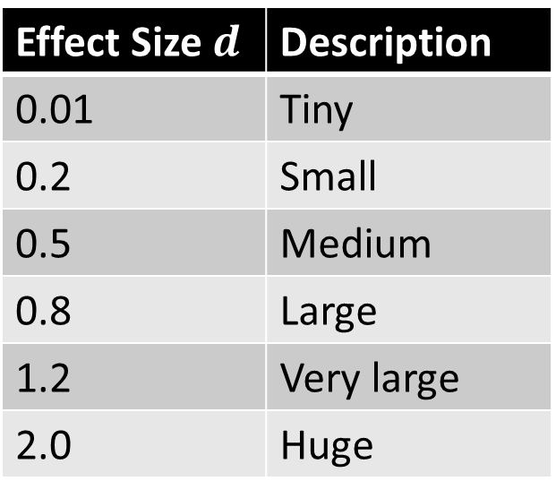
Effect Size – Rules of Thumb for t-tests
First proposed by Cohen (1988), expanded by Sawilowski (2009)
Effect Size $d$ | Description
0.01 | Tiny
0.2 | Small
0.5 | Medium
0.8 | Large
1.2 | Very large
2.0 | Huge

Slide 12
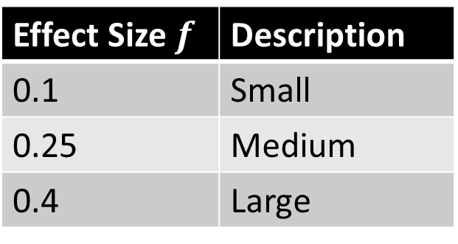
Effect Size – Rules of Thumb for ANOVA
ANOVA uses a different effect size measure, so Cohen has different guidelines:
Effect Size $f$ | Description
0.1 | Small
0.25 | Medium
0.4 | Large

Slide 13
Power Analysis with G*Power

Slide 14
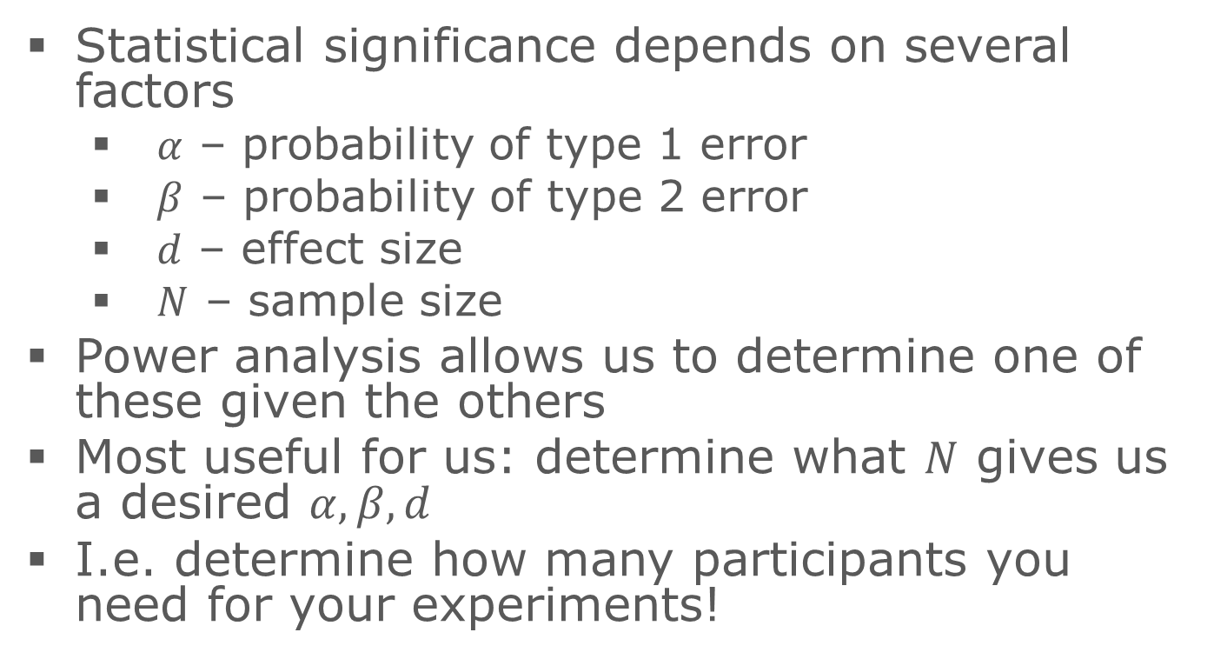
What is power analysis?
Statistical significance depends on several factors
$α$ – probability of type 1 error
$β$ – probability of type 2 error
$d$ – effect size
$N$ – sample size
Power analysis allows us to determine one of these given the others
Most useful for us: determine what $N$ gives us a desired $α,β,d$
I.e. determine how many participants you need for your experiments!

Slide 15
G*Power
Download from http://www.gpower.hhu.de/
Available for Windows and MacOSX

Slide 16
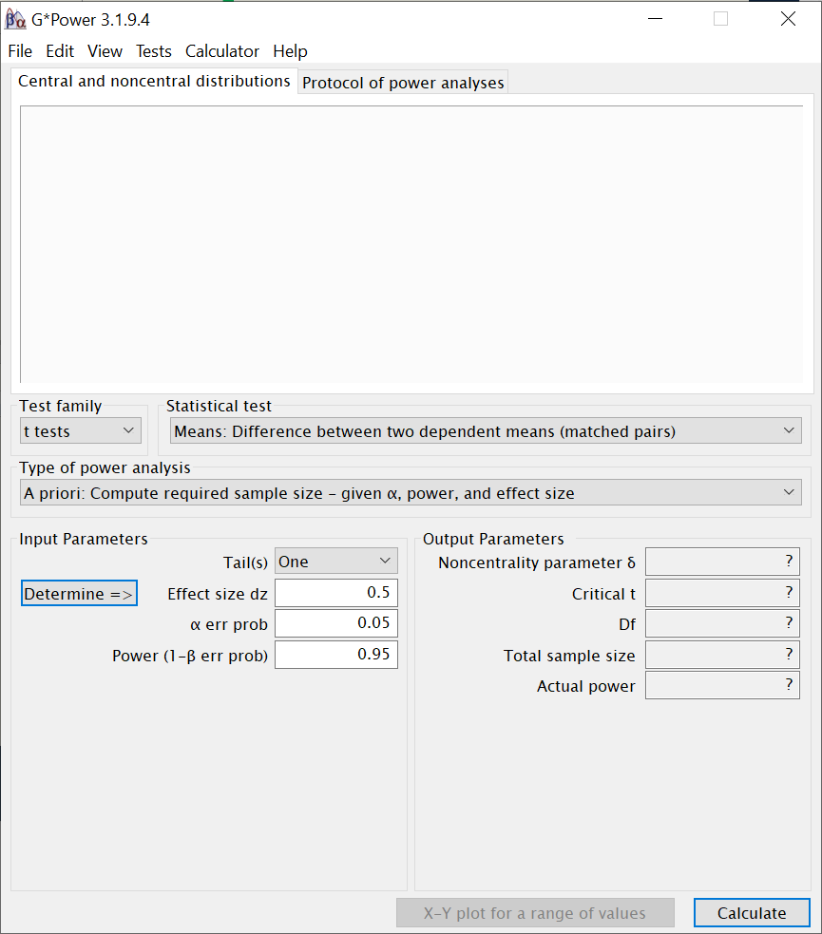
Common Settings
G*Power supports many different statistical tests – it’s vitally important to choose the correct one!
More on this in a few slides’ time

Slide 17
Common Settings
A priori analysis (to calculate sample size) is the most useful for us
Other settings are useful e.g. for analysing results a posteriori, for designing replication studies, etc.

Slide 18
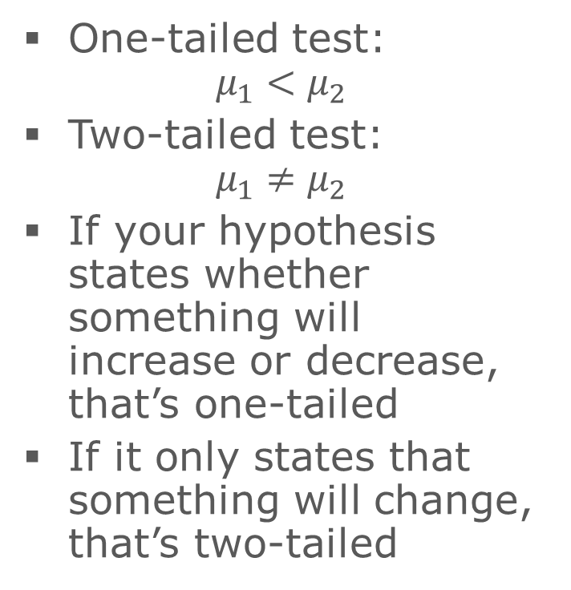
Common Settings
One-tailed test: $μ_{1}<μ_{2}$
Two-tailed test: $μ_{1}≠μ_{2}$
If your hypothesis states whether something will increase or decrease, that’s one-tailed
If it only states that something will change, that’s two-tailed

Slide 19
Common Settings
I recommend using Cohen’s guidelines to set effect size
For the scope of your dissertation project, best to stick to looking for “medium” (0.5) or “large” (0.8) effects
The “Determine” button is for calculating effect size from existing data

Slide 20
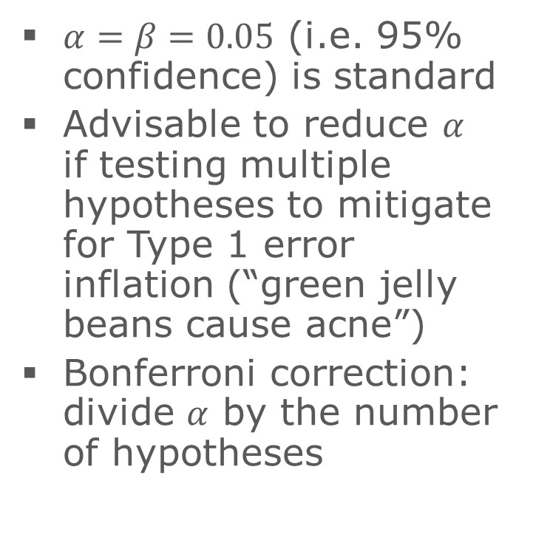
Common Settings
$α=β=0.05$ (i.e. 95% confidence) is standard
Advisable to reduce $α$ if testing multiple hypotheses to mitigate for Type 1 error inflation (“green jelly beans cause acne”)
Bonferroni correction: divide $α$ by the number of hypotheses

Slide 21
Common Settings
The total sample size is what we’re trying to find – the number of participants!

Slide 22
Example 1
Hypothesis: the presence of background music in a game affects the length of time the player takes to complete the level
Experiment design: A-B test (A=music, B=no music), each participant plays both variants in a random order

Slide 23
Example 1
We are comparing two means so we should use a t-test
How many tails?
Samples in the two groups are paired – same participants for both groups

Slide 24
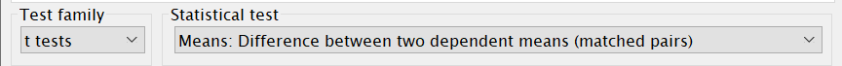
Example 1
Set the test:
All other settings as discussed on previous slides

Slide 25
Example 2
Hypothesis: Games Academy students will achieve a higher score in the game than students from other courses
Experiment design: two groups (GA students, non-GA students)

Slide 26
Example 2
We are comparing two means so we should use a t-test
How many tails?
Samples in the two groups are independent – different participants for each group

Slide 27
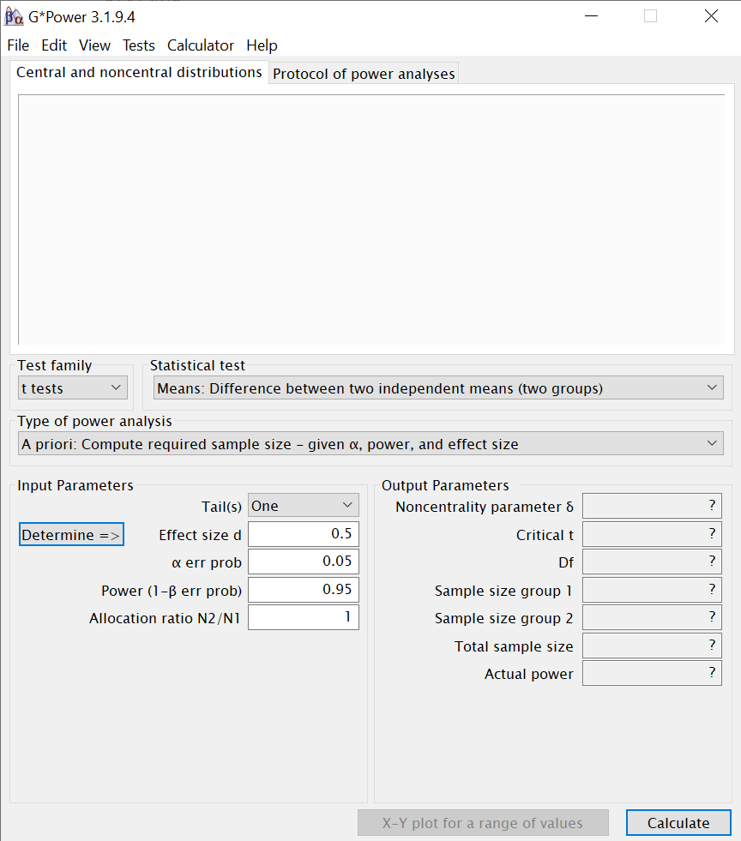
Example 2
Set the test:
Allocation ratio = 1 for equal number of participants in each group, or another value if not:
All other settings as discussed on previous slides

Slide 28
Example 3
Hypothesis: the colour of the protagonist’s hair in the game will influence the player’s enjoyment
Experiment design: multiple groups, each participant assigned to a group at random

Slide 29
Example 3
We are comparing more than two means so we should use ANOVA
ANOVA is always two-tailed (with more than two means we can’t make a one-tailed hypothesis)
One independent variable (colour) → one-way ANOVA

Slide 30
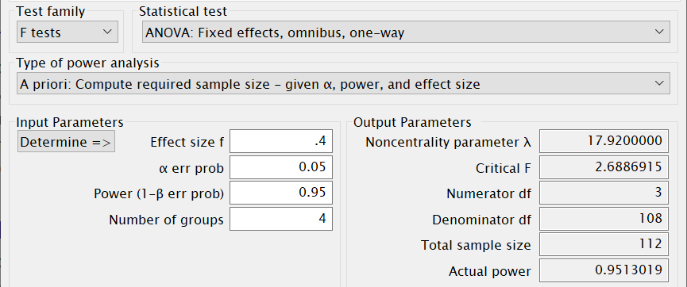
Example 3
Remember ANOVA uses a different effect size measure to t-tests so Cohen’s guidelines are different!
To be divided equally between groups

Slide 31
Information Presentation
Illustrating Your Findings

Slide 32
Information Presentation
There are various techniques for reformatting and reducing data to make the analysis more interpretable or to illustrate a key point
Graphical representations will also assist in decision making and reinforce the justification for those decisions --- e.g., has a hypothesis been falsified? To what extent is it clearly falsified?
An overall picture of the data can be gleaned and initial conclusions drawn
Notes:
32

Slide 33
Information Presentation
It is important to select the most effective ways to illustrate your findings in the dissertation
Your communication skills are under assessment --- keep all graphical depiction meaningful to justifying your analysis and/or your intellectual decisions
Provides an overall picture of the data underlying your findings to reach and support your conclusions
Be wary of delegating charts solely to important data:
Depictions can distort message of original data
Concise, but often lacks precision
Ensure adequate support in body of text
Leverage explicit references (e.g., “as shown in Figure 1”)
Notes:
33

Slide 34
Information Presentation
There are many ways of creating graphs in R and Rstudio!
We will use a library called ggplot2, which you may need to install and load
> install.packages("ggplot2", dependencies=TRUE)
> library(ggplot2)
Among its functions should be a qplot(), which covers most of the common charts.
Notes:
34

Slide 35
Information Presentation
Common formats for presenting information include:
Bar Chart
Histogram
Frequency Polygon & Ogive
Pie Chart
Scatter Plot
Box Plot

Slide 36
Do You Know Your Charts and Graphs?
Which chart or graph is associated with which description?
Frequency distribution |  | A circular chart with slices presenting percentage breakdown
Histogram |  | A summary of data presented as classes and frequencies
Ogive |  | A two-dimensional graph of data from two variables
Pie chart |  | A cumulative frequency polygon
Scatter plot |  | A vertical bar chart presenting a frequency distribution
Notes:
36

Slide 37
Bar Chart
A bar chart or bar graph is a chart or graph that presents categorical data with rectangular bars with heights or lengths proportional to the values that they represent.
The bars can be plotted vertically or horizontally.
Bar charts are useful for displaying data that are classified into nominal or ordinal categories in order to make comparisons.

Slide 38
Bar Chart
To a simple bar chart:
> qplot(dat$GENDER, geom="bar", stat="identity")
The geom argument refers to the type of chart that qplot will produce.
The stat argument is depreciated, but useful when no statistical analysis or summary statistic like a mean is needed. For a bar chart, “identify” defaults to a count.

Slide 39
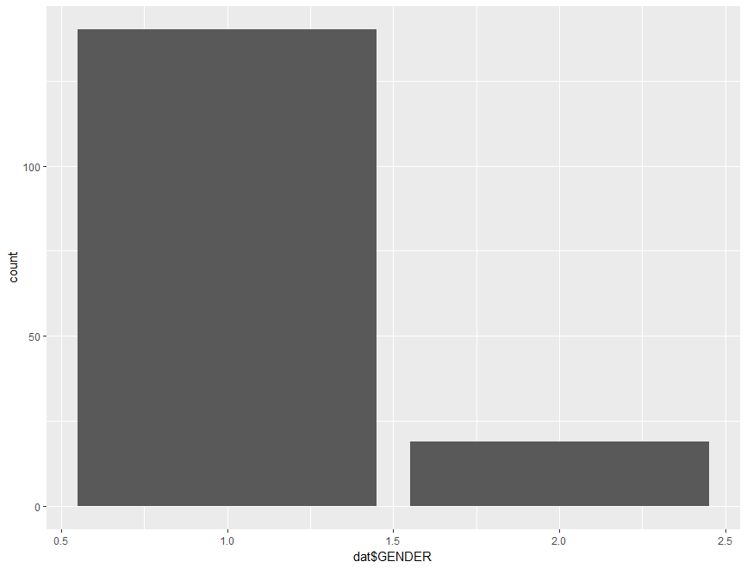
Bar Chart

Slide 40
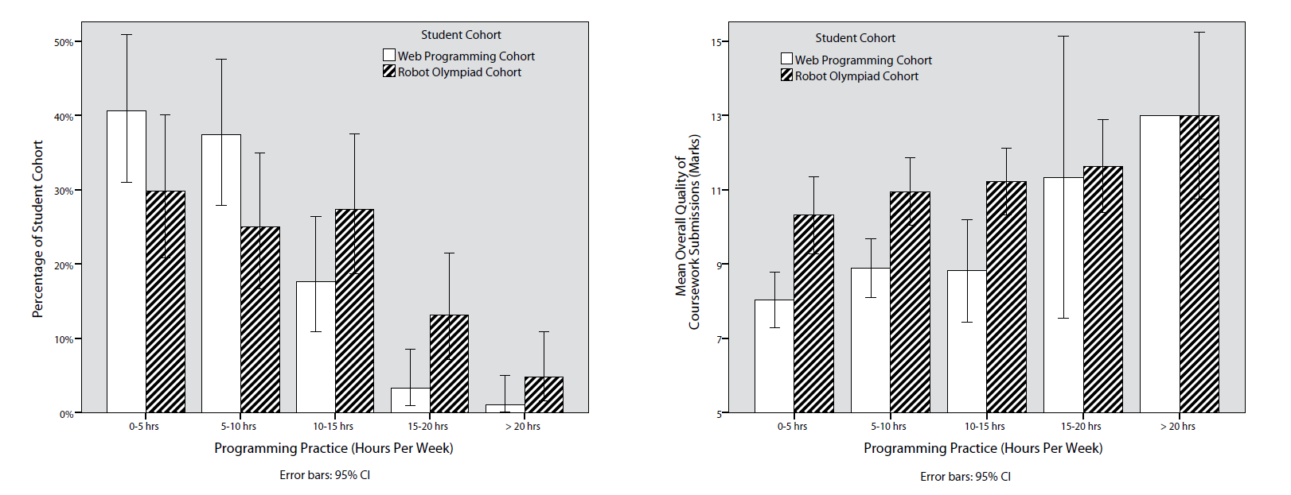
Bar Chart
Bar charts can be made much more complex using other ggplot functions:
http://www.cookbook-r.com/Graphs/Bar_and_line_graphs_(ggplot2)/

Slide 41
Histogram
A type of vertical bar chart used to depict a frequency distribution
Construction steps:
Label the x axis with the class endpoints
Label the y axis with the frequencies
Label the chart with an appropriate title, i.e. not ‘bar chart’
A quick look at the histogram reveals which class intervals produce the highest frequency totals
E.g. which age group most often enrols in undergraduate computing courses?
Notes:
41

Slide 42
Histogram
To display a frequency table, examining birth years from 1975 to 2000 in 5-year intervals, use the following command:
> summary(cut(dat$BIRTH_YEAR, c(1975,seq(1980,2000,5)), include.lowest=T,right=FALSE))
To display a histogram based on this data:
> hist(dat$BIRTH_YEAR, xlab="Year of Birth", ylab="Count", main="Breakdown of Birth Years", breaks=5)
Notes:
42

Slide 43
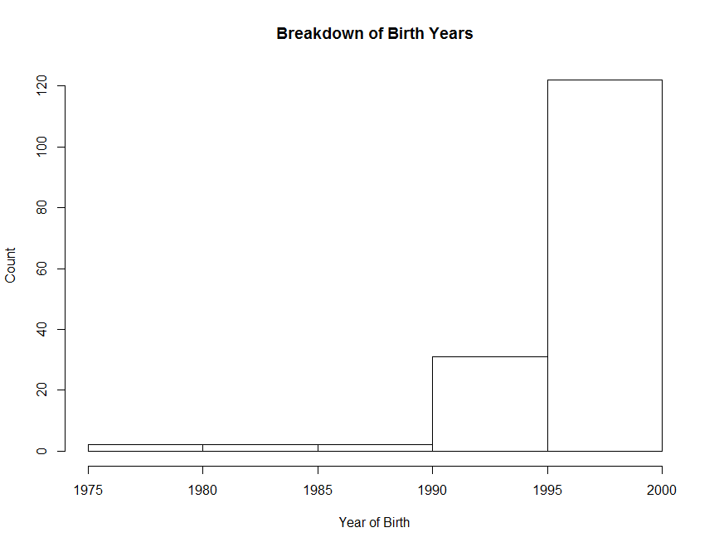
Histogram
Notes:
43

Slide 44
Frequency Polygon
A graph in which line segments connecting the dots depict a frequency distribution
Construction steps:
Label the x axis with the class endpoints
Label the y axis with the frequencies
Plot a dot for the frequency value at the midpoint of each class interval (different to Ogive)
Connect these dots with a line
Notes:
44

Slide 45
Frequency Polygon
To display a histogram of students’ conscientiousness, use the following command:
> ggplot(dat, aes(CONSCIENTIOUSNESS), stat="count") +
geom_freqpoly(binwidth = 20)
Notes:
45

Slide 46
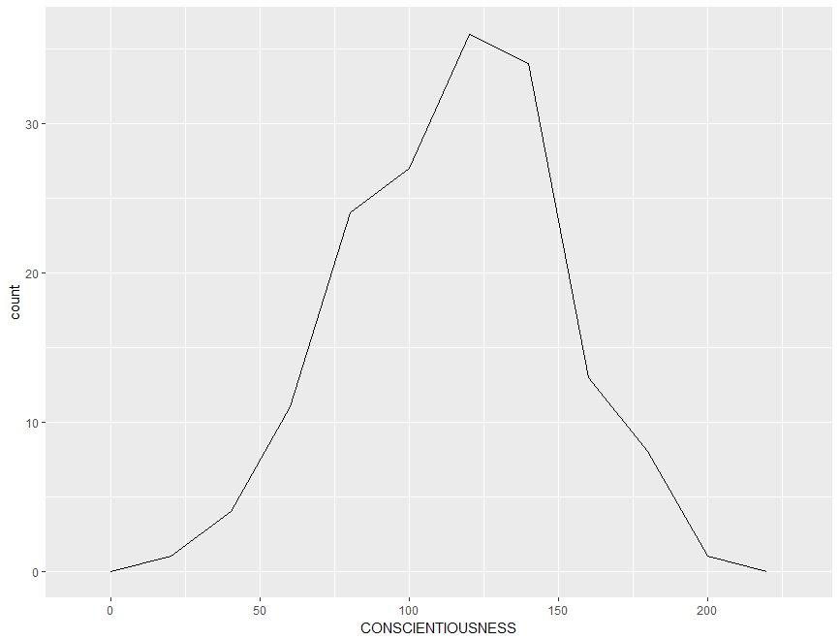
Frequency Polygon
Notes:
46

Slide 47
Ogive
A Cumulative Frequency (CF) polygon
Construction steps:
Label the x axis with the class endpoints
Label the y axis with the cumulative frequencies
A dot of ‘0’ is placed at the beginning of the first class
Mark a dot for the CF value at the end of each class interval
Connect these dots with a line
Notes:
47

Slide 48
Ogive
To construct an ogive, you need to format the data into cumulative frequencies:
> cumfreq0 <- c(0, cumsum(table(cut(dat$CONSCIENTIOUSNESS, seq(0, 240, by=20), right=FALSE))))
Then plot the chart based on this data:
> plot(seq(0, 240, by=20), cumfreq0, main="Range of Conscientiousness", xlab="Level of Conscientiousness", ylab="Cumulative Frequency") + lines(seq(0, 240, by=20), cumfreq0)
Notes:
48

Slide 49
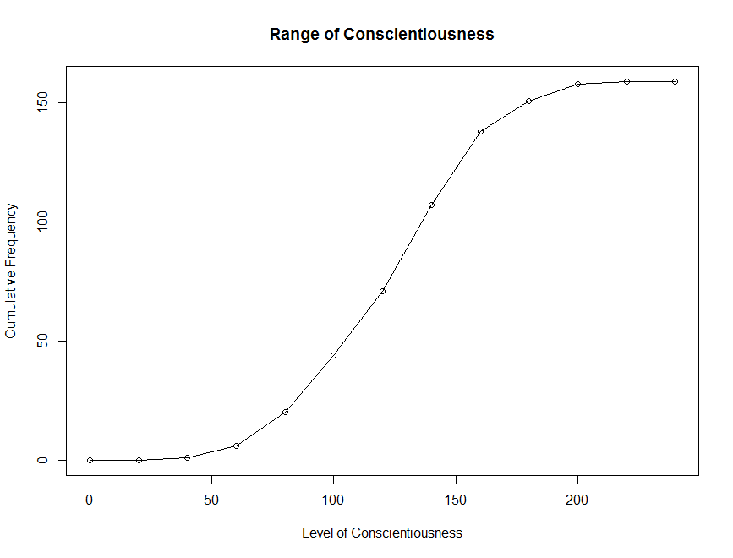
Ogive
Notes:
49

Slide 50
Pie Chart
A circular depiction of data where the area of the whole pie = 100% of the data being studied. Slices represent a % breakdown of each of the values
Business uses: e.g. for depicting budget categories, market share, time and resource allocation
Generally more difficult to interpret the size of the slices compared to the bars in a histogram. But- usage of ‘%’ can clarify slice size
Notes:
50

Slide 51
Pie Chart
Construction steps:
Convert each toothpaste brand amount to a proportion by dividing each individual amount by the total
E.g. 102 / 200 = 0.51
Convert each proportion to degrees by multiplying by 360°
E.g. 0.51 * 360° = 183.6°
Notes:
51

Slide 52
Pie Chart
To construct a pie chart, you first need to label the categories:
> Lbls <- c("Prior Experience with \na Pre-University Qualification", "Prior Experience without \na Pre-University Qualification", "No Prior Experience")
Then plot the pie chart based on this data:
> pie(table(dat$PRIOR_EXP), labels = lbls)
Notes:
52

Slide 53
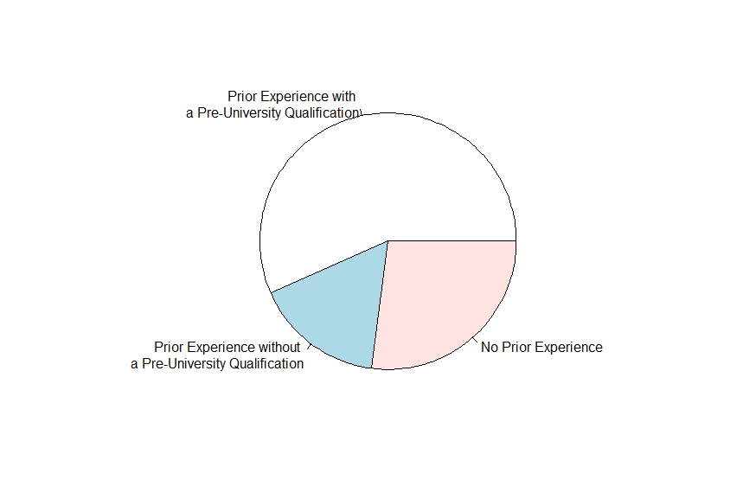
Pie Chart
Notes:
53

Slide 54
Pie Chart
Wrapping up commands into a single line:
> qplot(factor(dat$PRIOR_EXP, labels=c("Prior Experience with \na Pre-University Qualification", "Prior Experience without \na Pre-University Qualification", "No Prior Experience")), dat$ANXIETY, geom = "boxplot", main="Anxiety of Students from Different Backgrounds", xlab="Background", ylab="Level of Programming Anxiety")
Take note of the factor() command --- useful for distinguishing between different nominal characteristics or members of experimental and non-experimental groups!
The labels struct is setup in ascending order.
Notes:
54

Slide 55
Scatter Plot
Illustrates the relationship between two variables based on its underlying data points
E.g. the link between neurotic personality traits and programming anxiety
Scatter graph - a two-dimensional graph plot of pairs of points from two variables
Relationships will vary in strength, line of best fit used to indicate magnitude through slope
Notes:
55

Slide 56
Scatter Plot
For the line of best fit, going to use the rlm() function for a robust linear model to mitigate the influence of dataset outliers:
> library(MASS)
Then using the qplot() command with a combination of geom arguments including “point” (the scatter dots) and “smooth” (the line of best fit.
> qplot(dat$ANXIETY, dat$NEUROTICISM, geom = c("point", "smooth"), method="rlm", main="Correlation between Anxiety and Neuroticism", xlab="Anxiety", ylab="Neuroticism")
Try without the method argument. What happens?
Notes:
56

Slide 57
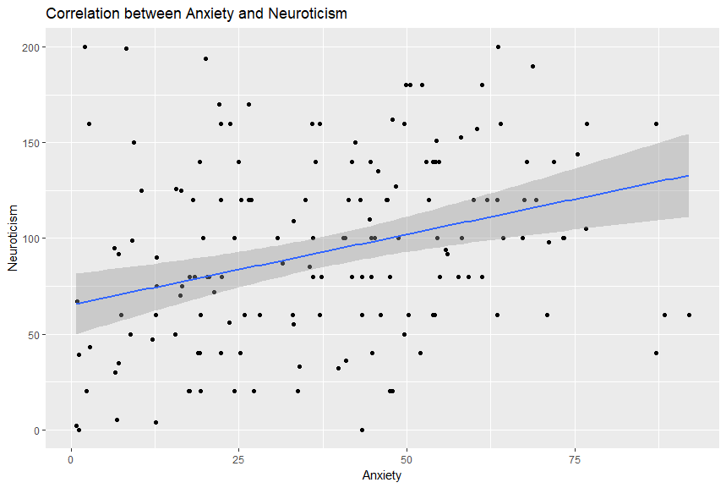
Scatter Plot
Notes:
57

Slide 58
Box Plot
Illustrates proportions of a distribution, and useful for comparing groups
Looking “down” on the distribution from the top, like viewing hills on a plane
Lines outside the box represent range
Box represents the lower and upper quartiles
Line inside the box represents the median
Notes:
58

Slide 59
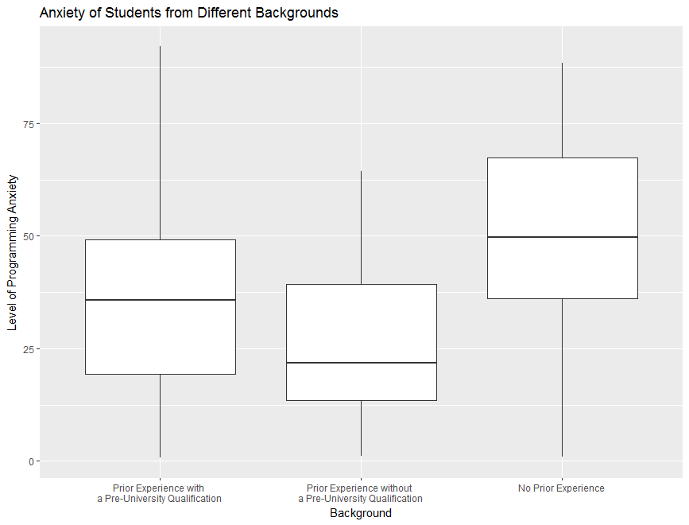
Box Plot
Notes:
59

