Slide 1
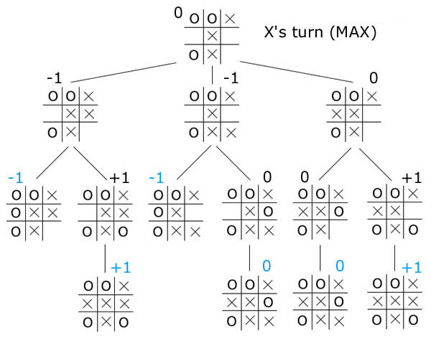
Minimax game tree search
X (max)
O (min)
X (max)
Notes:
Values are from X’s point of view
1. Back up values from terminal states (only one move available)
2. Consider child values (O to play)
3. Back up minimum value
4. Same for other branches
5. Consider child values (X to play)
6. Back up maximum value

