Slide 1
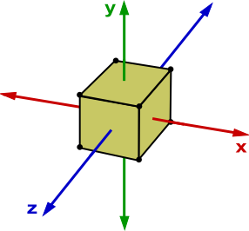
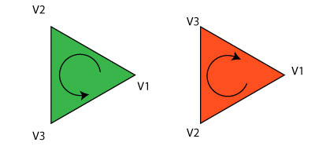
D
C
A
B
F (behind)
G
E
H
A
D
B
C

Slide 2
X
Y
Z
R
G
B
A
V₀
V₁
V₂

Slide 3
X
Y
Z
R
G
B
A
-0.5 | -0.5 | 0.0 | 1.0 | 0.0 | 0.0 | 1.0
0.5 | -0.5 | 0.0 | 0.0 | 1.1 | 0.0 | 1.0
0.0 | 0.2 | 0.0 | 0.0 | 0.0 | 1.0 | 1.0
V₀
V₁
V₂

Slide 4
Stride
X
Y
Z
R
G
B
A
-0.5 | -0.5 | 0.0 | 1.0 | 0.0 | 0.0 | 1.0
0.5 | -0.5 | 0.0 | 0.0 | 1.1 | 0.0 | 1.0
0.0 | 0.2 | 0.0 | 0.0 | 0.0 | 1.0 | 1.0
V₀
V₁
V₂

Slide 5
Offset = 3 * sizeof(float)
X
Y
Z
R
G
B
A
-0.5 | -0.5 | 0.0 | 1.0 | 0.0 | 0.0 | 1.0
0.5 | -0.5 | 0.0 | 0.0 | 1.1 | 0.0 | 1.0
0.0 | 0.2 | 0.0 | 0.0 | 0.0 | 1.0 | 1.0
V₀
V₁
V₂

