Slide 1

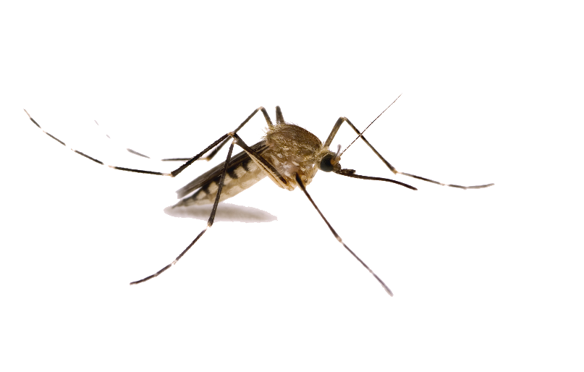
Week 7: 3D Geometry I Part 2: Lines and planes
COMP270: Mathematics for 3D Worlds and Simulations
This Photo by Unknown Author is licensed under CC BY-NC
This Photo by Unknown Author is licensed under CC BY-NC
Notes:
In this video, we’re going to revisit lines, which we met at the beginning of the module, and talk a little about planes, which have been mentioned in passing a few times, but not really defined in any specific way. I’m sure we’re all dreaming of travelling at the moment, but unfortunately
We won’t be dealing with these kinds of planes – though on the plus side, it means that we won’t have to deal with
Disease vectors like this mosquito.

Slide 2
Objectives
Define the equation of a plane
Extend techniques for determining intersections to 3D objects
Notes:
The kind of planes we’ll be looking at here are the ones that can be defined with an equation, which we can then use to determine intersections with lines and other objects in 3D space.

Slide 3








Recap: vector equation of a line
For a line defined by two points, we can represent any point on the line as a scalar multiple of the vector between the points, plus the vector to first point from the origin
$$p= p_{1}+tv$$
$$= p_{1}+t\left(p_{2}−p_{1}\right)$$
$$=\left(1−t\right)p_{1}+tp_{2}$$
$$v=p_{2}−p_{1}$$
$$p_{2}$$
$${tp}_{2}$$
$$p$$
$${(1−t)p}_{1}$$
$$p_{1}$$
$$O$$

Slide 4







Vector equation of a plane
Any two vectors $v_{1}$ and $v_{2}$ define a plane
Therefore, any point $p$ lying on the plane can be expressed as a linear combination of the two vectors, starting from any point $p_{1}$ on the plane:
$$p=p_{1}+sv_{1}+tv_{2}$$
$$v_{2}$$
$$p_{1}$$
$$s$$
$$p$$
$$t$$
$$v_{1}$$

Slide 5






Implicit equation of a plane
Any two vectors $v_{1}$ and $v_{2}$ define a plane
The vector perpendicular to both is the plane normal, ${n=v}_{1}×v_{2}$
The normal completely defines the orientation of the plane
Choose a point $p_{1}$that lies on the plane
For any other point $p$ that also lies on the plane: $\left(p−p_{1}\right)∙n=0$
$$n$$
$$v_{2}$$
$$p$$
$$p_{1}$$
$$v_{1}$$

Slide 6





Geometric equation of a plane
If $n=\left(\begin{matrix}a \\ b \\ c\end{matrix}\right)$, $p_{1}=\left(\begin{matrix}p_{x} \\ p_{y} \\ p_{z}\end{matrix}\right)$ and $p=\left(\begin{matrix}x \\ y \\ z\end{matrix}\right)$ then $\left(p−p_{1}\right)∙n=0$ gives:
$$\left(\begin{matrix}x−p_{x} \\ y−p_{y} \\ z−p_{z}\end{matrix}\right)∙\left(\begin{matrix}a \\ b \\ c\end{matrix}\right)=0$$
$$a\left(x−p_{x}\right)+b\left(y−p_{y}\right)+c\left(z−p_{z}\right)=0$$
$$ax+by+cz+\left(−ap_{x}−bp_{y}−cp_{z}\right)=0$$
$$ax+by+cz+d=0$$ where $d=−ap_{x}−bp_{y}−cp_{z}$
$$n$$
$$p−p_{1}$$
$$p$$
$$p_{1}$$

Slide 7
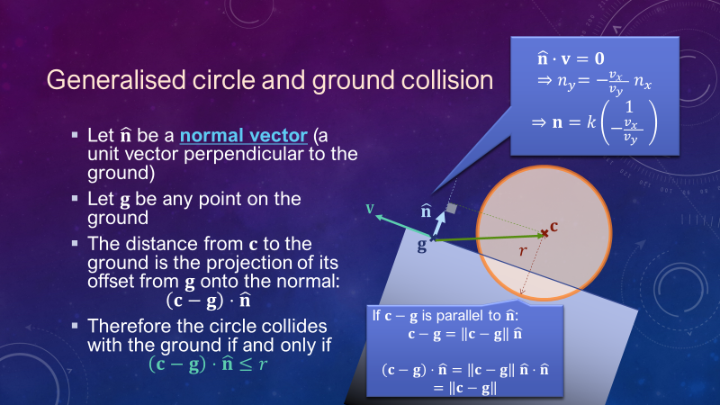





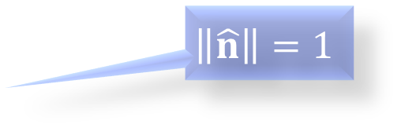


Distance of a plane from the origin
$d= \left\|p_{1}\right\|\cos{θ}$
$$=\left\|p_{1}\right\|\left\|\hat{n}\right\|\cos{θ}$$
$$=p_{1}∙\hat{n}$$
Since $\left(p−p_{1}\right)∙n=0⇒p∙n=$ $p_{1}∙n$, then$d=p∙\hat{n}$
$$\left\|\hat{n}\right\|=1$$
$$n$$
$$p$$
$$p_{1}$$
$$d$$
$$θ$$
$$O$$
Notes:
Equivalent to how we found the distance from a point to a sloped ground by taking a vector between the point and anywhere on the ground, and projecting it onto the normal to the ground.

Slide 8
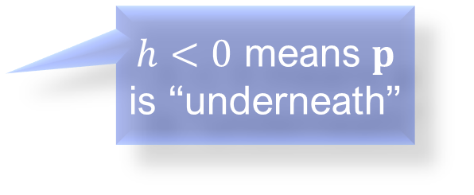




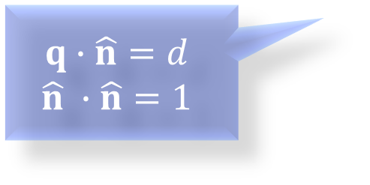


Distance of a point from a plane
Let $q$ be the point on the plane closest to $p$
Then $p−q=h\hat{n}$
Also, $p=q+\left(p−q\right)$:
$$p=q+h\hat{n}$$
$$p∙\hat{n}=\left(q+h\hat{n}\right)∙\hat{n}$$
$$p∙\hat{n}=d+h$$
$$h=p∙\hat{n}−d$$
$$p$$
$h<0$ means $p$ is “underneath”
$$h$$
$$\hat{n}$$
$$q$$
$$d$$
$$q∙\hat{n}=d$$
$$\hat{n} ∙\hat{n}=1$$
$$O$$
Notes:
Projection of the vector p onto the normal and subtract the distance from the origin to the plane.

Slide 9








Intersection of a line with a plane
A line through point $p_{1}$ with direction $v$ has equation $p=p_{1}+tv$
A plane with normal $n$ passing through the point $p_{2}$ has equation $\left(p−p_{2}\right)∙n=0$
If the line intersects the plane at $p$, $\left(\left(p_{1}+tv \right)−p_{2}\right)∙n=0$
Rearranging: $t= \frac{\left(p_{2}−p_{1}\right)∙n}{v∙n}$
$$n$$
$$v$$
$$p_{2}$$
Replace $p$
$$p$$
$$t$$
$$p_{1}$$

Slide 10
Intersections with other objects
Similar to in 2D!
Sphere – circle
Cuboid – rectangle
Some examples here: https://www.scratchapixel.com/lessons/3d-basic-rendering/minimal-ray-tracer-rendering-simple-shapes
Notes:
You can see some more examples of how to compute intersections with different objects on the scratchapixel website, as part of a tutorial on ray tracing, which is a technique to represent a 3 dimensional scene on a 2D surface by modelling the path of light rays as they interact with the objects; the next video will explain this in a little more detail.

