Slide 1
Week 8: 3D Geometry II Part 1: Matrices in 3D
COMP270: Mathematics for 3D Worlds and Simulations
Notes:
Hello, welcome to the second week of 3D computational geometry. In this part of the lecture, we’ll be looking at matrices,

Slide 2
Objectives
Extend 2D matrix operations into three dimensions, including:
Multiplication
Transformations
Homogeneous coordinates
Inverse
Notes:
Recapping the ideas and operations that we looked at in 2D at the start of the module, and seeing how they work in 3 dimensions, in terms of multiplication, representing transformations, including the use of homogeneous coordinates, and how to find the matrix representing the inverse transformation.

Slide 3

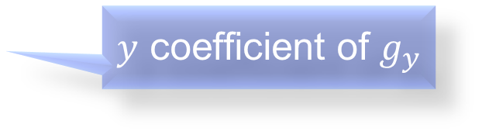



Recap: Matrices as functions
Provided the functions are linear
The elements of the matrix are the coefficients of the functions they represent
e.g. $g\left[\left(\begin{matrix}x \\ y\end{matrix}\right)\right]=\left(\begin{matrix}g_{x}(x, y) \\ g_{y}(x, y)\end{matrix}\right)=\left(\begin{matrix}0x+2y \\ x−y\end{matrix}\right)$ would be written as $\left(\begin{matrix}0 & 2 \\ 1 & −1\end{matrix}\right)$
$x$ coefficient of $g_{x}$
$y$ coefficient of $g_{x}$
$x$ coefficient of $g_{y}$
$y$ coefficient of $g_{y}$

Slide 4

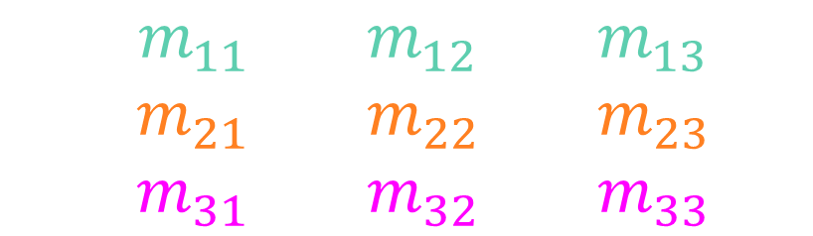

3D functions and matrices
$m\left[\left(\begin{matrix}x \\ y \\ z\end{matrix}\right)\right]=\left(\begin{matrix}m_{1}(x, y,z) \\ m_{2}(x, y,z) \\ m_{3}(x, y,z)\end{matrix}\right)=\left(\begin{matrix}m_{11}x+m_{12}y+m_{13}z \\ m_{21}x+m_{22}y+m_{23}z \\ m_{31}x+m_{32}y+m_{33}z\end{matrix}\right)$
$\left(\begin{matrix}m_{11} & m_{12} & m_{13} \\ m_{21} & m_{22} & m_{23} \\ m_{31} & m_{32} & m_{33}\end{matrix}\right)$
$$\left(\begin{matrix}x \\ y \\ z\end{matrix}\right)$$
$$=\left(\begin{matrix}m_{11}x+m_{12}y+m_{13}z \\ m_{21}x+m_{22}y+m_{23}z \\ m_{31}x+m_{32}y+m_{33}z\end{matrix}\right)$$

Slide 5


3×3 matrix multiplication
$$\left(\begin{matrix}a_{11} & a_{12} & a_{13} \\ a_{21} & a_{22} & a_{23} \\ a_{31} & a_{32} & a_{33}\end{matrix}\right)\left(\begin{matrix}b_{11} & b_{12} & b_{13} \\ b_{21} & b_{22} & b_{23} \\ b_{31} & b_{32} & b_{33}\end{matrix}\right)$$
$$=\left(\begin{matrix}a_{11}b_{11}+a_{12}b_{21}+a_{13}b_{31} & a_{11}b_{12}+a_{12}b_{22}+a_{13}b_{32} & a_{11}b_{13}+a_{12}b_{23}+a_{13}b_{33} \\ a_{21}b_{11}+a_{22}b_{21}+a_{23}b_{31} & a_{21}b_{12}+a_{22}b_{22}+a_{23}b_{32} & a_{21}b_{13}+a_{22}b_{23}+a_{23}b_{33} \\ a_{31}b_{11}+a_{32}b_{21}+a_{33}b_{31} & a_{31}b_{12}+a_{32}b_{22}+a_{33}b_{32} & a_{31}b_{13}+a_{32}b_{23}+a_{33}b_{33}\end{matrix}\right)$$
Element at $i, j$ is the dot product of row $i$ with column $j$

Slide 6
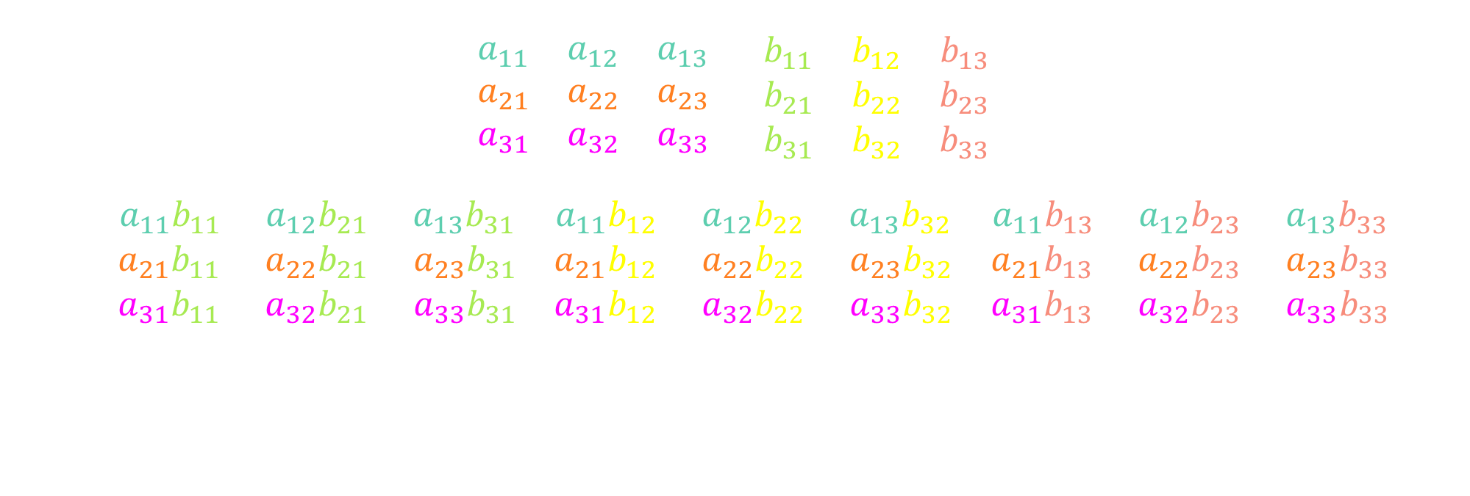
3×3 matrix multiplication – colour-coded
$$\left(\begin{matrix}a_{11} & a_{12} & a_{13} \\ a_{21} & a_{22} & a_{23} \\ a_{31} & a_{32} & a_{33}\end{matrix}\right)\left(\begin{matrix}b_{11} & b_{12} & b_{13} \\ b_{21} & b_{22} & b_{23} \\ b_{31} & b_{32} & b_{33}\end{matrix}\right)$$
$$=\left(\begin{matrix}a_{11}b_{11}+a_{12}b_{21}+a_{13}b_{31} & a_{11}b_{12}+a_{12}b_{22}+a_{13}b_{32} & a_{11}b_{13}+a_{12}b_{23}+a_{13}b_{33} \\ a_{21}b_{11}+a_{22}b_{21}+a_{23}b_{31} & a_{21}b_{12}+a_{22}b_{22}+a_{23}b_{32} & a_{21}b_{13}+a_{22}b_{23}+a_{23}b_{33} \\ a_{31}b_{11}+a_{32}b_{21}+a_{33}b_{31} & a_{31}b_{12}+a_{32}b_{22}+a_{33}b_{32} & a_{31}b_{13}+a_{32}b_{23}+a_{33}b_{33}\end{matrix}\right)$$

Slide 7

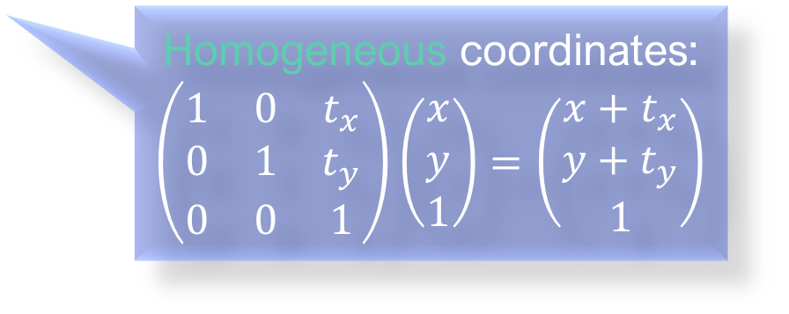
Recap: 2D affine transformations
Translation: $T=\left(\begin{matrix}1 & 0 & t_{x} \\ 0 & 1 & t_{y} \\ 0 & 0 & 1\end{matrix}\right)$
Rotation: $R_{θ}=\left(\begin{matrix}\cos{θ} & −\sin{θ} & 0 \\ \sin{θ} & \cos{θ} & 0 \\ 0 & 0 & 1\end{matrix}\right)$
Scale: $S=\left(\begin{matrix}s_{x} & 0 & 0 \\ 0 & s_{y} & 0 \\ 0 & 0 & 1\end{matrix}\right)$
Shear: $H_{x}=\left(\begin{matrix}1 & λ_{x} & 0 \\ 0 & 1 & 0 \\ 0 & 0 & 1\end{matrix}\right),H_{y}=\left(\begin{matrix}1 & 0 & 0 \\ λ_{y} & 1 & 0 \\ 0 & 0 & 1\end{matrix}\right)$
Homogeneous coordinates: $\left(\begin{matrix}1 & 0 & t_{x} \\ 0 & 1 & t_{y} \\ 0 & 0 & 1\end{matrix}\right)\left(\begin{matrix}x \\ y \\ 1\end{matrix}\right)=\left(\begin{matrix}x+t_{x} \\ y+t_{y} \\ 1\end{matrix}\right)$

Slide 8

3D homogeneous coordinates
Applying a 4x4 homogeneous matrix to a point/vector:
$$\left(\begin{matrix}\begin{matrix}r_{11} & r_{12} \\ r_{21} & r_{22}\end{matrix} & \begin{matrix}r_{13} & t_{x} \\ r_{23} & t_{y}\end{matrix} \\ \begin{matrix}r_{31} & r_{32} \\ 0 & 0\end{matrix} & \begin{matrix}r_{33} & t_{z} \\ 0 & 1\end{matrix}\end{matrix}\right)\left(\begin{matrix}\begin{matrix}x \\ y\end{matrix} \\ \begin{matrix}z \\ w\end{matrix}\end{matrix}\right)=\left(\begin{matrix}\begin{matrix}r_{11}x+r_{12}y+r_{13}z+t_{x}w \\ r_{21}x+r_{22}y+r_{23}z+t_{y}w\end{matrix} \\ \begin{matrix}r_{31}x+r_{32}y+r_{33}z+t_{z}w \\ w\end{matrix}\end{matrix}\right)$$
Note that only the $w$ coordinate is affected by the 4th column (translation values)
For points (which have a position), $w=1$
For vectors (which have only direction), $w=0$

Slide 9
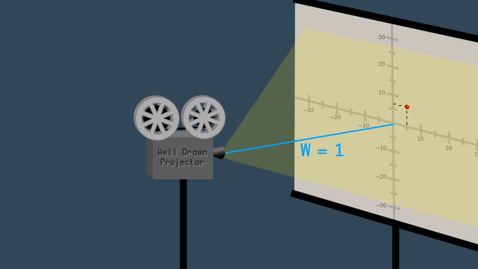


What is $w$?
An “extra dimension” (not time!) added to allow translations…
Extends 3D space to projective space
A scaling factor/“distance to the projector”:
$(x, y, z, w)→\left(\frac{x}{w},\frac{y}{w},\frac{z}{w}\right)$
$w=1$: direct mapping of a point to 3D space
$w=0$: a point that is infinitely far away/a vector with infinite length
More info:
https://www.tomdalling.com/blog/modern-opengl/explaining-homogenous-coordinates-and-projective-geometry/
https://hackernoon.com/programmers-guide-to-homogeneous-coordinates-73cbfd2bcc65

Slide 10

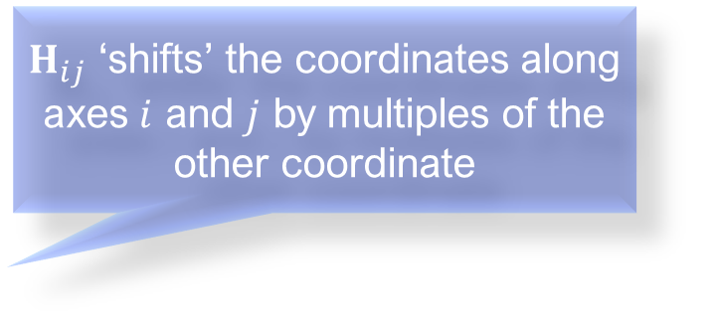
3D affine transformations
Translation: $T=\left(\begin{matrix}\begin{matrix}1 & 0 \\ 0 & 1\end{matrix} & \begin{matrix}0 & t_{x} \\ 0 & t_{y}\end{matrix} \\ \begin{matrix}0 & 0 \\ 0 & 0\end{matrix} & \begin{matrix}1 & t_{z} \\ 0 & 1\end{matrix}\end{matrix}\right)$
Scale: $S=\left(\begin{matrix}\begin{matrix}s_{x} & 0 \\ 0 & s_{y}\end{matrix} & \begin{matrix}0 & 0 \\ 0 & 0\end{matrix} \\ \begin{matrix}0 & 0 \\ 0 & 0\end{matrix} & \begin{matrix}s_{z} & 0 \\ 0 & 1\end{matrix}\end{matrix}\right)$
Shear: $H_{xy}=\left(\begin{matrix}\begin{matrix}1 & 0 \\ 0 & 1\end{matrix} & \begin{matrix}λ_{x} & 0 \\ λ_{y} & 0\end{matrix} \\ \begin{matrix}0 & 0 \\ 0 & 0\end{matrix} & \begin{matrix}1 & 0 \\ 0 & 1\end{matrix}\end{matrix}\right),$ $H_{xz}=\left(\begin{matrix}\begin{matrix}1 & λ_{x} \\ 0 & 1\end{matrix} & \begin{matrix}0 & 0 \\ 0 & 0\end{matrix} \\ \begin{matrix}0 & λ_{z} \\ 0 & 0\end{matrix} & \begin{matrix}1 & 0 \\ 0 & 1\end{matrix}\end{matrix}\right)$, $H_{yz}=\left(\begin{matrix}\begin{matrix}1 & 0 \\ λ_{y} & 1\end{matrix} & \begin{matrix}0 & 0 \\ 0 & 0\end{matrix} \\ \begin{matrix}λ_{z} & 0 \\ 0 & 0\end{matrix} & \begin{matrix}1 & 0 \\ 0 & 1\end{matrix}\end{matrix}\right)$
$H_{ij}$ ‘shifts’ the coordinates along axes $i$ and $j$ by multiples of the other coordinate

Slide 11

3D rotation matrices
Anticlockwise rotation in a right-handed coordinate system about:
The $x$-axis: $R_{x}\left(θ\right)=\left(\begin{matrix}\begin{matrix}1 & 0 \\ 0 & cosθ\end{matrix} & \begin{matrix}0 & 0 \\ −sinθ & 0\end{matrix} \\ \begin{matrix}0 & sinθ \\ 0 & 0\end{matrix} & \begin{matrix}cosθ & 0 \\ 0 & 1\end{matrix}\end{matrix}\right)$
The $y$-axis: $R_{y}\left(θ\right)=\left(\begin{matrix}\begin{matrix}cosθ & 0 \\ 0 & 1\end{matrix} & \begin{matrix}sinθ & 0 \\ 0 & 0\end{matrix} \\ \begin{matrix}−sinθ & 0 \\ 0 & 0\end{matrix} & \begin{matrix}cosθ & 0 \\ 0 & 1\end{matrix}\end{matrix}\right)$
The $z$-axis: $R_{z}\left(θ\right)=\left(\begin{matrix}\begin{matrix}cosθ & −sinθ \\ sinθ & cosθ\end{matrix} & \begin{matrix}0 & 0 \\ 0 & 0\end{matrix} \\ \begin{matrix}0 & 0 \\ 0 & 0\end{matrix} & \begin{matrix}1 & 0 \\ 0 & 1\end{matrix}\end{matrix}\right)$

Slide 12
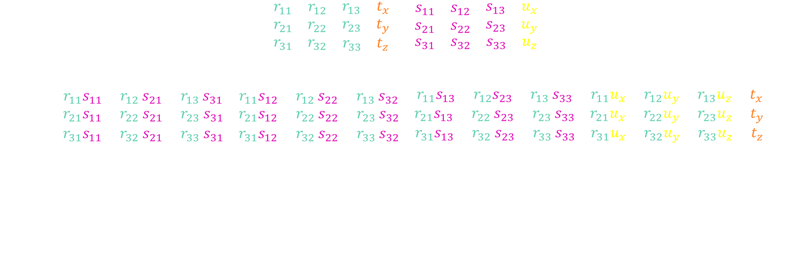
Multiplying homogeneous matrices
“Rotation (and scale) part”
“Translation part”
$$\left(\begin{matrix}\begin{matrix}r_{11} & r_{12} \\ r_{21} & r_{22}\end{matrix} & \begin{matrix}r_{13} & t_{x} \\ r_{23} & t_{y}\end{matrix} \\ \begin{matrix}r_{31} & r_{32} \\ 0 & 0\end{matrix} & \begin{matrix}r_{33} & t_{z} \\ 0 & 1\end{matrix}\end{matrix}\right)\left(\begin{matrix}\begin{matrix}s_{11} & s_{12} \\ s_{21} & s_{22}\end{matrix} & \begin{matrix}s_{13} & u_{x} \\ s_{23} & u_{y}\end{matrix} \\ \begin{matrix}s_{31} & s_{32} \\ 0 & 0\end{matrix} & \begin{matrix}s_{33} & u_{z} \\ 0 & 1\end{matrix}\end{matrix}\right)$$
$$=\left(\begin{matrix}\begin{matrix}r_{11}s_{11}{+ r}_{12}s_{21}{+ r}_{13}s_{31} & r_{11}s_{12}{+ r}_{12}s_{22}{+ r}_{13}s_{32} \\ r_{21}s_{11}{+ r}_{22}s_{21}{+ r}_{23}s_{31} & r_{21}s_{12}{+ r}_{22}s_{22}{+ r}_{23}s_{32}\end{matrix} & \begin{matrix}r_{11}s_{13}{{ + r}_{12}s}_{23}{+ r}_{13}s_{33} & r_{11}u_{x}+r_{12}u_{y}+r_{13}u_{z}{+ t}_{x} \\ r_{21}s_{13}{+ r}_{22}s_{23}{+ r}_{23}s_{33} & r_{21}u_{x}+r_{22}u_{y}+r_{23}u_{z}{+ t}_{y}\end{matrix} \\ \begin{matrix}r_{31}s_{11}{+ r}_{32}s_{21}{+ r}_{33}s_{31} & r_{31}s_{12}{+ r}_{32}s_{22}{+ r}_{33}s_{32} \\ 0 & 0\end{matrix} & \begin{matrix}r_{31}s_{13}{+ r}_{32}s_{23}{+ r}_{33}s_{33} & r_{31}u_{x}+r_{32}u_{y}+r_{33}u_{z}{+ t}_{z} \\ 0 & 1\end{matrix}\end{matrix}\right)$$

Slide 13

3D transformation order
Rotation then translation:
$$\left(\begin{matrix}\begin{matrix}1 & 0 \\ 0 & 1\end{matrix} & \begin{matrix}0 & t_{x} \\ 0 & t_{y}\end{matrix} \\ \begin{matrix}0 & 0 \\ 0 & 0\end{matrix} & \begin{matrix}1 & t_{z} \\ 0 & 1\end{matrix}\end{matrix}\right)\left(\begin{matrix}\begin{matrix}r_{11} & r_{12} \\ r_{21} & r_{22}\end{matrix} & \begin{matrix}r_{13} & 0 \\ r_{23} & 0\end{matrix} \\ \begin{matrix}r_{31} & r_{32} \\ 0 & 0\end{matrix} & \begin{matrix}r_{33} & 0 \\ 0 & 1\end{matrix}\end{matrix}\right)$$
$$=\left(\begin{matrix}\begin{matrix}r_{11} & r_{12} \\ r_{21} & r_{22}\end{matrix} & \begin{matrix}r_{13} & t_{x} \\ r_{23} & t_{y}\end{matrix} \\ \begin{matrix}r_{31} & r_{32} \\ 0 & 0\end{matrix} & \begin{matrix}r_{33} & t_{z} \\ 0 & 1\end{matrix}\end{matrix}\right)$$

Slide 14

3D transformation order: reversed
Translation then rotation:
$$\left(\begin{matrix}\begin{matrix}r_{11} & r_{12} \\ r_{21} & r_{22}\end{matrix} & \begin{matrix}r_{13} & 0 \\ r_{23} & 0\end{matrix} \\ \begin{matrix}r_{31} & r_{32} \\ 0 & 0\end{matrix} & \begin{matrix}r_{33} & 0 \\ 0 & 1\end{matrix}\end{matrix}\right)\left(\begin{matrix}\begin{matrix}1 & 0 \\ 0 & 1\end{matrix} & \begin{matrix}0 & t_{x} \\ 0 & t_{y}\end{matrix} \\ \begin{matrix}0 & 0 \\ 0 & 0\end{matrix} & \begin{matrix}1 & t_{z} \\ 0 & 1\end{matrix}\end{matrix}\right)$$
$$=\left(\begin{matrix}\begin{matrix}r_{11} & r_{12} \\ r_{21} & r_{22}\end{matrix} & \begin{matrix}r_{13} & r_{11}t_{x}+r_{12}t_{y}+r_{13}t_{z} \\ r_{23} & r_{21}t_{x}+r_{22}t_{y}+r_{23}t_{z}\end{matrix} \\ \begin{matrix}r_{31} & r_{32} \\ 0 & 0\end{matrix} & \begin{matrix}r_{33} & r_{31}t_{x}+r_{32}t_{y}+r_{33}t_{z} \\ 0 & 1\end{matrix}\end{matrix}\right)$$
Notes:
Even with transformation matrices, matrix multiplication is not commutative.

Slide 15
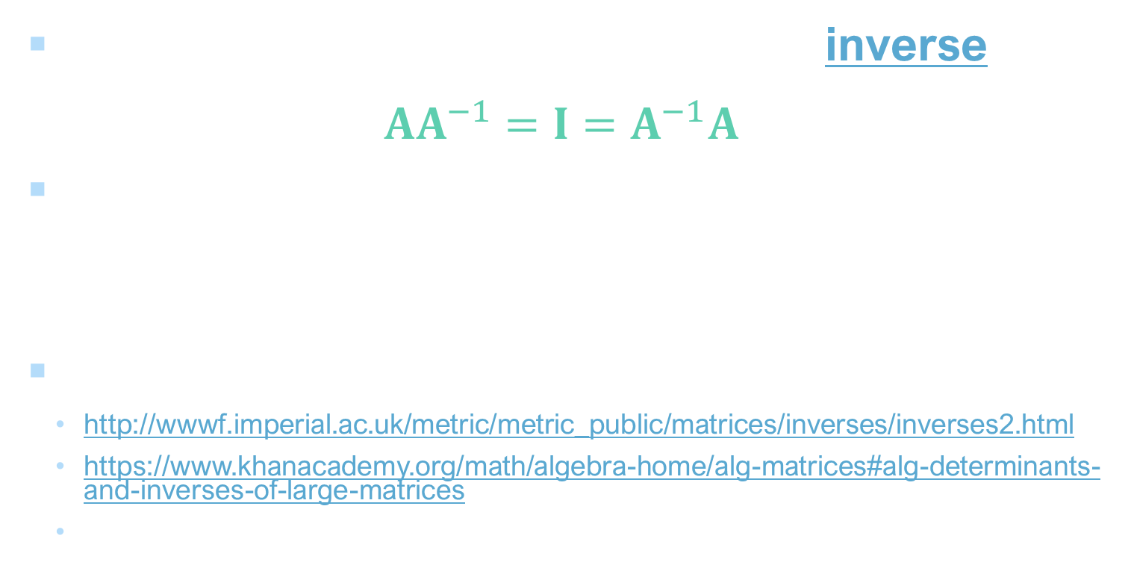
Recap: matrix inverse
Definition: for a square matrix $A$, the inverse of $A$ is a matrix $A^{−1}$ such that $AA^{−1}=I=A^{−1}A$
For 2×2 matrices, the inverse is given by ${\left(\begin{matrix}a & b \\ c & d\end{matrix}\right)}^{−1}=\frac{1}{ad−bc}\left(\begin{matrix}d & −b \\ −c & a\end{matrix}\right)$
For larger matrices…
http://wwwf.imperial.ac.uk/metric/metric_public/matrices/inverses/inverses2.html
https://www.khanacademy.org/math/algebra-home/alg-matrices#alg-determinants-and-inverses-of-large-matrices
3D Math Primer for Graphics and Game Development, Chapter 6
Notes:
Connected with multiplication is the idea of an inverse, which we defined before as…
Things are a little more straightforward with transformation matrices, though; as we saw with 2D matrices, the inverse of a transformation is just doing the opposite thing, so if we take that idea into 3D for each of the main types of transform,

Slide 16

Transformation matrix inverse: rotation
‘Flipped’ along the diagonal (convert columns to rows)
The inverse of a rotation matrix is its transpose
Because: the opposite of rotating by $θ$ is rotating by $–θ$, e.g.
$$R_{x}\left(θ\right)=\left(\begin{matrix}\begin{matrix}1 & 0 \\ 0 & cosθ\end{matrix} & \begin{matrix}0 & 0 \\ −sinθ & 0\end{matrix} \\ \begin{matrix}0 & sinθ \\ 0 & 0\end{matrix} & \begin{matrix}cosθ & 0 \\ 0 & 1\end{matrix}\end{matrix}\right)$$
$${R_{x}}^{−1}\left(θ\right)= R_{x}\left(−θ\right)=\left(\begin{matrix}\begin{matrix}1 & 0 \\ 0 & cos⁡(−θ)\end{matrix} & \begin{matrix}0 & 0 \\ −sin⁡(−θ) & 0\end{matrix} \\ \begin{matrix}0 & sin⁡(−θ) \\ 0 & 0\end{matrix} & \begin{matrix}cos⁡(−θ) & 0 \\ 0 & 1\end{matrix}\end{matrix}\right)=\left(\begin{matrix}\begin{matrix}1 & 0 \\ 0 & cosθ\end{matrix} & \begin{matrix}0 & 0 \\ sinθ & 0\end{matrix} \\ \begin{matrix}0 & −sinθ \\ 0 & 0\end{matrix} & \begin{matrix}cosθ & 0 \\ 0 & 1\end{matrix}\end{matrix}\right)={R_{x}}^{T}(θ)$$
Notes:
Starting with rotation

Slide 17

Transformation matrix inverse: translation
The inverse of a translation matrix is the same matrix with the signs on the translation components reversed
Because: the opposite of travelling $t$ units in one direction is travelling $t$ units in the opposite direction
$${\left(\begin{matrix}\begin{matrix}1 & 0 \\ 0 & 1\end{matrix} & \begin{matrix}0 & t_{x} \\ 0 & t_{y}\end{matrix} \\ \begin{matrix}0 & 0 \\ 0 & 0\end{matrix} & \begin{matrix}1 & t_{z} \\ 0 & 1\end{matrix}\end{matrix}\right)}^{−1}= \left(\begin{matrix}\begin{matrix}1 & 0 \\ 0 & 1\end{matrix} & \begin{matrix}0 & {−t}_{x} \\ 0 & −t_{y}\end{matrix} \\ \begin{matrix}0 & 0 \\ 0 & 0\end{matrix} & \begin{matrix}1 & −t_{z} \\ 0 & 1\end{matrix}\end{matrix}\right)$$

Slide 18

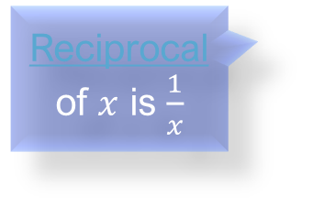
Transformation matrix inverse: scale
The inverse of a scale matrix is a scale matrix with the reciprocal scale factors
Because: the opposite of making something s times bigger is making is s times smaller
$${\left(\begin{matrix}\begin{matrix}s_{x} & 0 \\ 0 & s_{y}\end{matrix} & \begin{matrix}0 & 0 \\ 0 & 0\end{matrix} \\ \begin{matrix}0 & 0 \\ 0 & 0\end{matrix} & \begin{matrix}s_{z} & 0 \\ 0 & 1\end{matrix}\end{matrix}\right)}^{−1}= \left(\begin{matrix}\begin{matrix}\frac{1}{s_{x}} & 0 \\ 0 & \frac{1}{s_{y}}\end{matrix} & \begin{matrix}0 & 0 \\ 0 & 0\end{matrix} \\ \begin{matrix}0 & 0 \\ 0 & 0\end{matrix} & \begin{matrix}\frac{1}{s_{z}} & 0 \\ 0 & 1\end{matrix}\end{matrix}\right)$$
Reciprocal of $x$ is $\frac{1}{x}$

Slide 19

Transformation matrix inverse: combined
The inverse of a matrix product is the product of the inverse matrices, ordered in reverse
$${\left(AB\right)}^{−1}AB=I$$
$${\left(AB\right)}^{−1}ABB^{−1}=IB^{−1}$$
$${\left(AB\right)}^{−1}A=B^{−1}$$
$${\left(AB\right)}^{−1}AA^{−1}=B^{−1}A^{−1}$$
$${\left(AB\right)}^{−1}=B^{−1}A^{−1}$$
Notes:
Makes sense intuitively as if inverting is just doing each step backwards, we want to do them in the opposite order, too.

Slide 20
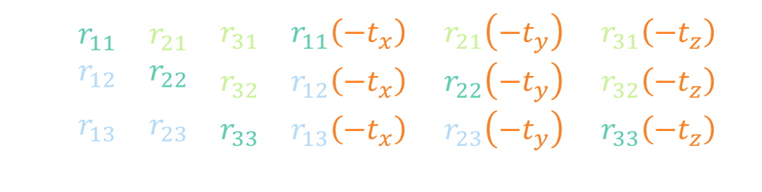
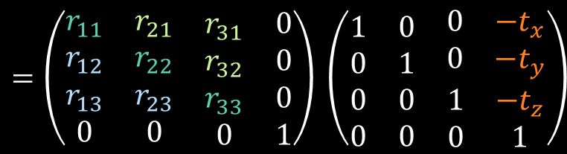
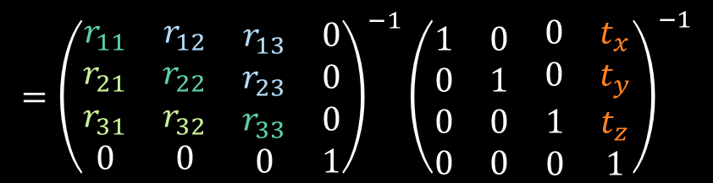

Transformation matrix inverse: example
Invert a combined rotation and translation:
${\left(\left(\begin{matrix}\begin{matrix}1 & 0 \\ 0 & 1\end{matrix} & \begin{matrix}0 & t_{x} \\ 0 & t_{y}\end{matrix} \\ \begin{matrix}0 & 0 \\ 0 & 0\end{matrix} & \begin{matrix}1 & t_{z} \\ 0 & 1\end{matrix}\end{matrix}\right)\left(\begin{matrix}\begin{matrix}r_{11} & r_{12} \\ r_{21} & r_{22}\end{matrix} & \begin{matrix}r_{13} & 0 \\ r_{23} & 0\end{matrix} \\ \begin{matrix}r_{31} & r_{32} \\ 0 & 0\end{matrix} & \begin{matrix}r_{33} & 0 \\ 0 & 1\end{matrix}\end{matrix}\right)\right)}^{−1}$
$$={\left(\begin{matrix}\begin{matrix}r_{11} & r_{12} \\ r_{21} & r_{22}\end{matrix} & \begin{matrix}r_{13} & 0 \\ r_{23} & 0\end{matrix} \\ \begin{matrix}r_{31} & r_{32} \\ 0 & 0\end{matrix} & \begin{matrix}r_{33} & 0 \\ 0 & 1\end{matrix}\end{matrix}\right)}^{−1}{\left(\begin{matrix}\begin{matrix}1 & 0 \\ 0 & 1\end{matrix} & \begin{matrix}0 & t_{x} \\ 0 & t_{y}\end{matrix} \\ \begin{matrix}0 & 0 \\ 0 & 0\end{matrix} & \begin{matrix}1 & t_{z} \\ 0 & 1\end{matrix}\end{matrix}\right)}^{−1}$$
$$=\left(\begin{matrix}\begin{matrix}r_{11} & r_{21} \\ r_{12} & r_{22}\end{matrix} & \begin{matrix}r_{31} & r_{11}\left({−t}_{x}\right)+r_{21}\left({−t}_{y}\right)+r_{31}\left({−t}_{z}\right) \\ r_{32} & r_{12}\left({−t}_{x}\right)+r_{22}\left({−t}_{y}\right)+r_{32}\left({−t}_{z}\right)\end{matrix} \\ \begin{matrix}r_{13} & r_{23} \\ 0 & 0\end{matrix} & \begin{matrix}r_{33} & r_{13}\left({−t}_{x}\right)+r_{23}\left({−t}_{y}\right)+r_{33}\left({−t}_{z}\right) \\ 0 & 1\end{matrix}\end{matrix}\right)$$
$$=\left(\begin{matrix}\begin{matrix}r_{11} & r_{21} \\ r_{12} & r_{22}\end{matrix} & \begin{matrix}r_{31} & 0 \\ r_{32} & 0\end{matrix} \\ \begin{matrix}r_{13} & r_{23} \\ 0 & 0\end{matrix} & \begin{matrix}r_{33} & 0 \\ 0 & 1\end{matrix}\end{matrix}\right) \left(\begin{matrix}\begin{matrix}1 & 0 \\ 0 & 1\end{matrix} & \begin{matrix}0 & {−t}_{x} \\ 0 & −t_{y}\end{matrix} \\ \begin{matrix}0 & 0 \\ 0 & 0\end{matrix} & \begin{matrix}1 & −t_{z} \\ 0 & 1\end{matrix}\end{matrix}\right)$$
Notes:
This is a general formula for inverting that kind of combined transformation, which you can implement directly in code (as you’ll see I’ve done in the third worksheet), provided you make sure that your transformations are always initially carried out in the correct order, with translation last; we’ll look more at the order of transformations in the next video, which develops the concept of coordinate spaces that we looked at last week a little further.

