Slide 1
Week 8: 3D Geometry II Part 4: Quaternions
COMP270: Mathematics for 3D Worlds and Simulations
Notes:
At the end of the last video, we introduced quaternions as a way to get around many of the problems with other ways of representing rotations, such as taking up a lot of space or providing inconsistent results that are difficult to interpolate.

Slide 2
Objectives
Introduce the key properties of quaternions
Identify their key use, i.e. SLERP
Notes:
In this video, we’re just going to introduce the key properties of quaternions. I won’t be going to into a lot of details as there’s quite a lot of algebra, plus it’s likely that you might not ever need to operate on quaternions directly; most graphics and maths libraries include them along with functions to convert to and from matrices and other more intuitive forms, so having a good enough idea of what they are to be able to use them appropriately is all that’s really necessary – and one of their key uses, which was mentioned in the last video, is for interpolation. If you are interested in learning more about them, then the 3D math primer textbook has a fairly comprehensive section on them, and there are plenty of resources online.

Slide 3
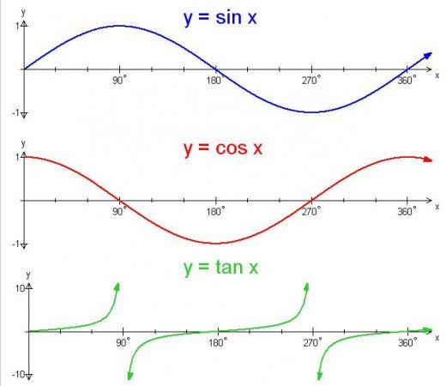

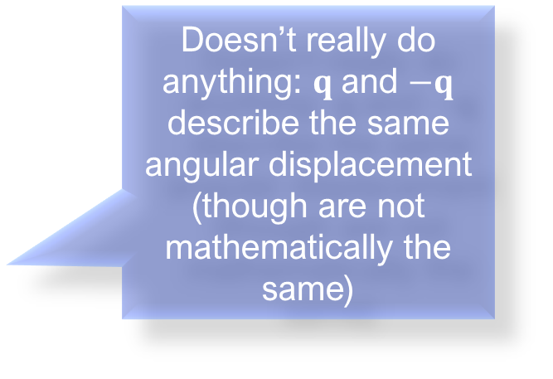
Quaternion representation
Encode the axis and angle of rotation as a scalar component $w$ and a 3D vector component $v$: $\left[\begin{matrix}w & v\end{matrix}\right]=\left[\begin{matrix}\cos{\frac{θ}{2}} & \sin{\frac{θ}{2}}\hat{n}\end{matrix}\right]$ $v=\left[\begin{matrix}x & y & z\end{matrix}\right]$
Negation: $−q=−\left[\begin{matrix}w & \left(\begin{matrix}x & y & z\end{matrix}\right)\end{matrix}\right]$ $=\left[\begin{matrix}−w & \left(−\begin{matrix}x & −y & −z\end{matrix}\right)\end{matrix}\right]$ $=−\left[\begin{matrix}w & v\end{matrix}\right]=\left[\begin{matrix}−w & −v\end{matrix}\right]$
$$=\left[\begin{matrix}−\cos{\frac{θ}{2}} & −\sin{\frac{θ}{2}}\hat{n}\end{matrix}\right]$$
$$=\left[\begin{matrix}\cos\left(\frac{θ}{2}+π\right) & \sin\left(\frac{θ}{2}+π\right)\end{matrix}\hat{n}\right]$$
$$=\left[\begin{matrix}\cos\left(\frac{θ+2π}{2}\right) & \sin\left(\frac{θ+2π}{2}\right)\end{matrix}\hat{n}\right]$$
Doesn’t really do anything: $q$ and $−q$ describe the same angular displacement (though are not mathematically the same)

Slide 4

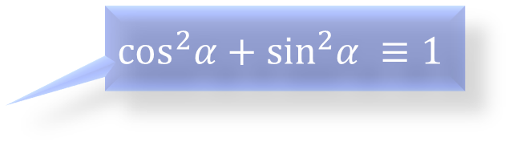
Quaternion magnitude
$$\left\|q\right\|=\left\|\left[\begin{matrix}w & \left(\begin{matrix}x & y & z\end{matrix}\right)\end{matrix}\right]\right\|$$
$$=\sqrt{w^{2}+x^{2}+y^{2}+z^{2}}$$
$$=\left\|\left[\begin{matrix}w & v\end{matrix}\right]\right\|$$
$$=\sqrt{w^{2}+{\left\|v\right\|}^{2}}$$
$$=\sqrt{\cos^{2}\left(\frac{θ}{2}\right)+{\left(sin\left(\frac{θ}{2}\right)\left\|\hat{n}\right\|\right)}^{2}}$$
$$=\sqrt{\cos^{2}\left(\frac{θ}{2}\right)+\sin^{2}\left(\frac{θ}{2}\right)}=1$$
$$\cos^{2}α+\sin^{2}α ≡1$$

Slide 5

Quaternion identity and inverse
Identity: $\left[1 0\right]$ and (geometrically) $\left[−1 0\right]=−\left[1 0\right]$
Complete rotation (360°) about any axis
$\left[−1 0\right]$ is from an odd multiple of 360°
Conjugate: $q^{∗}={\left[\begin{matrix}w & v\end{matrix}\right]}^{∗}=\left[\begin{matrix}w & −v\end{matrix}\right]$
Inverse: $q^{−1}=\frac{q^{∗}}{\left\|q\right\|}=q^{∗}$
Negating the rotation axis flips the positive rotation direction
Negating the angle is geometrically equivalent, but not mathematically

Slide 6

Quaternion multiplication
Hamilton product: $q_{1}q_{2}=\left[\begin{matrix}w_{1} & v_{1}\end{matrix}\right]\left[\begin{matrix}w_{2} & v_{2}\end{matrix}\right]$ $=\left[\begin{matrix}w_{1}w_{2}−v_{1}∙v_{2} & w_{1}v_{2}+w_{2}v_{1}+v_{1}×v_{2}\end{matrix}\right]$
Properties:
Associative but not commutative
$\left\|q_{1}q_{2}\right\|=\left\|q_{1}\right\|\left\|q_{2}\right\|=1$
The inverse of a quaternion product is equal to the product of the inverses in reverse order, ${\left(q_{1}q_{2}…q_{n}\right)}^{−1}={q_{n}}^{−1}{q_{n−1}}^{−1}…{q_{1}}^{−1}$

Slide 7

Applying a quaternion to a point
“Extend” a point $(x, y, z)$ into quaternion space by defining the quaternion $p=\left[\begin{matrix}0 & \left(\begin{matrix}x & y & z\end{matrix}\right)\end{matrix}\right]$
In general, $p$ is not a rotation as it may have any magnitude
Rotate $p$ about the axis $\hat{n}$ of a rotation quaternion $q=\left[\begin{matrix}cos\left(\frac{θ}{2}\right) & sin\left(\frac{θ}{2}\right)\hat{n}\end{matrix}\right]$ by performing the multiplication $p^{′}=qpq^{−1}$
Can verify by conversion to a matrix
Uses about the same number of operations as matrix multiplications

Slide 8

Combining quaternions
Rotating $p$ first by a quaternion $a$ and then by another, $b$, is equivalent to performing a single rotation by the quaternion product $ba$:
$$p^{′}=b\left(apa^{−1}\right)b^{−1}$$
$$=\left(ba\right)p{\left(ba\right)}^{−1}$$

Slide 9

Quaternion difference and exponentiation
Difference: given orientations $a$ and $b$, the angular displacement $d$ that rotates from $a$ to $b$ is given by $da=b$ $d=ba^{−1}$
log: $logq=log\left(\left[\begin{matrix}cosα & \hat{n}sinα\end{matrix}\right]\right)≡\left[\begin{matrix}0 & α\hat{n}\end{matrix}\right]$, with $α=\frac{θ}{2}$
Exponentiation: $q^{t}=$ “$q$multiplied by itself $t$ times” $=exp\left(tlogq\right)$
As $t$ varies from 0 to 1, $q^{t}$ varies from $\left[1 0\right]$ to $q$
Allows extraction of a “fraction” of an angular displacement
$q^{2}$ represents twice the angular displacement of $q$
Always uses the shortest arc; cannot represent multiple spins

Slide 10

Quaternion interpolation
Spherical linear interpolation (SLERP)
Algebraic form:
$$slerp\left(q_{0},q_{1},t\right)= {\left(q_{0}{q_{1}}^{−1}\right)}^{t}q_{0}$$
Analogous to standard linear interpolation (LERP): $∆a=a_{1}−a_{0}$
$$lerp\left(a_{0}{, a}_{1}, t\right)=a_{0}+t∆a$$
Compute the difference between the values
Take a fraction of the difference
Adjust the original value by the fraction of the difference

Slide 11
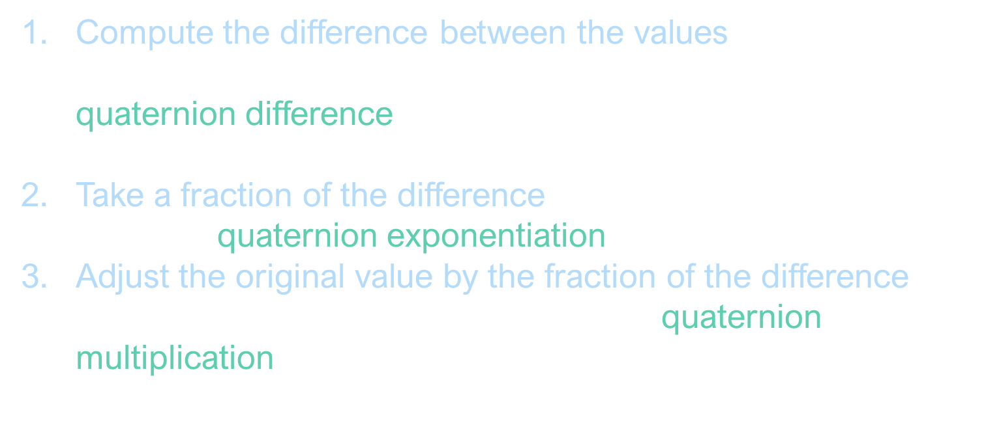
SLERP algebraic derivation
Compute the difference between the values The angular displacement from $q_{0}$ to $q_{1}$is given by the quaternion difference, $∆q=q_{1}{q_{0}}^{−1}$
Take a fraction of the difference Given by quaternion exponentiation, ${\left(∆q\right)}^{t}$
Adjust the original value by the fraction of the difference Combine the rotations $q_{0}$and ${\left(∆q\right)}^{t}$ via quaternion multiplication, ${\left(∆q\right)}^{t}q_{0}$

Slide 12

SLERP computation: alternate approach
Interpret quaternions as existing in a 4D Euclidean space
Since all rotation quaternions are unit length, they “live” on the surface of a 4D hypersphere
Interpolate around the arc along the surface of the hypersphere, which connects the quaternions…
$slerp\left(q_{0},q_{1},t\right)=\frac{\sin\left(1−t\right)ω}{\sin{ω}}q_{0}+\frac{\sin{tω}}{\sin{ω}}q_{1}$ $\cos{ω}=q_{0}∙q_{1}$

Slide 13

SLERPing problems
$q$ and $−q$represent the same orientation, but may give different results when SLERPed (because a 4D hypersphere has a different topology from Euclidean space)
Solution: choose signs of $q_{1}$ and $q_{2}$ so that the dot product is non-negative, i.e. selecting the shortest rotational arc between them.
If $q_{1}$ and $q_{2}$ are very close, then $ω$ is very small and so is $sinω$, which can cause problems with the division.
Use simple linear interpolation in these cases.

Slide 14

TODO
Quaternion dot product, $q_{1}∙q_{2}=\left[\begin{matrix}w_{1} & v_{1}\end{matrix}\right]∙\left[\begin{matrix}w_{2} & v_{2}\end{matrix}\right]=w_{1}w_{2}+v_{1}∙v_{2}$ $=\left[\begin{matrix}w_{1} & \left(\begin{matrix}x_{1} & y_{1} & z_{1}\end{matrix}\right)\end{matrix}\right]\left[\begin{matrix}w_{2} & \left(\begin{matrix}x_{2} & y_{2} & z_{2}\end{matrix}\right)\end{matrix}\right]=w_{1}w_{2}+x_{1}x_{2}+y_{1}y_{2}+z_{1}z_{2}$ $=$the w component of the quaternion difference $q_{2}{q_{1}}^{∗}=\cos\left(\frac{θ}{2}\right)$

