Slide 1
Week 9: Introduction to VFX Part 1: The Graphics Pipeline
COMP270: Mathematics for 3D Worlds and Simulations

Slide 2
Objectives
Recall the key stages of the graphics pipeline
Explain the differences between a CPU and a GPU

Slide 3
Hardware: CPUs vs. GPUs
CPU = central processing unit; GPU = graphics processing unit
GPUs are highly parallelised
Intel i7 6900K: 8 cores
NVIDIA GTX 1080: 2560 shader processors
GPUs are highly specialised
Optimised for floating-point calculations rather than logic
Optimised for performing the same calculation on several thousand vertices or pixels at once

Slide 4
General Purpose GPU (GPGPU)
Early GPUs used a fixed pipeline – could only be used for rendering 3D graphics
Modern GPUs use a programmable pipeline – can be programmed for other tasks
Physics simulation (e.g. PhysX)
Scientific computing (e.g. CUDA)
Deep learning (TensorFlow, PyTorch)
Notes:
The NVIDIA PhysX SDK is a scalable multi-platform physics solution supporting a wide range of devices, from smartphones to high-end multicore CPUs and GPUs. PhysX is already integrated into some of the most popular game engines, including Unreal Engine, and Unity3D.
CUDA® is a parallel computing platform and programming model developed by NVIDIA for general computing on graphical processing units (GPUs). With CUDA, developers are able to dramatically speed up computing applications by harnessing the power of GPUs.

Slide 5
Graphics APIs
Graphics APIs abstract away the differences between different manufacturers’ GPUs
There are several APIs in use today:
OpenGL: Open standard, very mature (since 1992), very widely supported
Vulkan: Open standard, less mature, lots of control on rendering, lots of work to get a basic sample working
Direct3D: Microsoft only
Metal: Apple only
Sony and Nintendo consoles have their own APIs (Microsoft use Direct3D)

Slide 6
Game Engines and Graphics APIs
Game Engines tend to support multiple Graphics API
They have an abstract rendering layer which has concrete implementations of D3D, OpenGL, Vulkan, Metal, Console APIs etc.
This allows the Engine to support multiple platforms
In addition, this makes it easier to upgrade the engine to support new versions of APIs or newly released APIs

Slide 7
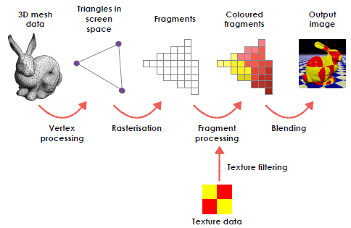
The 3D Graphics Pipeline

Slide 8
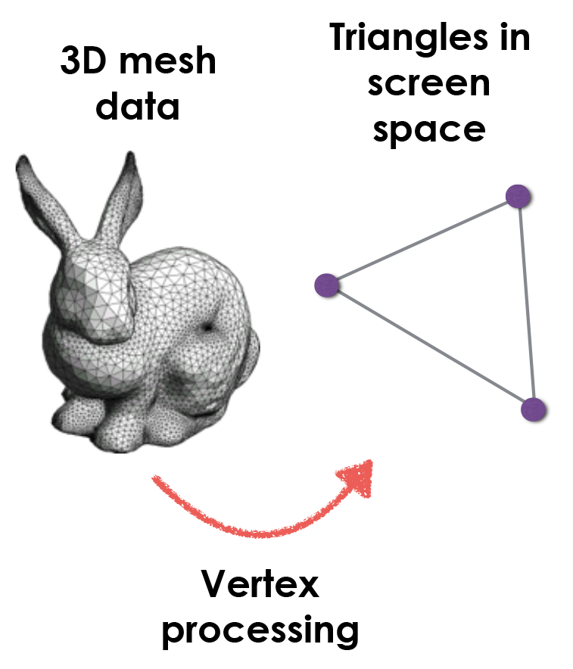
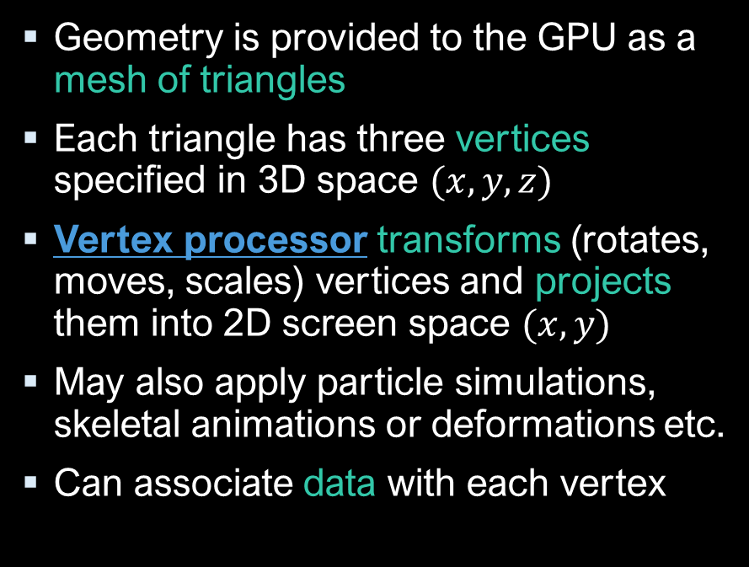
Vertex Processing
Geometry is provided to the GPU as a mesh of triangles
Each triangle has three vertices specified in 3D space $(x, y, z)$
Vertex processor transforms (rotates, moves, scales) vertices and projects them into 2D screen space $(x, y)$
May also apply particle simulations, skeletal animations or deformations etc.
Can associate data with each vertex

Slide 9
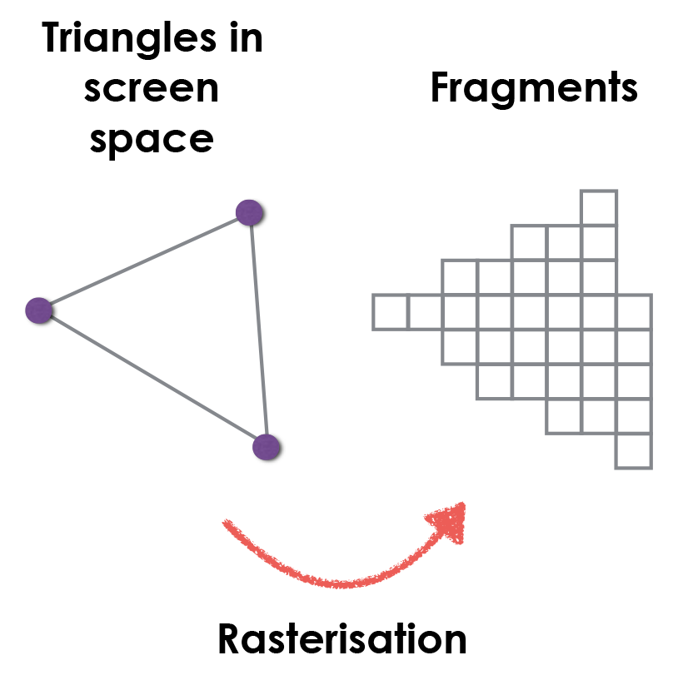
Rasterisation
Determine which fragments are covered by the triangle
In practical terms, “fragment” = “pixel”
Alternative to ray-tracing/ray-casting

Slide 10
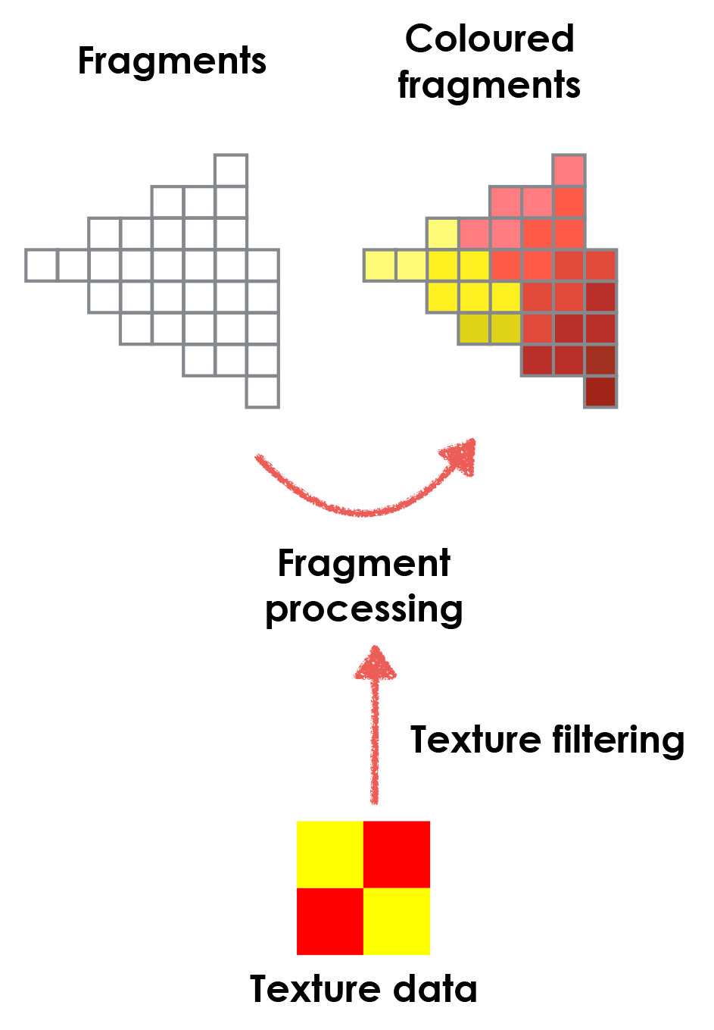
Fragment Processing
Determine the colour of each fragment covered by the triangle
Textures are 2D images that can be wrapped onto a 3D object
Colour is calculated based on texture, lighting and other properties of the surface being rendered (e.g. shininess, roughness)

Slide 11
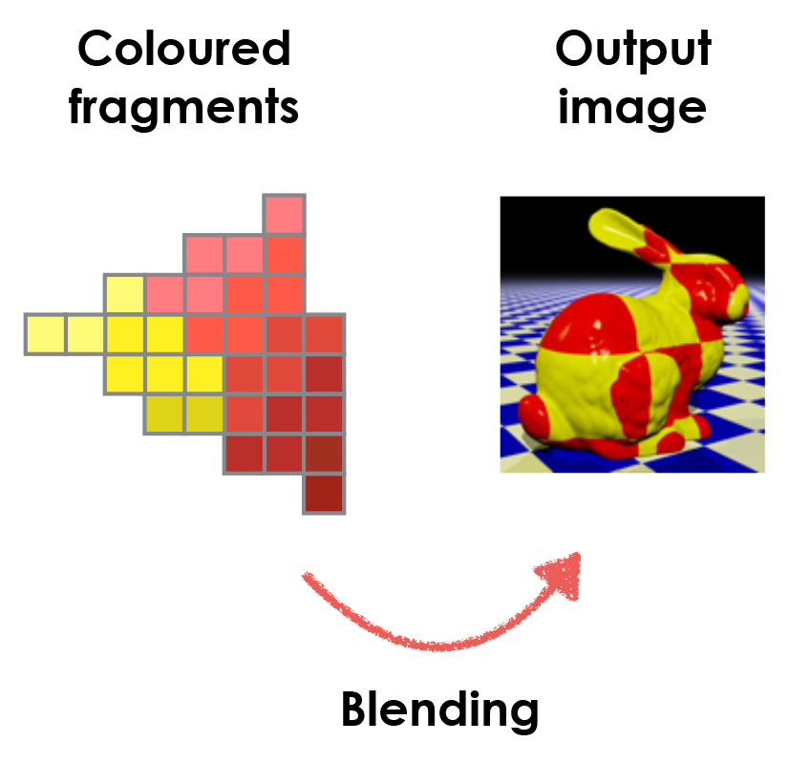
Blending
Combine these fragments with the existing content of the image buffer (or frame buffer)
Depth testing:
if the new fragment is “in front” of the old one, replace it
if it is “behind”, discard it
Alpha blending: combine the old and new colours for a semi-transparent appearance

