Slide 1
Week 9: Introduction to VFX Part 2: Shaders and Materials
COMP270: Mathematics for 3D Worlds and Simulations

Slide 2
Objectives
Define the function of a shader
Understand how the graphics pipeline is implemented in UE4

Slide 3
Programmable Units
The programmable units of the pipeline include:
Vertex Processor
Tessellation Control
Tessellation Evaluation
Geometry Processor
Fragment Processor
Programs for these units are called shaders

Slide 4
Vertex and Fragment Shaders
Required for any rendering to occur in D3D or OpenGL (other units are optional)
Vertex shader: responsible for geometric transformations, deformations, and projection
Takes in exactly one vertex as input
Outputs one vertex
Typical operations include transformations and animation
Fragment shader: responsible for the visual appearance of the surface
Takes in a pixel fragment (see rasterization)
Outputs colour and depth values
Typically used for shading calculations and texturing
AKA Pixel Shader

Slide 5
Shaders and Game Engines
Most game engines abstract shaders into Materials
These materials encapsulate a series of shaders and any other rendering states required to draw the effect
These systems allow greater control for performance
In addition, materials fit into an artist’s workflow

Slide 6
UE4 Material System
This system uses a visual programming language to control the look of an object in the scene
It consists of nodes called Material Expressions
These nodes are simply bits of shader code designed to perform a single task, e.g.
Multiplication
Texture Sample (also know as a look-up)
Blends
This allows you to build up a complex effect by chaining nodes together

Slide 7
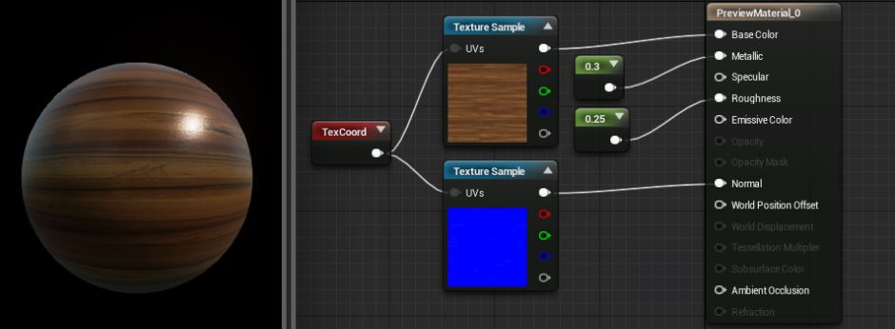
UE4 Material Node Graph

