Slide 1
Week 9: Introduction to VFX Part 3: Geometry Meshes
COMP270: Mathematics for 3D Worlds and Simulations

Slide 2
Objectives
Understand how a mesh is represented in memory
Implement custom meshes in UE4 or Unity

Slide 3
Packaging Data
One of the most important points in 3D graphics is that we are manipulating data on the GPU
This means we need to understand how to package that data on the application side:
How this data is represented in memory
How to operate on the data in shaders to achieve certain effects

Slide 4

Meshes
A mesh is a collection of vertices which define polygons on the surface of an object
Each vertex contains the $(x, y, z)$ coordinates of its position in local space – which is required for the shader to run
May contain other data
Usually created by an artist in applications such as Maya, and then exported in a file format such as FBX
We can also create custom meshes in code e.g.
Procedural Mesh in UE4 (via Blueprints or in C++)
Mesh Class in Unity
Vertices
Face
Procedural generation
Edges

Slide 5
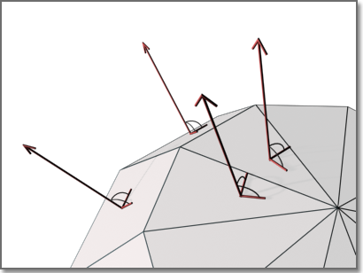
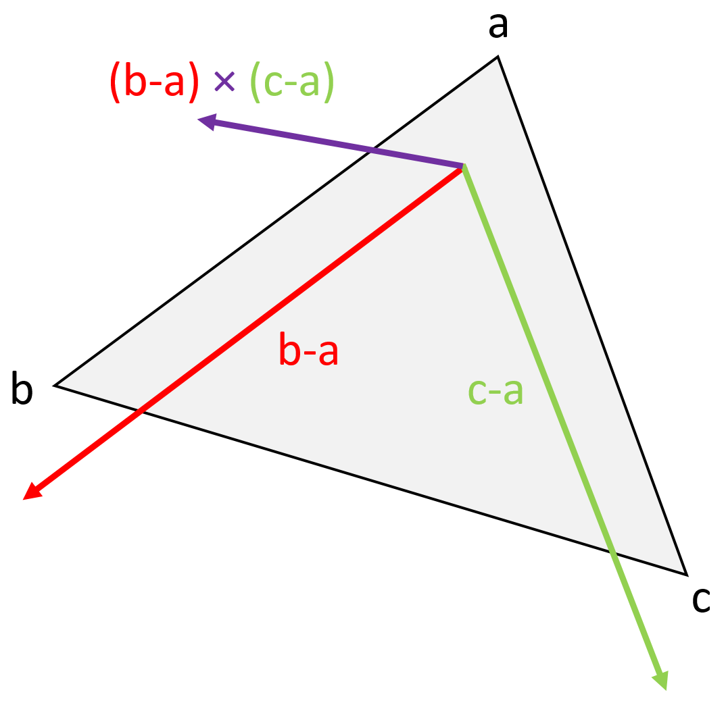

Surface Normals
The normal to a surface is a unit vector that is perpendicular to the surface
If we have two non-parallel vectors that are tangent to the surface, we can use the cross product to find the normal
For a triangle with vertices $a$, $b$, $c$, two such vectors are $b−a$ and $c−a$
So the normal is $\frac{n}{\left\|n\right\|}$ where $n= \left(b−a\right)×\left(c−a\right)$
Order is important..

Slide 6
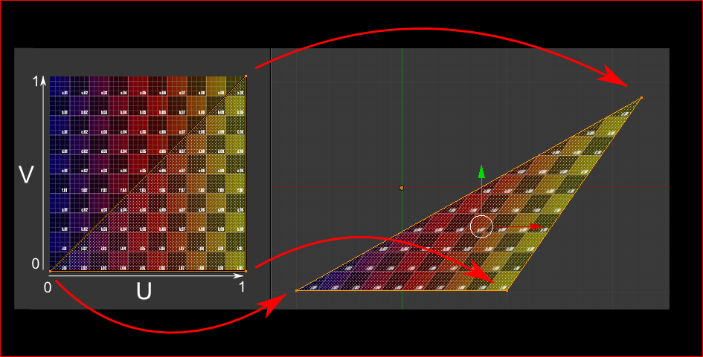

Texture Coordinates
We use UV coordinates to refer to points in a texture:
$u$ axis is horizontal and ranges from 0 (left) to 1 (right)
$v$ axis is vertical and ranges from 0 (bottom) to 1 (top)
Each vertex is associated with a $(u.v)$ value, with the texture interpolated in between

Slide 7

Flexible Vertex Format
In addition to the above vertex elements there can be other attributes, e.g.
Vertex Colours – r, g, b, a
Vertex Tangent – tangent to the surface $\left(x,y,z\right)$
Blend Weights – index of a bone and a float weight for skinning
There is nothing stopping you encoding any information into these
For example, you could use the vertex colours to hold target positions for animations

Slide 8





Vertex Buffer
The vertices are stored in a Vertex Buffer
In OpenGL and Direct3D, we fill these up and tell the pipeline which buffer to use
In UE4 and Unity, these buffers are usually hidden away from us
We typically use higher level classes such as C# Mesh and UE4 Procedural Mesh to add in our own geometry
$$e$$
$$c$$
x | y | z | r | g | b | a | …
$$d$$
$$a$$
$$b$$
vertexA | vertexB | vertexC | vertexB | vertexD | vertexC | vertexD | vertexE | vertexC
Triangle 1
Triangle 2
Triangle 3

Slide 9
Indices
Indices are integers which specify the vertices that make up the triangles of a mesh
In rendering this allows us to send less data to the pipeline
A triangulated cube would have 36 vertices, this will be at least 432 bytes (12 bytes per vertex)
With indices, we used 8 vertices and 36 indices, which is around 240 bytes in total.
vertexA | vertexB | vertexC | vertexD | vertexE
0 | 1 | 2 | 3 | 4
Vertex buffer
0 | 1 | 2 | 1 | 3 | 2 | 3 | 4 | 2
Index buffer
Triangle 1
Triangle 2
Triangle 3

Slide 10
Index Buffer
These indices are stored in an Index Buffer (Direct3D) or Element Buffer (OpenGL)
In OpenGL and Direct3D, we fill these up and tell the pipeline which buffer to use
In UE4 and Unity, these buffers are usually hidden away from us
We typically use higher level classes such as C# Mesh and UE4 Procedural Mesh to add in our own indices

Slide 11
Generating Meshes
Why?
Variety: possible to incorporate random variations
Scalability: choose the appropriate level of detail (number of vertices)
Convenience: allows developers to create geometry, to produce an effect or perhaps for visual debugging
How?
Calculate the vertex positions (and other data) to store in the vertex buffer
Identify with the relevant triangles in the index buffer
Start with a basic shape and modify it…

