Slide 1

2: Computational Geometry I
COMP270: Mathematics for 3D Worlds & Simulations

Slide 2

Number systems

Slide 3
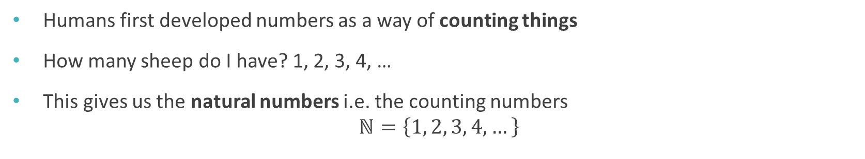
Counting
Humans first developed numbers as a way of counting things
How many sheep do I have? 1, 2, 3, 4, …
This gives us the natural numbers i.e. the counting numbers $ℕ=\left\{1, 2, 3, 4,…\right\}$
We use blackboard bold font for the standard number systems
Curly braces denote a set
… means continue this sequence to infinity

Slide 4
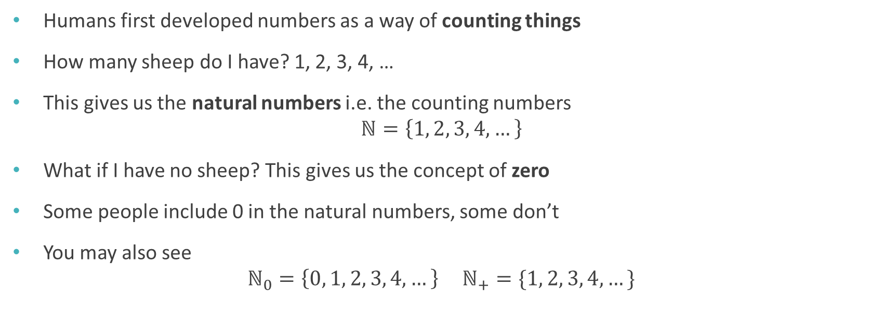
Counting
Humans first developed numbers as a way of counting things
How many sheep do I have? 1, 2, 3, 4, …
This gives us the natural numbers i.e. the counting numbers $ℕ=\left\{1, 2, 3, 4,…\right\}$
What if I have no sheep? This gives us the concept of zero
Some people include 0 in the natural numbers, some don’t
You may also see $ℕ_{0}=\left\{0, 1, 2, 3, 4, …\right\} ℕ_{+}=\{1, 2, 3, 4, …\}$

Slide 5

Integers
We can calculate with natural numbers
What is the answer to $3−5$? We need negative numbers
Adding negative numbers to the natural numbers gives us the integers (or whole numbers) $ℤ=\left\{…, −3, −2, −1, 0, 1, 2, 3, …\right\}$
Why Z? From the German Zahlen, meaning numbers
Infinite sequence to the left as well as to the right

Slide 6
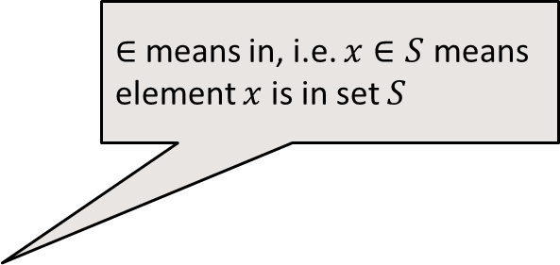

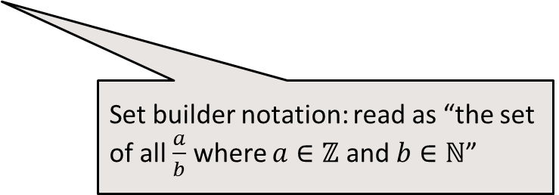
Fractions
We can do some divisions with integers, e.g. $6÷3=2$
But not others, e.g. $7÷3= ?$
To solve this we need fractions: $7÷3=\frac{7}{3}$
This gives us the rational numbers: $ℚ=\left\{\frac{a}{b}:a∈ℤ, b∈ℕ\right\}$
$∈$ means in, i.e. $x∈S$ means element $x$ is in set $S$
Why Q? From the German (also English) Quotient, meaning ratio or division
Set builder notation: read as “the set of all $\frac{a}{b}$ where $a∈ℤ$ and $b∈ℕ$”

Slide 7
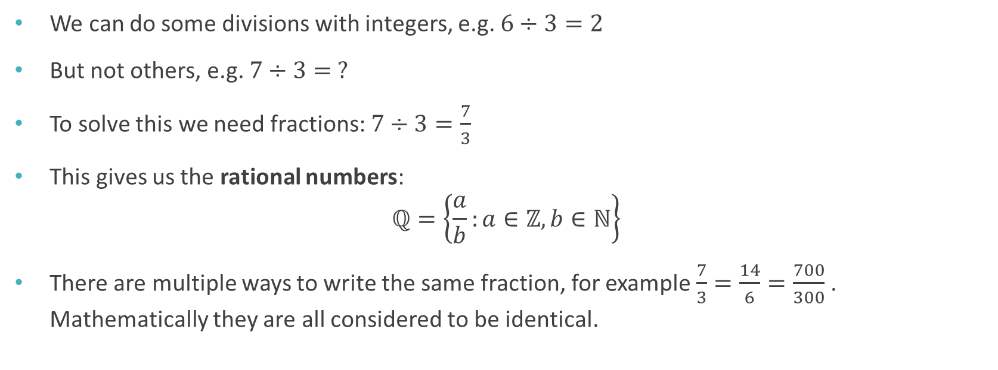
Fractions
We can do some divisions with integers, e.g. $6÷3=2$
But not others, e.g. $7÷3= ?$
To solve this we need fractions: $7÷3=\frac{7}{3}$
This gives us the rational numbers: $ℚ=\left\{\frac{a}{b}:a∈ℤ, b∈ℕ\right\}$
There are multiple ways to write the same fraction, for example $\frac{7}{3}=\frac{14}{6}=\frac{700}{300}$ . Mathematically they are all considered to be identical.

Slide 8
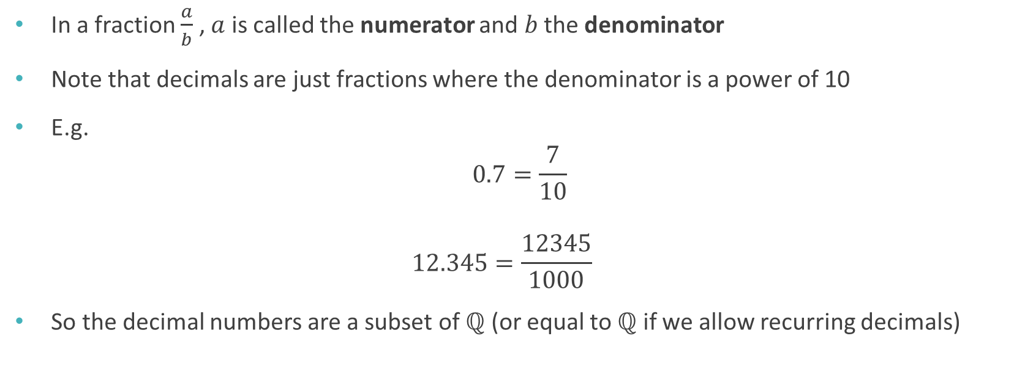
Decimals
In a fraction $\frac{a}{b}$ , $a$ is called the numerator and $b$ the denominator
Note that decimals are just fractions where the denominator is a power of 10
E.g. $0.7=\frac{7}{10}$ $12.345=\frac{12345}{1000}$
So the decimal numbers are a subset of $ℚ$ (or equal to $ℚ$ if we allow recurring decimals)

Slide 9
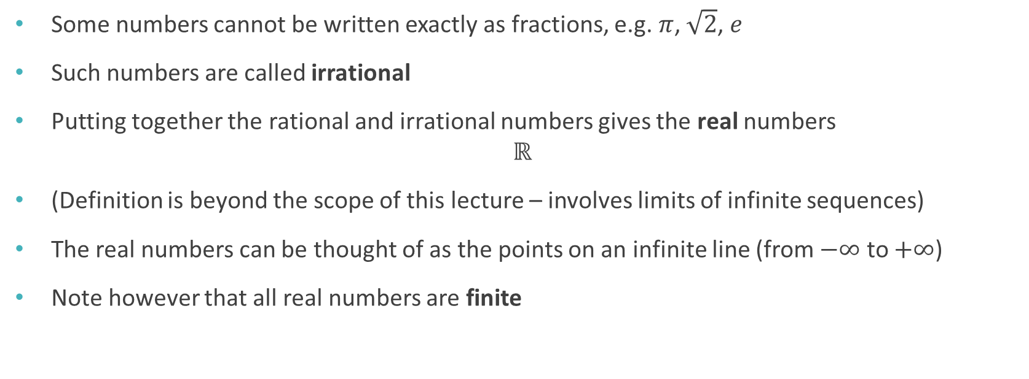
Reals
Some numbers cannot be written exactly as fractions, e.g. $π$, $\sqrt{2}$, $e$
Such numbers are called irrational
Putting together the rational and irrational numbers gives the real numbers $ℝ$
(Definition is beyond the scope of this lecture – involves limits of infinite sequences)
The real numbers can be thought of as the points on an infinite line (from $−∞$ to $+∞$)
Note however that all real numbers are finite

Slide 10
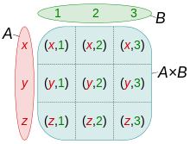
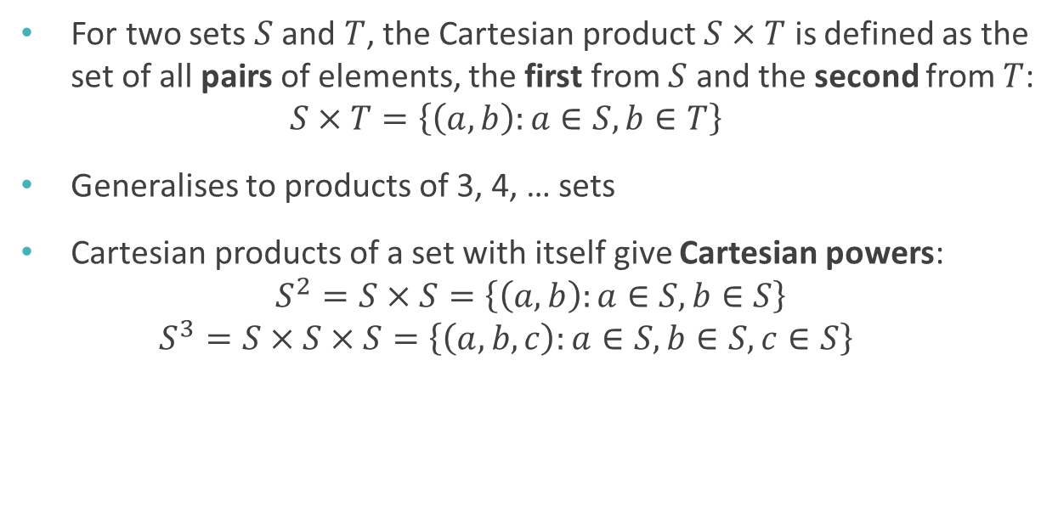
Cartesian product
Named after René Descartes, 1596-1650, French mathematician
For two sets $S$ and $T$, the Cartesian product $S×T$ is defined as the set of all pairs of elements, the first from $S$ and the second from $T$: $S×T=\left\{\left(a,b\right):a∈S, b∈T\right\}$
Generalises to products of 3, 4, … sets
Cartesian products of a set with itself give Cartesian powers: $S^{2}=S×S=\left\{\left(a,b\right):a∈S, b∈S\right\}$ $S^{3}=S×S×S=\left\{\left(a,b,c\right):a∈S, b∈S, c∈S\right\}$

Slide 11
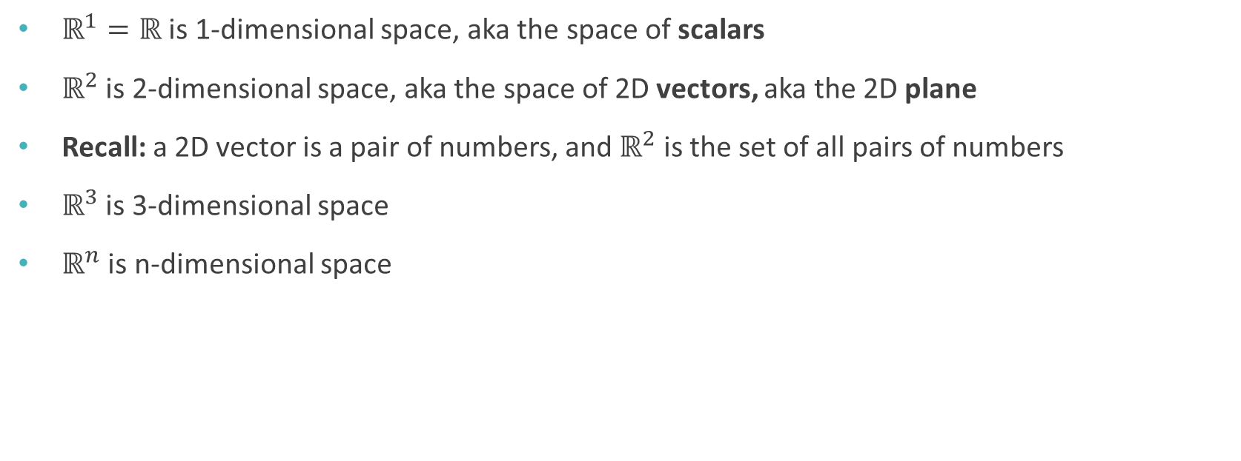
Cartesian coordinate systems
$ℝ^{1}=ℝ$ is 1-dimensional space, aka the space of scalars
$ℝ^{2}$ is 2-dimensional space, aka the space of 2D vectors, aka the 2D plane
Recall: a 2D vector is a pair of numbers, and $ℝ^{2}$ is the set of all pairs of numbers
$ℝ^{3}$ is 3-dimensional space
$ℝ^{n}$ is n-dimensional space

Slide 12

Other number systems
Complex numbers $ℂ$
Quaternions, octonians, …

Slide 13
Functions

Slide 14
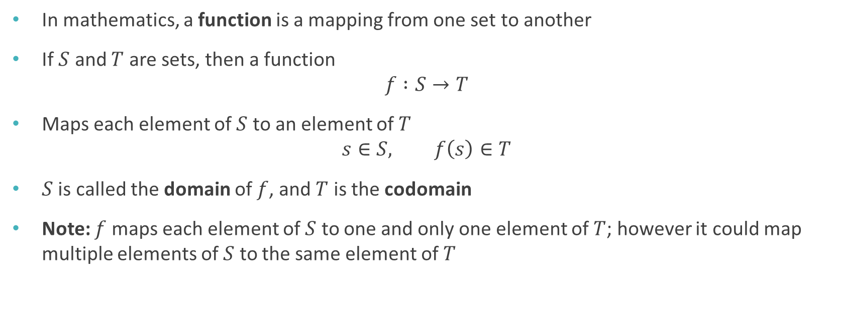
Functions
In mathematics, a function is a mapping from one set to another
If $S$ and $T$ are sets, then a function $f :S→T$
Maps each element of $S$ to an element of $T$ $s∈S, f\left(s\right)∈T$
$S$ is called the domain of $f$, and $T$ is the codomain
Note: $f$ maps each element of $S$ to one and only one element of $T$; however it could map multiple elements of $S$ to the same element of $T$

Slide 15
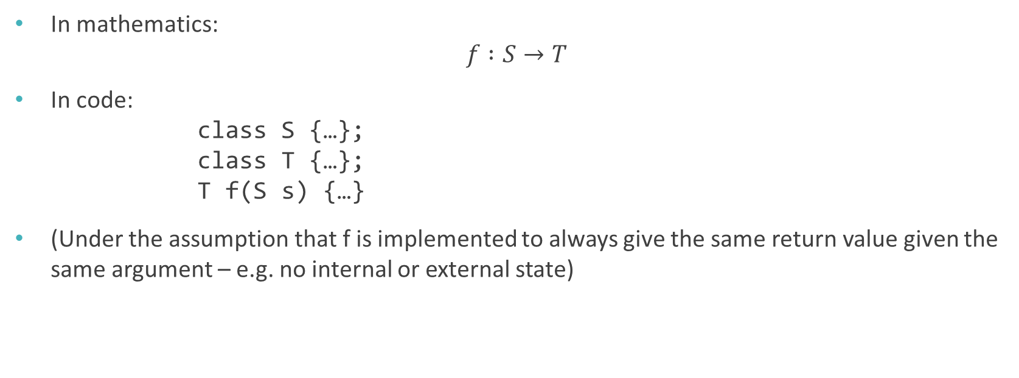
Functions vs functions
In mathematics: $f :S→T$
In code: class S {…}; class T {…}; T f(S s) {…}
(Under the assumption that f is implemented to always give the same return value given the same argument – e.g. no internal or external state)

Slide 16

Functions vs functions
In mathematics: $f :ℝ→ℤ$
In code: int f(float x) {…}
OK, so $ℤ$ and int aren’t really the same, nor are $ℝ$ and float, but close enough for computing…

Slide 17

Multiple arguments
The domain of a function could be a Cartesian product: $f :A×B→C$
In code: C f(A a, B b) {…}

Slide 18
Curves

Slide 19
What is a curve?
“The [curved] line is […] the first species of quantity, which has only one dimension, namely length, without any width nor depth, and is nothing else than the flow or run of the point which […] will leave from its imaginary moving some vestige in length, exempt of any width.”
Euclid, Elements (English translation from Wikipedia)

Slide 20
What is a curve?
“The [curved] line is […] the first species of quantity, which has only one dimension, namely length, without any width nor depth, and is nothing else than the flow or run of the point which […] will leave from its imaginary moving some vestige in length, exempt of any width.”
Euclid, Elements (English translation from Wikipedia)

Slide 21
What is a curve?
“The [curved] line is […] the first species of quantity, which has only one dimension, namely length, without any width nor depth, and is nothing else than the flow or run of the point which […] will leave from its imaginary moving some vestige in length, exempt of any width.”
Euclid, Elements (English translation from Wikipedia)

Slide 22
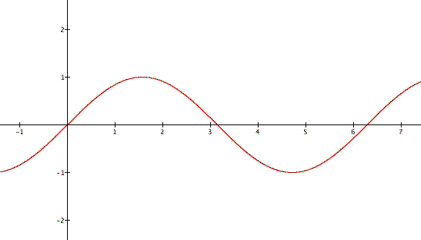

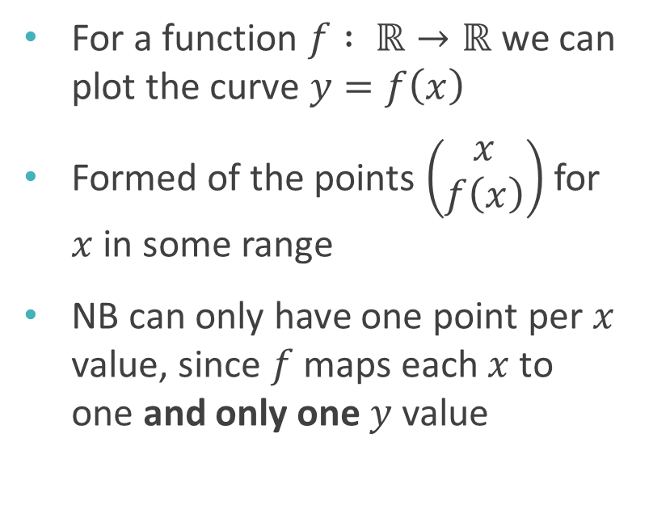
Defining a curve
For a function $f : ℝ→ℝ$ we can plot the curve $y=f\left(x\right)$
Formed of the points $\left(\begin{matrix}x \\ f\left(x\right)\end{matrix}\right)$ for $x$ in some range
NB can only have one point per $x$ value, since $f$ maps each $x$ to one and only one $y$ value
$$y=\sin\left(x\right)$$

Slide 23
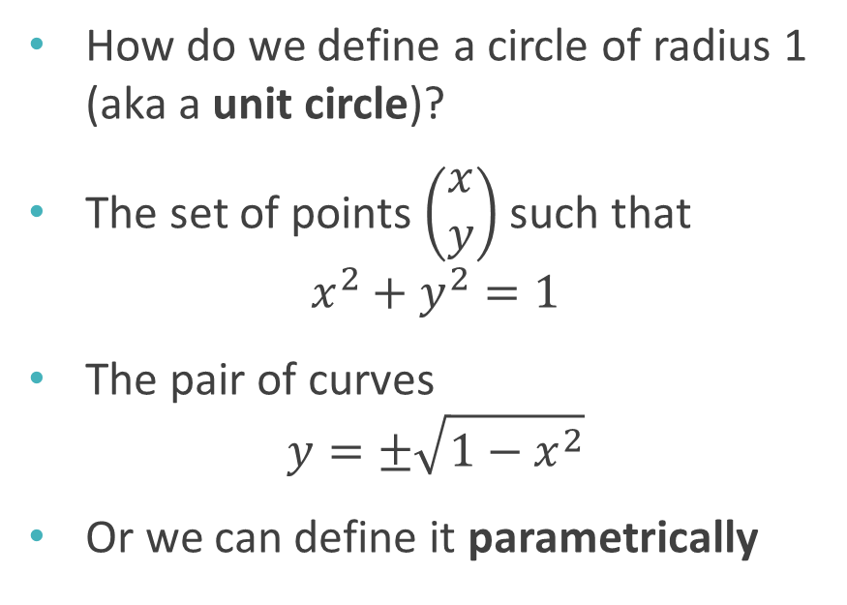
Defining a curve
y
How do we define a circle of radius 1 (aka a unit circle)?
The set of points $\left(\begin{matrix}x \\ y\end{matrix}\right)$ such that $x^{2}+y^{2}=1$
The pair of curves $y=±\sqrt{1−x^{2}}$
Or we can define it parametrically
1
-1
1
x
-1

Slide 24
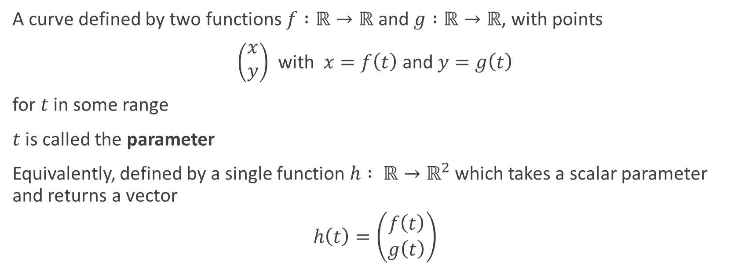
Parametric curve
A curve defined by two functions $f :ℝ→ℝ$ and $g :ℝ→ℝ$, with points
$\left(\begin{matrix}x \\ y\end{matrix}\right)$ with $x=f\left(t\right)$ and $y=g\left(t\right)$
for $t$ in some range
$t$ is called the parameter
Equivalently, defined by a single function $h : ℝ→ℝ^{2}$ which takes a scalar parameter and returns a vector
$$h\left(t\right)=\left(\begin{matrix}f\left(t\right) \\ g\left(t\right)\end{matrix}\right)$$

Slide 25
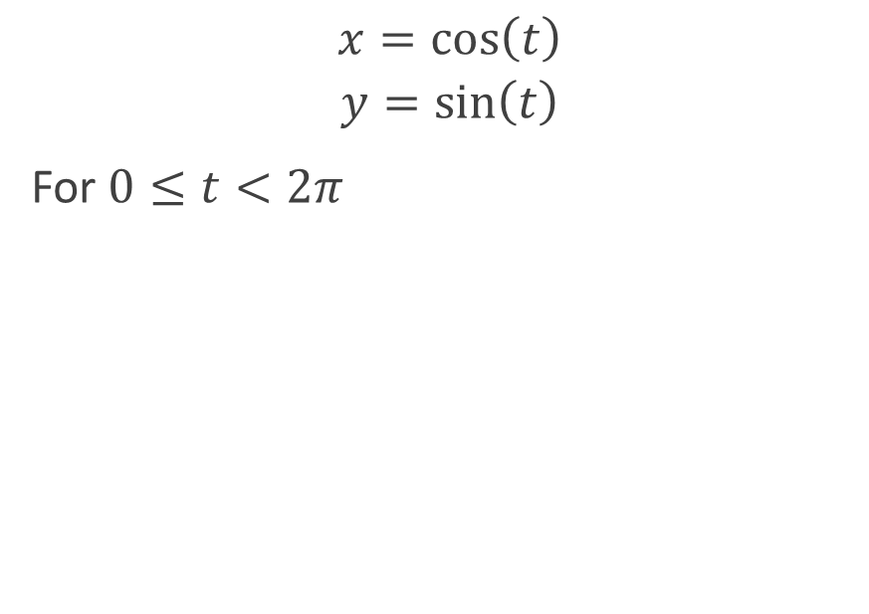
Parametric definition of a unit circle
y
$$x=\cos\left(t\right)$$
$$y=\sin\left(t\right)$$
For $0≤t<2π$
1
-1
1
x
-1

Slide 26

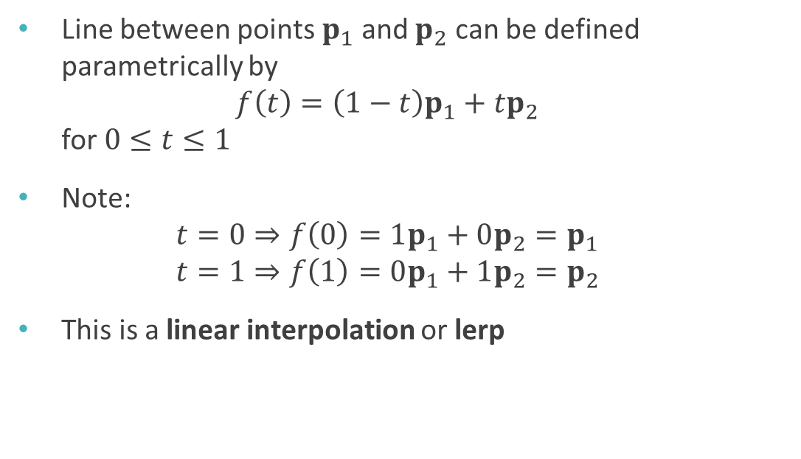

Lines are curves too
Line between points $p_{1}$ and $p_{2}$ can be defined parametrically by $f\left(t\right)=\left(1−t\right)p_{1}+tp_{2}$ for $0≤t≤1$
Note: $t=0⇒f\left(0\right)=1p_{1}+0p_{2}=p_{1}$ $t=1⇒f\left(1\right)=0p_{1}+1p_{2}=p_{2}$
This is a linear interpolation or lerp
$$p_{1}$$
$$p_{2}$$

Slide 27
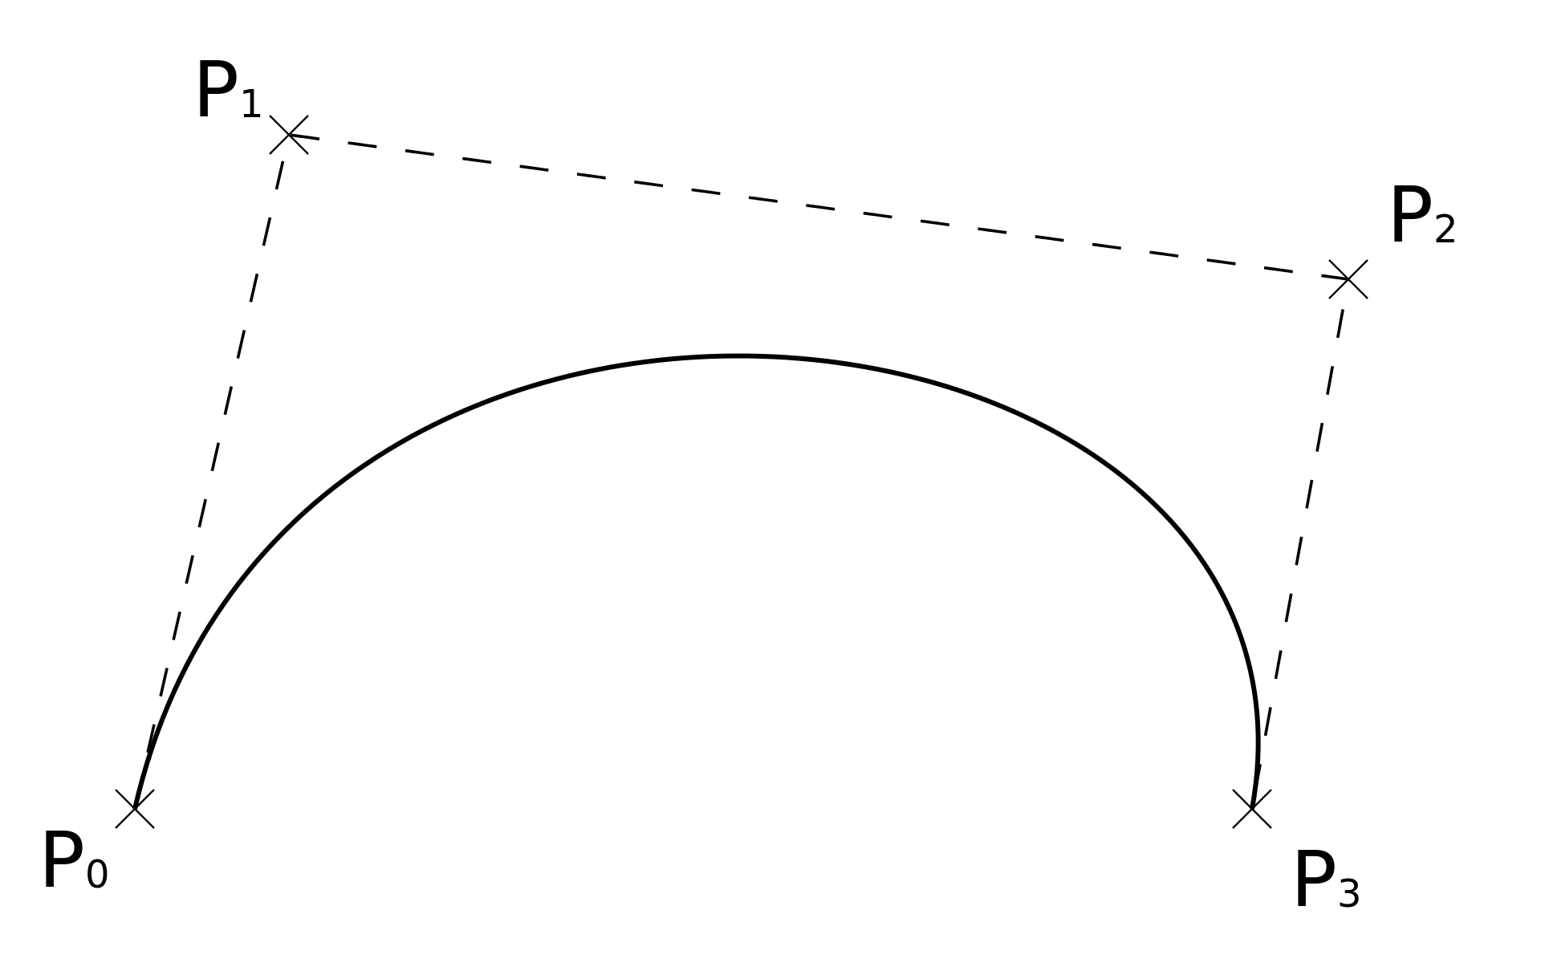
Bézier curves
Named after Pierre Bézier, 1910-1999, French engineer
Defined by a number of control points
Commonly used in computer graphics and game development, as allows artists/designers good control over the precise shape of the curve
See worksheet A…

