Slide 1

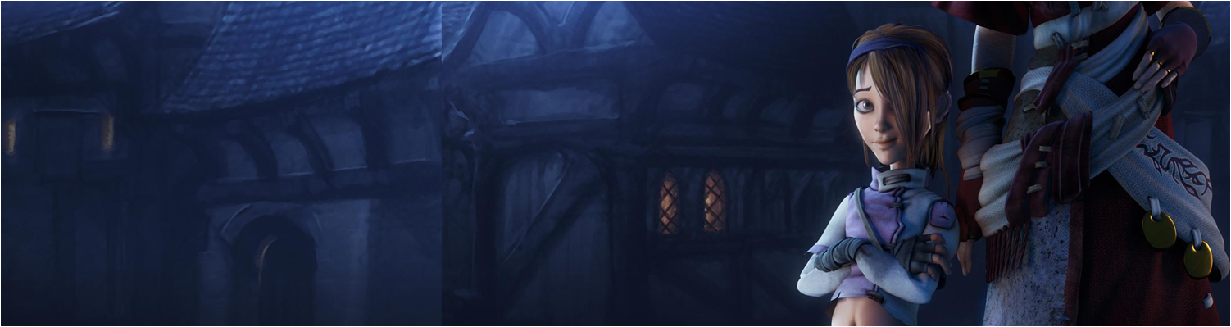


Workshop 1: 2D Vector revision
COMP270: Mathematics for 3D Worlds and Simulation
BSc (Hons) Computing for Games

Slide 2
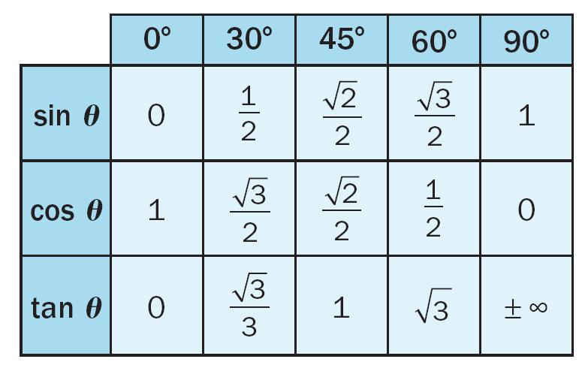
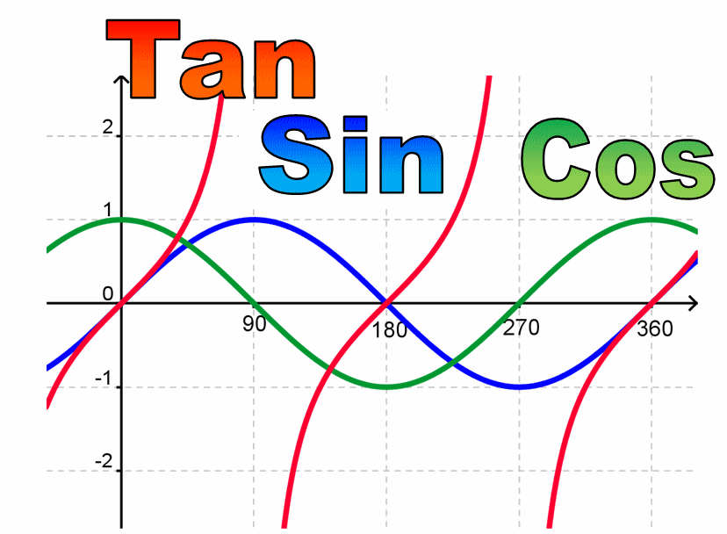
Trigonometric Values

Slide 3

Answers: Question 1
True: $\left({3 \atop 5}\right)$ - $\left({1 \atop 2}\right)$ = $\left({2 \atop 3}\right)$ $\left({101 \atop −97}\right)$ - $\left({99 \atop −100}\right)$ = $\left({2 \atop 3}\right)$
False: $\left({−3 \atop −5}\right)$ - $\left({−1 \atop −2}\right)$ = $\left({−2 \atop −3}\right)$ $\left({−101 \atop −97}\right)$ - $\left({−99 \atop −100}\right)$ = $\left({−2 \atop 3}\right)$
… The length is the same, but the direction isn’t.

Slide 4

Answers: Question 1 cont.
c. False: vectors have both direction and length.
d. True
e. False; addition is commutative
f. False! $\left({x \atop y}\right)=\left({x \atop y}\right) − \left({0 \atop 0}\right)$ is the displacement from the origin to (x, y).

Slide 5
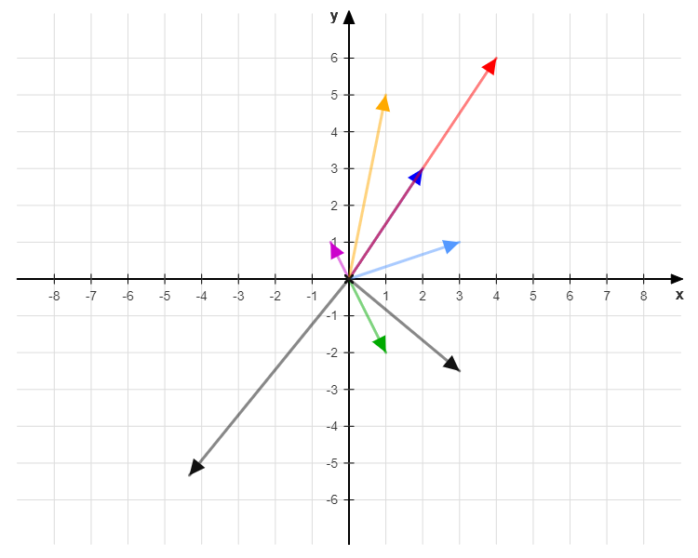



Answers: Question 2
a-b
2a
a
-$\frac{1}{2}$b
a+b
b
$\frac{1}{2}$a+2b
-2a-$\frac{1}{3}$b

Slide 6

Answers: Question 3
$\left({18 \atop −6}\right)$
$\left({2 \atop 2.5}\right)$
$\left({7 \atop −1}\right)$
$\sqrt{{(−12)}^{2}+5^{2}}=13$
$\left\|\left({9 \atop −4}\right)+\left({3 \atop −12}\right)\right\|=\sqrt{{12}^{2}+{(−16)}^{2}}=20$
$\left\|\left({−1 \atop \frac{−2}{\sqrt{2}}}\right)+\left({\frac{1}{2} \atop \frac{−1}{\sqrt{2}}}\right)\right\|=\sqrt{{\left(\frac{−1}{2}\right)}^{2}+{\left(\frac{−3}{\sqrt{2}}\right)}^{2}}=\frac{\sqrt{19}}{2}$

Slide 7

Answers: Question 4
(2, -2) $\left({−3 \atop 7}\right)+\left({5 \atop −9}\right)−\left({0 \atop 0}\right)=\left({2 \atop −2}\right)$
(-9, 15) $a−b=\left({−3 \atop 7}\right)−\left({5 \atop −9}\right)=\left({−8 \atop 16}\right)$ describes a displacement anywhere in space, but in this case we want to find the point relative to the origin we end up at if we travel along $a−b$ starting from (-1, -1): $\left({−1 \atop −1}\right)+\left({−8 \atop 16}\right)=\left({−9 \atop 15}\right)$
(4, 6) The length of the vector from (1, 2) to (7, 10) is $\left\|\left({7 \atop 10}\right)−\left({1 \atop 2}\right)\right\|=\left\|\left({6 \atop 8}\right)\right\|=\sqrt{6^{2}+8^{2}}=$10 We want the vector that is half as long in the same direction, $\left({3 \atop 4}\right)$, added to the starting point.

Slide 8
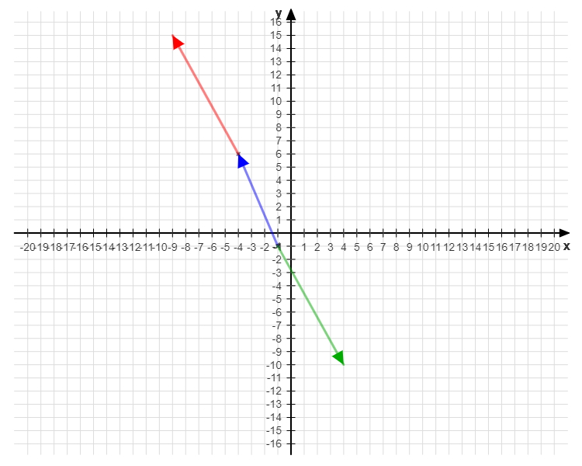
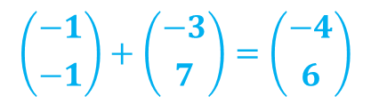
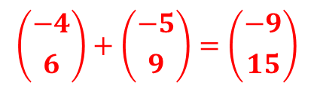
Answers: Question 4b visualised!
$$\left({−4 \atop 6}\right)+\left({−5 \atop 9}\right)=\left({−9 \atop 15}\right)$$
-b
$$\left({−1 \atop −1}\right)+\left({−3 \atop 7}\right)=\left({−4 \atop 6}\right)$$
a
(-1, -1)
b

Slide 9

Answers: Question 5
b
α = tan⁻¹$\frac{\sqrt{3}}{3}$ = 30° β = tan⁻¹$\frac{\sqrt{3}}{1}$ = 60° θ = 60° - 30° = 30°
α = tan⁻¹$\frac{3}{3}$ = 45° β = tan⁻¹$\frac{2}{−2}$ = 135° θ = 135° - 45° = 90°
θ
β
a
α

Slide 10

Answers: Question 6
$\left({3 \atop \sqrt{3}}\right)∙\left({1 \atop \sqrt{3}}\right)=3+3=6$ $\left\|\left({3 \atop \sqrt{3}}\right)\right\|\left\|\left({1 \atop \sqrt{3}}\right)\right\|=\sqrt{12}×\sqrt{4}=4\sqrt{3}$ θ = cos⁻¹$\frac{6}{4\sqrt{3}}$ = cos⁻¹$\frac{\sqrt{3}}{2}$ = 30°
$\left({3 \atop 3}\right)∙\left({−2 \atop 2}\right)=−6+6=0$ θ = cos⁻¹$0$ = 90°

Slide 11


Answers: Question 7
(i) $n\left({1 \atop 1}\right)$ (ii) $n\left({−1 \atop 1}\right)$
(i) $n\left({1 \atop 1}\right)$ (ii) $n\left({1 \atop −1}\right)$
(i) $n\left({1 \atop 2}\right)$ (ii) $n\left({2 \atop −1}\right)$

Slide 12

Answers: Question 7 cont.
For any vector $\left({x \atop y}\right)$, the vector $n\left({x \atop y}\right)$ is parallel:
$$\left({x \atop y}\right)∙n\left({x \atop y}\right)=nx^{2}+ny^{2}=n(x^{2}+y^{2})$$
$$\left\|\left({x \atop y}\right)\right\|\left\|n\left({x \atop y}\right)\right\|=\sqrt{x^{2}+y^{2}}×\sqrt{n^{2}(x^{2}+y^{2})}=n(x^{2}+y^{2})$$
θ = cos⁻¹1 = 0

Slide 13

Answers: Question 7 cont.
For any vector $\left({x \atop y}\right)$, the vector $n\left({y \atop −x}\right)$ is perpendicular:
$$\left({x \atop y}\right)∙n\left({y \atop −x}\right)=nxy=nyx=0$$
θ = cos⁻¹0 = 90°

Slide 14

Answers: Question 8a
Use the sign of the dot product between $v$ and $x – p$. This follows from the geometric interpretation of the dot product: $$v∙\left(x−p\right)= \left\|v\right\|\left\|x−p\right\|cosθ$$ where θ is the angle between $v$ and $x−p$.
p
x-p
θ
x
v

Slide 15

Answers: Question 8a cont.
$$v∙\left(x−p\right)= \left\|v\right\|\left\|x−p\right\|cosθ$$
Both $\left\|v\right\|$ and $\left\|x−p\right\|$are always positive, leaving the sign of the dot product entirely up to the value of $cosθ$. If $cosθ$ > 0 then $θ$ is less than 90° and $x$ is in front of the NPC. Similarly, if $cosθ$ < 0 then $θ$ is greater than 90 ° and $x$ is behind the NPC.
The special case of $v∙\left(x−p\right)=0$ means that x lies either directly to the left or the right of the NPC. If this case does not need to be handled explicitly, it can be assigned arbitrarily to mean either in front or behind.

Slide 16

Answers: Question 8b
$x$ is in front of the NPC. $\left({5 \atop −2}\right)∙\left[\left({0 \atop 0}\right)−\left({−3 \atop 4}\right)\right]=\left({5 \atop −2}\right)∙\left({3 \atop −4}\right)=15+8=23$
$x$ is in front of the NPC. $\left({5 \atop −2}\right)∙\left[\left({1 \atop 6}\right)−\left({−3 \atop 4}\right)\right]=\left({5 \atop −2}\right)∙\left({4 \atop 2}\right)=20−4=$16
$x$ is behind the NPC. $\left({5 \atop −2}\right)∙\left[\left({−6 \atop 0}\right)−\left({−3 \atop 4}\right)\right]=\left({5 \atop −2}\right)∙\left({−3 \atop −4}\right)=−15+8=−7$
$x$ is behind the NPC. $\left({5 \atop −2}\right)∙\left[\left({−4 \atop 7}\right)−\left({−3 \atop 4}\right)\right]=\left({5 \atop −2}\right)∙\left({−1 \atop 3}\right)=−5−6=−$11
$x$ is in front of the NPC. $\left({5 \atop −2}\right)∙\left[\left({5 \atop 5}\right)−\left({−3 \atop 4}\right)\right]=\left({5 \atop −2}\right)∙\left({8 \atop 1}\right)=40−2=38$
$x$ is in front of the NPC. $\left({5 \atop −2}\right)∙\left[\left({−3 \atop 0}\right)−\left({−3 \atop 4}\right)\right]=\left({5 \atop −2}\right)∙\left({0 \atop −4}\right)=0+8=8$
$x$ is in directly to the side of the NPC. $\left({5 \atop −2}\right)∙\left[\left({−6 \atop −3.5}\right)−\left({−3 \atop 4}\right)\right]=\left({5 \atop −2}\right)∙\left({−3 \atop −7.5}\right)=−15+15=0$

Slide 17

Answers: Question 9a
To determine whether the point $x$ is visible to the NPC, compare $cosθ$to $cos⁡(Φ/2):$
If $cosθ ≥cos⁡(Φ/2),$then $x$ is visible to the NPC.
p
x-p
^{Φ}/₂
θ
x
v

Slide 18

Answers: Question 9b
$cos⁡(Φ/2)$=$cos(45°)$≈ 0.707
$x$ is visible to the NPC ($cosθ$≈ 0.854)
$x$ is not visible to the NPC ($cosθ$≈ 0.664)
$x$ is not visible to the NPC ($cosθ$≈ -0.260)
$x$ is not visible to the NPC ($cosθ$≈ -0.646)
$x$ is visible to the NPC ($cosθ$≈ 0.875)
$x$ is not visible to the NPC ($cosθ$≈ 0.371)
$x$ is not visible to the NPC ($cosθ=0$)

Slide 19

Answers: Question 9c
$x$ is visible to the NPC: $\left\|\left({0 \atop 0}\right)−\left({−3 \atop 4}\right)\right\|=5<7$
[$x$ is outside the FOV]
[$x$ is outside the FOV]
[$x$ is outside the FOV]
$x$ is not visible to the NPC: $\left\|\left({5 \atop 5}\right)−\left({−3 \atop 4}\right)\right\|=\sqrt{65}>7$
[$x$ is outside the FOV]
[$x$ is outside the FOV]

