Slide 1

4: Newtonian Mechanics
COMP270: Mathematics for 3D Worlds & Simulations

Slide 2

Trigonometric identities

Slide 3

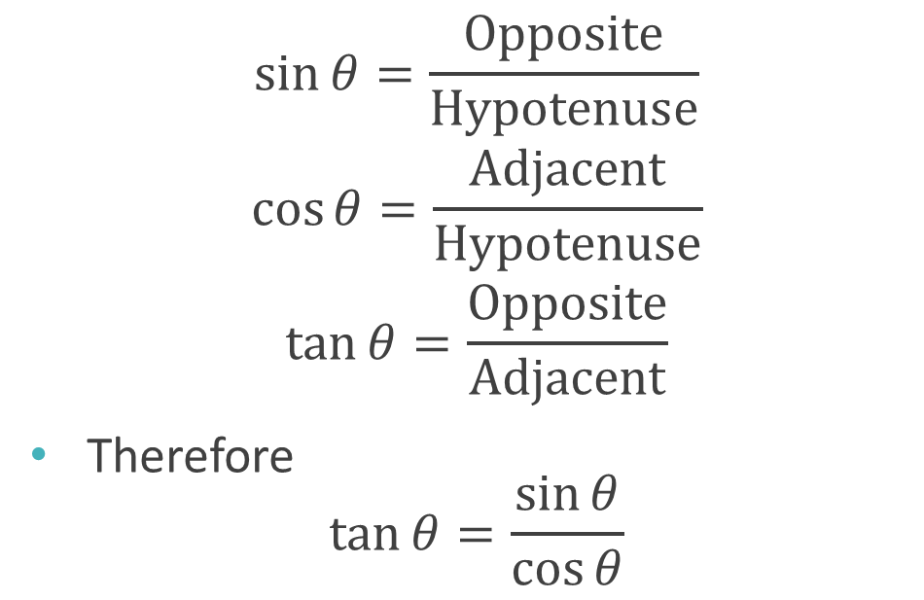
Silly Old Harry Caught A Herring Trawling Off America
$$\sin{θ}=\frac{\text{Opposite}}{\text{H}\text{ypotenuse}}$$
$$\cos{θ}=\frac{\text{Adjacent}}{\text{H}\text{ypotenuse}}$$
$$\tan{θ}=\frac{\text{Opposite}}{\text{Adjacent}}$$
Therefore $\tan{θ}=\frac{\sin{θ}}{\cos{θ}}$
Hypotenuse
Opposite
$$θ$$
Adjacent

Slide 4

Other trigonometric functions
Secant: $\sec{θ}=\frac{1}{\cos{θ}}$
Cosecant: $\csc{θ}=\frac{1}{\sin{θ}}$
Cotangent: $\cot{θ}=\frac{1}{\tan{θ}}$

Slide 5

Pythagorean identities
Named after Pythagoras of Samos (c570 – c495 BC), Greek philosopher
$$\sin^{2}{θ}+\cos^{2}{θ}=1$$
Divide through by $\cos^{2}{θ}$:
$$1+\tan^{2}{θ}=\sec^{2}{θ}$$
Divide through by $\sin^{2}{θ}$:
$$1+\cot^{2}{θ}=\csc^{2}{θ}$$

Slide 6
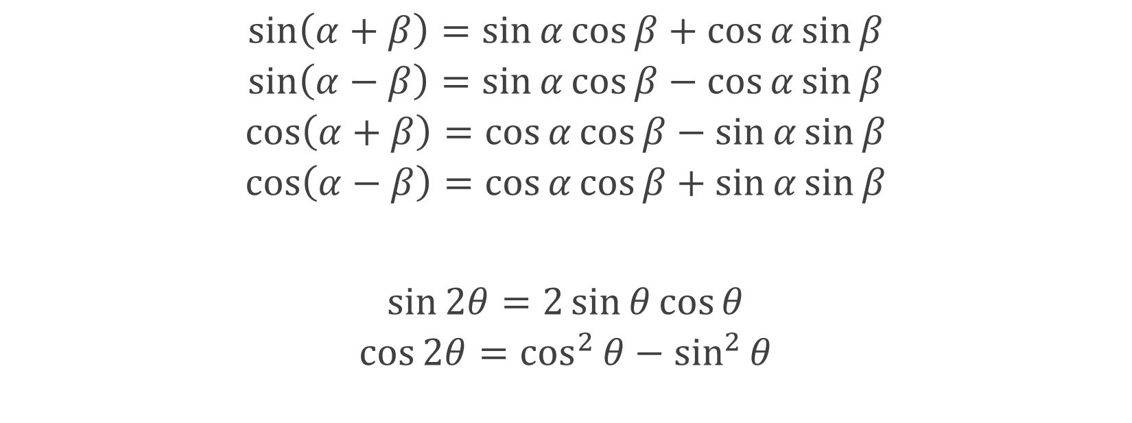
Sum, difference, double angle formulae
$$\sin\left(α+β\right)=\sin{α}\cos{β}+\cos{α}\sin{β}$$
$$\sin\left(α−β\right)=\sin{α}\cos{β}−\cos{α}\sin{β}$$
$$\cos\left(α+β\right)=\cos{α}\cos{β}−\sin{α}\sin{β}$$
$$\cos\left(α−β\right)=\cos{α}\cos{β}+\sin{α}\sin{β}$$
$$\sin{2θ}=2\sin{θ}\cos{θ}$$
$$\cos{2θ}=\cos^{2}{θ}−\sin^{2}{θ}$$

Slide 7
Calculus

Slide 8
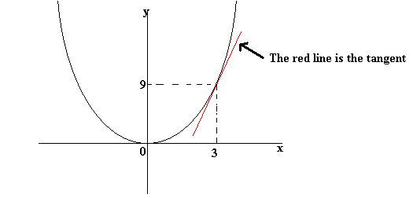
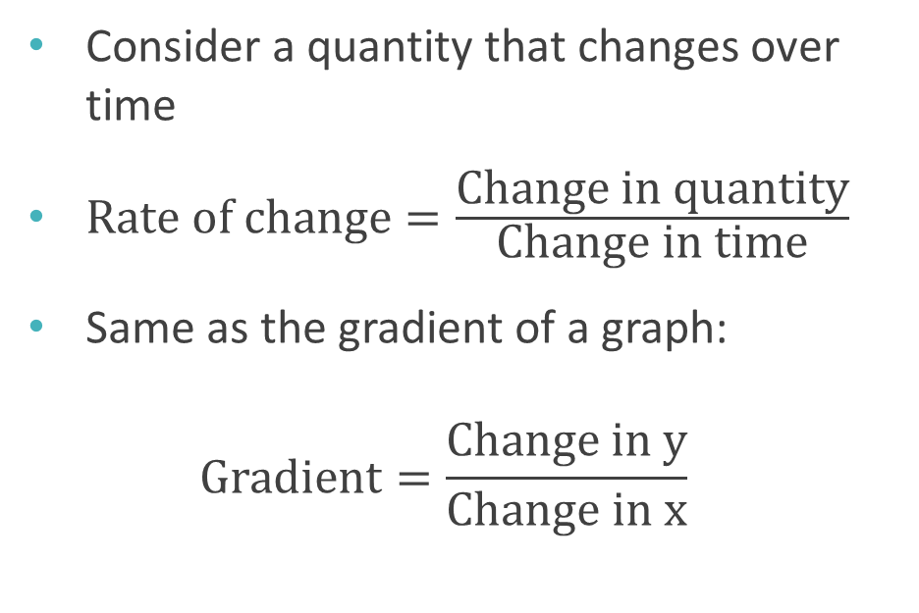
Rates of change
Consider a quantity that changes over time
$\text{Rate} \text{of} \text{change}=\frac{\text{Change} \text{in} \text{quantity}}{\text{Change} \text{in} \text{time}}$
Same as the gradient of a graph: $\text{Gradient}=\frac{\text{Change} \text{in} \text{y}}{\text{Change} \text{in} \text{x}}$

Slide 9
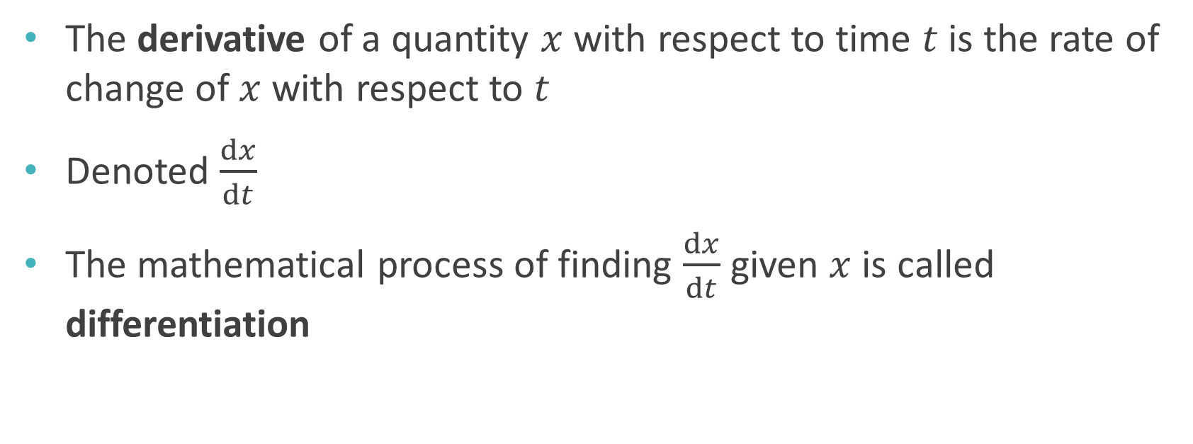
Derivatives
The derivative of a quantity $x$ with respect to time $t$ is the rate of change of $x$ with respect to $t$
Denoted $\frac{dx}{dt}$
The mathematical process of finding $\frac{dx}{dt}$ given $x$ is called differentiation

Slide 10
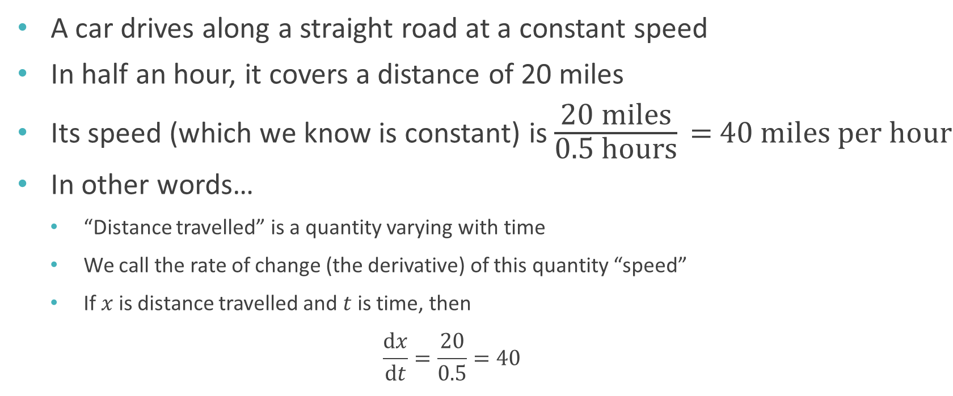
Derivatives: example
A car drives along a straight road at a constant speed
In half an hour, it covers a distance of 20 miles
Its speed (which we know is constant) is $\frac{\text{20 }\text{miles}}{\text{0.5 }\text{hours}}\text{ = 40 }\text{miles} \text{per} \text{hour}$
In other words…
“Distance travelled” is a quantity varying with time
We call the rate of change (the derivative) of this quantity “speed”
If $x$ is distance travelled and $t$ is time, then $\frac{dx}{dt}=\frac{20}{0.5}=40$

Slide 11
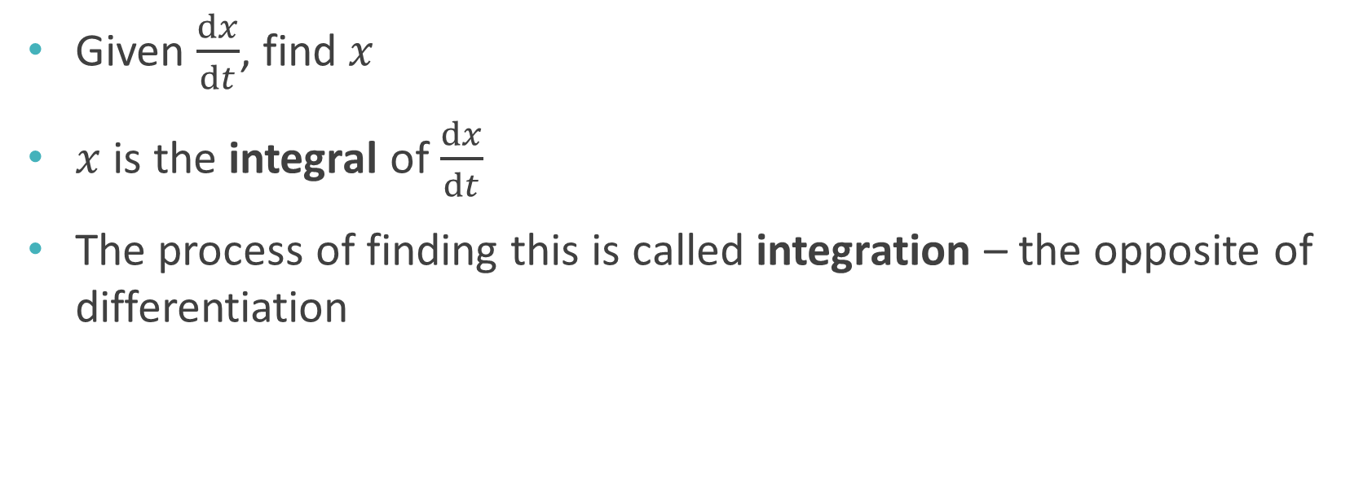
Integration
Given $\frac{dx}{dt}$, find $x$
$x$ is the integral of $\frac{dx}{dt}$
The process of finding this is called integration – the opposite of differentiation

Slide 12
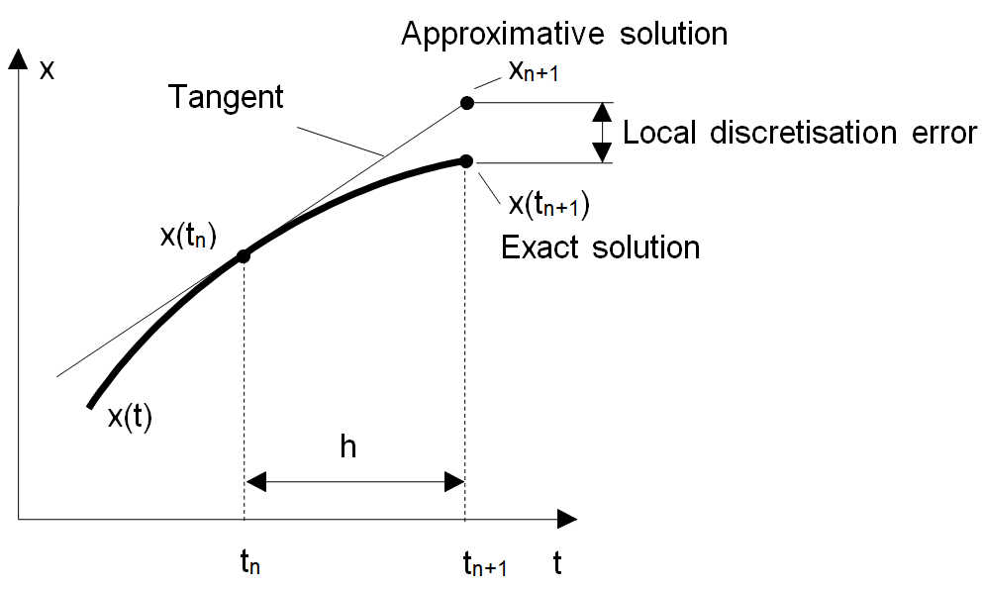
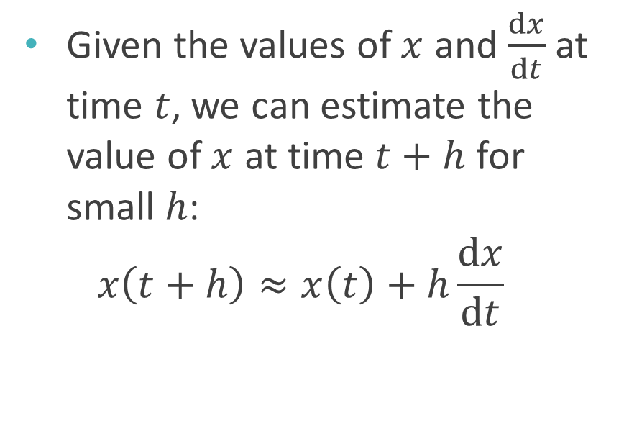
Numerical integration – Euler’s method
Leonhard Euler (1707-1783), Swiss mathematician
Pronounced “oiler”
Given the values of $x$ and $\frac{dx}{dt}$ at time $t$, we can estimate the value of $x$ at time $t+h$ for small $h$: $x\left(t+h\right)≈x\left(t\right)+h\frac{dx}{dt}$

Slide 13
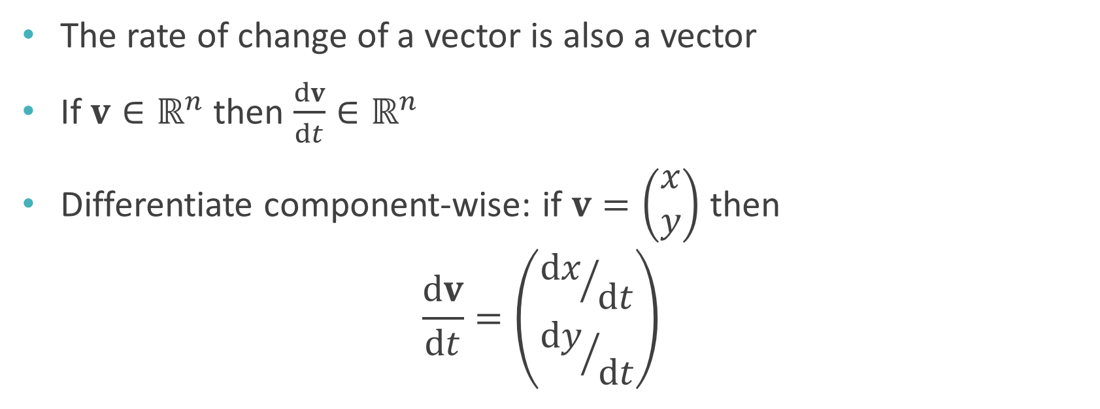
Calculus with vectors
The rate of change of a vector is also a vector
If $v∈ℝ^{n}$ then $\frac{dv}{dt}∈ℝ^{n}$
Differentiate component-wise: if $v=\left(\begin{matrix}x \\ y\end{matrix}\right)$ then $\frac{dv}{dt}=\left(\begin{matrix}{dx}/{dt} \\ {dy}/{dt}\end{matrix}\right)$

Slide 14
Basic mechanics

Slide 15
Basic quantities of mechanics
Position describes an object’s location in space
Velocity is rate of change of position
Acceleration is rate of change of velocity

Slide 16
Velocity and speed
Velocity is a vector quantity – has a magnitude and a direction
We call the magnitude of velocity the speed

Slide 17
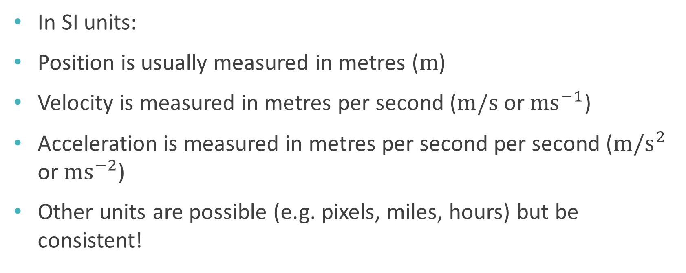
Units
Système international, or the International System of Units
In SI units:
Position is usually measured in metres ($m$)
Velocity is measured in metres per second ($m/s$ or $ms^{−1}$)
Acceleration is measured in metres per second per second ($m/s^{2}$ or $ms^{−2}$)
Other units are possible (e.g. pixels, miles, hours) but be consistent!

Slide 18
Force
Named after Isaac Newton (1642-1726/27), English mathematician
SI unit: Newtons (N)
Forces occur when objects interact
E.g. gravity, air resistance, friction
E.g. reaction force
E.g. car engine, rocket engine, launched projectile, muscle, …

Slide 19
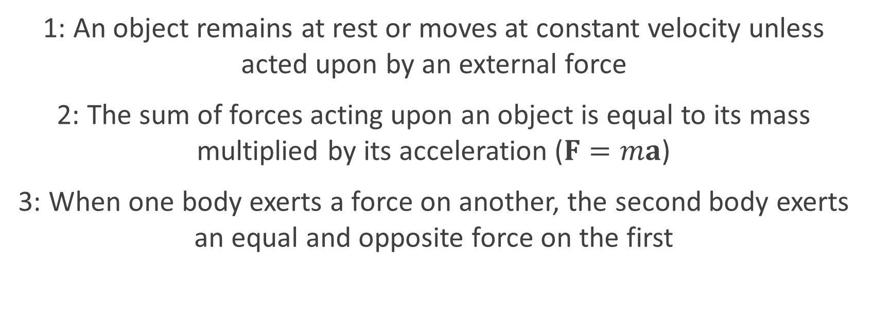
Newton’s Laws of Motion
1: An object remains at rest or moves at constant velocity unless acted upon by an external force
2: The sum of forces acting upon an object is equal to its mass multiplied by its acceleration ($F=ma$)
3: When one body exerts a force on another, the second body exerts an equal and opposite force on the first

Slide 20
Simulating Newtonian physics
For each object, store its position and velocity
On each time step:
Apply numerical integration to the velocity to determine the new position
Calculate the forces acting upon the object, and thus the acceleration from Newton’s 2nd law
Apply numerical integration to the aceleration to determine the new velocity

Slide 21
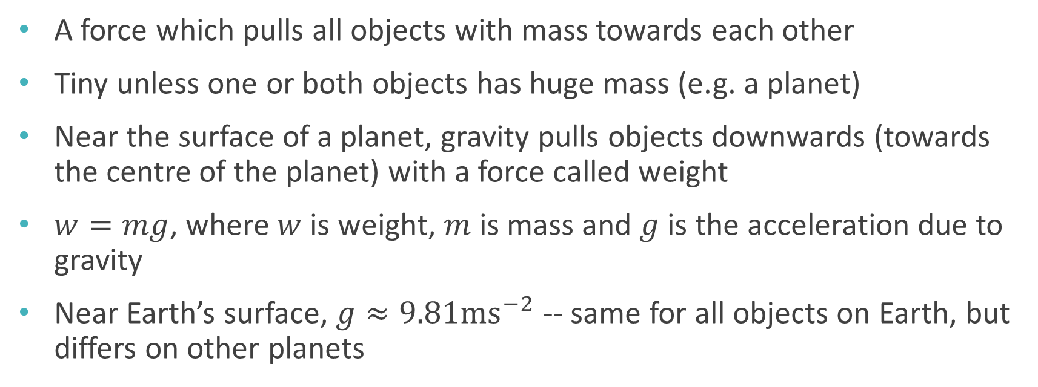
Gravity
A force which pulls all objects with mass towards each other
Tiny unless one or both objects has huge mass (e.g. a planet)
Near the surface of a planet, gravity pulls objects downwards (towards the centre of the planet) with a force called weight
$w=mg$, where $w$ is weight, $m$ is mass and $g$ is the acceleration due to gravity
Near Earth’s surface, $g≈9.81ms^{−2}$ -- same for all objects on Earth, but differs on other planets

Slide 22
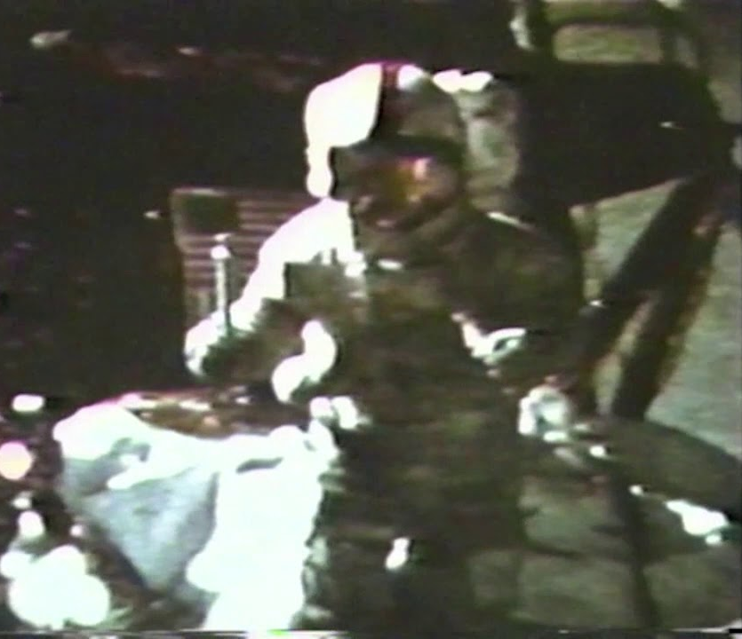
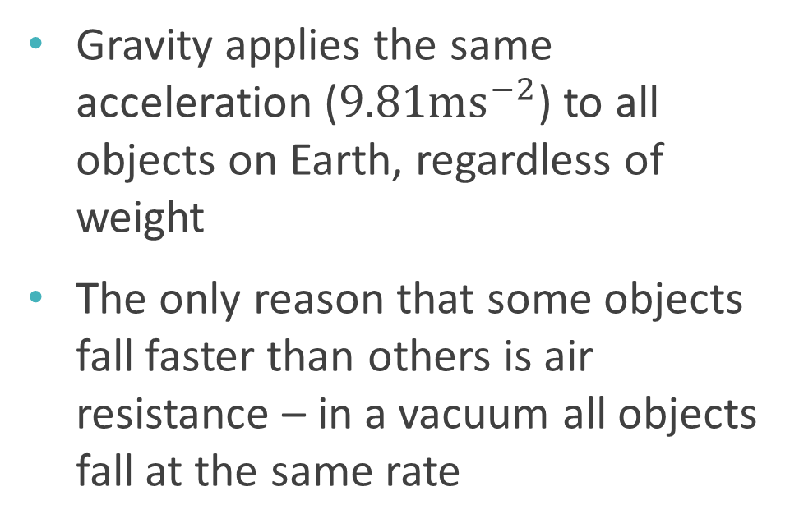
Gravity
Gravity applies the same acceleration ($9.81ms^{−2}$) to all objects on Earth, regardless of weight
The only reason that some objects fall faster than others is air resistance – in a vacuum all objects fall at the same rate

Slide 23
Equations of motion

Slide 24



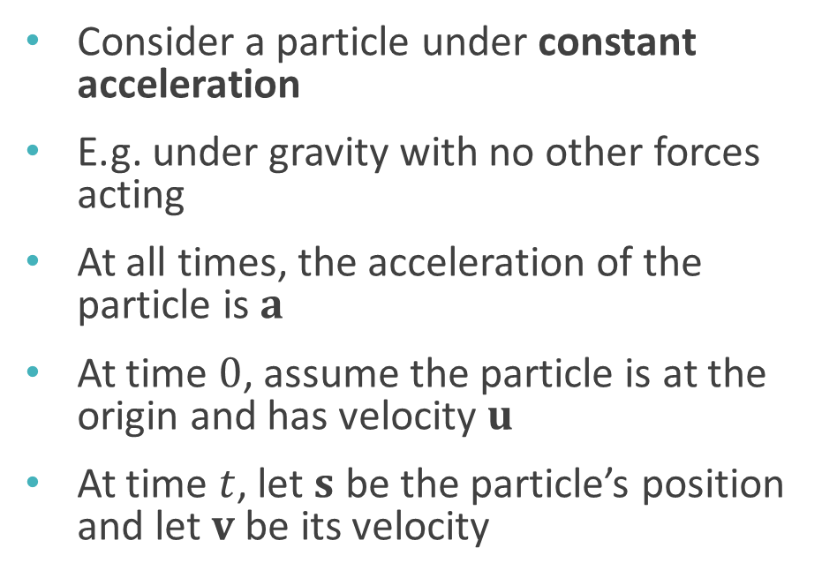




Setup
Consider a particle under constant acceleration
E.g. under gravity with no other forces acting
At all times, the acceleration of the particle is $a$
At time $0$, assume the particle is at the origin and has velocity $u$
At time $t$, let $s$ be the particle’s position and let $v$ be its velocity
Time $t$
$$u$$
Time $0$
$$s$$
$$v$$
$$a$$
$$a$$

Slide 25

Equations of motion (SUVAT equations)
$$v=u+at$$
$$s=ut+\frac{1}{2}at^{2}$$
$$s=\frac{1}{2}\left(u+v\right)t$$
$${\left\|v\right\|}^{2}={\left\|u\right\|}^{2}+2a⋅s$$
$$s=vt−\frac{1}{2}at^{2}$$

Slide 26
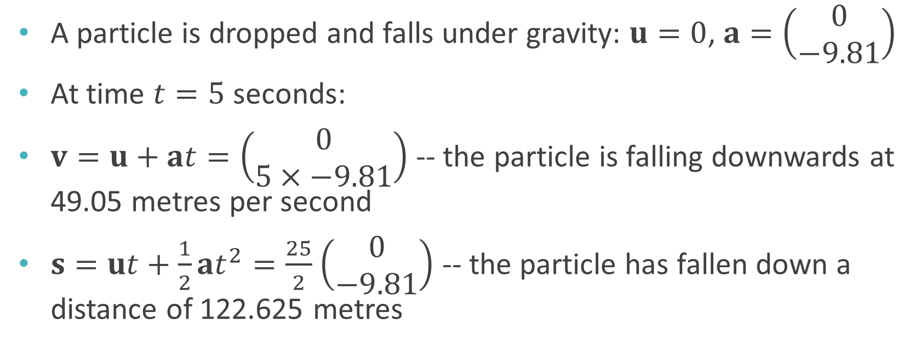
Example
A particle is dropped and falls under gravity: $u=0$, $a=\left(\begin{matrix}0 \\ −9.81\end{matrix}\right)$
At time $t=5$ seconds:
$v=u+at=\left(\begin{matrix}0 \\ 5×−9.81\end{matrix}\right)$ -- the particle is falling downwards at 49.05 metres per second
$s=ut+\frac{1}{2}at^{2}=\frac{25}{2}$ $\left(\begin{matrix}0 \\ −9.81\end{matrix}\right)$ -- the particle has fallen down a distance of 122.625 metres

Slide 27
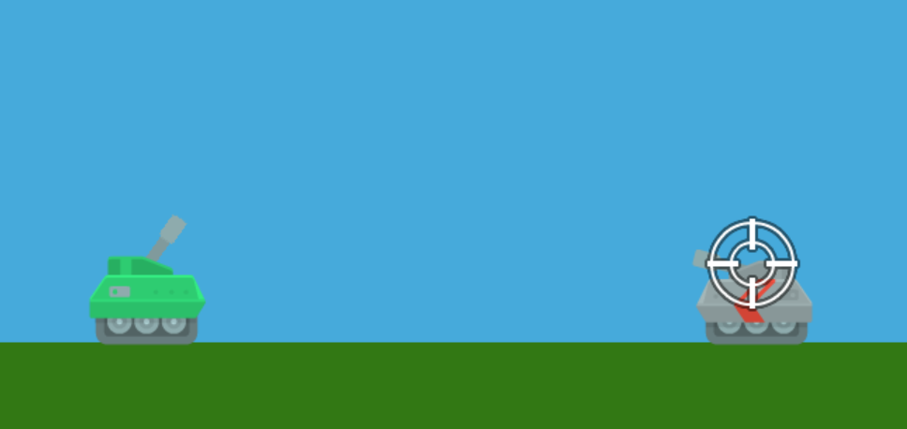
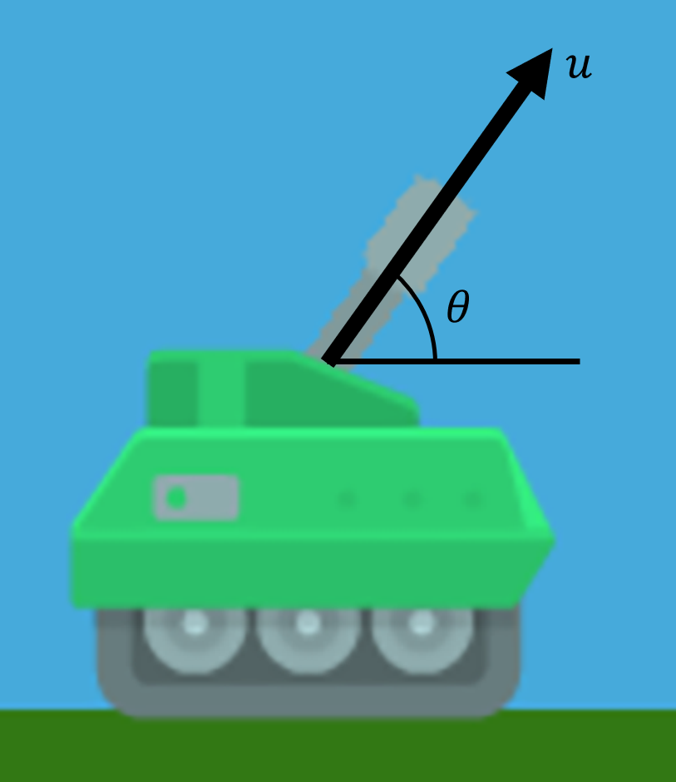
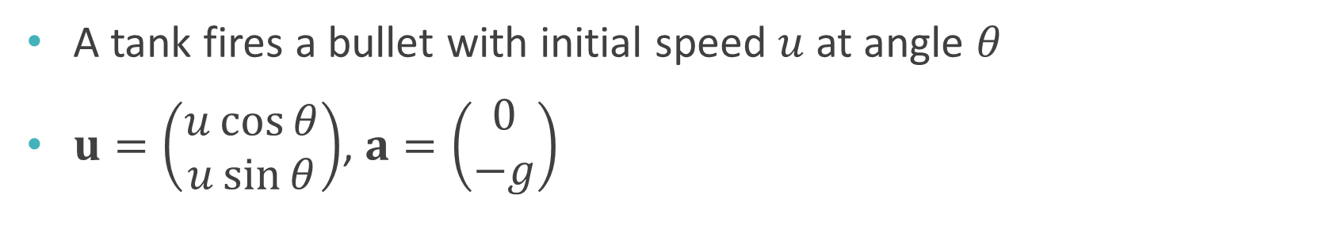
Projectile motion
A tank fires a bullet with initial speed $u$ at angle $θ$
$u=\left(\begin{matrix}u\cos{θ} \\ u\sin{θ}\end{matrix}\right)$, $a=\left(\begin{matrix}0 \\ −g\end{matrix}\right)$

Slide 28
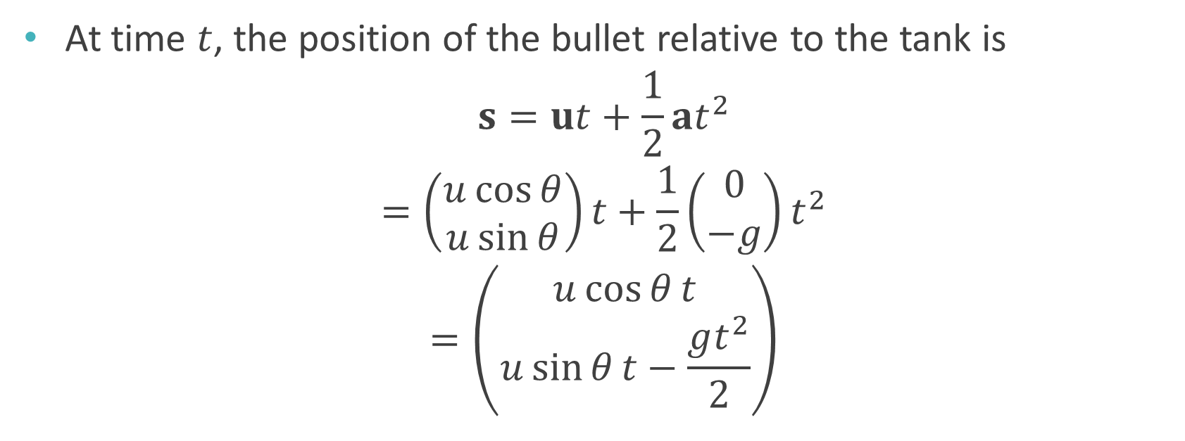
Projectile motion
At time $t$, the position of the bullet relative to the tank is
$$s=ut+\frac{1}{2}at^{2}$$
$$=\left(\begin{matrix}u\cos{θ} \\ u\sin{θ}\end{matrix}\right)t+\frac{1}{2}\left(\begin{matrix}0 \\ −g\end{matrix}\right)t^{2}$$
$$=\left(\begin{matrix}u\cos{θ}t \\ u\sin{θ}t−\frac{gt^{2}}{2}\end{matrix}\right)$$

Slide 29
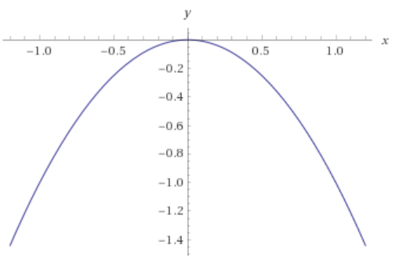
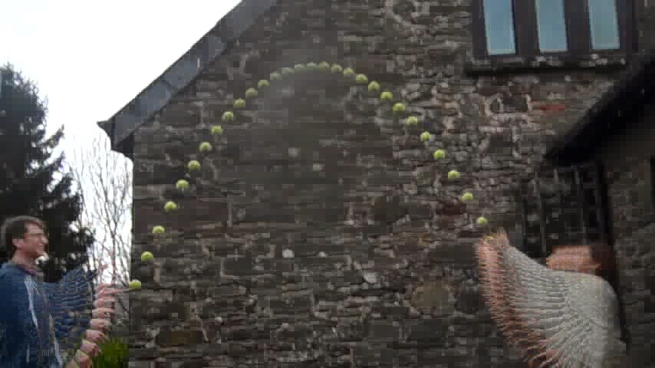
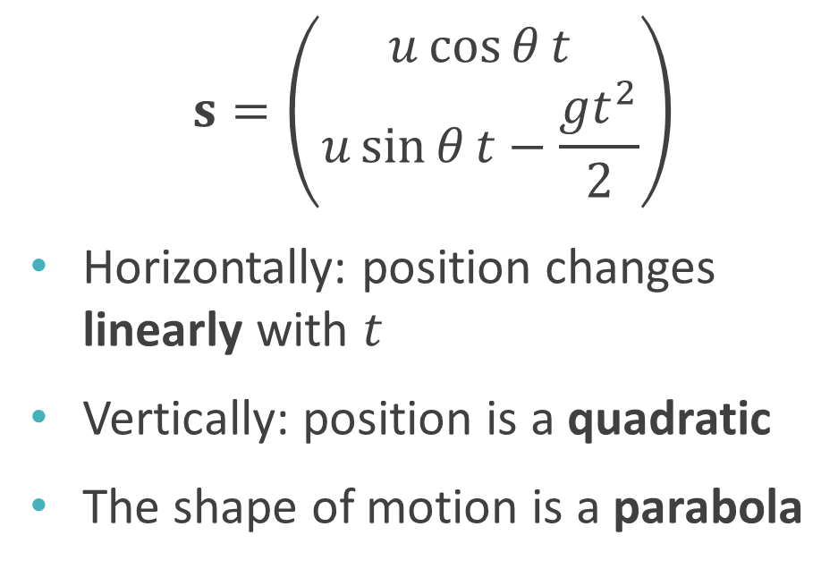

Projectile motion
$$y=−x^{2}$$
$$s=\left(\begin{matrix}u\cos{θ}t \\ u\sin{θ}t−\frac{gt^{2}}{2}\end{matrix}\right)$$
Horizontally: position changes linearly with $t$
Vertically: position is a quadratic
The shape of motion is a parabola
http://www.tom-e-white.com/2015/03/tennis-ball-parabola.html

Slide 30
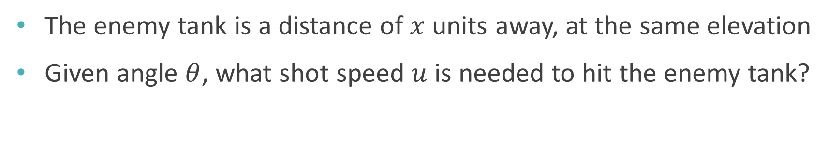
Projectile motion
The enemy tank is a distance of $x$ units away, at the same elevation
Given angle $θ$, what shot speed $u$ is needed to hit the enemy tank?

Slide 31
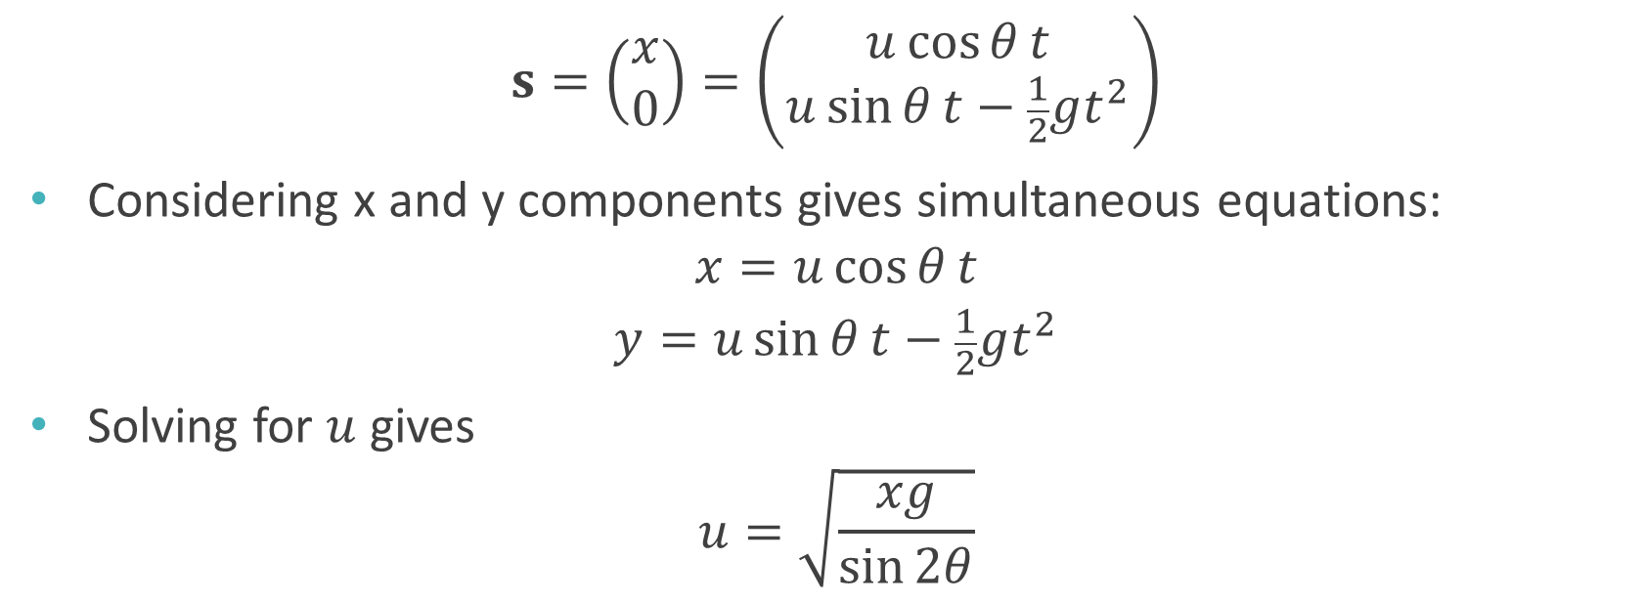
Finding the shot speed
$$s=\left(\begin{matrix}x \\ 0\end{matrix}\right)=\left(\begin{matrix}u\cos{θ}t \\ u\sin{θ}t−\frac{1}{2}gt^{2}\end{matrix}\right)$$
Considering x and y components gives simultaneous equations:
$$x=u\cos{θ}t$$
$$y=u\sin{θ}t−\frac{1}{2}gt^{2}$$
Solving for $u$ gives
$$u=\sqrt{\frac{xg}{\sin{2θ}}}$$

Slide 32
Worksheet B

Slide 33
Worksheets
Worksheet A: due today!
Worksheet B: now available on LearningSpace
Due in 2 weeks (28th October)

