Slide 1
Programming languages
COMP110: Principles of Computing

Slide 2
What is a programming language?
A program is a sequence of instructions for a computer to perform a specific task
A programming language is a formal language for communicating these sequences of instructions

Slide 3
Which is the best programming language?
There is no “best” programming language
There are hundreds of programming languages, each better suited to some tasks than others
Sometimes your choice of {platform, framework, game engine} dictates your choice of language

Slide 4
Low level languages
In the 70s/80s/90s, games were written in Assembly, which translates directly to CPU instructions
Modern AAA games and game engines are written in C++, a low-level language which is gives a high degree of control over hardware

Slide 5
High level languages
Smaller teams and indie developers often use higher level languages, for more rapid development
C# (XNA, Unity)
Python (EVE Online, Pygame, Kivy, Ren’py)
JavaScript (browser games)
ActionScript (Flash games)
Objective-C, Swift (iOS games)
Java (Minecraft, Android games)

Slide 6
Scripting languages
Many games use scripting languages in addition to their main development language
Lua (many AAA games)
Bespoke languages (many AAA games)
Some game engines have their own scripting language
UnrealScript (Unreal Engine games)
GML (GameMaker games)

Slide 7
Special purpose languages
There are special purpose languages for certain tasks
SQL (database access)
HLSL, GLSL (GPU shader programming)
LEX, YACC (script interpreters)

Slide 8
Markup languages
Remember, a programming language is a way of expressing sequences of instructions
Not to be confused with markup languages and data interchange formats
HTML, CSS, Markdown, LaTeX
XML, JSON, YAML

Slide 9
Quiz / discussion

Slide 10
A quick history lesson
http://www.levenez.com/lang/lang.pdf

Slide 11
IDE: Integrated Development Environment
“Why not just use Notepad?”
An IDE provides many useful tools for software development
Workspace management
Syntax highlighting
Code completion
Navigation
API documentation
Debugging
Profiling

Slide 12
Introducing PyCharm

Slide 13
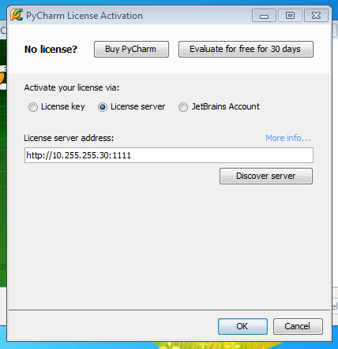
First-time setup for PyCharm on lab PCs

Slide 14
First-time setup for PyCharm on lab PCs
License server:
http://10.255.255.30:1111
Interpreter path:
C:\Python27\python.exe

Slide 15
Setting up your own PCs
Python 2.7
https://www.python.org/
PyCharm
https://www.jetbrains.com/pycharm/
https://www.jetbrains.com/student/
Visual Studio Community
https://www.visualstudio.com/

