Slide 1
An Introduction to Digital Sound
Creative Computing: Tinkering – Lecture 8 – Michael Scott

Slide 2

Introduction

Slide 3
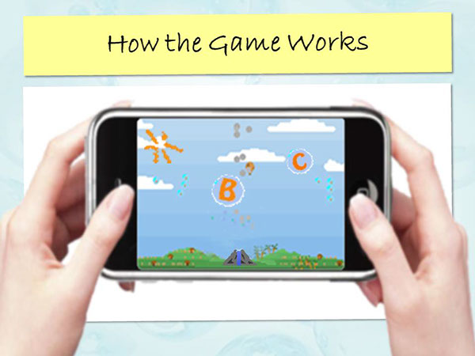
Introduction

Slide 4
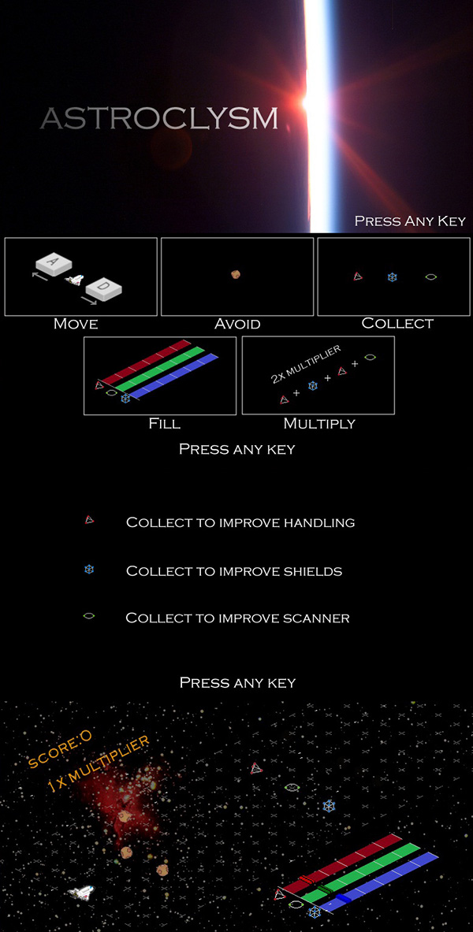
Introduction

Slide 5
Introduction

Slide 6
Introduction
https://www.youtube.com/watch?v=oF7POPv1GyQ

Slide 7
Learning Objectives
By the end of this session, you will be able to:
Recognise several ways how sound is used in games
Explain what sound and waves are
Describe how sound can be represented digitally
Write a program that will create a sound

Slide 8

Notes:
Cues the Reward
Ambience
Feedback to the Player – Footsteps
Footsteps change in tone?

Slide 9
How are sounds used in games?
An Introduction to Digital Sound

Slide 10
Notes:
Linked to gameplay and/or animation

Slide 11
What is Sound? What is a Wave?
An Introduction to Digital Sound

Slide 12
What is Sound?
Quick Definition A wave of compression and rarefaction in an elastic medium, such as air, which can be detected by an animal’s sense of hearing

Slide 13

What is Sound?

Slide 14
What is Sound?

Slide 15
What is Sound?

Slide 16
What is Sound?

Slide 17
What is a Wave?

Slide 18
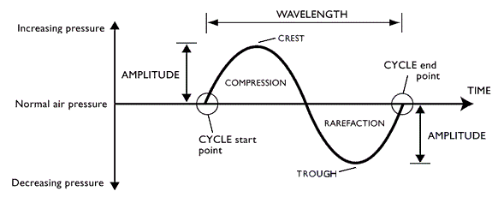
What is a Wave?

Slide 19
What is a Wave?

Slide 20
What is Sound?
Many animals are able to sense sound in two key ways: volume and pitch.
Volume The intensity of the change in pressure, as signified by the amplitude of a wave
Pitch The frequency of the change, as signified by the length of the wave and its velocity (i.e., “the speed of sound”)

Slide 21
What is a Wave?

Slide 22
HOW CAN SOUND BE REPRESENTED DIGITALLY?
Introduction to Digital Sound

Slide 23
How Can Sound Be Represented Digitally?
One method is to represent the wave itself and one approach to do this is Linear Pulse Code Modulation (LPCM).
An array of integers is created
The value of these integers represents the amplitude of the wave
With linear coding, the way how bytes correspond to real-world measures - called quantisation - is uniform across the range
The positions in the array represent time, and so each element contains a sample of the wave amplitude

Slide 24
How Can Sound Be Represented Digitally?

Slide 25
How Can Sound Be Represented Digitally?
Sample Rate How many samples are taken per second (consequently, how much time is represented by each element in the array)?
Bit Depth How many bits are available to represent the value?

Slide 26
How Can Sound Be Represented Digitally?
Sample Rate i.e., range of frequencies which can be recorded
Bit Depth i.e., the number of amplitude levels which can be represented

Slide 27
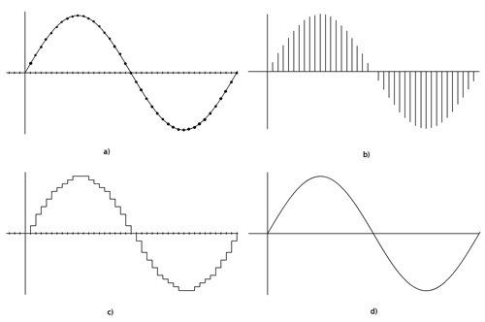
How Can Sound Be Represented Digitally?
Source

Slide 28
How Can Sound Be Represented Digitally?
Representation (Data)

Slide 29
How Can Sound Be Represented Digitally?
Representation (Data)
Bit Depth
Sample Rate

Slide 30
How Can Sound Be Represented Digitally?
Reconstructed Output

Slide 31
Can I Write a Program to Create Sound?
Introduction to Digital Sound

Slide 32
Activity
>>> filename=pickAFile()
>>> print filename
/Users/guzdial/mediasources/preamble.wav
>>> sound=makeSound(filename)
>>> print sound
Sound of length 421109
>>> samples=getSamples(sound)
>>> print samples
Samples, length 421109
>>> print getSampleValueAt(sound,1)
36
>>> print getSampleValueAt(sound,2)
29
>>> explore(sound)
Open JES
Find an Wav File
Explore the Sound Functions in JES
Ask Questions on Slack

Slide 33
Activity
>>> print getLength(sound)
220568
>>> print getSamplingRate(sound)
22050.0
>>> print getSampleValueAt(sound,220568)
68
>>> print getSampleValueAt(sound,220570)
I wasn't able to do what you wanted.
The error java.lang.ArrayIndexOutOfBoundsException has occurred
Please check line 0 of
>>> print getSampleValueAt(sound,1)
36
>>> setSampleValueAt(sound,1,12)
>>> print getSampleValueAt(sound,1)
12
Open JES
Find an Wav File
Explore the Sound Functions in JES
Ask Questions on Slack

Slide 34
Activity
>>> print getLength(sound)
220568
>>> print getSamplingRate(sound)
22050.0
>>> print getSampleValueAt(sound,220568)
68
>>> print getSampleValueAt(sound,220570)
I wasn't able to do what you wanted.
The error java.lang.ArrayIndexOutOfBoundsException has occurred
Please check line 0 of
>>> print getSampleValueAt(sound,1)
36
>>> setSampleValueAt(sound,1,12)
>>> print getSampleValueAt(sound,1)
12
Open JES
Find an Wav File
Explore the Sound Functions in JES
Ask Questions on Slack

Slide 35
Samples
In this notation, the samples defines the position of the components within the speaker
By changing the position of the speaker rapidly waves rapidly enough, sound is produced
But, of course, there are thousands of samples...!

Slide 36
“But there are thousands of these samples!”
How do we do something to these samples to manipulate them, when there are thousands of them per second?
We use a loop and get the computer to iterate in order to do something to each sample.
An example loop:
for sample in getSamples(sound):
value = getSample(sample)
setSample(sample,value)

Slide 37
Recipe to Increase the Volume
def increaseVolume(sound):
for sample in getSamples(sound):
value = getSampleValue(sample)
setSampleValue(sample,value * 2)
Using it:
>>> f="/Users/guzdial/mediasources/gettysburg10.wav"
>>> s=makeSound(f)
>>> increaseVolume(s)
>>> play(s)
>>> writeSoundTo(s, "/Users/guzdial/mediasources/louder-g10.wav")

Slide 38
How did that work?
When we evaluate increaseVolume(s), the function increaseVolume is executed
The sound in variable s becomes known as sound
sound is a placeholder for the sound object s.
>>> f=pickAFile()
>>> s=makeSound(f)
>>> increaseVolume(s)
def increaseVolume(sound):
for sample in getSamples(sound):
value = getSampleValue(sample)
setSampleValue(sample,value * 2)

Slide 39
Starting the loop
getSamples(sound) returns a sequence of all the sample objects in the sound.
The for loop makes sample be the first sample as the block is started.
def increaseVolume(sound):
for sample in getSamples(sound):
value = getSampleValue(sample)
setSampleValue(sample,value * 2)
Compare:
for pixel in getPixels(picture):

Slide 40
Executing the block
We get the value of the sample named sample.
We set the value of the sample to be the current value (variable value) times 2
def increaseVolume(sound):
for sample in getSamples(sound):
value = getSampleValue(sample)
setSampleValue(sample,value * 2)

Slide 41
Next sample
Back to the top of the loop, and sample will now be the second sample in the sequence.
def increaseVolume(sound):
for sample in getSamples(sound):
value = getSampleValue(sample)
setSampleValue(sample,value * 2)

Slide 42
And increase that next sample
We set the value of this sample to be the current value (variable value) times 2.
def increaseVolume(sound):
for sample in getSamples(sound):
value = getSampleValue(sample)
setSampleValue(sample,value * 2)

Slide 43
And on through the sequence
The loop keeps repeating until all the samples are doubled
def increaseVolume(sound):
for sample in getSamples(sound):
value = getSampleValue(sample)
setSampleValue(sample,value * 2)

Slide 44
Activity
Write out the increase volume function in JES and test it out yourself
Stretch Goal
Copy the volume function, and repurpose it to generate a tone using the sin() maths function

Slide 45
TINKERING AUDIO ASSIGNMENT
Introduction to Digital Sound

Slide 46
Coursework
Write six algorithms
Use the algorithms to create ‘gameplay theme(s)’ for your mobile app project
Assignment Brief Demo

Slide 47
FINAL REMARKS
Introduction to Digital Sound

Slide 48
Additional Resources
How Sound is Used in Games http://www.amplifon.co.uk/resources/playing-with-your-mind/
How Sound Works http://www.educationscotland.gov.uk/resources/s/sound/amplitude.asp
Digital Representation of Sound http://www.jiscdigitalmedia.ac.uk/guide/an-introduction-to-digital-audio

Slide 49
Additional Resources
Frequently Asked Questions http://www.sciforums.com/threads/speakers-how-do-they-produce-different-sounds-simultaneously.97540/
Any Other Questions or Concerns -- Please Email michael.scott@falmouth.ac.uk

Slide 50
Thank You For Listening
Michael Scott

Slide 51
How Can Sound Be Represented Digitally?
Nyquist-Shannon theorem states that sample must occur at double the bandwidth of the source signal
Radio tends to use 22,050 bits per second
This enables sounds under 11kHz to be represented
Anything above 11kHz will be lost (or distorted), but most human speech is under 8kHz

Slide 52
How Can Sound Be Represented Digitally?
Each element is an integer number (i.e., two bytes)
What is the range of available combinations?
16 bits, 216 = 65,536
But we want both positive and negative values to indicate compressions and rarefactions.
What if we use one bit to indicate positive (0) or negative (1)?
That leaves us with 15 bits
15 bits, 215 = 32,768
One of those combinations will stand for zero; we'll use a “positive” one, so that's one less pattern for positive (i.e. up to 32,767)

