Slide 1
Academic Writing
COMP130: Game Platform History

Slide 2
SCHOLARLY LITERATURE
Referencing Appropriate Work

Slide 3
Scholarly Work
What is a ‘scholarly’ work? How do you know if something is scholarly?
Discuss in Slack for 5 minutes
Someone will present the discussion and findings

Slide 4
Pyramid of Sources
Scholarly Journals and Conferences Proceedings
Scholarly Books and Book Chapters
Government Documents
Trade Books and Whitepapers
Specialized Magazines
General-Interest Magazines and Newspapers
General Encyclopaedias
Specialised Academically-Authored Encyclopaedias
Websites, Wikipedia, Blogs, etc.
4chan, Reddit, StackOverflow

Slide 5
Pyramid of Sources
Scholarly Articles and Conference Proceedings

Slide 6
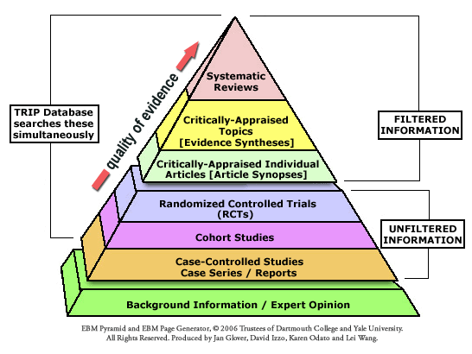
A Pyramid of Sources

Slide 7
Appropriateness of Sources
It is important to question the appropriateness of the sources you are using in your academic work.
It is important to determine:
Validity: are claims based upon a correct interpretation of the evidence?
Rigor: was the method of collecting evidence appropriate enough to ensure comprehensive coverage while also avoiding bias?

Slide 8
Appropriateness of Sources
Reliability: has the claim been replicated or, at least, been reviewed by other academics
Authoritativeness: do we know who the author is? does the author have enough experience in the field to present a fair and balanced argument?
Venue: is the publisher reputable and free of undue editorial influences?

Slide 9
Appropriateness of Sources
There are of course exceptions where sources are presented as artefacts and/or archives;
It would be fine to cite a newspaper as a form of evidence for a claim based on the reception of a new technology
It would be fine to cite a manufacturer’s technical manual to avoid describing the technical feature of the platform
The way in which sources are used is therefore important.

Slide 10
DISCUSSIONS
Crafting Appropriate Discussion

Slide 11
Discussions
What is a ‘discussion’ in an academic context? What does a discussion do?
Discuss in Slack for 5 minutes
Someone will present the discussion and findings

Slide 12
Effective Discussions
Relevant
Manageable in terms of research and other practical considerations
Specific, yet sustainable
Original
Consistent with Requirements
Clear and Simple
Interesting
http://www.socscidiss.bham.ac.uk/research-question.html

Slide 13
Effective Discussions
Relevant:
The question will be of academic and intellectual interest to people in the field you have chosen to study. The question arises from issues raised in the literature or in practice.
You should be able to establish a clear purpose for your research in relation to the chosen field. For example, are you filling a gap in knowledge, analysing academic assumptions or professional practice, monitoring a development in practice, comparing different approaches or testing theories within a specific population?

Slide 14
Effective Discussions
Manageable:
You need to be realistic about the scope and scale of the project. The question you ask must be within your ability to tackle. Can this data be accessed within the limited time and resources you have available to you?
Sometimes a research question appears feasible, but when you start your fieldwork or library study, it proves otherwise. In this situation, it is important to write up the problems honestly and to reflect on what has been learnt.

Slide 15
Effective Discussions
Specific, yet sustainable:
The question should not simply copy others. It should show your own imagination and your ability to construct and develop research issues.
It needs to give sufficient scope to develop into a research project in the future.

Slide 16
Effective Discussions
Consistent with requirements:
The question must allow you the scope to satisfy the learning outcomes of the course.
For example, in this module you should conduct a theoretical study, one that does not contain analysis of empirical data. You should conduct an appropriate review of the academic literature and show how you have gone about using theoretical models and reasoning to produce new insights about the subject.

Slide 17
Effective Discussions
Clear and Simple:
The complexity of a question can frequently hide unclear thoughts and lead to a confused research process. A very elaborate research question, or a question which is not differentiated into different parts, may hide concepts that are contradictory or not relevant. This needs to be clear and thought-through, but it is one of the hardest parts of your work.
You may feel tempted to 'make do' with a broad and vague research question for the moment. However, a muddled question is likely to generate muddled data and equally muddled analysis.

Slide 18
Effective Discussions
Clear and Simple:
If you create a clear and simple research question, you may find that it becomes more complex as you think about the situation you are studying and undertake the literature review. Having one key question with several sub-components will guide your research here.

Slide 19
Effective Discussions
Interesting:
The question needs to intrigue you and maintain your interest throughout the project. There are two traps to avoid:
Some questions are convenient – the best you can come up with when asked to state a question or, perhaps, the question fits in with the assessment so you decide it will suffice.
Some questions are fads – they arise out of a set of personal circumstances, for example a job application. Once the circumstances change you may lose interest for the topic and it becomes very tedious.

Slide 20
Discussion and Arguments
The core of academic discussion is evidence-based argument
The goal of your writing is to present a new idea
Show that the idea is true (or, at least, supported by most of the credible available evidence)
Defend the idea
Propose useful applications of the idea or how the idea could be developed further

Slide 21
Discussion and Arguments
A useful way to structure an argument (and subsequently the flow and structure of the work) is “SEED”
S: make a statement
E: expand on the statement
E: provide evidence
D: develop the statement in light of the evidence

Slide 22
GETTING STARTED ON THE ESSAY
Writing Your Game Platform History Essay

Slide 23
The process of writing an essay
‘Writing an essay does not simply ‘happen’ on a particular day. Effectively, you start the writing process as soon as you begin to study the topic of your next essay.’
Northedge 2005: 297

Slide 24
Stages of Essay Writing
Cottrell 2008: 176-177
1. Clarify task
2. Collect and record
information
7. Final draft
3. Organise and plan
6. Review and revise your first draft
4. Engage, reflect and
evaluate
5. Write an outline and first draft

Slide 25
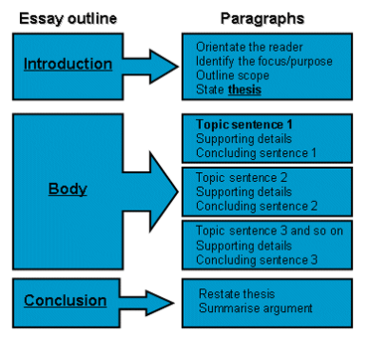

Slide 26
MIND MAPS
Using Your Notes to Plan Your Essay

Slide 27
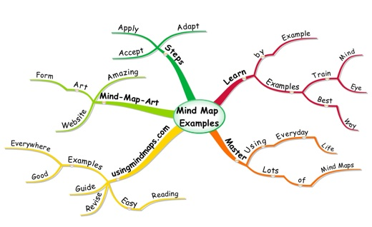
Mind Maps

Slide 28
Mind Maps
A technique developed by Tony Buzan to represent words, ideas, tasks, or other objects which are connected to and arranged around a central key theme
Mind maps are a tool that assists us to think and remember, solve problems and take action
A non-linear way of organising information which captures a flow of ideas
Can be applied to structuring an essay

Slide 29
Drawing a Mind Map
Centre First
Place a word or image in the middle of a page. This symbolizes what you want to think about.
Think!
Adopt an open, creative attitude. Let go of your apprehension about quality and think!
Associate
As ideas emerge, write down one or two words about your idea and connect them to your central theme.

Slide 30
Drawing a Mind Map
4. Think Fast!
You may find you work best in short bursts of activity. Use this time productively.
5. Break Boundaries
The bigger the piece of paper, the more ideas you will have.
Don’t judge
Put down everything you can think of, this exercise is to help you reflect upon and connext on your thoughts and ideas.

Slide 31
Drawing a Mind Map
7. Keep Moving!
Momentum is important to make use of your time drawing a mind map – if you cannot think of something draw empty lines from the themes and ideas.
8. Allow organisation
Sometimes you will see relationships and connections immediately and can add more branches. Sometimes you don’t but may discover new connections later, so connect these to the central theme.

Slide 32
Drawing a Mind Map
https://bubbl.us/mindmap
Extend your notes by drawing a mind map and post it to Slack!

