Slide 1
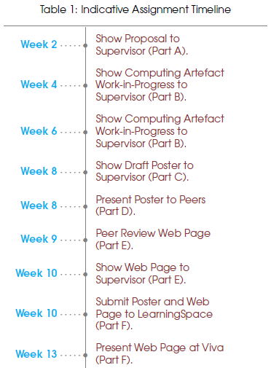
Module Roadmap
Worksheet A
Worksheet B
Worksheet C
Worksheet D

