Slide 1

5: Newtonian Mechanics II
COMP270: Mathematics for 3D Worlds & Simulations

Slide 2

Worksheet B

Slide 3
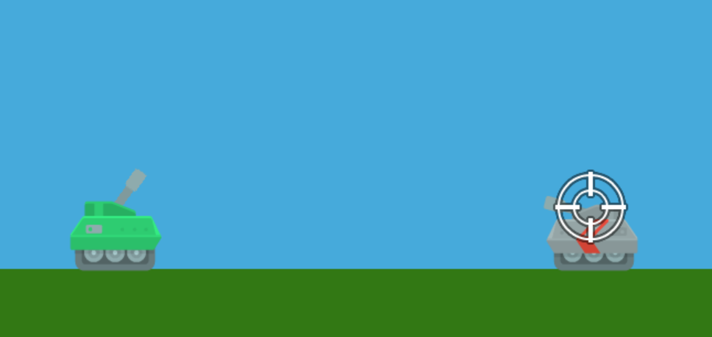
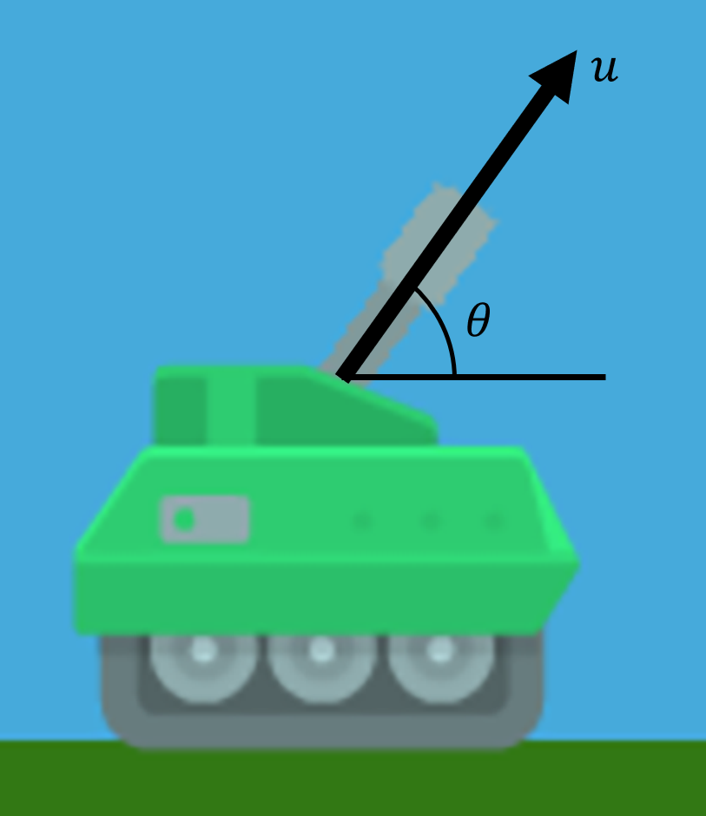
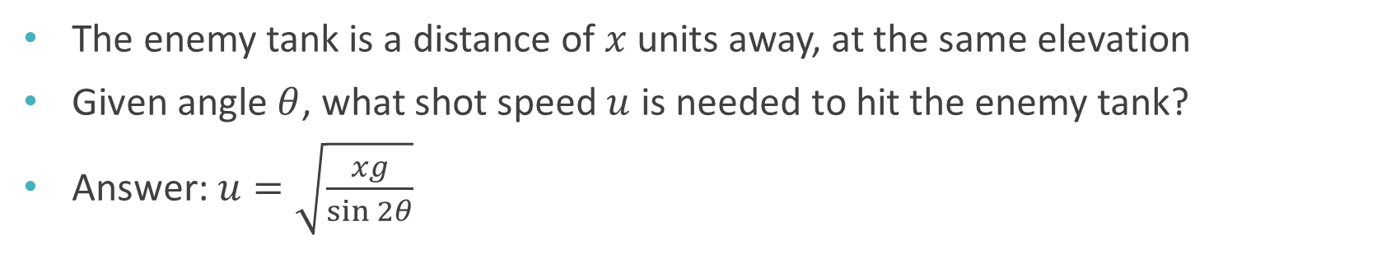
Projectile motion
The enemy tank is a distance of $x$ units away, at the same elevation
Given angle $θ$, what shot speed $u$ is needed to hit the enemy tank?
Answer: $u=\sqrt{\frac{xg}{\sin{2θ}}}$

Slide 4
Distance between a point and a line

Slide 5

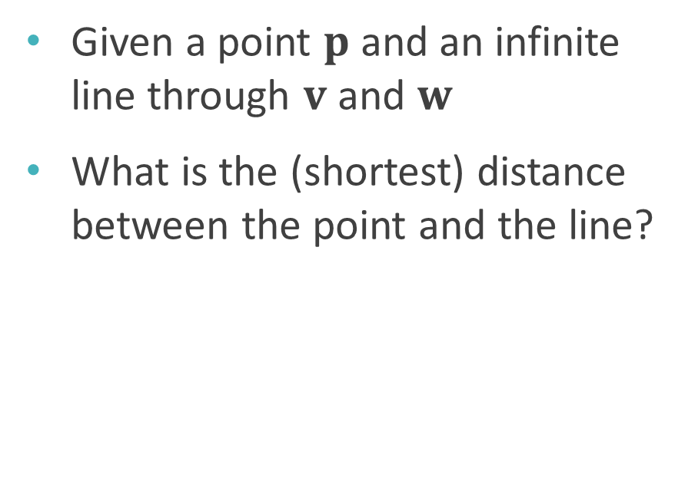


Distance between a point and a line
Given a point $p$ and an infinite line through $v$ and $w$
What is the (shortest) distance between the point and the line?
$$v$$
$$p$$
?
$$w$$

Slide 6
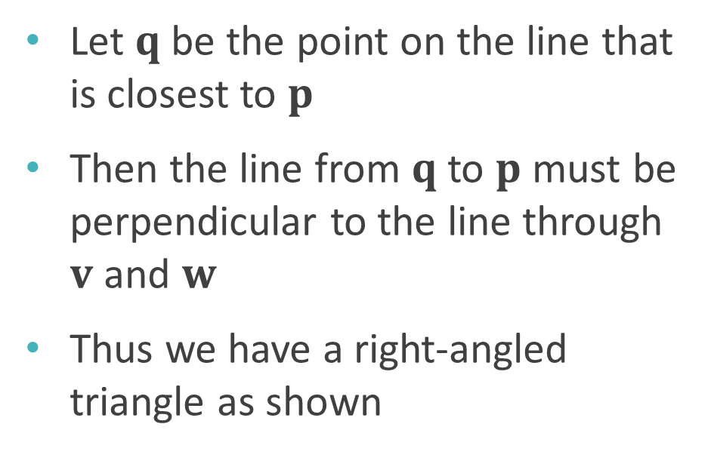


Distance between a point and a line
Let $q$ be the point on the line that is closest to $p$
Then the line from $q$ to $p$ must be perpendicular to the line through $v$ and $w$
Thus we have a right-angled triangle as shown
$$v$$
$$p$$
$$q$$
$$w$$

Slide 7

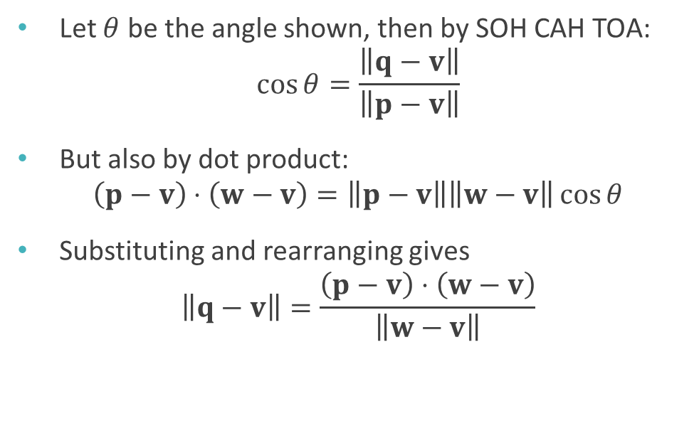
Distance between a point and a line
Let $θ$ be the angle shown, then by SOH CAH TOA: $\cos{θ}=\frac{\left\|q−v\right\|}{\left\|p−v\right\|}$
But also by dot product: $\left(p−v\right)⋅\left(w−v\right)=\left\|p−v\right\|\left\|w−v\right\|\cos{θ}$
Substituting and rearranging gives $\left\|q−v\right\|=\frac{\left(p−v\right)⋅\left(w−v\right)}{\left\|w−v\right\|}$
$$v$$
$$θ$$
$$p$$
$$q$$
$$w$$

Slide 8
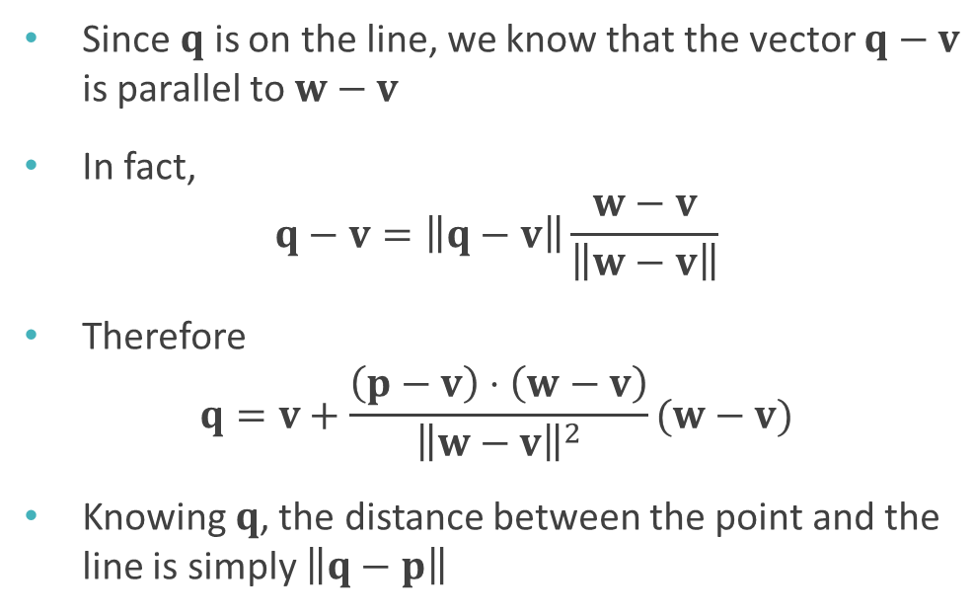
Distance between a point and a line
Since $q$ is on the line, we know that the vector $q−v$ is parallel to $w−v$
In fact, $q−v=\left\|q−v\right\|\frac{w−v}{\left\|w−v\right\|}$
Therefore $q=v+\frac{\left(p−v\right)⋅\left(w−v\right)}{{\left\|w−v\right\|}^{2}}(w−v)$
Knowing $q$, the distance between the point and the line is simply $\left\|q−p\right\|$
$$v$$
$$θ$$
$$p$$
$$q$$
$$w$$

Slide 9
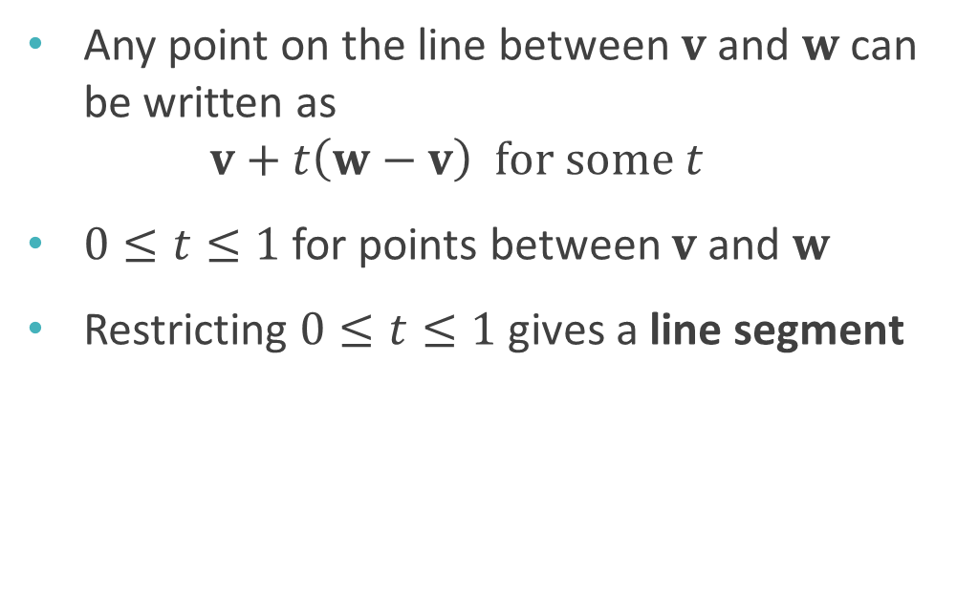
Parametric form of a line
Any point on the line between $v$ and $w$ can be written as $v+t\left(w−v\right) for some t$
$0≤t≤1$ for points between $v$ and $w$
Restricting $0≤t≤1$ gives a line segment
$$v$$
$$w$$

Slide 10
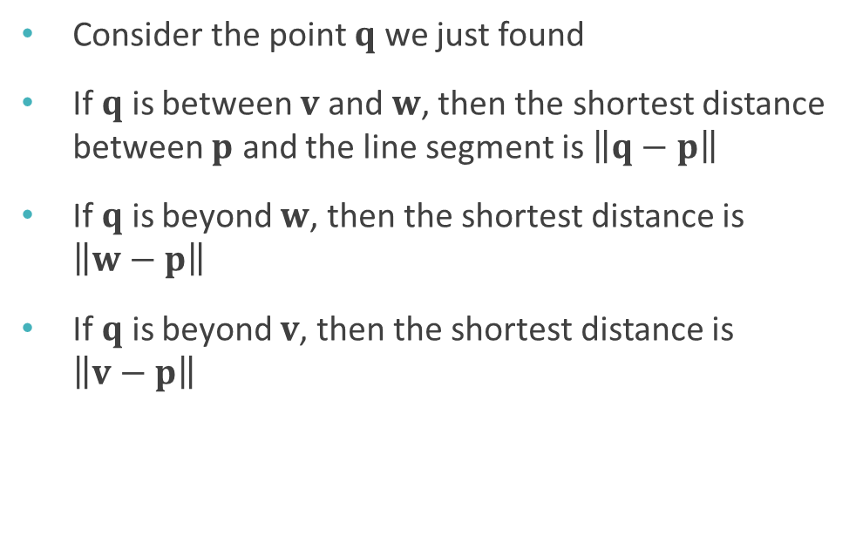
Distance between a point and a line segment
Consider the point $q$ we just found
If $q$ is between $v$ and $w$, then the shortest distance between $p$ and the line segment is $\left\|q−p\right\|$
If $q$ is beyond $w$, then the shortest distance is $\left\|w−p\right\|$
If $q$ is beyond $v$, then the shortest distance is $\left\|v−p\right\|$
$$v$$
$$p$$
$$q$$
$$w$$

Slide 11
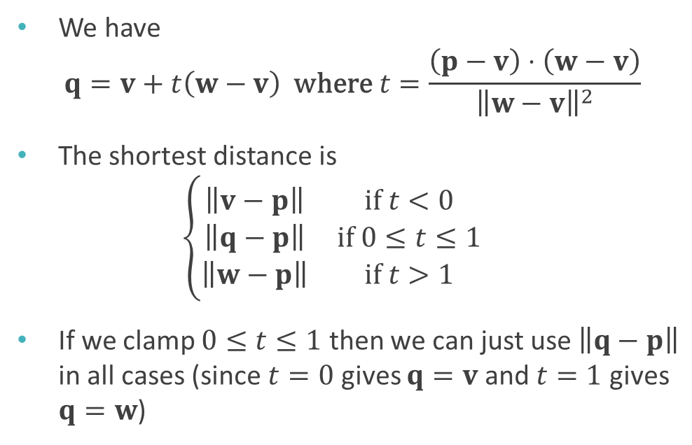
Distance between a point and a line segment
We have $q=v+t\left(w−v\right) \text{where} t=\frac{\left(p−v\right)⋅\left(w−v\right)}{{\left\|w−v\right\|}^{2}}$
The shortest distance is $\left\{\begin{matrix}\left\|v−p\right\| & \text{if} t<0 \\ \left\|q−p\right\| & \text{if} 0≤t≤1 \\ \left\|w−p\right\| & \text{if} t>1\end{matrix}\right.$
If we clamp $0≤t≤1$ then we can just use $\left\|q−p\right\|$ in all cases (since $t=0$ gives $q=v$ and $t=1$ gives $q=w$)
$$v$$
$$p$$
$$q$$
$$w$$

Slide 12
Clamping in code
To clamp a value x between a and b:
max(a, min(b, x))

Slide 13
Collision detection

Slide 14

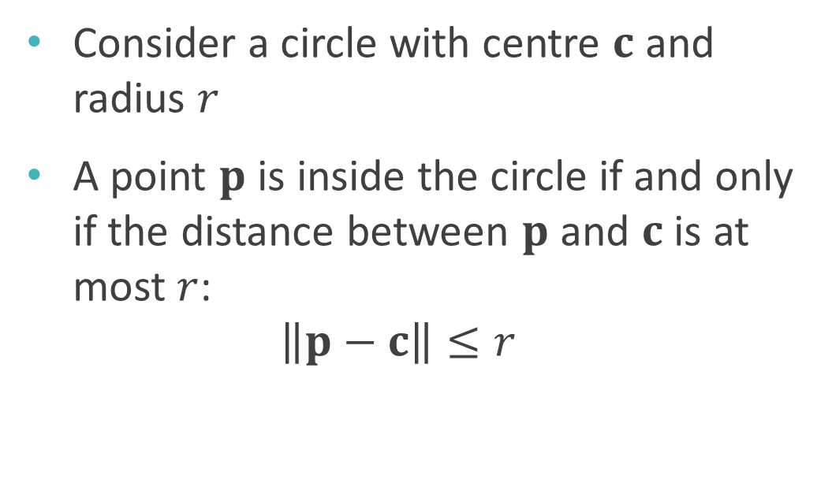


Point and circle collision
Consider a circle with centre $c$ and radius $r$
A point $p$ is inside the circle if and only if the distance between $p$ and $c$ is at most $r$: $\left\|p−c\right\|≤r$
$$r$$
$$p$$
$$c$$

Slide 15

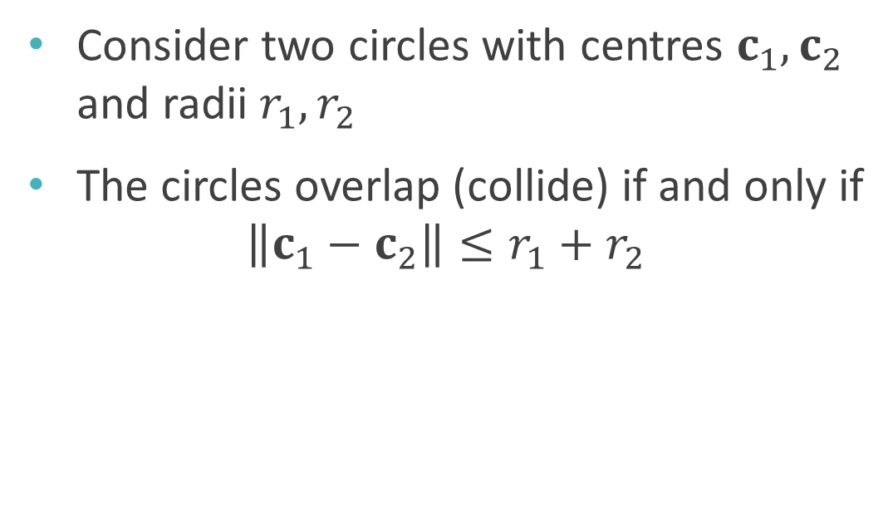



Circle and circle collision
Consider two circles with centres $c_{1},c_{2}$ and radii $r_{1},r_{2}$
The circles overlap (collide) if and only if $\left\|c_{1}−c_{2}\right\|≤r_{1}+r_{2}$
$$c_{1}$$
$$r_{1}$$
$$r_{2}$$
$$c_{2}$$

Slide 16
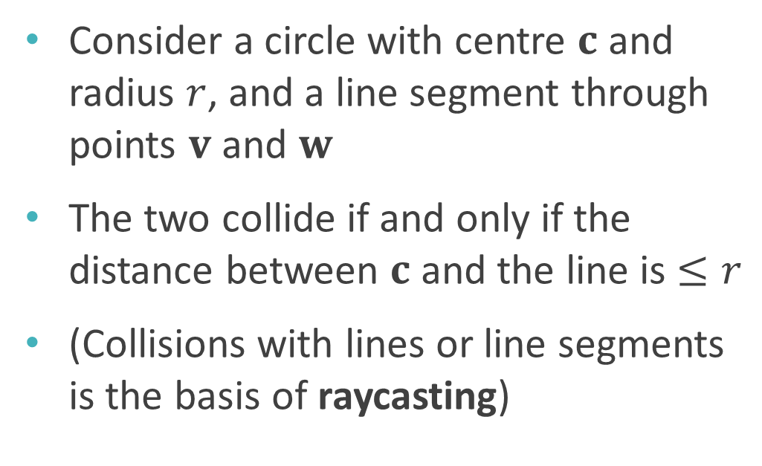


Circle and line collision
$$v$$
Consider a circle with centre $c$ and radius $r$, and a line segment through points $v$ and $w$
The two collide if and only if the distance between $c$ and the line is $≤r$
(Collisions with lines or line segments is the basis of raycasting)
$$r$$
$$c$$
$$w$$

Slide 17

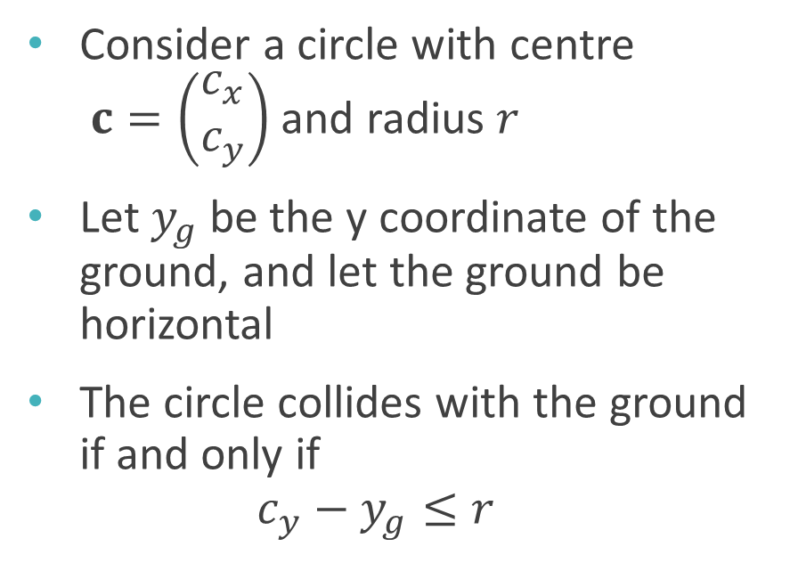

Circle and ground collision
Consider a circle with centre $c=\left(\begin{matrix}c_{x} \\ c_{y}\end{matrix}\right)$ and radius $r$
Let $y_{g}$ be the y coordinate of the ground, and let the ground be horizontal
The circle collides with the ground if and only if $c_{y}−y_{g}≤r$
$$c$$
$$r$$

Slide 18
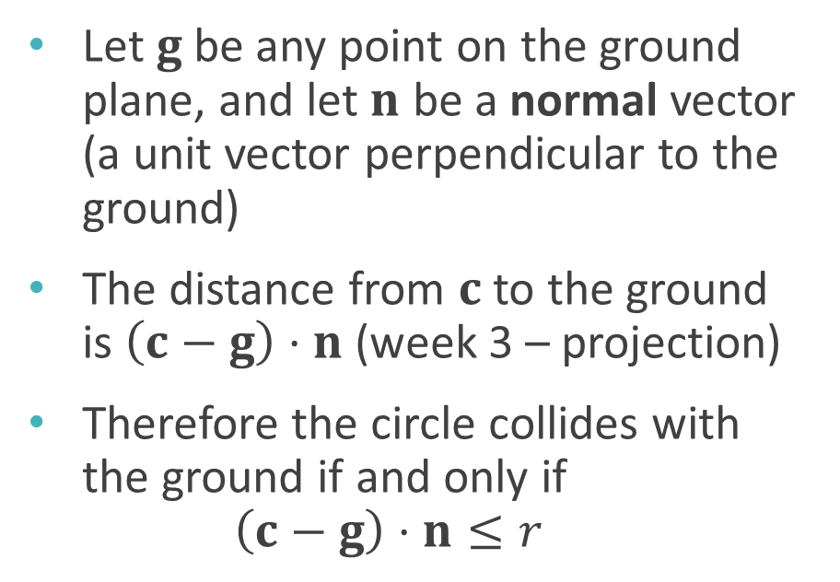


Generalised circle and ground collision
Let $g$ be any point on the ground plane, and let $n$ be a normal vector (a unit vector perpendicular to the ground)
The distance from $c$ to the ground is $\left(c−g\right)⋅n$ (week 3 – projection)
Therefore the circle collides with the ground if and only if $\left(c−g\right)⋅n≤r$
$$n$$
$$c$$
$$g$$
$$r$$

Slide 19
More complex shapes
General collision detection is beyond the scope of this module
Algorithms and libraries do exist

Slide 20
Collision response

Slide 21
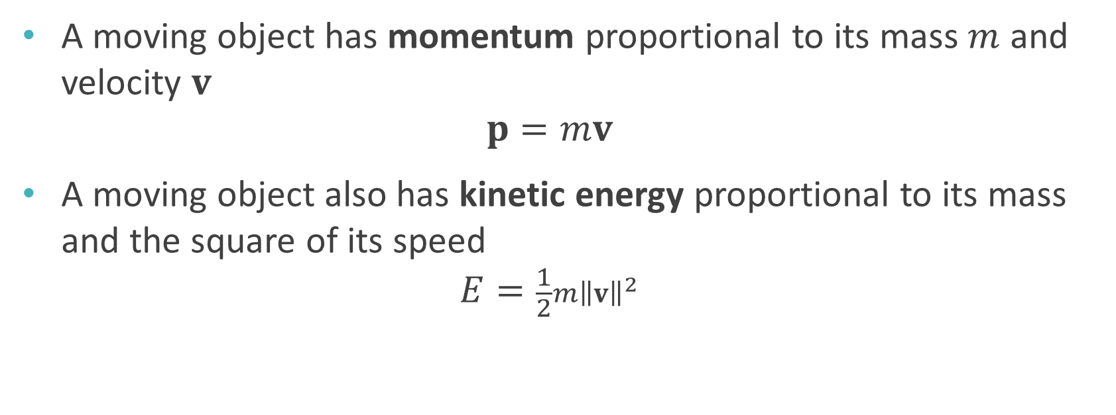
Energy and momentum
A moving object has momentum proportional to its mass $m$ and velocity $v$ $p=mv$
A moving object also has kinetic energy proportional to its mass and the square of its speed $E=\frac{1}{2}m{\left\|v\right\|}^{2}$

Slide 22
Conservation
When two objects collide, the total momentum is conserved
In an elastic collision, the total kinetic energy is also conserved
In an inelastic collision, some kinetic energy is lost (e.g. as sound, heat etc)
These can be used to calculate the velocities of the objects after collision

Slide 23
Contact normal
Reaction force acts along the contact normal – perpendicular to both surfaces
Component of velocity parallel to the normal changes; component perpendicular to the normal does not (disregarding friction)

Slide 24


Change in coordinate systems
Useful to consider the situation in a different coordinate system
Instead of x-y axes, use u-v axes parallel and perpendicular to the normal
Equivalent to rotation
Can use dot product to convert between systems
$$v$$
$$u$$

Slide 25


Change in coordinate systems
Under the new coordinates, reaction force acts along the u axis
So can calculate collision response just by using u components of vectors
This is a common trick – solving problems by transforming to a more convenient coordinate system
$$v$$
$$u$$

Slide 26
Worksheet B

Slide 27
Worksheet B
Due next week!
Worksheet review tutorials (with Joan) next Monday

